Slide 1
Food Truck

Slide 2
Food Truck
Overview
Each morning, you split 30 minutes between preparing burgers and preparing fries for a later sale
You sell one item: Combos consisting of one burger and one order of fries
Earnings are equal to the number of Combos you bring
Whichever is smaller (number of burgers you bring or number of fries you bring) is the number of combos

Slide 3
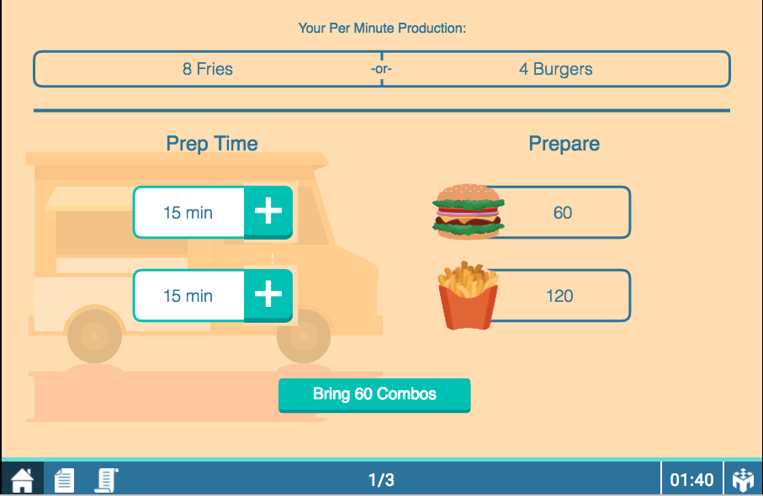
Your Screen
Per minute productivity

Slide 4
Your Screen
Proposed time allocation

Slide 5
Your Screen
Result of proposed time allocation

Slide 6
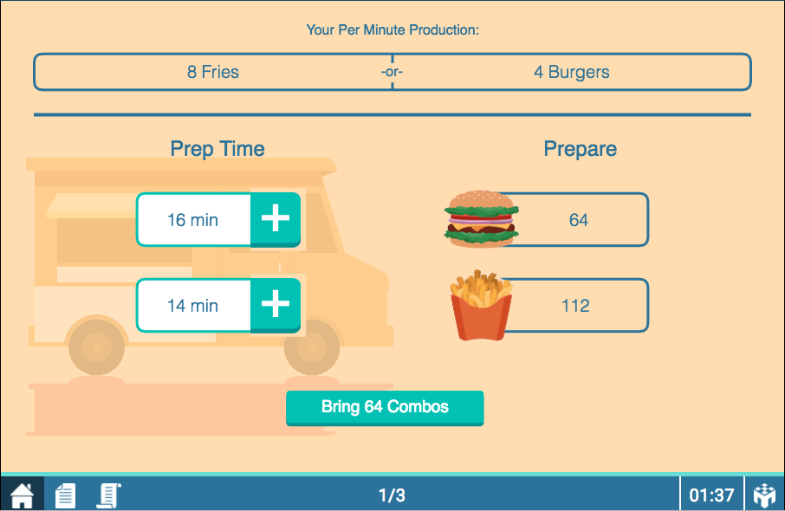
Your Screen
Increase burger time (decreases fries time)

Slide 7

Your Screen
Increase fries time (decrease burger time)

Slide 8
Your Screen
Happy Playing!
Finalize time allocation

