Slide 1

Market for Oranges

Slide 2
A Market for Oranges
Overview: Each Round
  Participants are divided into different markets
  Half in each market are buyers and half are sellers
Overview: Transacting
  Students can buy or sell one orange at a time
  Buyers submit bids, or an offer to buy an orange
  Sellers submit asks, or an offer to sell an orange
  When a bid > ask, we have a sale!

Slide 3
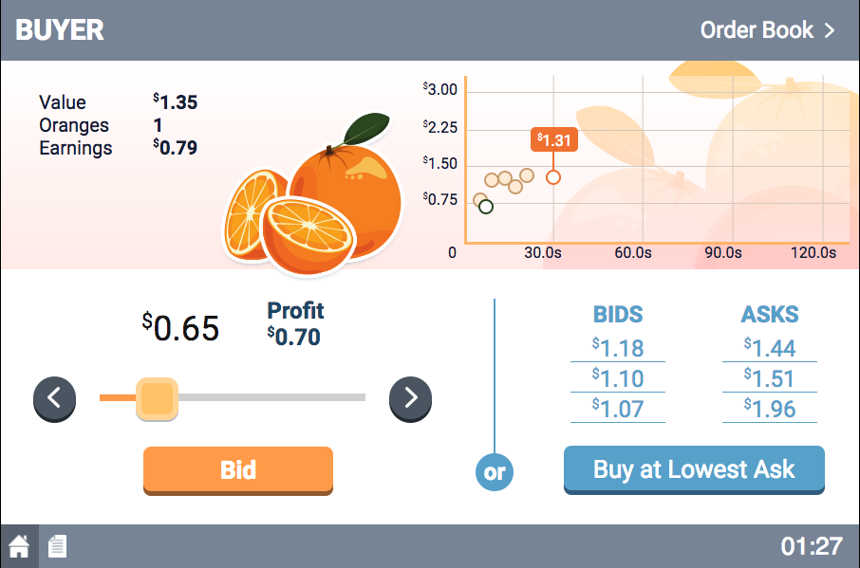
Buyer’s Screen
Buyer’s current situation
9

Slide 4
Buyer’s Screen
Group’s previous transaction prices

Slide 5
Buyer’s Screen
Slide to desired bid value
Press Bid to submit

Slide 6
Buyer’s Screen
Most appealing offers to sell
Buy button

Slide 7
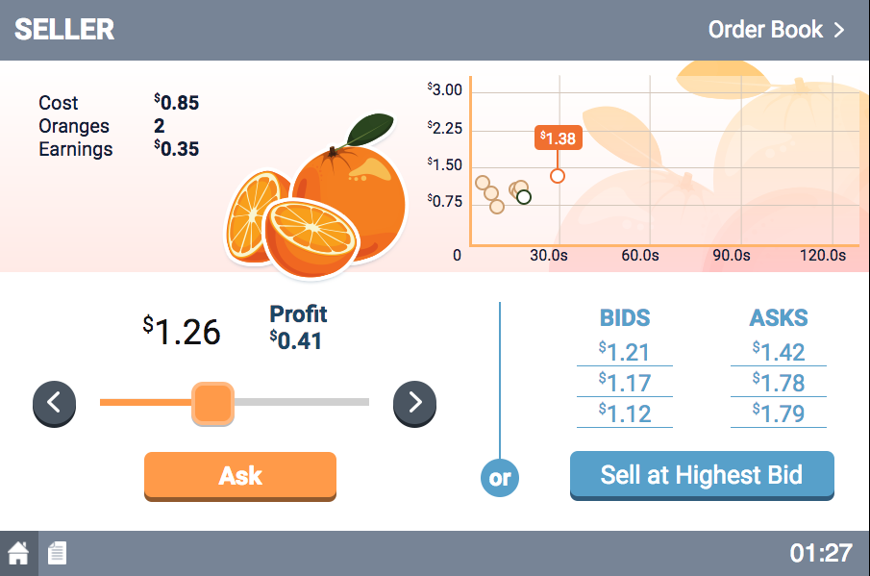
Seller’s Screen
Seller’s current situation

Slide 8
Seller’s Screen
Group’s previous transactions

Slide 9
Seller’s Screen
Slide to desired ask value
Press to submit Ask

Slide 10
Seller’s Screen
Most appealing offers to buy
Sell button

Slide 11
Summary
You buy an orange if:
  You click Buy at Lowest Ask, OR
  You have the highest Bid and a seller accepts highest bid
You sell an orange if:
  You click Sell at the Highest Bid, OR
  You have the lowest Ask and a buyer accepts lowest ask

Slide 12
Earnings
Buyer: each orange bought
  Earnings = Orange value – Price paid
Seller: each orange sold
  Earnings = Price received – Orange cost
Remember
  Total earnings equals the sum of all transactions
  The value (or cost) of each orange is indicated on your screen
  A negative number is smaller than zero!

Slide 13
Earnings: An Example
Example
  Transaction price = $1.08
  Value to buyer = $1.32; cost to seller = $0.74
buyer | value | – | price | = | earnings
 | $1.32 | – | $1.08 | = | $0.24
seller | price | – | cost | = | earnings
 | $1.08 | – | $0.74 | = | $0.34

Slide 14
Earnings: An Example
Example
  Transaction price = $1.08
  Value to buyer = $1.32; cost to seller = $0.74
Buyer | Value | – | Price | = | Earnings
 | $1.32 | – | $1.08 | = | $0.24
seller | price | – | cost | = | earnings
 | $1.08 | – | $0.74 | = | $0.34

Slide 15
Earnings
Happy Playing!
Example
  Transaction price = $1.08
  Value to buyer = $1.32; cost to seller = $0.74
Buyer | Value | – | Price | = | Earnings
 | $1.32 | – | $1.08 | = | $0.24
Seller | Price | – | Cost | = | Earnings
 | $1.08 | – | $0.74 | = | $0.34

