Slide 1

A Market for Oil

Slide 2
A Market for Oil
Overview
  Each season, each firm chooses its quantity
  You pay a cost for each barrel of oil you produce
    Per-barrel cost is the same for all firms
  Market price depends on total production
    More total production ➔ Lower market price
  Your payoff equals your profits

Slide 3
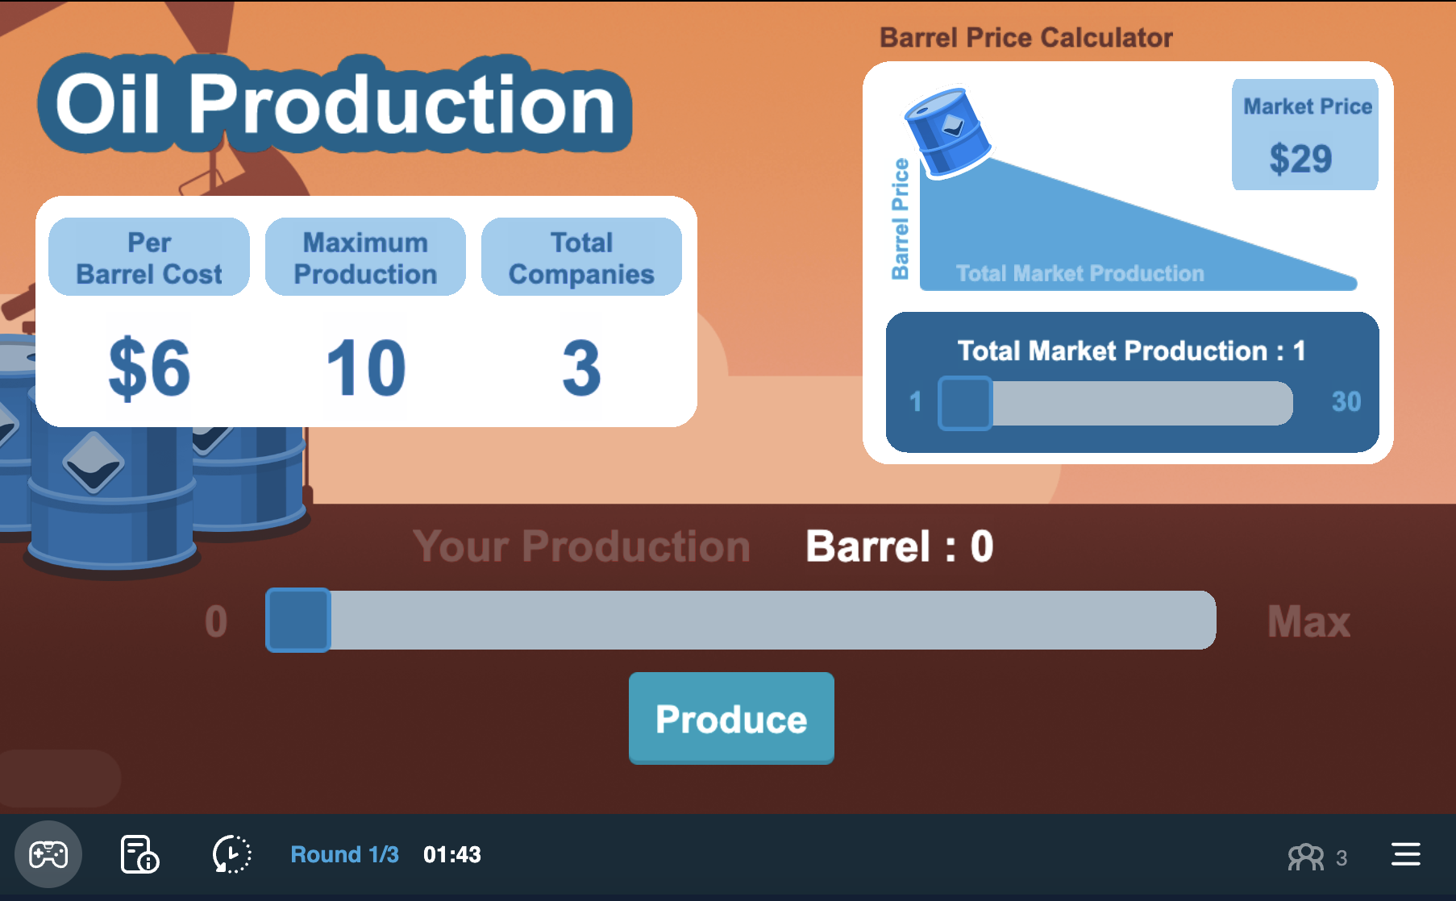
Your Game Screen
Current round / total number of rounds

Slide 4
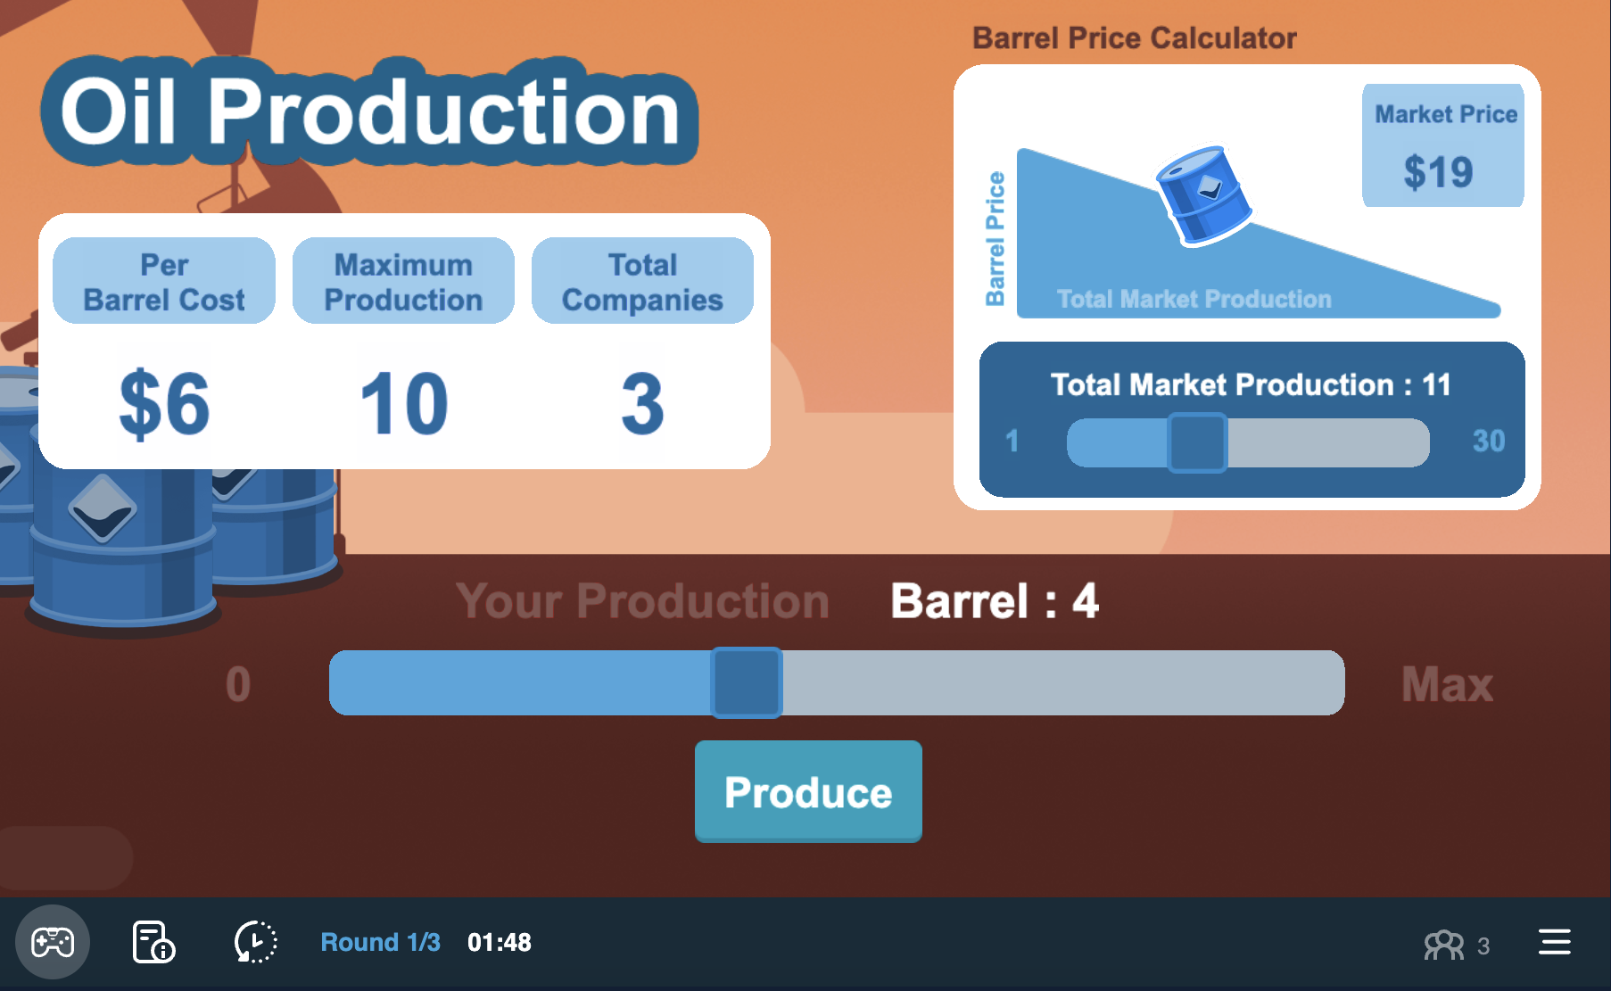
Your Game Screen
Market information

Slide 5
Your Game Screen
Forecast quantity to forecast market price

Slide 6
Your Game Screen
Slide to choose your production

Slide 7
Your Game Screen
Submit your choice

Slide 8
Payoffs
Overview
  Price revealed after all have chosen production
An Example
  2 firms: each pays $6 per barrel of oil produced
  One produces 10, the other chooses 9
  Suppose resulting price is $11
Payoff | = | Produced | x | (Price – Cost)
firm 1 | = | 10 | x | ($11 – $6) | = | $50
firm 2 | = | 9 | x | ($11 – $6) | = | $45

Slide 9
Payoffs
Overview
  Price revealed after all have chosen production
An Example
  2 firms: each pays $6 per barrel of oil produced
  One produces 10, the other chooses 9
  Suppose resulting price is $11
Payoff | = | Produced | x | (Price – Cost)
Firm 1 | = | 10 | x | ($11 – $6) | = | $50
firm 2 | = | 9 | x | ($11 – $6) | = | $45

Slide 10
Payoffs
Happy Playing!
Overview
  Price revealed after all have chosen production
An Example
  2 firms: each pays $6 per barrel of oil produced
  One produces 10, the other chooses 9
  Suppose resulting price is $11
Payoff | = | Produced | x | (Price – Cost)
Firm 1 | = | 10 | x | ($11 – $6) | = | $50
Firm 2 | = | 9 | x | ($11 – $6) | = | $45

