Slide 1
Split the Pie

Slide 2
split the pie
overview
  paired into groups of two; one is randomly selected to be Divider
  divider chooses how to divide sum of money
  Responder chooses either Accept or Reject
    if Accept, then earnings determined by accepted proposal
    if Reject, then both players earn $0

Slide 3
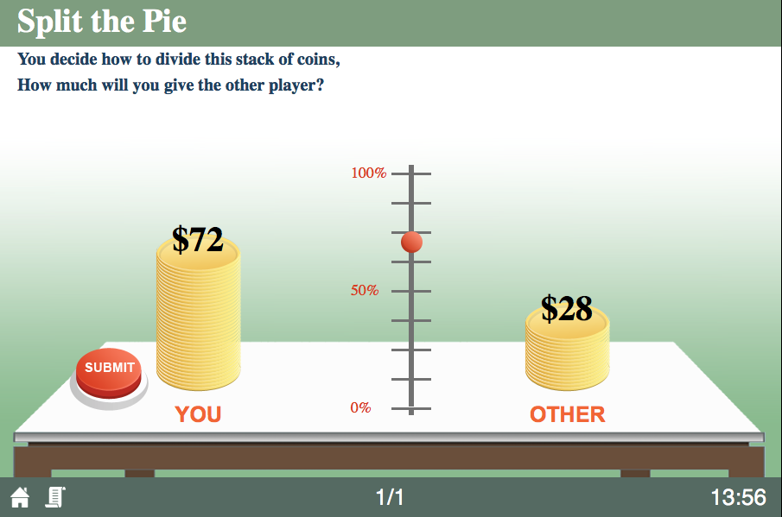
divider game screen
User slider to divide money

Slide 4
divider game screen
Press submit to make choice

Slide 5
split the pie
happy playing!
overview
  paired into groups of two; one is randomly selected to be Divider
  divider chooses how to divide sum of money
  payoffs are determined by this choice

