Slide 1

market for coffee: living the mug life
overview
  two roles: wholesaler (coffee roaster) and retailer (café)
  wholesaler posts a price per coffee bag for the retailer
    Has information on marginal cost and retailer demand
  retailer decides how many bags to buy at wholesale price
    Has information on customer demand
  wholesaler profit
    quantity retailer purchases x (wholesale price – marginal cost)
  retailer profit
    quantity customers purchase x (retail price – wholesale price)
9A Playground for Decisions
9

Slide 2
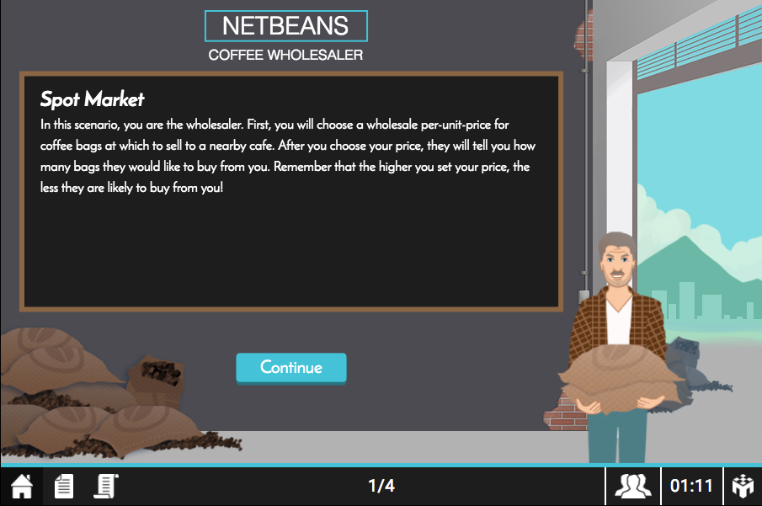

your game screen (wholesaler)
current round/total number of rounds
9A Playground for Decisions
9

Slide 3
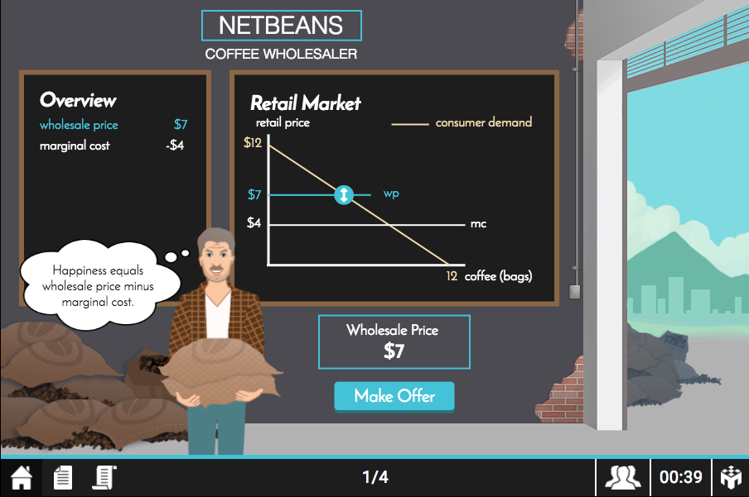
your game screen (wholesaler)
cost information. market information
9A Playground for Decisions
9

Slide 4
your game screen
slide button to alter wholesaler price
9A Playground for Decisions
9

Slide 5
your game screen (wholesaler)
post chosen price to the retailer
9A Playground for Decisions
9

Slide 6
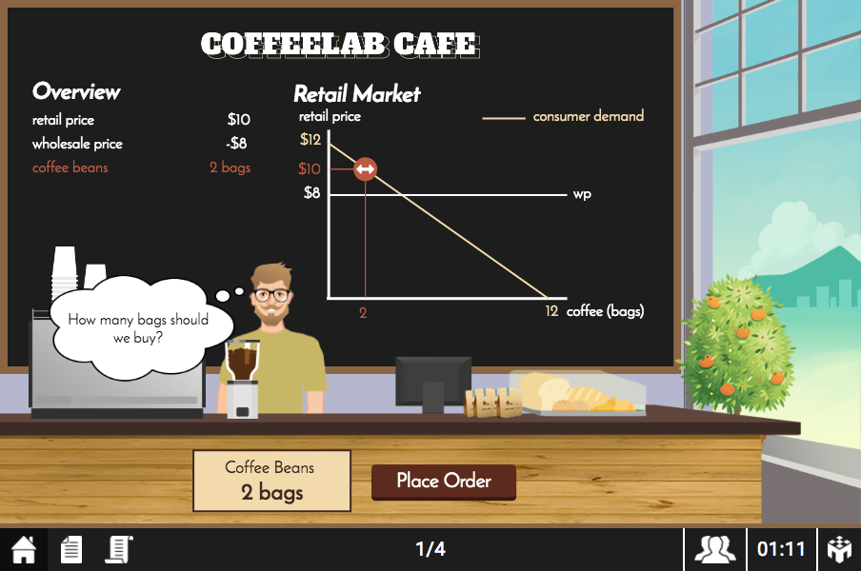
your game screen (retailer)
cost information. market information
9A Playground for Decisions
9

Slide 7
your game screen (retailer)
slide button to alter retail price and quantity
9A Playground for Decisions
9

Slide 8
your game screen (retailer)
place quantity order to the wholesaler
9A Playground for Decisions
9

Slide 9
your game screen (retailer)
check the instructions. check your history
9A Playground for Decisions
9

Slide 10
profit calculations
an example
  suppose inverse market demand is P = 20 – Q
  wholesaler sets a price of $10/bag of coffee and has a cost of $4/bag of coffee
  retailer purchases 8 bags
  resulting price is 20 – 8 = $12
payoff | = | quantity | x | (price – cost)
9A Playground for Decisions
9

Slide 11
payoffs
an example
  suppose inverse market demand is P = 20 – Q
  wholesaler sets a price of $10/bag of coffee and has a cost of $4/bag of coffee
  retailer purchases 8 bags
  resulting price is 20 – 8 = $12
payoff | = | quantity | x | (price – cost)
retailer | = | 8 | x | ($12 – $10) | = | $16
9A Playground for Decisions
9

Slide 12
payoffs
happy playing!
an example
  suppose inverse market demand is P = 20 – Q
  wholesaler sets a price of $10/bag of coffee and has a cost of $4/bag of coffee
  retailer purchases 8 bags
  resulting price is 20 – 8 = $12
payoff | = | quantity | x | (price – cost)
retailer | = | 8 | x | ($12 – $10) | = | $16
wholesaler | = | 8 | x | ($10 – $4) | = | $48
9A Playground for Decisions
9

