Slide 1

Guessing Game

Slide 2
Guessing Game
Overview: Each Round
  Each player submits an integer of 100 or smaller
  Computer calculates the target, equal to the average of all the choices times a multiplier
  The winning choice: submitted choice closest to target
    Prize evenly split amongst those submitting winning choice
  Everybody else wins nothing

Slide 3
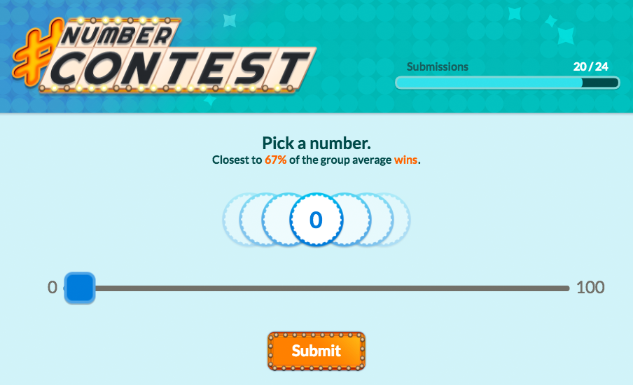
Game Screen
Use slider to choose a number

Slide 4
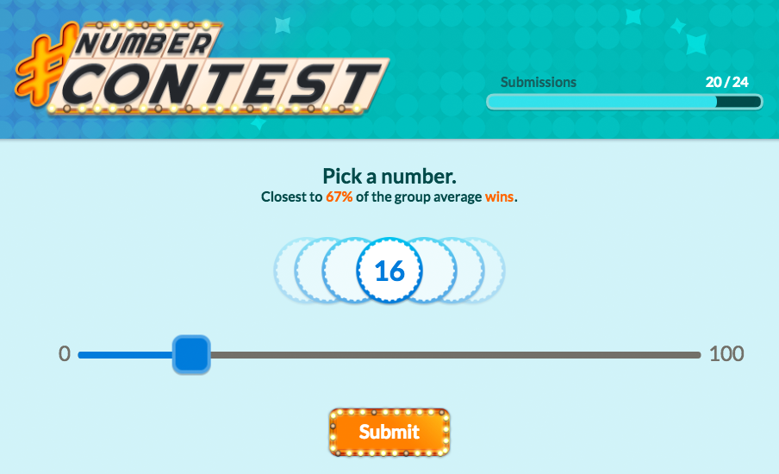
Game Screen
Then press submit

Slide 5
Game Screen
Target = multiplier x average choice

Slide 6
Payoffs: An Example
Suppose a game of six players
  Choices = {18; 33; 36; 65; 72; 82}
  Multiplier = 0.67
Calculating the target
  Average choice = 51
  Target is 34.17 = 51 × 0.67
Outcome
  The player who chose 33 wins the prize

