Slide 1

Insurance Market
Overview
  Humans have settled Mars!
  Meteor strikes threaten to destroy homes on Mars.
  You sell meteor insurance to the homes on Mars.
    You can only set a single price
    Homeowners see this price and decide to buy or not
  Revenues depend on how many homeowners buy
  Costs depend on the values of the insured homes destroyed in the meteor shower.
9Serious games. Seriously fun.
9

Slide 2
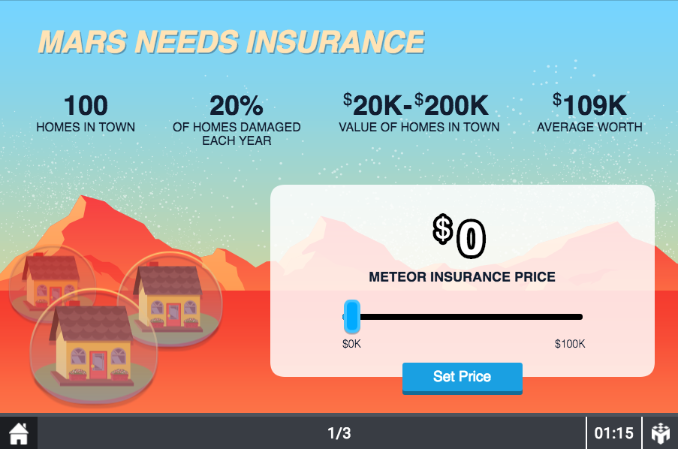
Game Screen
Possible buyers of homeowners insurance
9Serious games. Seriously fun.
9

Slide 3
Game Screen
Expected homes damaged. Range of home values.
9Serious games. Seriously fun.
9

Slide 4
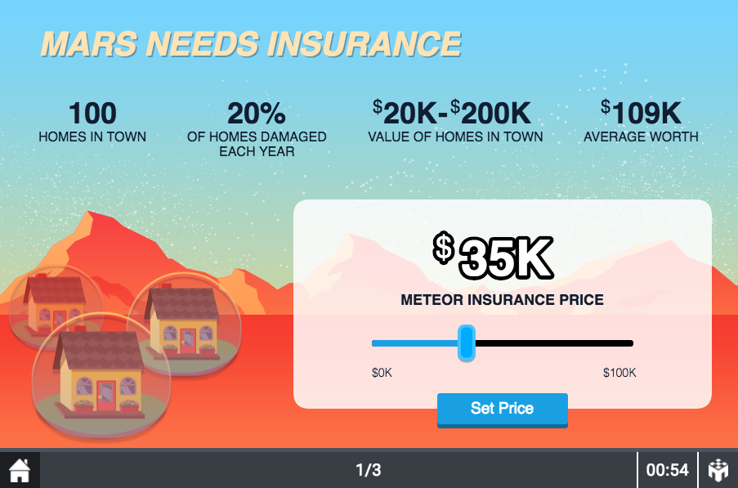
Game Screen
Move the slider to choose a price
9Serious games. Seriously fun.
9

Slide 5
Game Screen
Press button to set price
9Serious games. Seriously fun.
9

Slide 6
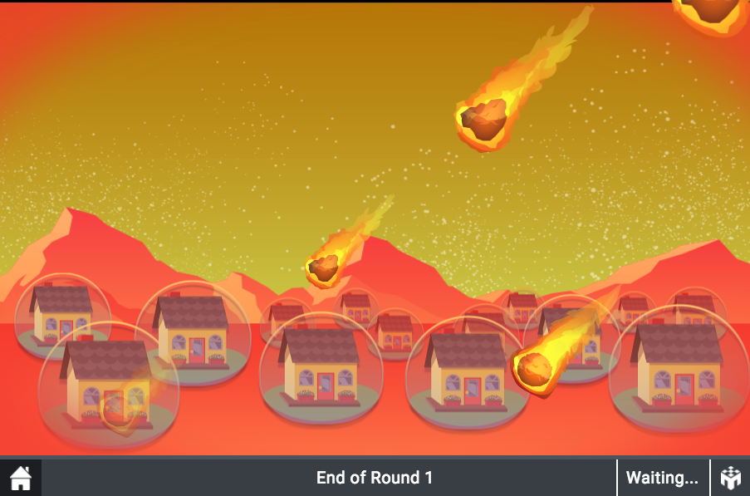
Game Screen
Meteor shower ensues …
9Serious games. Seriously fun.
9

Slide 7
Payoffs
Happy playing!
Profit from Insurance Sales
  Profit = Price x N – Sum(Values of Damaged Homes)
An Example
  You set price to 10K and 10 homeowners buy
    Revenue = $10,000x10 = $100,000
  Two homes are damaged (50K and 30K)
    Cost = $50,000 + $30,000 = $80,000
  Profit = $10,000x10 – ($50,000 + $30,000) = $20,000
9Serious games. Seriously fun.
9

