Slide 1

caveat emptor
overview
  Everyone matched in buyer-seller pairs.
  The Seller:
    knows how much she values the car;
    knows that the buyer places a value on her car which may or may not be different from her value;
    makes a take-it-or-leave-it offer to sell car to matched buyer.
  The Buyer:
    knowing only the range of possible car values, chooses whether to accept seller’s offer;
    after choosing whether to buy, only then does he learn his value for the car.
9A Playground for Decisions
9

Slide 2
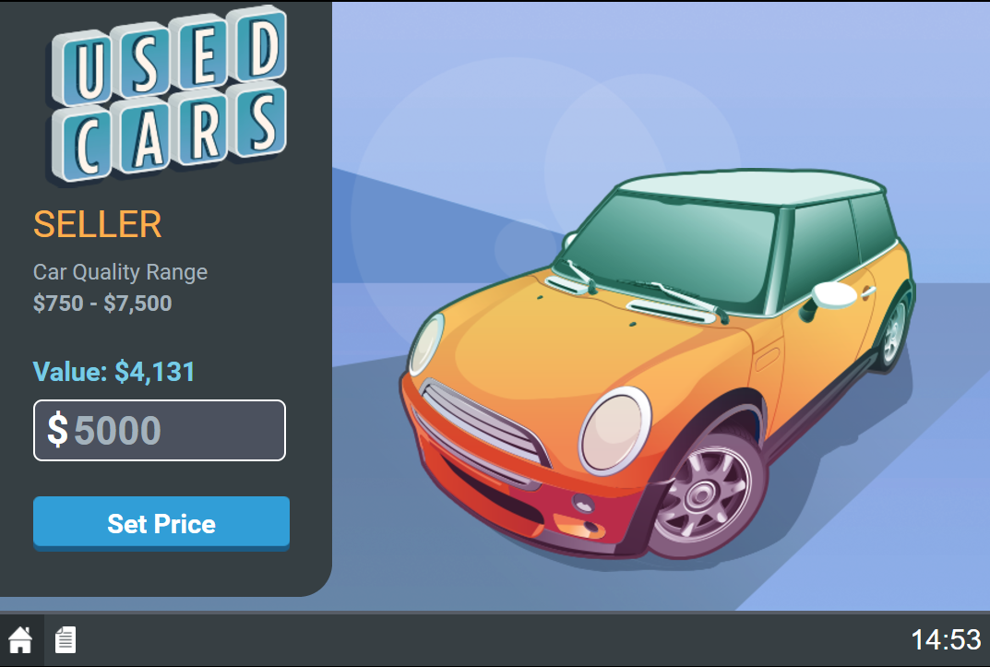
seller’s screen
range of buyer values for the whole market
9A Playground for Decisions
9

Slide 3
seller’s screen
seller’s value of the car
9A Playground for Decisions
9

Slide 4
seller’s screen
Enter a take-it-or-leave-it asking price. Set price.
9A Playground for Decisions
9

Slide 5
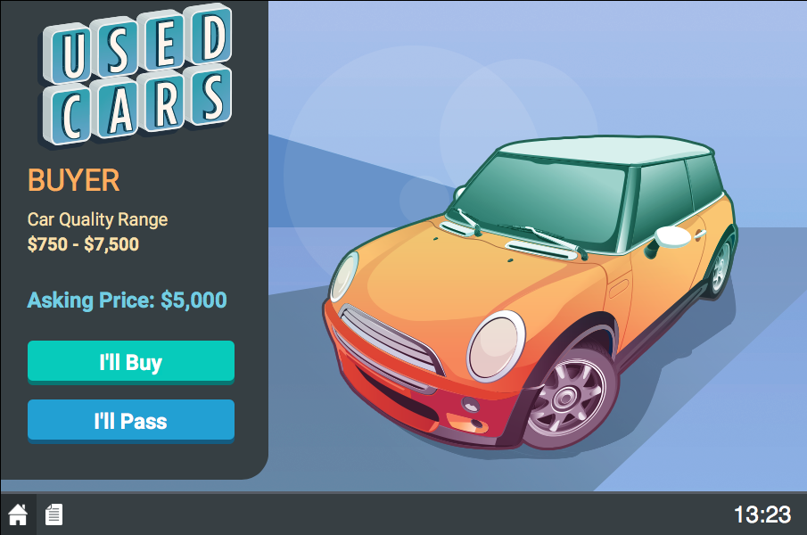
buyer’s screen
range of buyer values for the whole market
9A Playground for Decisions
9

Slide 6
buyer’s screen
seller’s asking price
9A Playground for Decisions
9

Slide 7
buyer’s screen
choose whether to buy the car or pass
9A Playground for Decisions
9

Slide 8
earnings
buyer
  if buys: earnings=buyer value – price paid
  if does not buy: earnings=0
seller
  if sells: earnings=price received – seller value
  if does not sell: earnings=0
9A Playground for Decisions

Slide 9
payoffs: an example
example
  transaction price = $3,800
  value to buyer = $4,500
  seller value= $3,000
buyer | value | – | price | = | earnings
 | $1.32 | – | $1.08 | = | $0.24
seller | price | – | cost | = | earnings
 | $1.08 | – | $0.74 | = | $0.34
9A Playground for Decisions

Slide 10
earnings: an example
example
  transaction price = $3,800
  value to buyer = $4,500
  seller value= $3,000
buyer | value | – | price | = | earnings
 | $4,500 | – | $3,800 | = | $700
seller | price | – | cost | = | earnings
 | $1.08 | – | $0.74 | = | $0.34
9A Playground for Decisions

Slide 11
earnings: an example
happy playing!
example
  transaction price = $3,800
  value to buyer = $4,500
  seller value= $3,000
buyer | value | – | price | = | earnings
 | $4,500 | – | $3,800 | = | $700
seller | price | – | value | = | earnings
 | $3,800 | – | $3,000 | = | $800
9A Playground for Decisions

