Slide 1

matching pennies
overview
  paired into groups of two; one is Row, the other Column
  each simultaneously chooses whether to place penny heads up (H) or tails up (T)
  Row keeps both pennies if the coins match (both heads or both tails)
  Column keeps both pennies if coins do not match (one heads and one tails)
  after choices revealed, on to next round(?) if Reject, then both players earn $0
9A Playground for Decisions
9

Slide 2
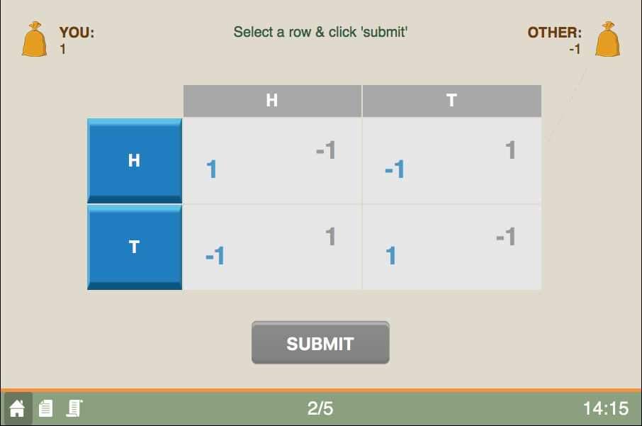
game screen
current round/total rounds
9A Playground for Decisions
9

Slide 3
game screen
your entries are in blue
9A Playground for Decisions
9

Slide 4
game screen
if both choose heads (H)
9A Playground for Decisions
9

Slide 5
game screen
choose an action
9A Playground for Decisions
9

Slide 6
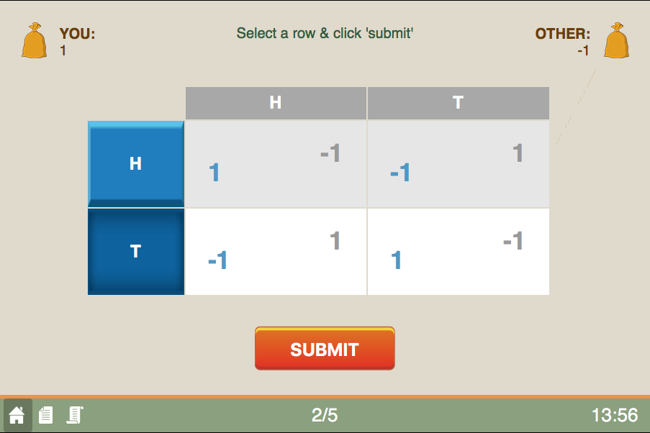
game screen
press to submit
9A Playground for Decisions
9

Slide 7
game screen
the history button
9A Playground for Decisions
9

Slide 8
matching pennies
payoffs
  payoff equals change in pennies
  Row keeps both if match; Column if mismatch
  example: one chooses H; the other T
    Row loses her penny: Payoff=-1
    Column gains a penny: Payoff=1
happy playing!
9A Playground for Decisions
9

