Slide 1

a card game
overview
  groups of two; one is Row, the other Column
  each with three number cards (2, 3 and 4) and a Joker
  each round, each plays 1 of the 4 cards
  choices revealed, loser gives winner 5 cents
    Two Jokers: Row wins
    One Joker: Column wins
    Two matching number cards: Column wins
    Two different number cards: Row wins
9A Playground for Decisions
9

Slide 2
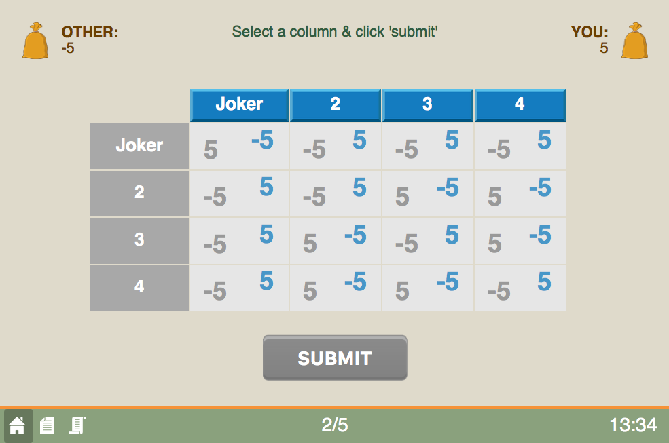
game screen
current round/total rounds
9A Playground for Decisions
9

Slide 3
game screen
your entries are in blue
9A Playground for Decisions
9

Slide 4
game screen
example: row loses if two Jokers . . .
9A Playground for Decisions
9

Slide 5
game screen
but row wins if only one Joker
9A Playground for Decisions
9

Slide 6
game screen
but row wins if only one Joker
9A Playground for Decisions
9

Slide 7
game screen
choose an action
9A Playground for Decisions
9

Slide 8
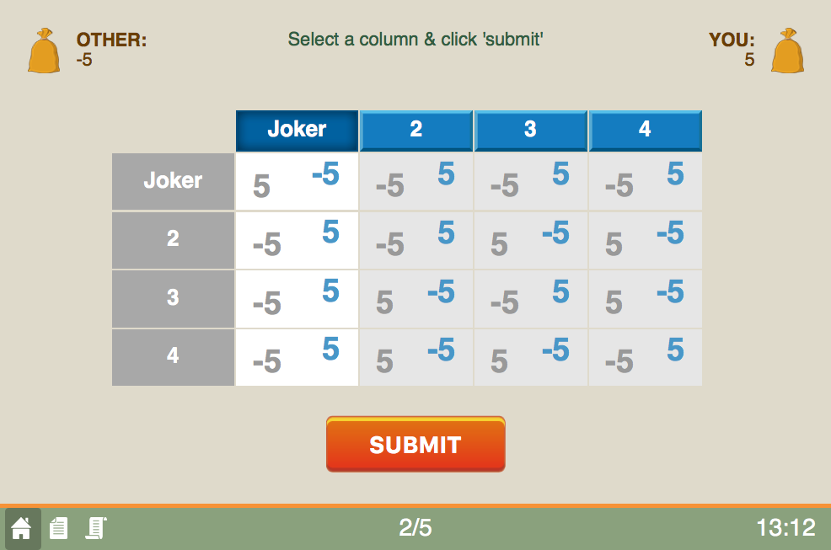
game screen
press to submit
9A Playground for Decisions
9

Slide 9
game screen
happy playing!
the history button
9A Playground for Decisions
9

