Slide 1

MobDrive

Slide 2
MobDrive
Each Day
  Each player chooses whether to drive that day.
    Pay a fixed cost any day you drive
    Profit=$0 any day you do not drive
    Use the Profit Predictor to help make decision
  Then, that day’s revenue per hour driven announced to all.
    More drivers = lower revenue per hour
  Finally, each driver chooses how many hours to drive.
    You incur a cost for each hour you drive
  On to the next day . . .

Slide 3
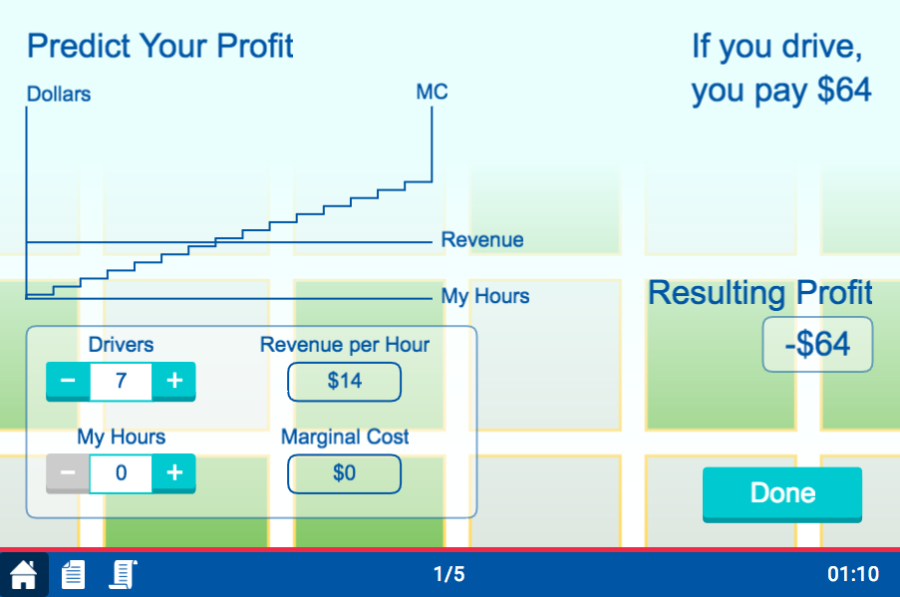
Predict Your Profits
Fixed cost incurred if you drive

Slide 4
Predict Your Profits
Revenue per hour if 7 drivers drive

Slide 5
Predict Your Profits
Revenue per hour if 7 drivers drive

Slide 6

Predict Your Profits
Revenue per hour if 5 drivers drive

Slide 7
Predict Your Profits
Revenue per hour if 5 drivers drive

Slide 8
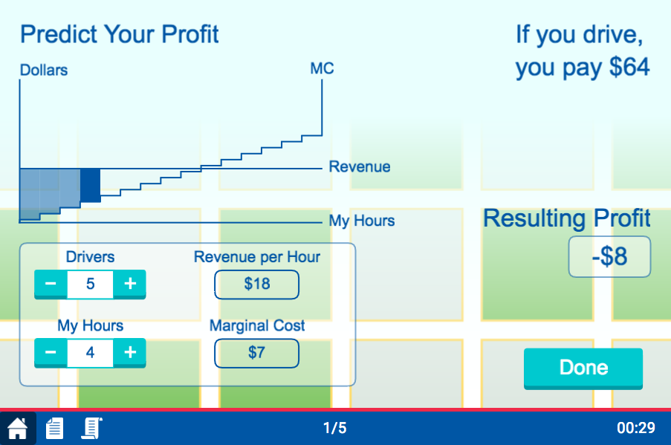
Predict Your Profits
Profit if 5 drivers and you drive for 4 hours

Slide 9
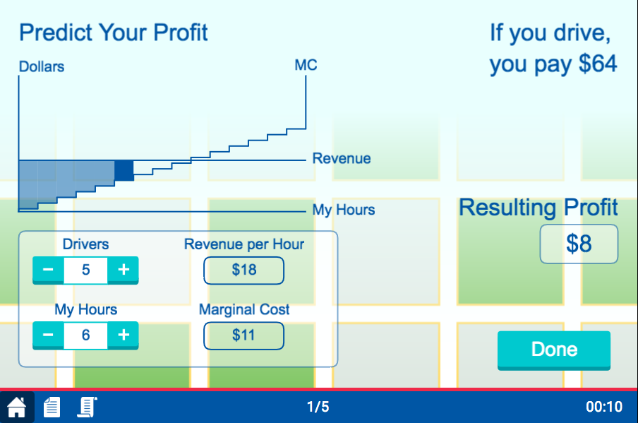
Predict Your Profits
Profit if 5 drivers and you drive for 6 hours

Slide 10
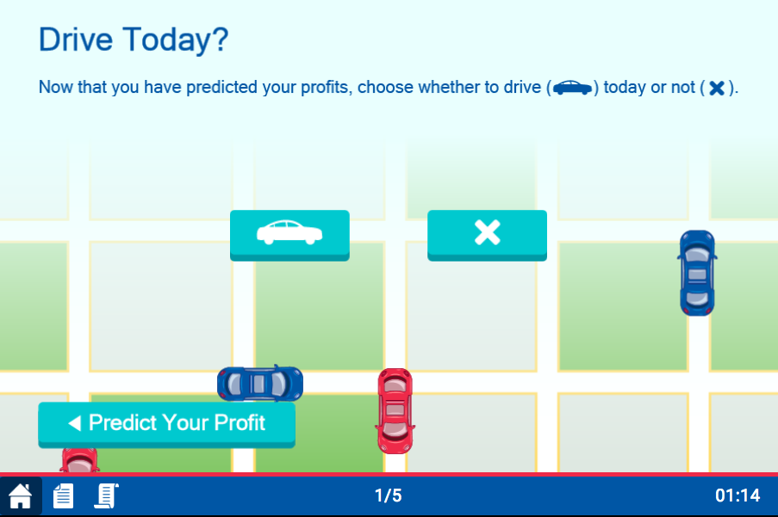
To Drive, or Not to Drive
To drive
To not drive

Slide 11
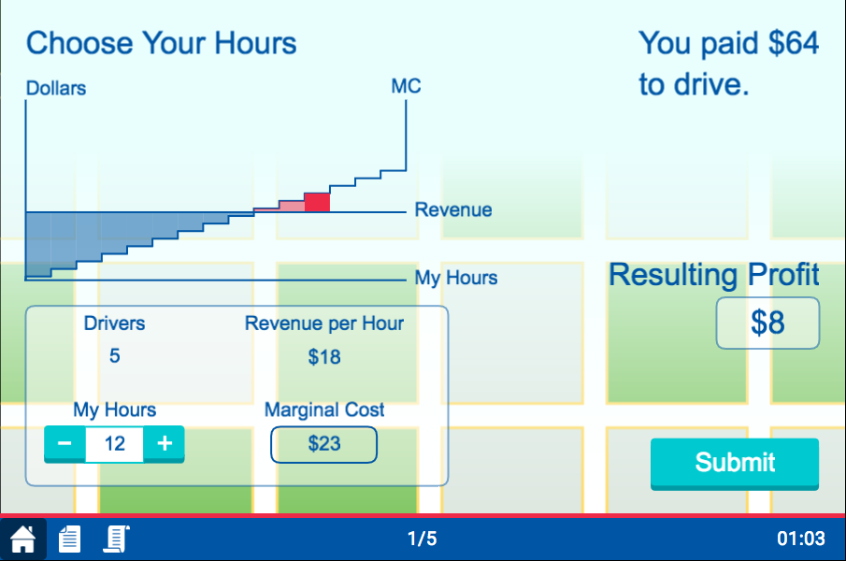
If You Choose to Drive
Revenue per hour given number of drivers driving today

Slide 12
If You Choose to Drive
Choose your hours

Slide 13
If You Choose to Drive
Choose your hours
Press “Submit”

Slide 14
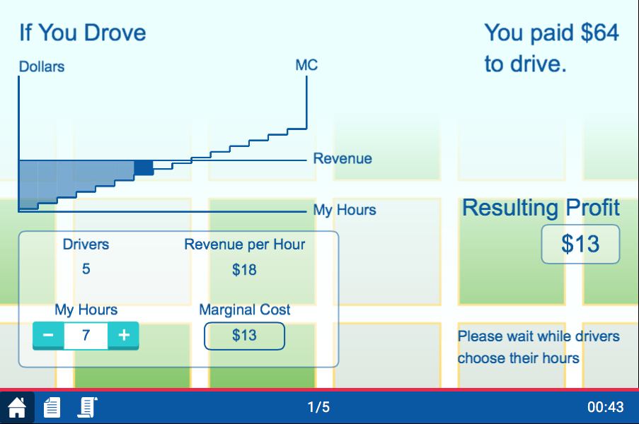
If You Choose to NOT Drive
Happy playing!
Could I have made a profit?

