Slide 1

zombie democracy
overview
  you and two others zombies have some humans to divide
  each round, each zombie submits proposal
  one randomly chosen and voted upon
  accepted if 2 or more zombies accept
  if proposal rejected:
    Some humans escape!
    Move to next round
  payoff: humans you get in accepted proposal
9A Playground for Decisions
9

Slide 2
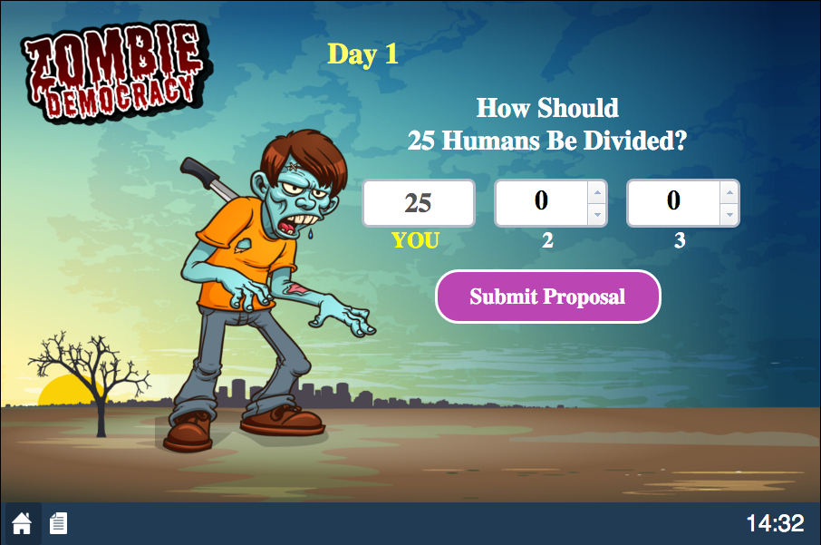
submitting a proposal
current number of humans
9A Playground for Decisions
9

Slide 3
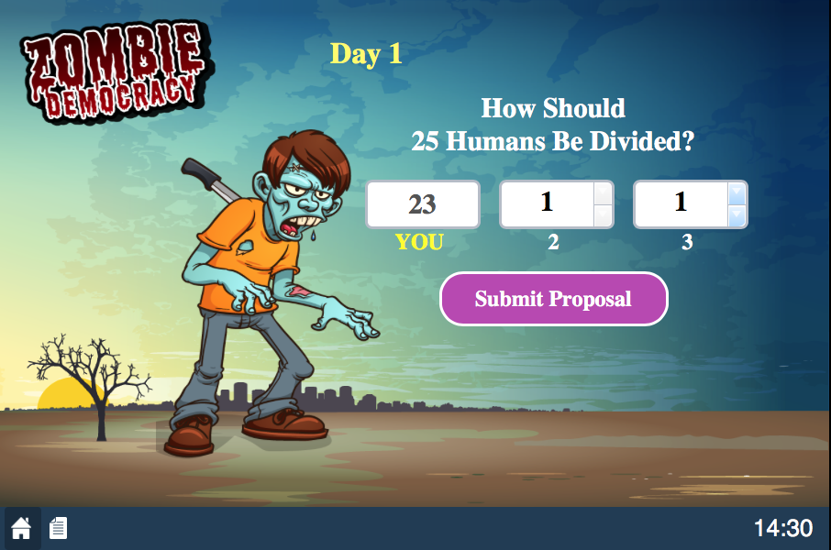
submitting a proposal
adjust to create proposal
9A Playground for Decisions
9

Slide 4
submitting a proposal
and press to submit
9A Playground for Decisions
9

Slide 5
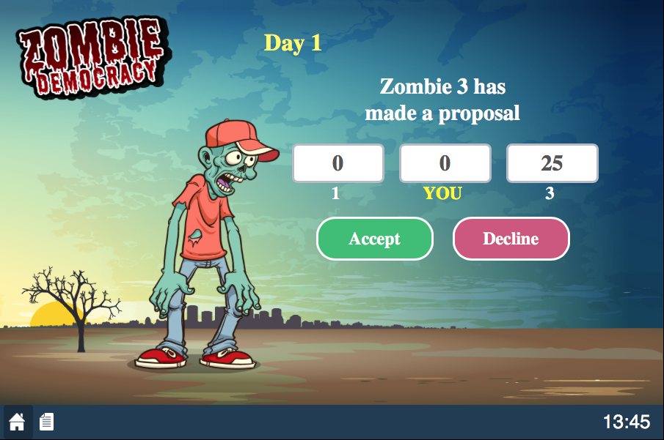
voting
the proposal to be considered
9A Playground for Decisions
9

Slide 6
voting
happy playing!
submit your vote
9A Playground for Decisions
9

