Slide 1

Monopoly Market

Slide 2
Monopoly Market: Patented Fun!
Overview
  One role: the market monopolist
  Each round: choose how many pallets of pharmaceuticals to ship
    This affects the market price of your product
  Market demand is known. Marginal revenue and marginal cost information are provided.

Slide 3
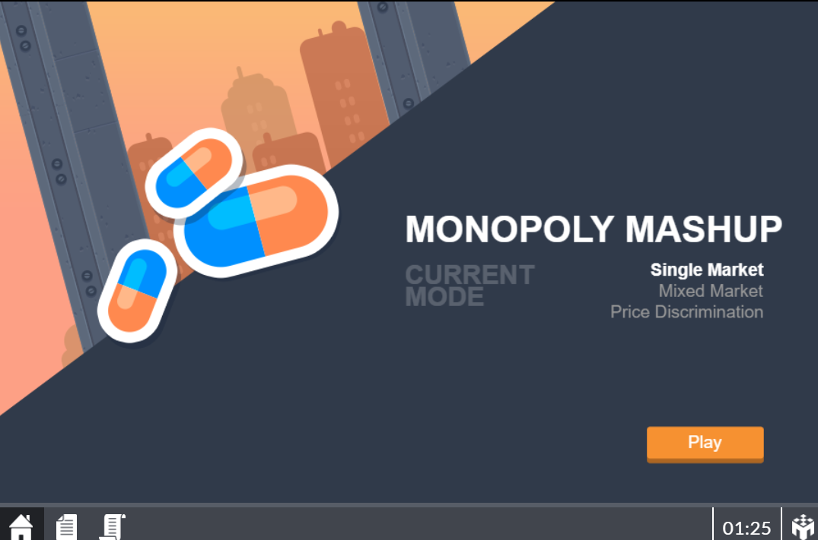
Start Screen
Current market condition

Slide 4
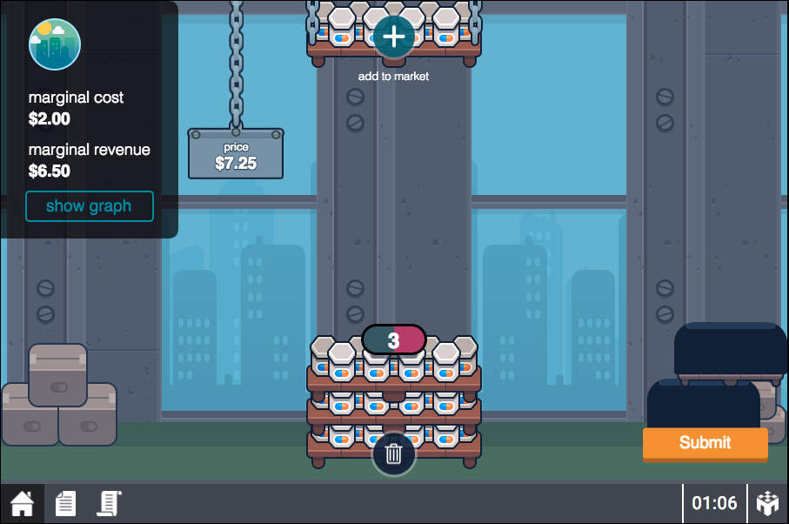
Your Game Screen
Current number of pallets Increase pallets

Slide 5
Your Game Screen
Market price at current number of pallets

Slide 6
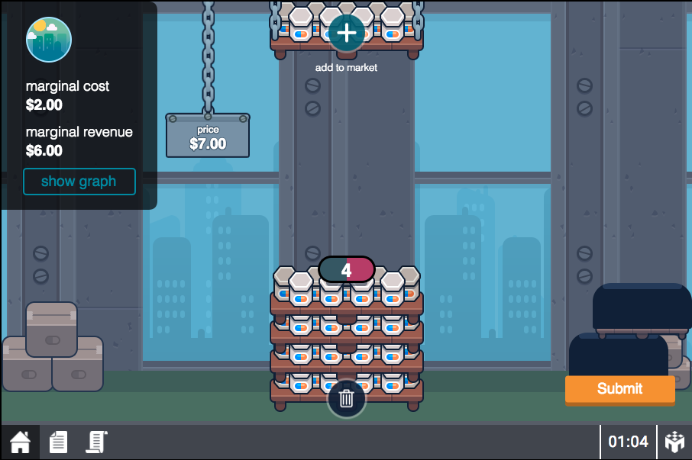
Your Game Screen
To remove pallet, click trash icon

Slide 7
Your Game Screen
Cost and revenue information Show graph

Slide 8
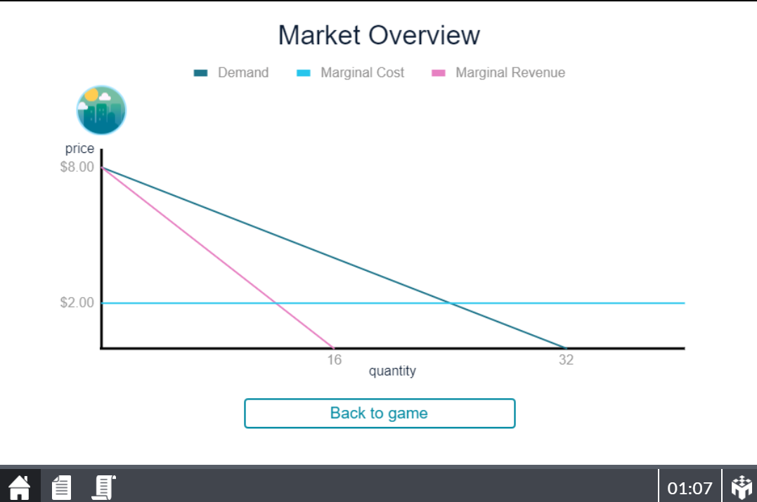
Market Graph
Click button to go back to game
9

Slide 9
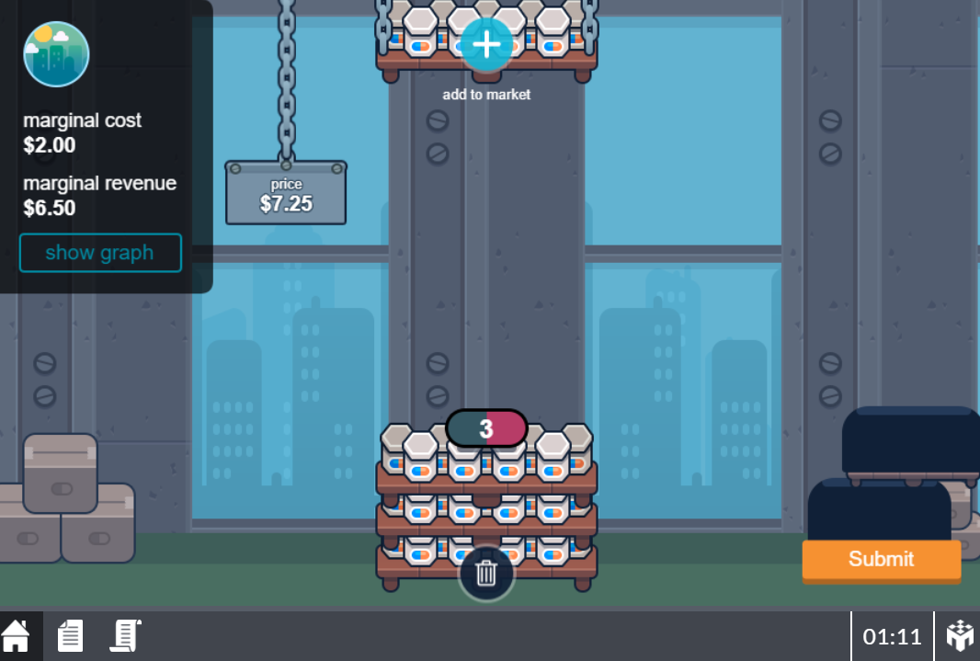
Your Game Screen
Click submit to finalize shipment
9

Slide 10
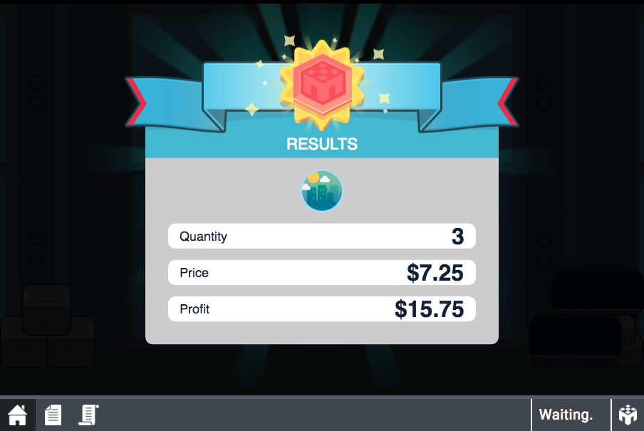
Profit Screen

Slide 11
Your Game Screen
View previous rounds

Slide 12
Payoffs
An Example
  Suppose inverse market demand is P = 8 – 0.25Q
  Marginal cost is constant at $2 per pallet
  Suppose 4 units are produced
  Market price is P = 8 - 0.25(4)
Profit | = |  | Quantity | x | (Price | - | Cost)

Slide 13
Payoffs
Happy Playing!
An Example
  Suppose inverse market demand is P = 8 – 0.25Q
  Marginal cost is constant at $2 per pallet
  Suppose 4 units are produced
  Market price is $7
Profit | = |  | Quantity | x | (Price | - | Cost)
$20 | = |  | 4 | x | ($7 | - | $2)

