Slide 1

Prisoner’s Dilemma

Slide 2
The Dilemma
Overview
  Paired into groups of two: one is Row, the other Column
  Each simultaneously chooses either C (cooperate) or D (defect)
  A player choosing D
    Increases own payoffs by 4
    Decreases match’s payoffs by 8
  After choices revealed, on to next round (if you choose to play multiple rounds)
9

Slide 3
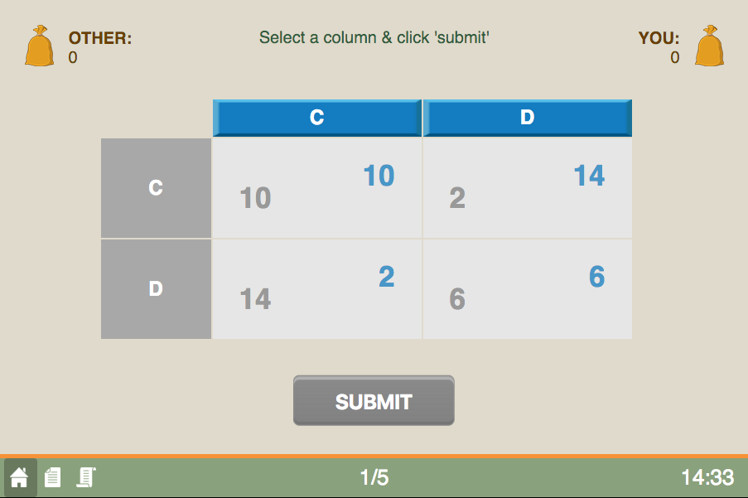
Game Screen
Current round / Total rounds

Slide 4
Game Screen
Your entries are in blue

Slide 5
Game Screen
If both choose C
9

Slide 6
Game Screen
Choose an action

Slide 7
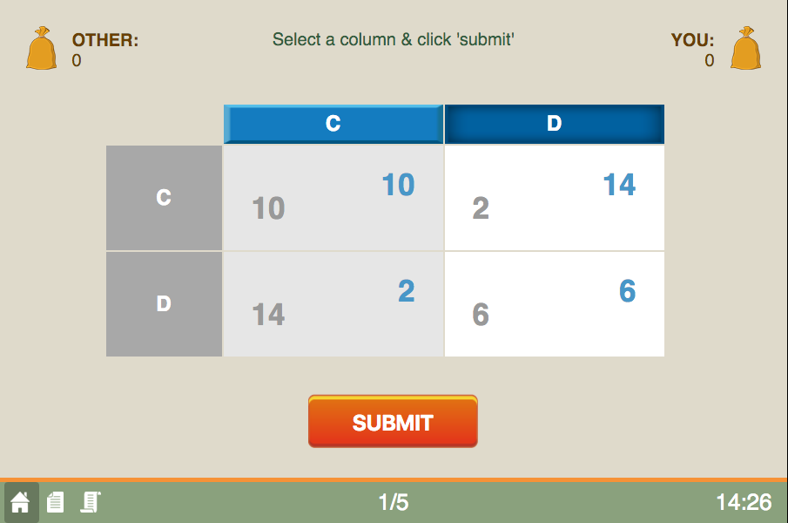
Game Screen
Press to submit

Slide 8
Game Screen
Happy Playing!
The history button

