Slide 1

Painting Auction

Slide 2
Painting Auction
Overview
You and other bidders are in an auction for a painting
Each player submits one bid
You do not know what others bid
Highest bidder wins the painting and pays her bid

Slide 3
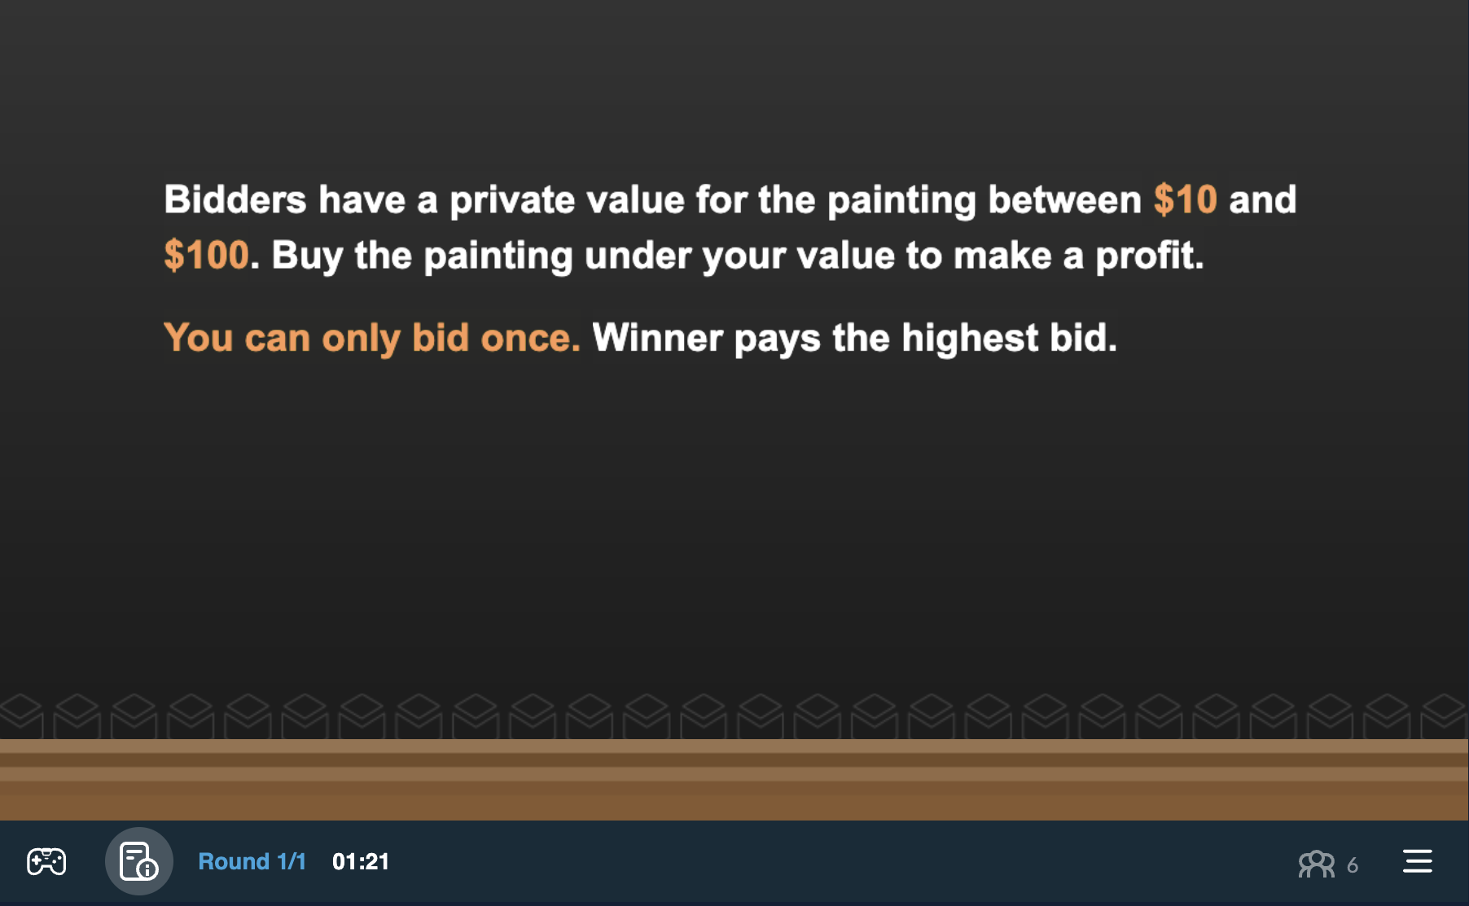
Intro Screen
Range of other bidder values

Slide 4
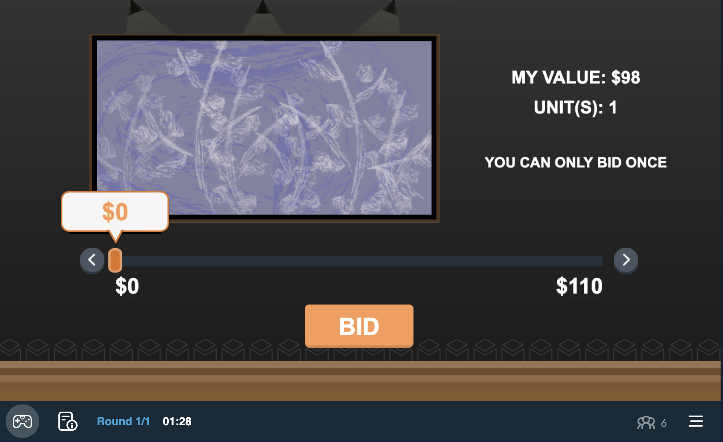
Game Screen
Your value of the painting

Slide 5
Game Screen
Move slider to desired bid

Slide 6
Game Screen
Indicates number the slider is currently resting on

Slide 7
Game Screen
Click ‘Bid’ to place a bid!

Slide 8
Payoffs
Happy Playing!
End of Game
Highest bidder at the end of the auction is the winner
Payoff for Winner
Payoff = Winner’s Value – Winner’s Bid
Payoff for All Other Players
Payoff for All Other Players = $0

