Slide 1

rock, paper, scissors
overview
  paired into groups of two
  each simultaneously chooses between rock (R), paper (P) and scissors (S)
  choices revealed, loser gives winner a penny
    Same action? It’s a tie!
    {Rock; Paper}: Paper wins (covers rock)
    {Paper; Scissors}: Scissors wins (cuts paper)
    {Scissors; Rock}: Rock wins (smashes scissors)
9A Playground for Decisions
9

Slide 2
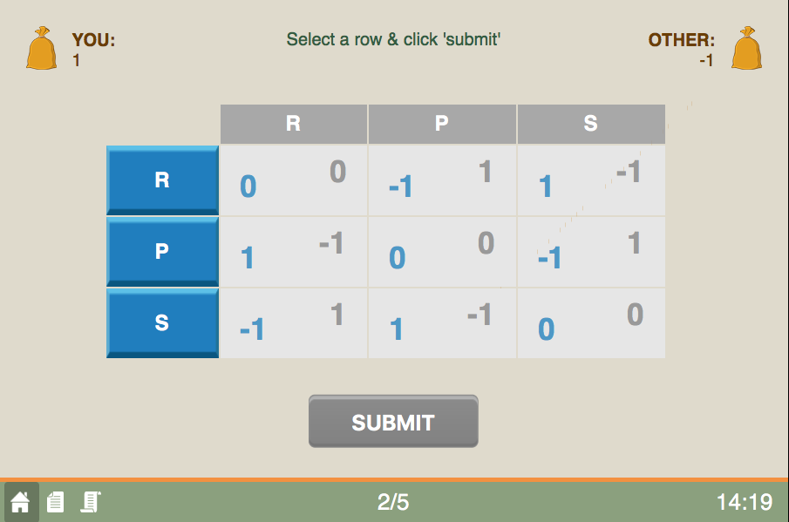
game screen
current round/total rounds
9A Playground for Decisions
9

Slide 3
game screen
your entries are in blue
9A Playground for Decisions
9

Slide 4
game screen
you choose scissors, match chooses rock
9A Playground for Decisions
9

Slide 5
game screen
choose an action
9A Playground for Decisions
9

Slide 6
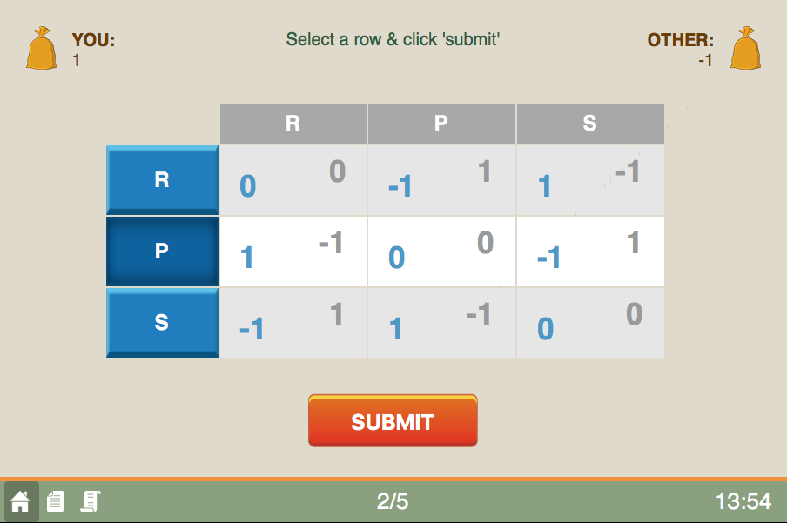
game screen
press to submit
9A Playground for Decisions
9

Slide 7
game screen
happy playing!
the history button
9A Playground for Decisions
9

