Slide 1

airline competition
overview
  each of 2 airlines chooses how many flights
    each pays same per-flight cost
    revenue per flight depends on total flights
  LeadAir first chooses its number of flights
  Number of LeadAir flights publicly announced
  FollowAir then chooses its number of flights
happy playing!
9A Playground for Decisions
9

Slide 2
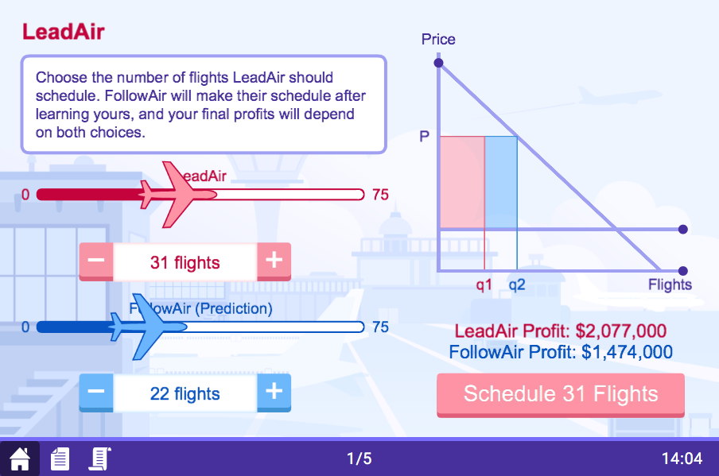
LeadAir screen
if LeadAir schedules 31 flights . . .
9A Playground for Decisions
9

Slide 3
LeadAir screen
and FollowAir schedules 22 flights . . .
9A Playground for Decisions
9

Slide 4
LeadAir screen
then profits for each firm will be
9A Playground for Decisions
9

Slide 5
LeadAir screen
to schedule flights shown here
9A Playground for Decisions
9

Slide 6
LeadAir screen
press this button
9A Playground for Decisions
9

Slide 7
LeadAir screen
and then wait XXX waiting screen
9A Playground for Decisions
9

Slide 8
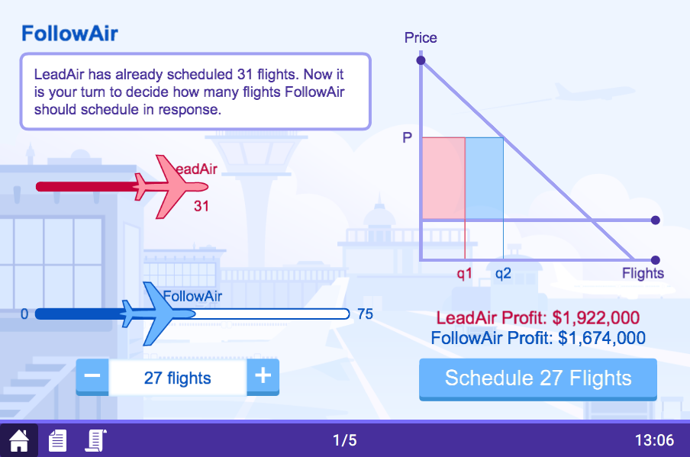
FollowAir screen
number scheduled by LeadAir
9A Playground for Decisions
9

Slide 9
FollowAir screen
use slider to consider different schedules
9A Playground for Decisions
9

Slide 10
FollowAir screen
and see effect on profits
9A Playground for Decisions
9

Slide 11
FollowAir screen
to schedule flights shown here
9A Playground for Decisions
9

Slide 12
FollowAir screen
press this button
9A Playground for Decisions
9

Slide 13
FollowAir screen
happy playing!
and this will be each firm’s profits
9A Playground for Decisions
9

