Slide 1

stag hunt
overview
  you and partner at opposite ends of path
  each simultaneously chooses Stag or Hare
  only catch stag if both choose Stag
    payoff=5 for both
  catch hare (payoff=3) if choose Hare
  one Stag and one Hare?
    payoff=0 for Stag hunter
    Reject, then both players earn $0
9A Playground for Decisions
9

Slide 2
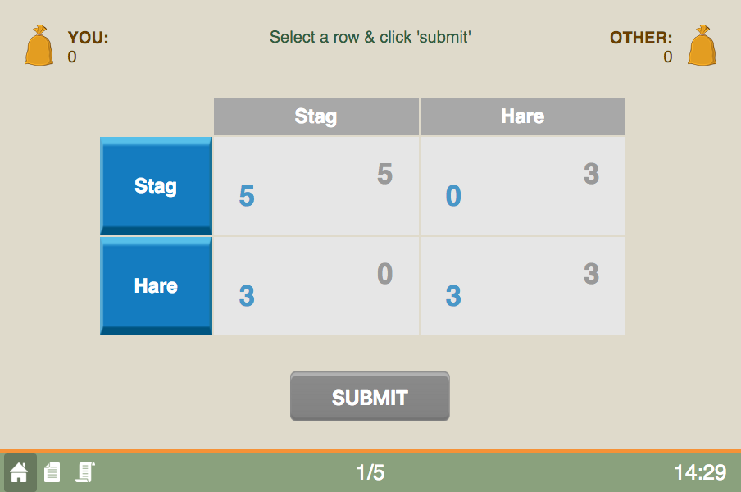
game screen
current round/total rounds
9A Playground for Decisions
9

Slide 3
game screen
your entries are in blue
9A Playground for Decisions
9

Slide 4
game screen
if you choose Stag and partner Hare
9A Playground for Decisions
9

Slide 5
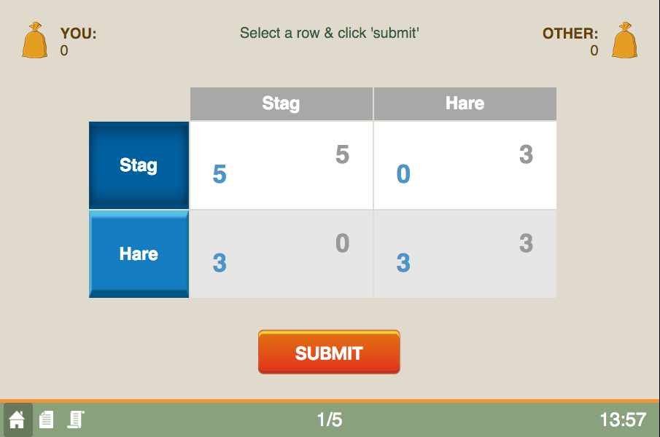
game screen
choose an action
9A Playground for Decisions
9

Slide 6
game screen
press to submit
9A Playground for Decisions
9

Slide 7
game screen
happy playing!
the history button
9A Playground for Decisions
9

