Slide 1

Trust: An Investment Game

Slide 2
An Investment Game
Overview
  Groups of two: Investor and Responder
  Each starts with some amount of money
  The Investor chooses how much to send to Responder (the investment)
  Responder gets investment × multiplier
  The Responder chooses how much money to return to Investor
9

Slide 3
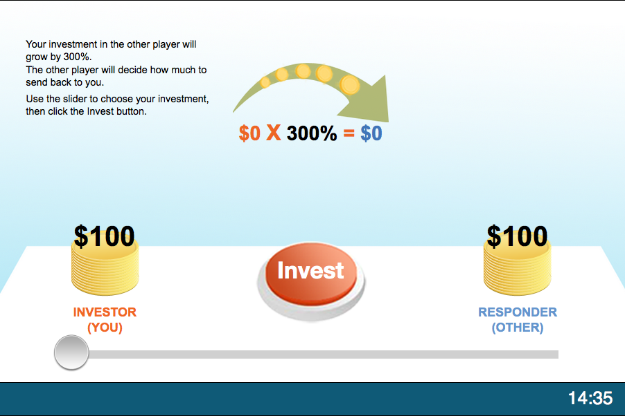
Initial Game Screen
Initial Amounts of Money

Slide 4
Initial Game Screen
Multiplier

Slide 5
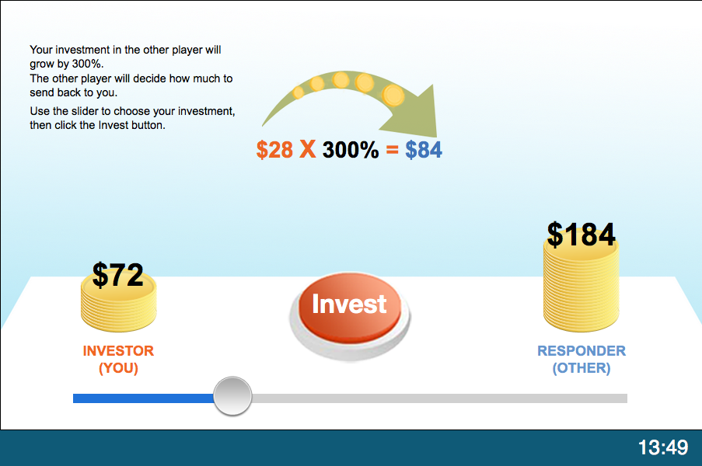
Game Screen: Investor
Move slider to choose investment

Slide 6
Game Screen: Investor
Press invest to submit choice

Slide 7
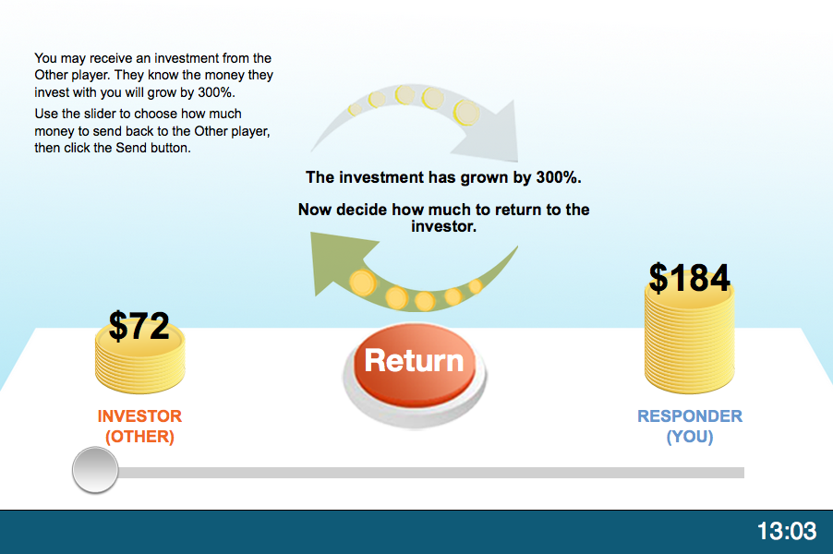
Game Screen: Responder
Balances after investment

Slide 8
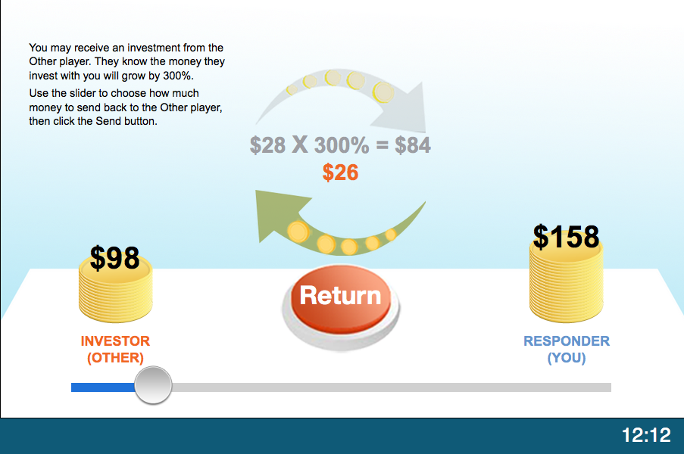
Game Screen: Responder
Move slider to choose return amount

Slide 9
Game Screen: Responder
Press return to submit choice
9

Slide 10
Payoffs: An Example
Suppose
  Both start with $100; Multiplier = 300%
  Investor invests $28; Responder returns $26
  Happy Playing!
Investor | Initial | – | Investment | + | Return | = | Payoff
 | $100 | – | $28 | + | $26 | = | $98
Responder | Initial | + | Investment x Multiplier | – | Return | = | Payoff
 | $100 | + | $84 | – | $26 | = | $158

