Slide 1

Elections!
overview: each game
  compete against another player in 1 or more elections
    beforehand, you may participate in one or more polls
  for each election or poll
    candidates simultaneously chose policy: a number from 0 to 100
    each automated voter:
      chooses the candidate whose policy is closest to his ideal policy,
      chooses randomly if both policies equally close
    results are announced
  A voter’s ideal policy fixed for the game
    Voter locations are revealed after final election
9Serious games. Seriously fun.
9

Slide 2
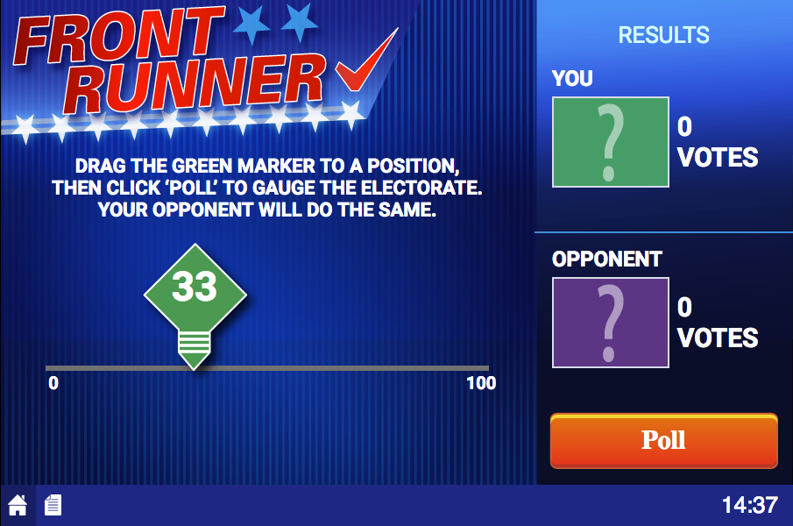
Game Screen
Move to choose your policy
9Serious games. Seriously fun.
9

Slide 3
Game Screen
Submit your policy for a Poll
9Serious games. Seriously fun.
9

Slide 4
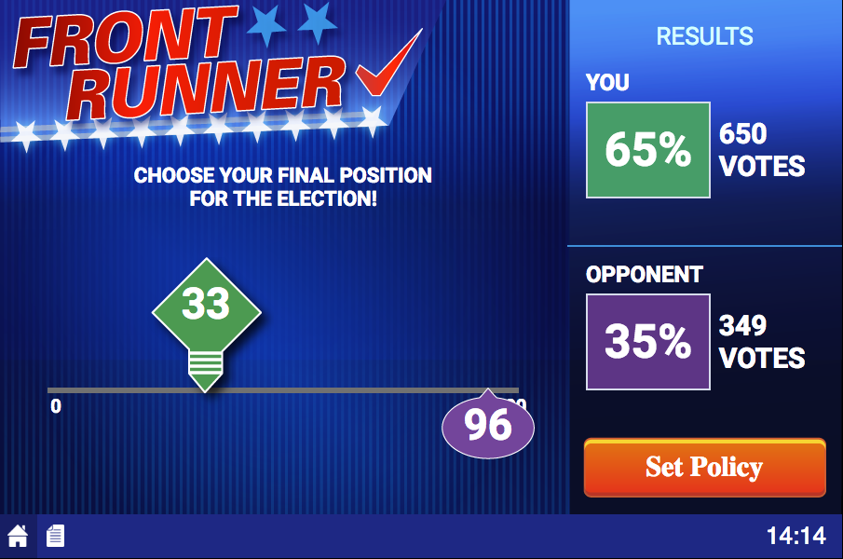
Game Screen: Poll/Election Results
Policies chosen by candidates
9Serious games. Seriously fun.
9

Slide 5
Game Screen: Poll/Election Results
Results!
9Serious games. Seriously fun.
9

Slide 6
Game Screen
Submit your policy for an Election
9Serious games. Seriously fun.
9

Slide 7
Payoffs
summary
  Poll outcomes do not factor into payoffs
  Each election, you earn 100 points if you win
Happy playing!
9Serious games. Seriously fun.
9

