Slide 1
to vote, or not to vote (i.e. abstain)?
overview
  Basketball Club, vote decides whether a basketball team is created at school. Total number of voters is known.
  Minimum threshold, if the number of votes meets or exceeds a minimum threshold the team is created.
  Each person has a cost to voting: this depends on a student’s distance to the school. Abstention has no direct cost.
possible outcomes
  You vote, threshold is met
  You vote, threshold is not met
  You abstain, threshold is met
  You abstain, threshold is not met

Slide 2
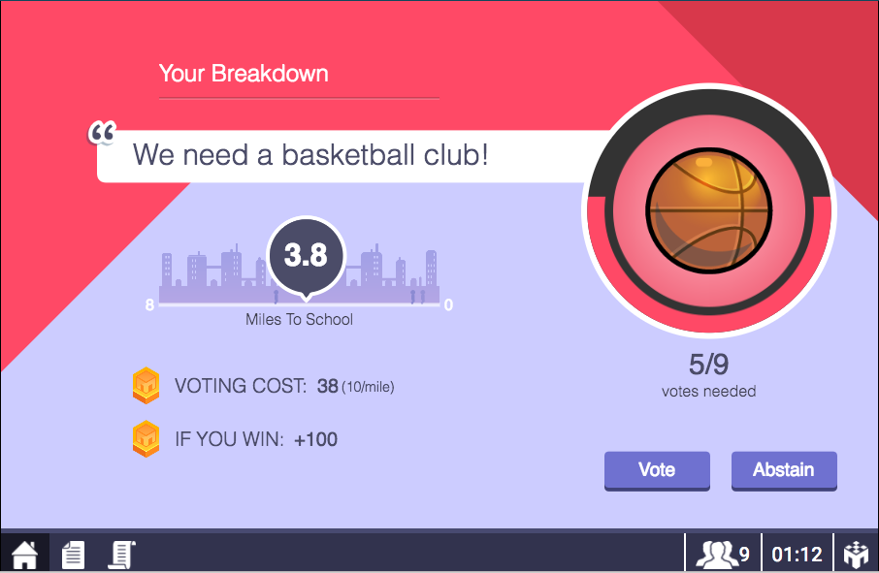
your screen
How many people are in your group?
9

Slide 3
your screen
What fraction of the group need to vote to win?

Slide 4
your screen
Decisions you can make
9

Slide 5
your screen
Things to consider

Slide 6
your screen
Refresher on the rules

Slide 7
payoffs
an example
  Each gets 100 points if the team created; 0 if not.
  Voting costs 10 points per mile
  Bruce lives 3.5 miles away and decides to vote.
  Richard lives 5 miles away and does not vote.
  Outcome = team created
 |  | outcome | - | voting cost | = | payoff
Bruce |  | 100 | - | 35 | = | 65
Richard |  | 100 | - | 0 | = | 100

Slide 8
payoffs
an example
  Each gets 100 points if the team created; 0 if not.
  Voting costs 10 points per mile
  Bruce lives 3.5 miles away and decides to vote.
  Richard lives 5 miles away and does not vote.
  Outcome = team created
 |  | outcome | - | voting cost | = | payoff
Bruce |  | 100 | - | 35 | = | 65
Richard |  | 100 | - | 0 | = | 100

Slide 9
payoffs
happy playing!
an example
  Each gets 100 points if the team created; 0 if not.
  Voting costs 10 points per mile
  Bruce lives 3.5 miles away and decides to vote.
  Richard lives 5 miles away and does not vote.
  Outcome = team created
 |  | outcome | - | voting cost | = | payoff
Bruce |  | 100 | - | 35 | = | 65
Richard |  | 100 | - | 0 | = | 100

