Slide 1

a night out
overview
  groups of two: one is Row, the other Column
  each simultaneously chooses whether to go to the Concert or the Play
    assume no cell phones!
  the worst outcome is choosing different events
  Row prefers meeting at Concert
  Column prefers meeting at PlayReject, then both players earn $0
9A Playground for Decisions
9

Slide 2
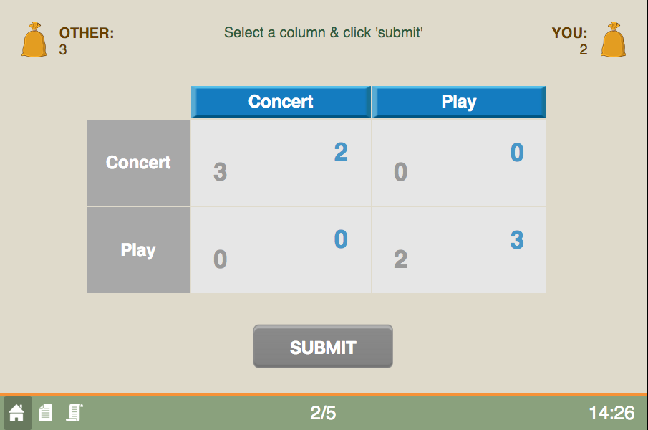
game screen
current round/total rounds
9A Playground for Decisions
9

Slide 3
game screen
your entries are in blue
9A Playground for Decisions
9

Slide 4
game screen
if both choose concert
9A Playground for Decisions
9

Slide 5
game screen
choose an action
9A Playground for Decisions
9

Slide 6
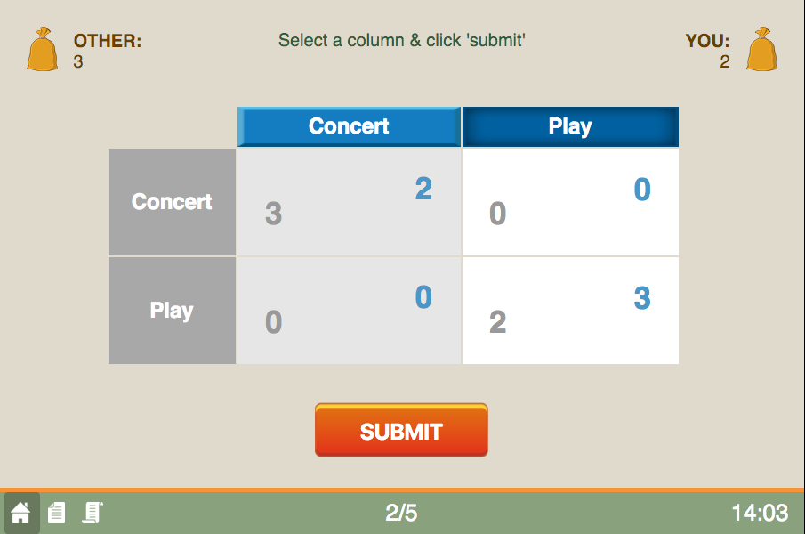
game screen
press to submit
9A Playground for Decisions
9

Slide 7
game screen
happy playing!
the history button
9A Playground for Decisions
9

