Slide 1
Quality Control and Data Integrity for MSIS and ID&R
Alvina Ocegueda, MSDRS
Valerea Cruz, OSPI
Veronica Avila, OSPI

Slide 2

Vision
All students prepared for post-secondary pathways, careers, and civic engagement.
Mission
Transform K–12 education to a system that is centered on closing opportunity gaps and is characterized by high expectations for all students and educators. We achieve this by developing equity-based policies and supports that empower educators, families, and communities.
Values
Ensuring Equity
Collaboration and Service
Achieving Excellence through Continuous Improvement
Focus on the Whole Child

Slide 3
Equity Statement
Each student, family, and community possesses strengths and cultural knowledge that benefits their peers, educators, and schools.
Ensuring educational equity:
Goes beyond equality; it requires education leaders to examine the ways current policies and practices result in disparate outcomes for our students of color, students living in poverty, students receiving special education and English Learner services, students who identify as LGBTQ+, and highly mobile student populations.
Requires education leaders to develop an understanding of historical contexts; engage students, families, and community representatives as partners in decision-making; and actively dismantle systemic barriers, replacing them with policies and practices that ensure all students have access to the instruction and support they need to succeed in our schools.

Slide 4
Tribal Land Acknowledgement
I would like to acknowledge the Indigenous people who have stewarded this land since time immemorial and who still inhabit the area today, the Confederated Tribes and Bands of Indigenous people of Yakama Nation.
Notes:
OSPI Official Agency Tribal Land Acknowledgement
(applies to those hosting, presenting or speaking from the Old Capitol Building or the ancestral lands of the Squaxin Island people)
Squaxin Island Tribe - OSPI
“I would like to acknowledge the indigenous people who have stewarded this land since time immemorial and who still inhabit the area today, the Steh-Chass Band of Indigenous people of the Squaxin Island Tribe.”
Squaxin Island Tribal History – additional history you may wish to include in your acknowledgement and learn more about:
The Squaxin Island Tribe was created by combining seven-bands of indigenous peoples from throughout South Puget Sound. Those seven-bands were originally placed on a reservation in 1854 called Squaxin Island near Thurston and Mason Counties.
Olympia sits on the shores of Budd Inlet. Budd Inlet was known as Steh-Chass, titled after the band of People who lived there since time immemorial.
The Steh-Chass People are one of the seven bands who make up the Squaxin Island Tribe.

Slide 5




Agenda
MSDRS & MSIS Updates
MSIS 2.0 updates. Data change Request
Quality Control and Data Integrity
Updating School District Directory and building information.
eCOE Review
Process for reviewing COE before submitting for approval. Approval timeline and expectations.
Challenge COE’s
Timeline and process of challenge COEs.

Slide 6



MSDRS Services, Updates Quality Control, Data Integrity Alvina Ocegueda

Slide 7
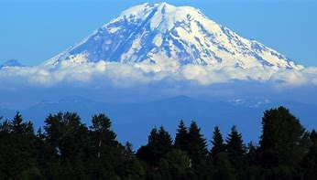
MSDRS & MSIS Updates
Migrant
Student
Data
Reporting
Support
New Name
Migrant Student Data, Reporting, and Support
Keeping the same acronym still MSDRS
(changing the “R” from Recruitment to Reporting)
Contact
msis@msdr.org – MSIS Related Questions
msdr@msdr.org – General Questions
509-837-2712

Slide 8
MSDRS Services for Records Clerks & Recruiters
MSIS Support
MSIS Access – Passwords
School Buildings- Verifications and New IDs
Data Entry Screens
Reports
Error Messages
Quality Control
Family Eligibility Reviews (FERs)
Data Change Requests
School District Directory (staff and dates)
eCOE Technical Assistance
iPad App
eCOE Review & Approvals
PASS
Portable Assisted Study Sequence credit retrieval program
Student Events
Dare to Dream
Other summer events
MSDRS

Slide 9
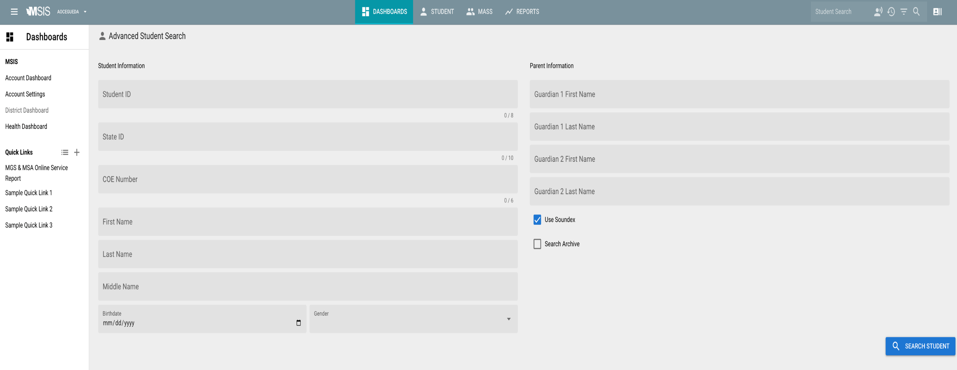
MSIS 2.0 – Release date 12/2/24

Slide 10

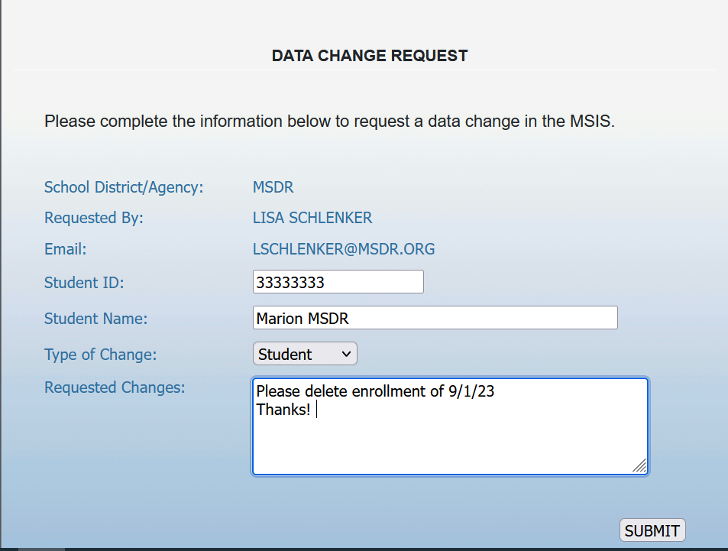
DATA CHANGE REQUEST

Slide 11
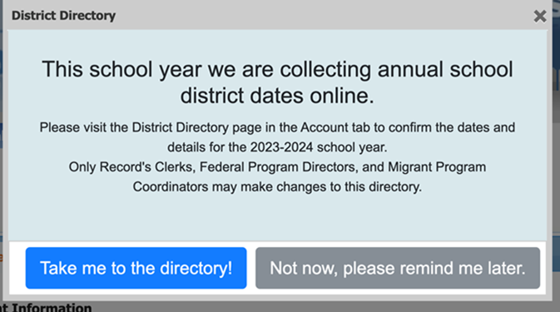

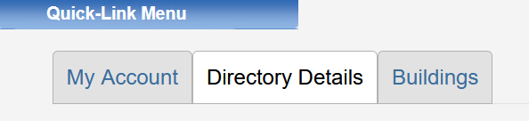
School District Directory/ Buildings

Slide 12


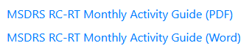
24-25 SCHOOL YEAR OSPI/MSDRS ACTIVITY GUIDE
Activity Guide for
24-25 School Year
COMING SOON
to MSDRS website
Be on the lookout revised guide!
WHERE TO FIND:
Resource Page

Slide 13
OSPI Data Reporting Due Dates
REGULAR SCHOOL YEAR
End of Term, No later than September 15th
SUMMER PROGRAM
End of Term, No later than September 15th
All services and student record information should be reported at the end of the program term or 30 days of student’s withdrawal.
OSPI

Slide 14


MSIS Reminders
Enrollments
AUGUST 14TH
2024-2025 MSIS ROLLOVER TO NEW SCHOOL YEAR
Enrollments for 2024-2025 can be processed on or after 8/14/2024
COEs
AUGUST 19TH
2024-2025 COE SCHOOL YEAR STARTS 8/19/2024
All COEs completed on or after August
19th will be entered in the MSIS for the 24-25 SY

Slide 15

WHO DO I CONTACT FOR…
School District
Directory
Dates & Staff
Updates during
Regular School
Year & Summer
Building
Verification
Process
Regular School
Year & Summer
Student Data
Changes
-Enrollment Deletions
-Student Information
Updates (Spelling,
Birthdates, etc.)
-QAD Information
-Adding a NEW
Student to a COE
Quality Control
& Data Integrity
Activities
Data Clean Up such
as Enrollments,
Assessments,
Supplemental and
Secondary Data.
Electronic Change Request ONLY
ALL changes will
need to be requested electronically through MSIS for auditing
purposes. NO phone calls or emails will be accepted to make
changes to data for
School Year 24-25
MSDRS SUPPORT for Records Clerks MSIS@MSDR.ORG or (509) 837-2712
MSDRS

Slide 16

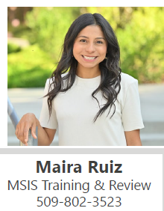
WHO DO I CONTACT FOR…
MSIS TRAINING
On data entry of
migrant student
information into the
MSIS for Records
Clerks and training
on MSIS to other Ed. Staff in migrant
funded school districts
TECHNICAL
ASSISTANCE
To Records Clerks on Migrant Student
Data Reporting
and/or MSIS Reports
MSIS DATA
MONITORING
ACTIVITIES
Fall/Winter, Spring
and Summer Data
RECORDS CLERK
TRAINING
MATERIALS
Records Clerk
training materials
www.msdr.org
OSPI SUPPORT for Records Clerks
WWW.K12.WA.US or Contact Maira Ruiz maira.ruiz@k12.wa.us

Slide 17
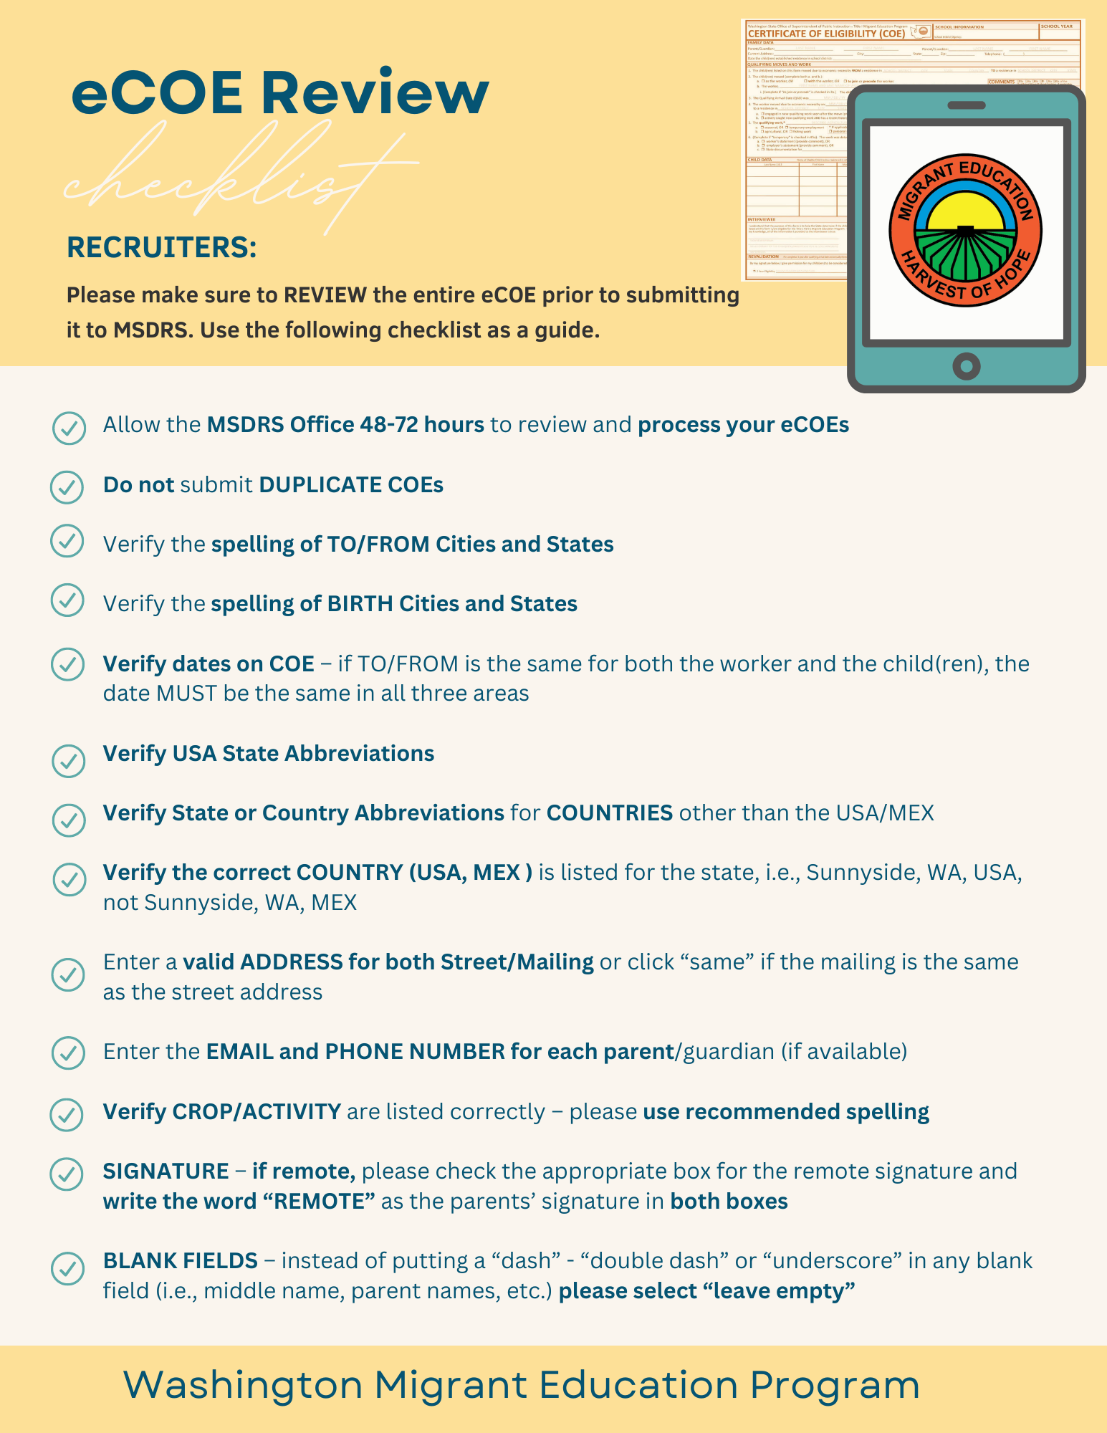
OSPI-Services and eCOE Review Veronica Avila

Slide 18

OSPI Services
RT & RC Training
Coordination for training of new staff & on-going training for current staff.
Materials provided by OSPI staff.
Onsite Modeling
RT & RC
Technical Assistance
Migrant student data reporting and or MSIS reports, eCOE
ID&R Questions
ID&R RT Assistance Request
MSIS Data Monitoring Activities
Fall/Winter, Spring, and Summer.
ID&R District Plans
and Recruiter Logs
ID&R Plan Assistance: Fall training at ESD’s to review IDR plans with RT and FPD’s
Monitoring RT Logs
Challenge COE Approvals
All challenge COE’s get approved by OSPI staff.

Slide 19
eCOE
eCOE Timeline
How eCOE is processed and approved
Reviewing eCOE
Importance of eCOE review
Comments, Qualifying Work and
Common Errors
Remote and RT Signature

Slide 20
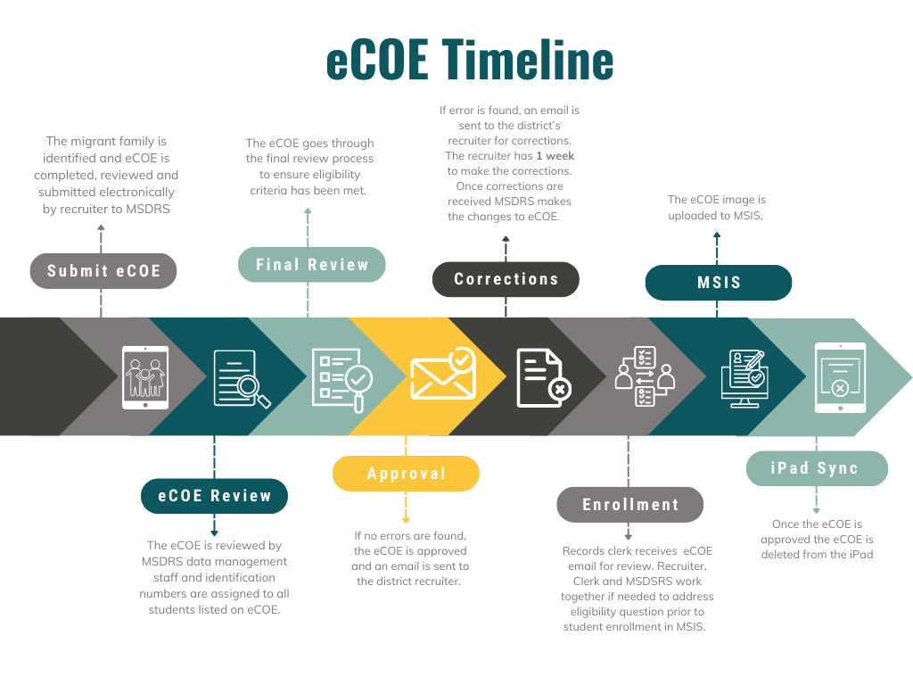

Slide 21
Importance of eCOE Review
Follow up
1. Can avoid delays in Student Enrollment
2. Can avoid eCOE deletions
-Follow-up with request for Information
-If eCOE is a possible duplicate you will get email from MSDRS, check your records and reply to email.
3. Allows RECRUITER to make the corrections directly on eCOE, rather than going through the data change form after it’s been approved.
4. Legal document used to verify eligibility
Deleted eCOE
Duplicate
No Student Enrollment

Slide 22
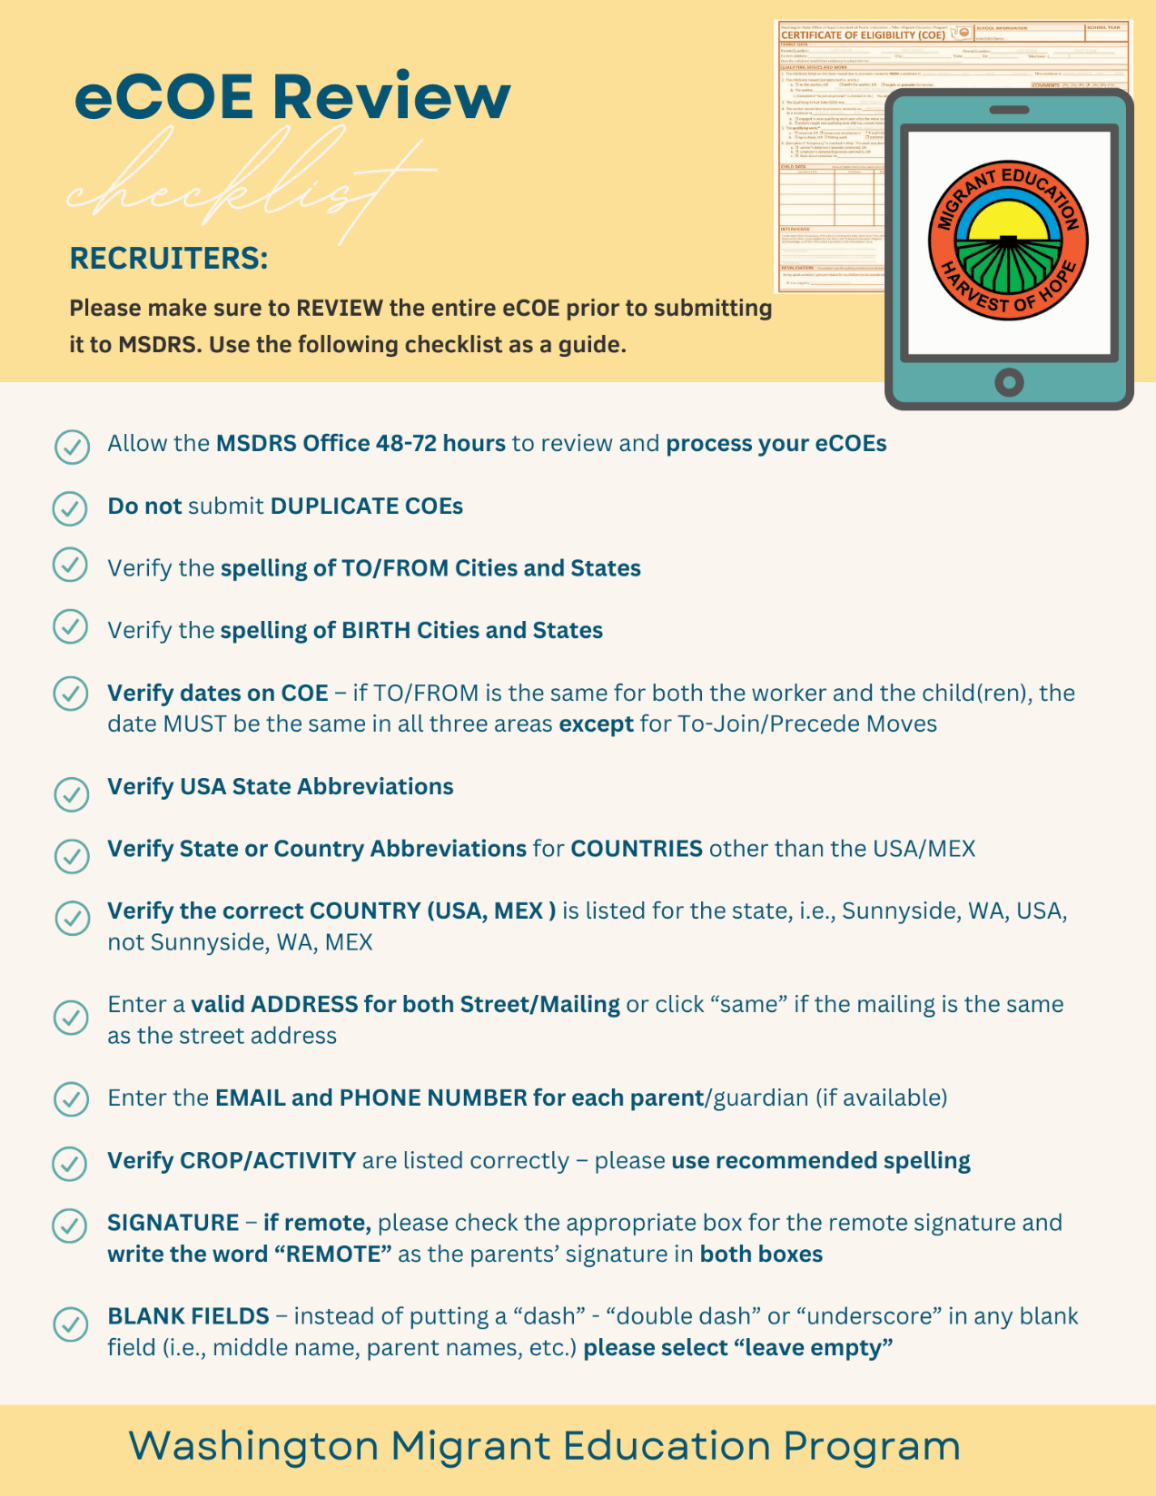
Common Errors
All checklist items are important!
Comments
Qualifying Work and Dates
Signatures

Slide 23
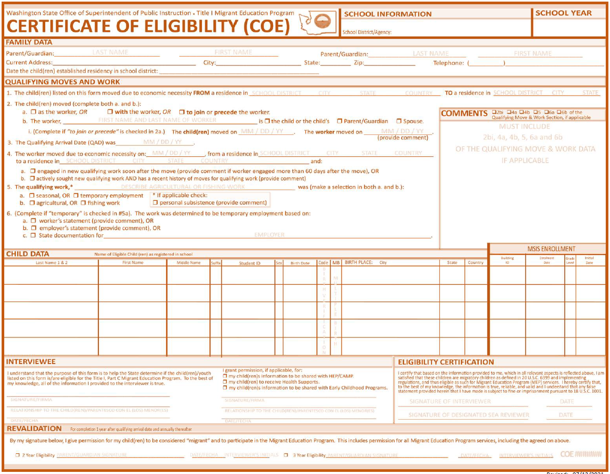
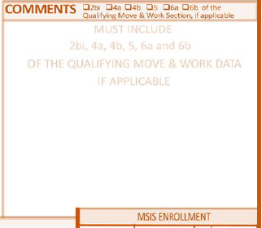
Comments
To Join & To Precede Moves
Short Duration Moves
Shared COE
Temporary Employment
Challenged COE

Slide 24

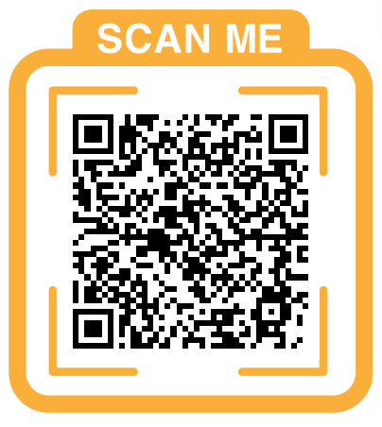
Qualifying Work & Dates
Recruiters benefit from having knowledge in Agriculture and jobs related to eligibility.
Crops as they relate to seasons
Location and crops or activities
Great resources to learn!
-OSPI RT Open MIC 2024-2025
-IDRC
Template Qualifying Activities List Rev2.xlsx - Google Sheets
Provided by IDRC

Slide 25
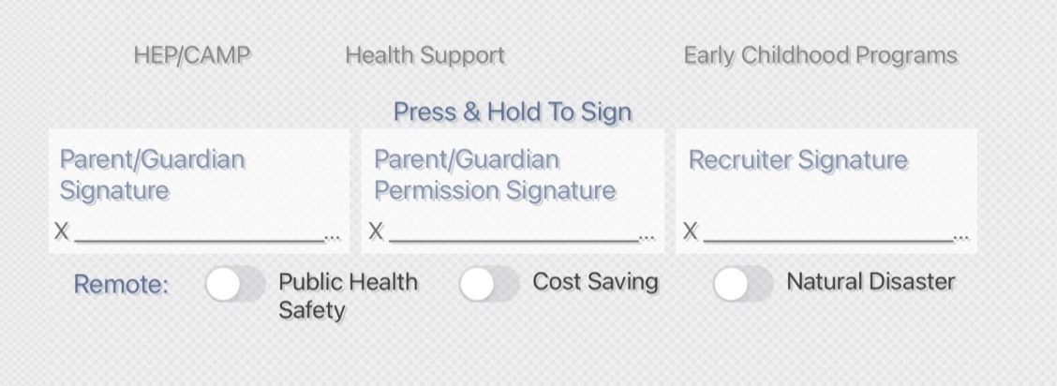
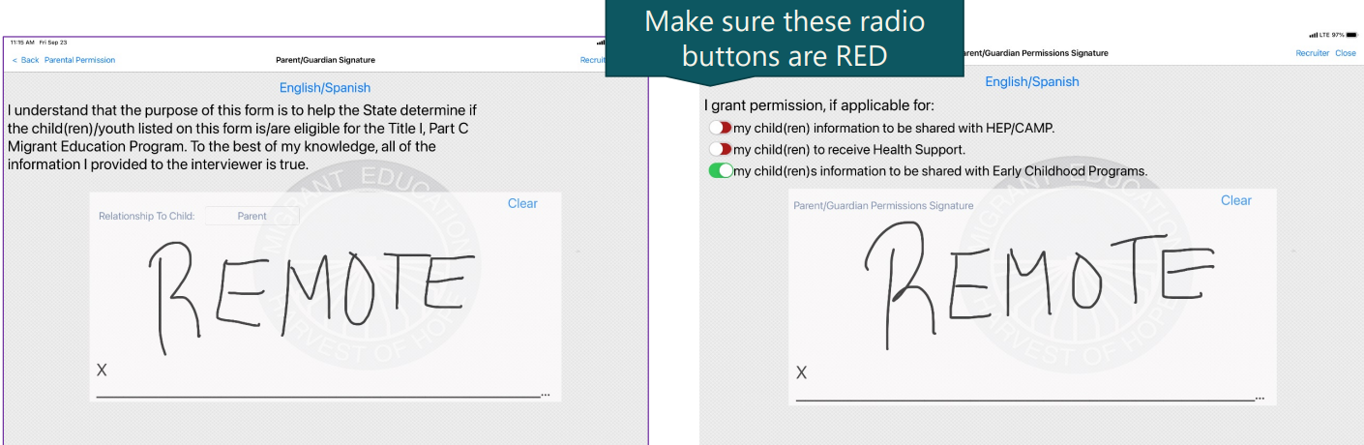
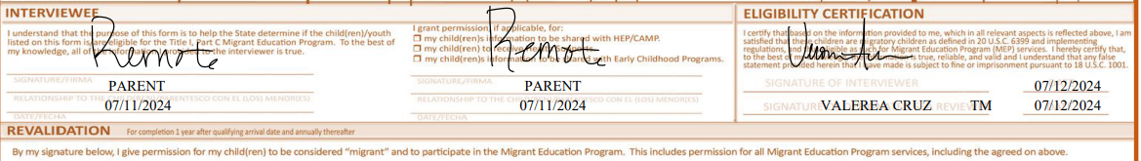
eCOE Signatures
Remote Signature & Recruiter Signature

Slide 26
eCOE Things to remember
Use the eCOE Review Checklist to go over
information on your iPad before you submit
To MSDRS for approval.
Contact your OSPI State Recruiter if you have
Eligibility questions or questions on any section
of the eCOE prior to submitting.
Once COE is submitted and approved any
Changes will require a data change form
through the MSIS.

Slide 27





Challenged COE
Valerea Cruz

Slide 28
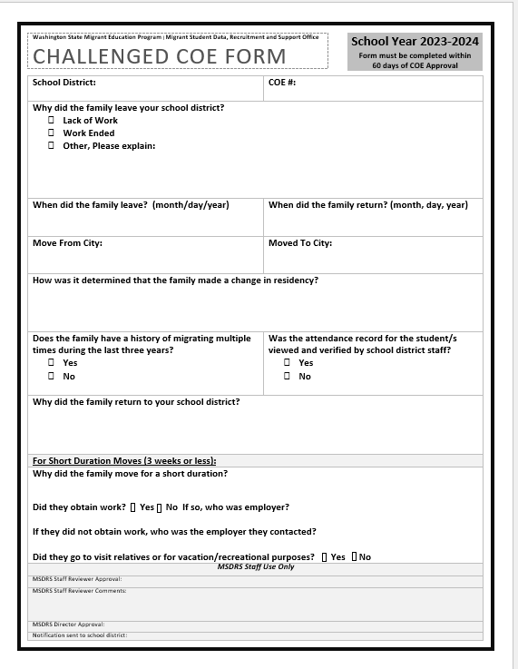
What is a CHALLENGED COE?
A Challenged COE is a form that validates that the student(s) did move away from your school district and established a new residence in another district, state or country when the local district did not withdraw the students(s). A complete Challenge COE form records the new residence and move criteria that validates the COE.

Slide 29
Things to remember CHALLENGED COE
Some migrant families “move” or have “short duration moves” into a different school district during school breaks such as winter break, spring break or long weekend holidays. If the move was to seek or work in agriculture/fishing and NOT vacation, the family move can be considered a NEW Qualifying Move for purposes of migrant eligibility.
If the student DOES NOT withdraw from their School District before they move, they are considered active students in their district. To establish a NEW RESIDENCE in a different district MSDRS uses a challenged COE form to validate that the student(s) did in fact move away.
ATTENDANCE verification is required for approval. For example, if a family moves to California during spring break to work and stays an additional week, attendance records need to reflect that student was absent for the week after the break.
A Challenged COE provides proof of the NEW RESIDENCE for OME auditing purposes.

Slide 30
Short Duration Move (3 weeks or less)
With moves of three weeks or less, additional comments will be required to explain why the move was for qualifying purposes. How was it determined that the move was for economic necessity and not to visit relatives or for vacation?
If the move away from your district was to seek or obtain work
What kind of crop and activity did the worker seek or obtain?
Employer name
If the move was related to lack of work or reduction of work hours and family moved to live economically cheaper in a different location, then the recruiter need comments referring to:
Due to lack of work hours, family moved to California because cost of living is cheaper than staying in Sunnyside
If the move was related to lack of work or reduction of hours and family moved to earn a living somewhere else, the recruiter would need comments such as:
Family moved to California due to lack of work or reduction of hours
Family moved to California to work

Slide 31
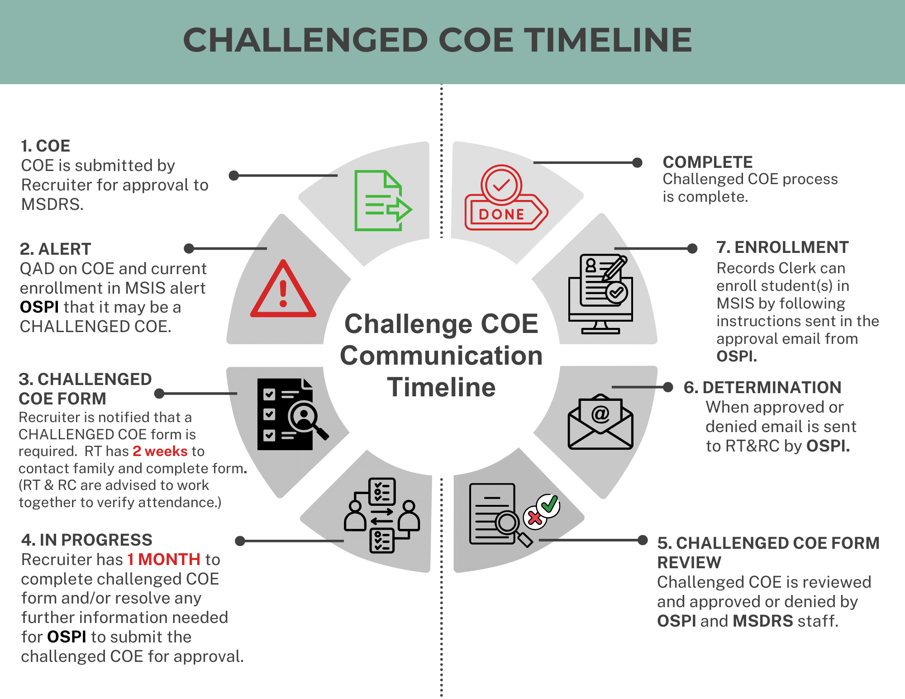

Slide 32
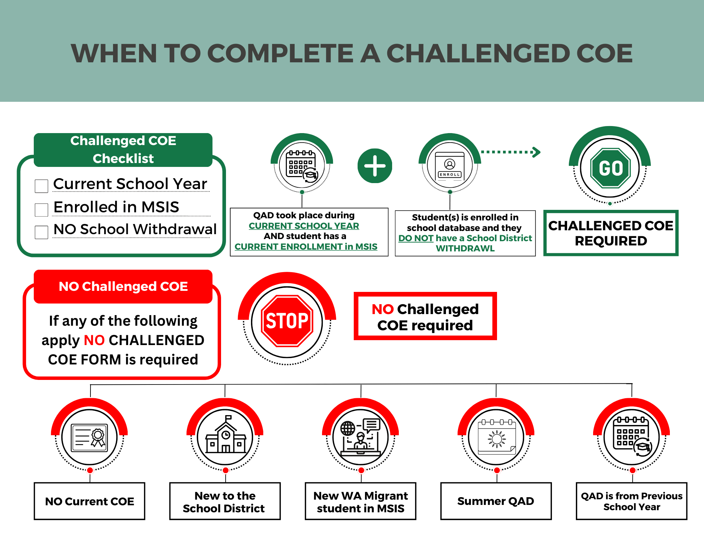
24-25 school year starts
AUGUST
19TH

Slide 33
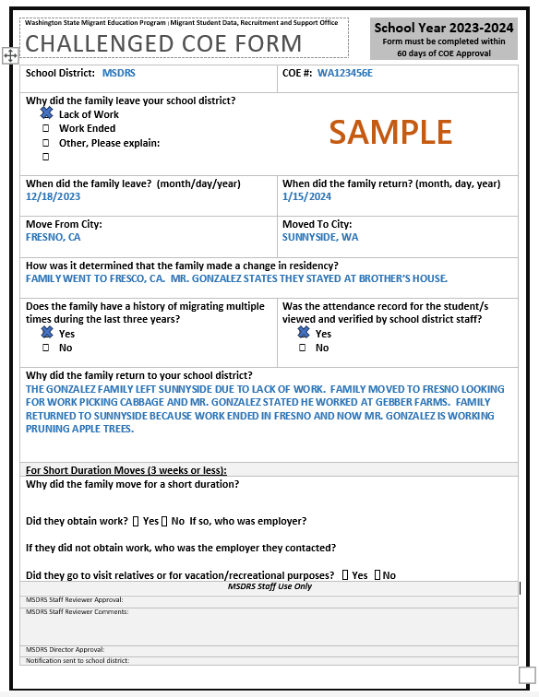
Challenged COE Example

Slide 34

?
Questions?

Slide 35
Thank you!

Slide 36
Notes:
OSPI Official Agency Tribal Land Acknowledgement
(applies to those hosting, presenting or speaking from the Old Capitol Building or the ancestral lands of the Squaxin Island people)
Squaxin Island Tribe - OSPI
“I would like to acknowledge the indigenous people who have stewarded this land since time immemorial and who still inhabit the area today, the Steh-Chass Band of Indigenous people of the Squaxin Island Tribe.”
Squaxin Island Tribal History – additional history you may wish to include in your acknowledgement and learn more about:
The Squaxin Island Tribe was created by combining seven-bands of indigenous peoples from throughout South Puget Sound. Those seven-bands were originally placed on a reservation in 1854 called Squaxin Island near Thurston and Mason Counties.
Olympia sits on the shores of Budd Inlet. Budd Inlet was known as Steh-Chass, titled after the band of People who lived there since time immemorial.
The Steh-Chass People are one of the seven bands who make up the Squaxin Island Tribe.

