Slide 1
MSIS Reporting Updates and Preparing for 2024-2025 School Year
Maira Ruiz, OSPI

Slide 2

Vision
All students prepared for post-secondary pathways, careers, and civic engagement.
Mission
Transform K–12 education to a system that is centered on closing opportunity gaps and is characterized by high expectations for all students and educators. We achieve this by developing equity-based policies and supports that empower educators, families, and communities.
Values
Ensuring Equity
Collaboration and Service
Achieving Excellence through Continuous Improvement
Focus on the Whole Child

Slide 3
Equity Statement
Each student, family, and community possesses strengths and cultural knowledge that benefits their peers, educators, and schools.
Ensuring educational equity:
Goes beyond equality; it requires education leaders to examine the ways current policies and practices result in disparate outcomes for our students of color, students living in poverty, students receiving special education and English Learner services, students who identify as LGBTQ+, and highly mobile student populations.
Requires education leaders to develop an understanding of historical contexts; engage students, families, and community representatives as partners in decision-making; and actively dismantle systemic barriers, replacing them with policies and practices that ensure all students have access to the instruction and support they need to succeed in our schools.

Slide 4
Tribal Land Acknowledgement
I would like to acknowledge the Indigenous people who have stewarded this land since time immemorial and who still inhabit the area today, the Confederated Tribes and Bands of Indigenous people of Yakama Nation.
Notes:
OSPI Official Agency Tribal Land Acknowledgement
(applies to those hosting, presenting or speaking from the Old Capitol Building or the ancestral lands of the Squaxin Island people)
Squaxin Island Tribe - OSPI
“I would like to acknowledge the indigenous people who have stewarded this land since time immemorial and who still inhabit the area today, the Steh-Chass Band of Indigenous people of the Squaxin Island Tribe.”
Squaxin Island Tribal History – additional history you may wish to include in your acknowledgement and learn more about:
The Squaxin Island Tribe was created by combining seven-bands of indigenous peoples from throughout South Puget Sound. Those seven-bands were originally placed on a reservation in 1854 called Squaxin Island near Thurston and Mason Counties.
Olympia sits on the shores of Budd Inlet. Budd Inlet was known as Steh-Chass, titled after the band of People who lived there since time immemorial.
The Steh-Chass People are one of the seven bands who make up the Squaxin Island Tribe.

Slide 5




Agenda
MSDRS/OSPI Services
Review the services the MSDRS office provides to our districts and the services the OSPI office provides.
MSIS Reporting Due Dates
Discuss upcoming deadlines for regular and summer school.
MSIS and MSIS2.0 Training
Discuss trainings options for MSIS and training opportunities upon release of MSIS2.0.
MSIS 2024-2025 School Year Reminders
Preparing for 24-25 school year reporting.

Slide 6



MSDRS Services, Updates Quality Control, Data Integrity

Slide 7

MSDRS & MSIS Updates
Migrant
Student
Data
Reporting
Support
New Name
Migrant Student Data, Reporting, and Support
Keeping the same acronym still MSDRS
(changing the “R” from Recruitment to Reporting)
Contact
msis@msdr.org – MSIS Related Questions
msdr@msdr.org – General Questions
509-837-2712

Slide 8
MSDRS Services
MSIS Support
MSIS Access – Passwords
School Buildings- Verifications and New IDs
Data Entry Screens
Reports
Error Messages
Quality Control
Family Eligibility Reviews (FERs)
Data Change Requests
School District Directory (staff and dates)
eCOE Technical Assistance
iPad App
eCOE Review & Approvals
PASS
Portable Assisted Study Sequence credit retrieval program
Student Events
Dare to Dream
Other events
MSDRS

Slide 9

OSPI Services
RT & RC Training
Coordination for training of new staff & on-going training for current staff.
Materials provided by OSPI staff.
Onsite Modeling
RT & RC
Technical Assistance
Migrant student data reporting and or MSIS reports, eCOE
ID&R Questions
ID&R RT Assistance Request
MSIS Data Monitoring Activities
Fall/Winter, Spring, and Summer.
ID&R District Plans
and Recruiter Logs
ID&R Plan Assistance: Fall training at ESD’s to review IDR plans with RT and FPD’s
Monitoring RT Logs
Challenge COE Approvals
All challenge COE’s get approved by OSPI staff.

Slide 10


WHO DO I CONTACT FOR…
School District
Directory
Dates & Staff
Updates during
Regular school
Year & Summer
Building
Verification
Process
Regular school
Year & Summer
Student Data
Changes
-Enrollment Deletions
-Student Information
Updates (Spelling,
Birthdates, etc.)
-QAD Information
-Adding a NEW
student to a COE
Quality Control
& Data Integrity
Activities
Data Clean Up such
As enrollments,
Assessments,
Supplemental and
Secondary data.
Electronic Change Request ONLY
ALL changes will
need to be requested electronically through MSIS for auditing
purposes. NO phone calls or emails will be accepted to make
Changes to data for
School year 24-25
MSDRS SUPPORT for Records Clerks www.MSDR.ORG OR (509) 837-2712
MSDRS

Slide 11

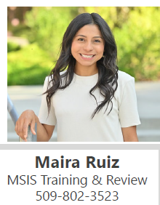
WHO DO I CONTACT FOR…
MSIS TRAINING
On data entry of
Migrant student
information into the
MSIS for Records
Clerks and training
on MSIS to other Ed.
Staff in Migrant
funded LEA’s
TECHNICAL
ASSISTANCE
To Records Clerks on Migrant Student
Data Reporting
and/or MSIS Reports
MSIS DATA
MONITORING
ACTIVITIES
Fall/Winter, Spring
and Summer Data
RECORDS CLERK
TRAINING
MATERIALS
All records clerk
training materials
OSPI SUPPORT for Records Clerks
WWW.K12.WA.US OR Contact Maira Ruiz maira.ruiz@k12.wa.us

Slide 12

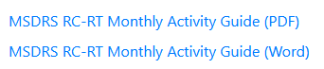
24-25 SCHOOL YEAR OSPI/MSDRS ACTIVITY GUIDE
Activity Guide
Find on MSDRS Resource Page
For both RC and RT staff
Updates will be available when resource page is complete
WHERE TO FIND:
Resource Page

Slide 13
OSPI Data Reporting Due Dates 2023-2024 School Year
REGULAR SCHOOL YEAR
End of Term, No later than September 15th
SUMMER PROGRAM
End of Term, No later than September 15th
All services and student record information should be reported at the end of the program term or 30 days of student’s withdrawal.
OSPI

Slide 14

Records Clerk Training
Limited MSIS training will be available to new Records Clerks. Please connect with me to schedule a meeting!
Monthly RC Meetings will continue this school year. Registration will be emailed a few weeks prior to monthly meeting. Our first meeting will be Tuesday, September 3rd : 10:00-11:00am.
Technical Assistance available monthly.

Slide 15

Records Clerk In-Person Training Coming this Fall!
ESD 189 South
Tuesday, October 29th
ESD 189 North
Thursday, October 31st
ESD 171
Tuesday, November 5th
Registration coming soon!
ESD 105
Wednesday, November 6th
ESD 123
Thursday, November 7th

Slide 16
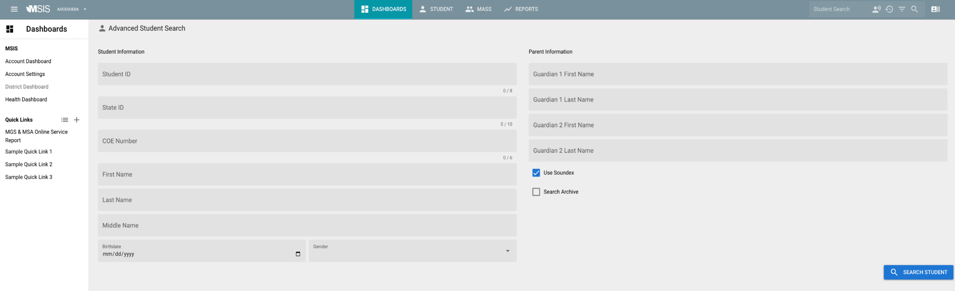
MSIS 2.0 – Release date 12/2/24
MSIS2.0 Training will be available twice a week starting on 12/3/24 and continue through January
Notes:
5 people maximum per training session
Registration link will be emailed as we get closer to the release date.

Slide 17

Completing the 2023-2024 School Year
Process all enrollments before September 15th
Process all withdrawals
Enter all Supplemental Services provided throughout the school year
Report Pre/Post assessments (if this applies to your district)

Slide 18

Preparing for the 2024-2025 School Year
Update school district directory/buildings
Process Enrollments
Enrollments for 2024-2025 can be processed on or after 8/14/2024
Obtain Copy of 2024-2025 Grant
Report Supplemental Services
Report Pre-Assessment Scores (if applicable)
MSIS2.0 Release

Slide 19

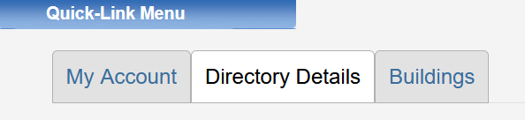
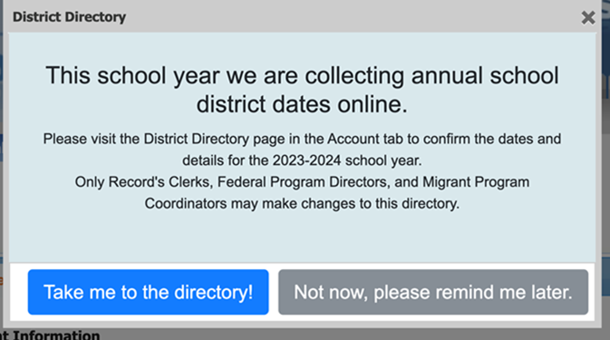
Update Your School District Directory/ Buildings
Enter your first/last day of school
Verify active buildings
First week of October: you will need to validate your email on MSIS to continue having access

Slide 20
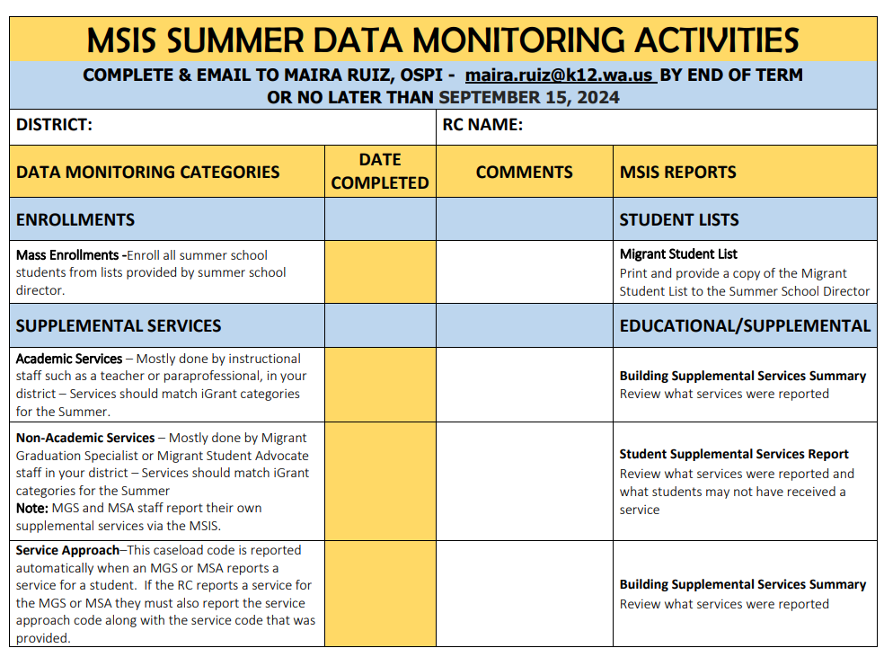
Did your district have a summer program?
Yes: Submit Summer Data Monitoring by September 15^{th.}
No: No need to submit Data Monitoring, however, check for summer QADs and process pending enrollments

Slide 21
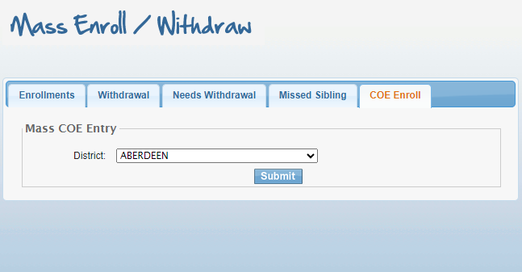
MSIS: Process Pending Enrollments
Check your COE Enroll Tab:
If students were in your district this summer (they have a summer QAD) but did not attend a summer program, please enroll them as OS.

Slide 22

MSIS: Enrollments
Enrollments: August 14th
2024-2025 MSIS rollover to new year
Enrollments can be processed on or after 8/14/2024
Reminder: Enroll on or after the QAD date
Examples:
7/24/2024 QAD– enroll on first day of school
10/19/2024 QAD– enroll on 10/21/2024 (because 10/19 is a Saturday)
Reminder: Process OS enrollments for the school year

Slide 23

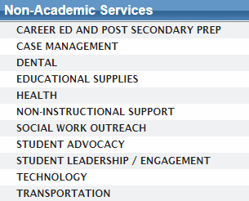
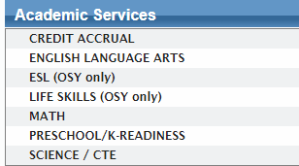
MSIS: Supplemental Services
Verify which supplemental services your district applied for:
You will report services listed on your grant.

Slide 24

MSIS: Pre/Post Assessments
Is your district providing ELA and/or Math services?
Yes: Report Pre/Post assessments
No: You do not need to do anything

Slide 25
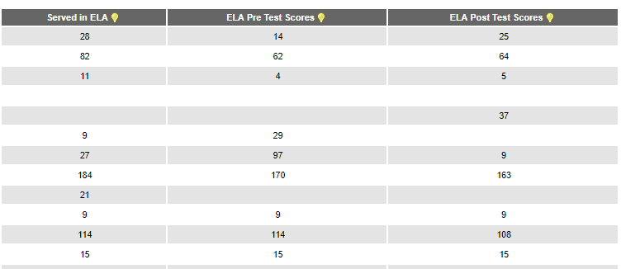
MSIS: Pre/Post Assessments
If you are reporting Pre/Post assessment scores, please make sure:
The number of students served in that subject area and the number of students you are reporting test scores for is as close as possible

Slide 26
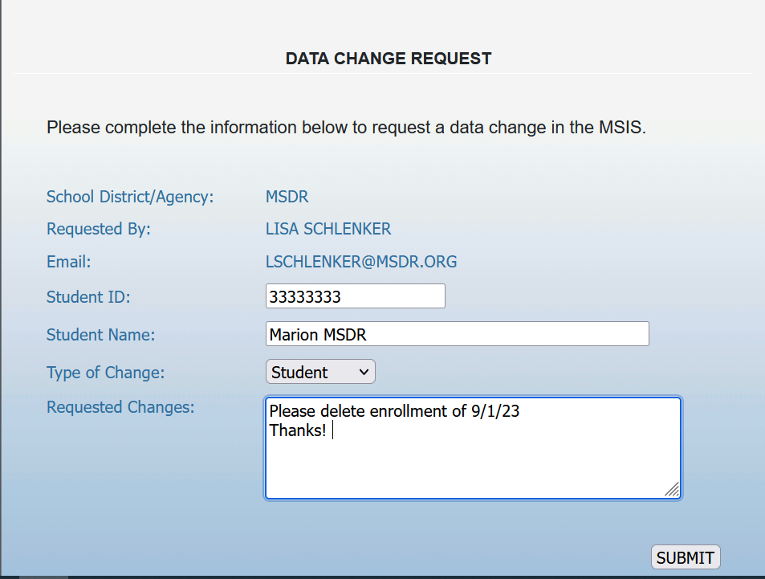

Made a Mistake?
Submit a data change request:
Changes to enrollment
Changes to student information

Slide 27
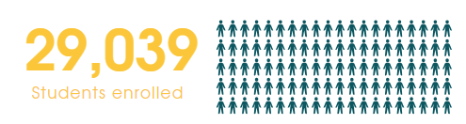
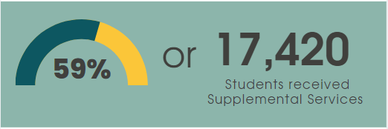
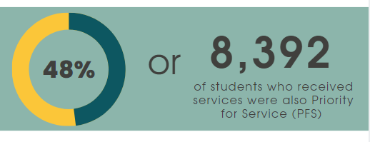
Washington MEP At A Glance: 23-24 School Year
As of 7/31/2024:

Slide 28

?
Questions?

Slide 29
Thank you!

Slide 30
Notes:
OSPI Official Agency Tribal Land Acknowledgement
(applies to those hosting, presenting or speaking from the Old Capitol Building or the ancestral lands of the Squaxin Island people)
Squaxin Island Tribe - OSPI
“I would like to acknowledge the indigenous people who have stewarded this land since time immemorial and who still inhabit the area today, the Steh-Chass Band of Indigenous people of the Squaxin Island Tribe.”
Squaxin Island Tribal History – additional history you may wish to include in your acknowledgement and learn more about:
The Squaxin Island Tribe was created by combining seven-bands of indigenous peoples from throughout South Puget Sound. Those seven-bands were originally placed on a reservation in 1854 called Squaxin Island near Thurston and Mason Counties.
Olympia sits on the shores of Budd Inlet. Budd Inlet was known as Steh-Chass, titled after the band of People who lived there since time immemorial.
The Steh-Chass People are one of the seven bands who make up the Squaxin Island Tribe.

