Slide 1
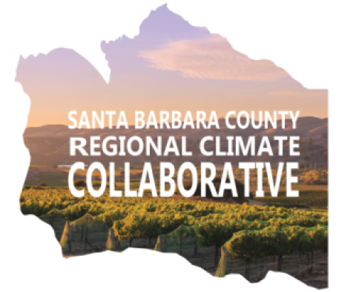
Santa Barbara County Regional Climate Collaborative
2021-26 Strategic Plan

Slide 2
The Challenge
No one jurisdiction or organization can overcome the climate crisis. Addressing it will require transformative change at multiple scales. Many of the biggest challenges require solutions outside the jurisdiction or tool set of individual institutions, but most institutions are not structured to work beyond their boundaries. Without a collaborative approach, we will fail to meet our climate goals.

Slide 3
Our Mission
The Santa Barbara County Regional Climate Collaborative's purpose is to build local capacity to advance regional scale solutions to the climate crisis and enhance resilience.

Slide 4
Our Vision
A carbon neutral, climate-resilient, prosperous and equitable Santa Barbara County.

Slide 5

How We Got Here (Background)
2018
2019
2020
2018 Central Coast Sustainability Summit
Collaborative Launch – Call for Members & Applications
Local Govt Meetings
Local Govt Meetings
Local Govts & Stakeholders Conceptual Meeting
County Supervisors approved staff & budget to launch Collaborative
By-Laws drafted and reviewed by Local Govts
1st Steering Committee Meeting
Notes:
Conversation to start a Regional Collaborative spawned from the 2018 Central Coast Sustainability Summit.
Day after the Summit, The Sustainability Division convened Local Govts and stakeholders to discuss the prospect of forming a regional collaborative. Since the initial meeting, The County Sustainability Division has convened several meetings with local governments to develop the structure and objectives of the collaborative.
In mid 2019, the County BOS approved a budget to launch the collaborative. The Sustainability Division has since brought on a project manager to assist and lead the formation effort.
Fast forward to present day, the lunch of Collaborative was announced on March 4th at the Sea-Level Rise & Flooding Round table

Slide 6

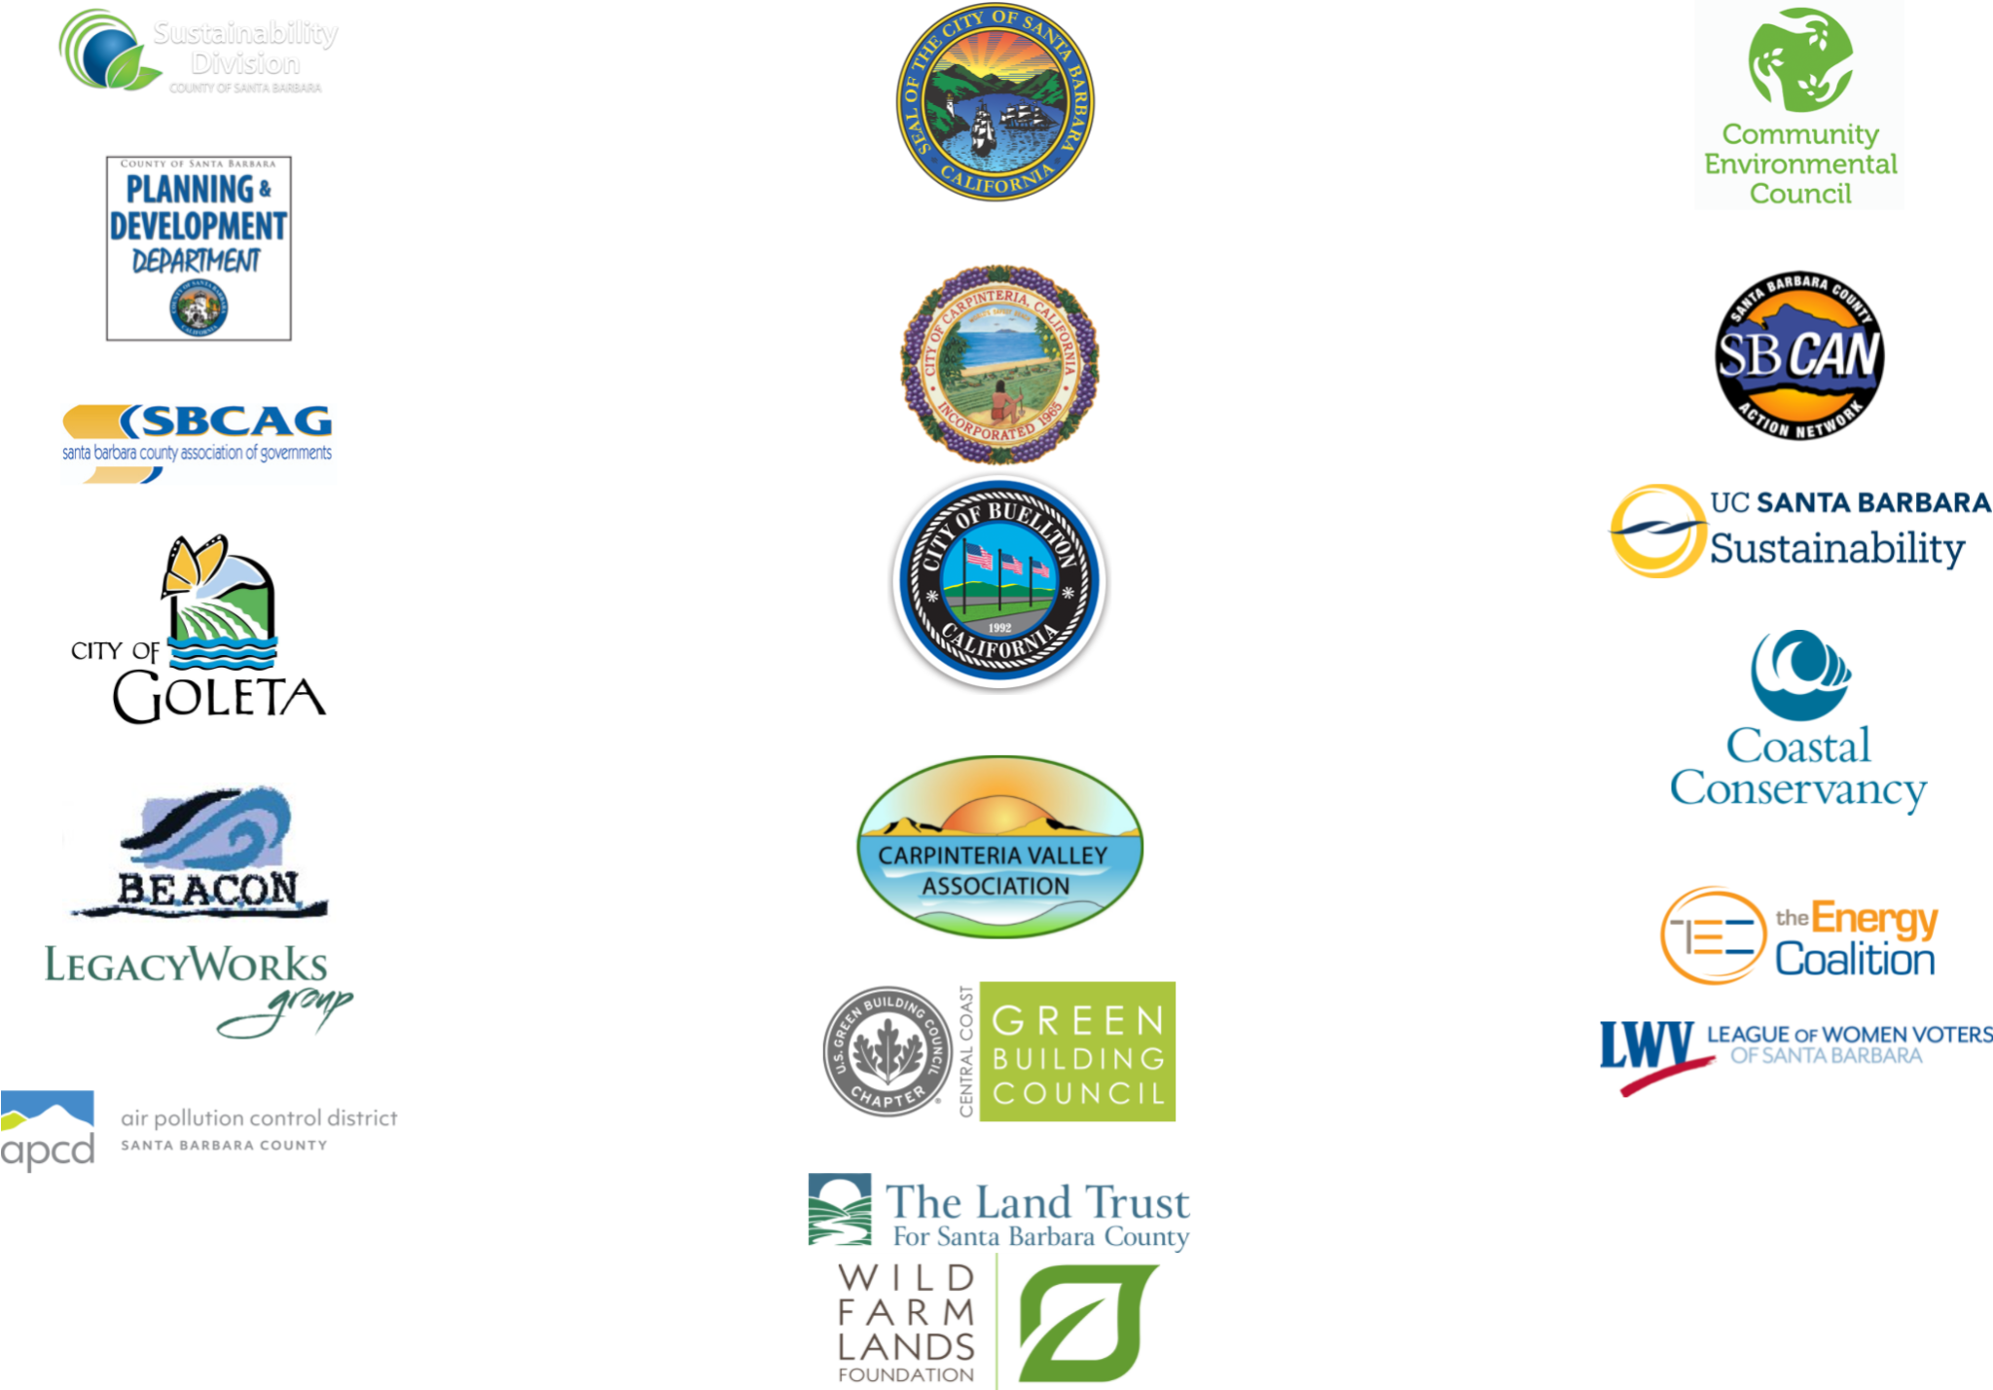
Who we are

Slide 7
Organizational Structure
Steering Committee
Equity Advisory & Outreach Committee
Clean Energy Assurance Subcommittee
Sea Level Rise Adaptation Subcommittee
Carbon Farming & Land Stewardship Subcommittee
General Members

Slide 8
Steering Committee Composition
Organization | Member | Org Type | Region
County of SB | Ashley Watkins | Local Govt | Countywide
Santa Barbara | Alelia Parenteau | Local Govt | South Coast - City
Carpinteria | Erin Maker | Local Govt | South Coast – City
UCSB Sustainability | Mo Lovegreen | Education | South Coast
SBCAG | Andrew Orfila | Special District | Countywide
Community Environmental Council | Michael Chiacos | Non-Profit | Countywide
Santa Barbara County Action Network | Nadia Abushanab | Non-Profit | Countywide
Santa Barbara 350 | Michelle Sevilla | Non-Profit | Countywide

Slide 9
Committees
Committee | Chairs/Co-Chairs/Vice-Chairs | Meeting Days/Times
Steering Committee | Chair, Alelia Parenteau (City of Santa Barbara) | Monthly, second Thursday, 1-3 pm
Equity Advisory & Outreach Committee | Chair, Michelle Sevilla (350 Santa Barbara) Vice Chair, Ana Rosa Rizo-Centino (La Casa de la Rasa) | Bimonthly, second Wednesday, 10-12 pm
Clean Energy Assurance Subcommittee | Chair, Bri Winkler (City of Santa Barbara) Vice Chair, Marisa Hanson (County of Santa Barbara) | Monthly, second Monday, 11-12 pm
Sea Level Rise Adaptation Subcommittee | Chair, Charles Lester (UC Santa Barbara) Vice Chair, Melissa Hetrick (City of Santa Barbara) | Monthly, third Wednesday, 10-11 am
Land Stewardship & Carbon Farming Subcommittee | Chair, Frank Chen (County of Santa Barbara) | Bimonthly, second Wednesday, 4-5:30 pm

Slide 10
Connect diverse partners to build relationships, exchange ideas and learn from each others’ experiences
Leverage and share resources (funding, knowledge, people, power) to coordinate strategies and launch joint initiatives that advance regional climate solutions
Advance equity by lifting up community needs, strengths and ideas through thoughtful and empowering community engagement
Champion policies, programs and projects that recognize the regional nature of climate change impacts and solutions
What we do (Functions)
Notes:
REVISED VERSION

Slide 11
First Year Accomplishments
Steering Committee
Adopted Collaborative By-Laws
Established three subcommittees from applications received
Submitted one grant application to Carbon Neutral Cities Alliance
Approved integration of the Equity Advisory & Outreach Committee
Initiated Strategic Planning process
Submitted Letter of Support for California Climate Resilience Budget
Subcommittees
Equity Advisory & Outreach Committee
Advised County’s One Climate Initiative projects
Clean Energy Assurance
Established a shared purpose, vision, definitions
Created a shared resource library
Advised Energy Assurance & Assessment Services
Identified critical facilities for energy resilience
Sea Level Rise Adaptation
Held watch party for Managed Retreat Series
Shared local challenges to Local Coastal Plan updates
Initiated concepts for SLR webinar series and creation of shared regional adaptation principles
Carbon Farming & Land Stewardship
Advised TerraCount Carbon Stock Analysis

Slide 12
Connect diverse partners to build relationships, exchange ideas and learn from each other’s experiences
Strategies
Encourage each member to give a presentation on behalf of the Collaborative to their own organization
Encourage each member to recruit one additional member into the Collaborative
Target outreach to community leaders, elected officials and business associations
Conduct annual membership satisfaction surveys
Recruit and maintain strong subcommittee chairs
Provide clear support and guidance for the subcommittees in establishing work goals
Hold working session(s) on Collaborative issues at the Central Coast Sustainability Summit
Plan to hold at least two events for General Members
Metrics of Success
Member recruitment & retainment
Member satisfaction
North County representation
Business representation
Public Activities

Slide 13
Connect diverse partners to build relationships, exchange ideas and learn from each other’s experiences
Category | Failure Avoiding 100% of these | Minimum Success Achieving 100% of these | Target Success Achieving 40-60% of these | Epic Success
Member Recruitment and Retention | Loss of members due to lack of interest | Sustain current membership levels | Increase membership by 25% | Increase membership by 50%
Membership Satisfaction | Members disagree they have received value from their membership | Members agree they have received value from their membership | Members strongly agree they have received value from their membership | Members would recommend joining the Collaborative to their peers
North County Representation | No participation from NC agencies | Active participation from cities of Solvang, Lompoc and Santa Maria | All NC jurisdictions are active members | Active collaborative project with NC jurisdiction
Business Representation | No businesses, business associations and chambers are active members | Like-minded businesses are members | Major businesses, business associations and chambers are active members | Active collaborative project with a businesses, business associations or chambers
Public Activities | No public activity held | One public activity per year | Two public activities per year Subcommittee webinars that have high attendance (30-60 participants) | More than two public activities held

Slide 14
Leverage and share resources (funding, knowledge, people, power) to coordinate strategies and launch joint initiatives that advance regional climate
Strategies
Invite members to present their organizations, programs and projects to other members
Create a public database to track carbon emissions, key indicators and reduction strategies
Convene individuals and groups with similar interest from different areas to communicate about regional issues
Ensure that relevant funding opportunities are discussed at the level of the subcommittee, and that members have support in exploring these opportunities
Metrics of Success
Subcommittee Activity
Projects & Funding
Capacity Building
Innovation

Slide 15
Leverage and share resources (funding, knowledge, people, power) to coordinate strategies and launch joint initiatives that advance regional climate solutions
Category | Failure Avoiding 100% of these | Minimum Success Achieving 100% of these | Target Success Achieving 40-60% of these | Epic Success
Subcommittee Activity | A subcommittee is discontinued due to lack of interest | One new subcommittee is formed per year | All of the subcommittees that have been identified in SP have been formed | Participation/ Membership in subcommittees from a wide range of community groups and agencies New subcommittees are formed organically by members
Projects & Funding | No potential projects and funding sources identified | Identified potential projects and funding sources | Submitted at least two joint proposals together | Awarded funding for a joint proposal
Capacity Building | One jurisdiction has an adopted Climate Action Plan | Two jurisdictions have adopted Climate Action Plans | Three jurisdictions have adopted Climate Action Plans | Four or more jurisdictions have adopted Climate Action Plans
Innovation (Technology, Program, Project, Governance, etc) | No new innovations are developed or implemented | One new innovation is developed and/or implemented on a limited scale | One new innovation is implemented on a wide scale; or two innovations are developed | Innovation(s) is/are sustainable without external funding Three or more innovations are developed and/or implemented

Slide 16
Advance equity by lifting up community needs, strengths and ideas through thoughtful and empowering community engagement
Strategies
Make accessible steering and subcommittee meetings (interpretation, closed captioning, recorded for later viewing)
Increase EA+OC membership from frontline communities
Integrate EA+OC into governance structure, and defer decision-making authority when appropriate
Direct Subcommittees to reference the community engagement findings that have already happened/continue to occur (Resilience Roundtables, Regional Green New Deal)
Prioritize EA+OC stipend into budget process with options to increase donations.
Review and revise (if necessary) dues structure to ensure equitable contribution to EA+OC stipend.
Metrics of Success
EA+OC Membership
EA+OC Policy
EA+OC Stipend & Budget
Equitable Representation & Decision Making
Community-led Projects (Regional Green New Deal, CEC Resilience Roundtable)

Slide 17
Advance equity by lifting up community needs, strengths and ideas through thoughtful and empowering community engagement
Category | Failure Avoiding 100% of these | Minimum Success Achieving 100% of these | Target Success Achieving 40-60% of these | Epic Success
EA+OC Membership | Membership declines | Membership stays the same | Membership expands by 25% | Membership expands and diversifies by 50%
EA+OC Policy | Advises only one agency (County) | Advises two agencies | Advises three agencies | Advises four agencies
EA+OC Equity Stipend Budget | Budget is not replenished | Budget is sustained at same levels by County | Budget is sustained by Collaborative revenue | Budget is expanded by Collaborative revenue
Equitable Representation & Decision Making | No EJ/SJ organizations are active members | Mostly EJ organizations are active members | Like-minded EJ and SJ organizations are active members EJ and SJ organizations are involved in decision-making in a Subcommittee or Steering Committee | Active collaborative project with an EJ or SJ member EJ and SJ organizations lead decision-making in a Subcommittee or Steering Committee
Community-led Projects (Regional Green New Deal, CEC Resilience Roundtable) | No GND and/or RRT project is developed and/or implemented | One GND and/or RRT project is developed and/or implemented Community groups are consulted but do not lead | Two GND and/or RRT projects are developed and/or implemented Community groups are involved but do not lead | Three or more GND and/or RRT projects are developed and/or implemented Community groups lead on project development and/or implementation

Slide 18
Champion policies, programs and projects that recognize the regional nature of climate change impacts and solutions
Strategies
Subcommittees will work to create alignment on a policy platform
Subcommittees will develop metrics to determine levels of success, including minimum, target, and epic.
Metrics of Success
Local Legislation/Policy Making
Collaborative Projects or Programs
Subcommittee Metrics

Slide 19
Champion policies, programs and projects that recognize the regional nature of climate change impacts and solutions
Category | Failure Avoiding 100% of these | Minimum Success Achieving 100% of these | Target Success Achieving 40-60% of these | Epic Success
Local Legislation/ Policy Making | No new policies adopted | Two local agencies coordinate to adopt similar policies | More than two local agencies adopt similar policies | Local agencies coordinate policy implementation
Resilience Hubs | No hub is identified | Pilot hub is identified and developed Resilience hub framework is developed | More than one hub is established | New hubs are led and developed by grassroots efforts
Energy Assurance & Assessment | No buildings benchmarked | One building benchmarked in each jurisdiction | One building assessed for energy resilience in each jurisdiction | At least one building moves forward with energy resilience recommendations
Electric Vehicles | BEV/PHEVs: 5,088 Level 2 chargers: 281 DCFC: 37 | BEV/PHEVs: 7,710 Level 2 chargers: 972 DCFC: 153 | BEV/PHEVs: 10,333 Level 2 chargers: 691 DCFC: 116 | BEV/PHEVs: >10,333 Level 2 chargers: 972 DCFC: 153
Restoration and Regenerative Agriculture | No new project | One restoration or regenerative agriculture project is implemented | More than one restoration or regenerative agriculture project is implemented Project is ushered through carbon market | Locally generated carbon offsets are sold (preferably to local offtaker)

Slide 20
Our
Impact
Programs and staff have the resources and capacity to implement and continuously improve climate policies and programs.
Strong and diverse cross-sector partnerships support transformative and equitable regional climate action.
State and local policy and funding decisions prioritize regional climate action.
All of the region’s communities benefit from reduced risks to life and property, increased wellness and prosperity, and greater sustainability.

