Slide 1

MMIS-Provider Services Module
John Thomas
State of Montana
State Procurement Bureau
Shellie McCann
State of Montana
Montana Program for Automating and Transforming Healthcare (MPATH)

Slide 2

Sourcing Team
Montana
Shellie McCann
Dave Mangold
Helena Breidenbach
Wyoming
Jesse Springer
John Benskin
Oregon
Reilly Jones
Todd Howard
South Dakota
Scott Johnson
South Carolina
John Stevens
Shannon Berry
Cooperative Development Coordinator NASPO ValuePoint

Slide 3
Purpose
To establish multiple Master Agreements for Provider Services Module for States Medicaid Management Information Systems:
State governments
The District of Columbia & territories of the United States
Government subdivisions (potentially cities or counties in need of Provider Services Module)

Slide 4
Service Delivery Model
Each Offeror proposed SaaS
Each Offeror’s solution will be hosted
The State will not retain ownership of the solution
Ownership
  Per the Master Agreement the State owns all customizations and configurations to the solution but the vendor retains all ownership in the proposed solution.
  State retains all ownership of their data.
Notes:
The Offeror’s will provide a SaaS solution hosted on the cloud that meets a robust set of security requirements. The purchase equates to a lease agreement where the use of the solution ends at the end of the contract term. The department only retains ownership in the customizations and configurations but not the actual solution.

Slide 5
Benefits of Agreements
CMS National Approval
Six qualifying pre-approved Provider Services solutions
Reduced procurement / acquisition timeline
States determine best fit and best value to meet business needs
Comprehensive terms and conditions included in all Master Agreements
Predefined costs
Robust Performance Standards
Comprehensive Requirements
MECT checklist items mapped to requirements to support certification
Federally compliant and configurable solutions to address state specific laws and policy

Slide 6
Provider Services Module Base Scope of Work
The Provider Services base solution is an overall provider enrollment and maintenance solution that will accept and process applications through a web-based provider self-service tool, on paper or through other national enrollment solutions (e.g., Provider Enrollment Chain Owner System (PECOS)).
The Provider Services base solution will be workflow driven to allow both internal and external users to follow defined business processes that will ensure the user experience is optimized and established policies are followed.
The Provider Services base solution includes an automated screening and monitoring component to complete required screening and monitoring activities for enrolling and actively enrolled providers compliant with the Code Federal Regulations 42 CFR 455.436 in addition to state specific requirements and policy.
The Provider Services base solution includes an established library of standardized operational reports as well as the ability to create a wide array of configurable detail level and summary level reports, dashboards and queries.
The Provider Services base solution will have a high degree of configurability to:
Allow enrolling providers to enroll in one or more program types (e.g., Care Management, waiver, CHIP, Standard Medicaid) using a single enrollment event.
Collect conditional enrollment and maintenance data that is configurable by provider role ( e.g., ORP, Rendering, Attending and Billing/Pay to Providers) and provider classification (e.g., case manager, physician, home health agency) and displays indicators on the provider record to distinguish the provider role(s) and classifications.
Support real-time edits allowing providers to submit corrections to applications.
Allow or prevent provider enrollment based on a variety of characteristics.
Notes:
The Provider Services scope of work was developed to meet the needs for any state or territory obtaining a Federally compliant Provider Enrollment, Screening and Monitoring solution, however, there were some unique needs identified by the mulit-state sourcing team that drove the decision to create P:rovider Services Base Scope of work-Services all 50 states would likely need and Options A and Options B.
Other considerations were not only did we need a solution that was Federally compliant but highly configurable to support unique state policies, we also needed a solution that would be able to be certified by CMS. So requirements to address Certification checklist criteria are included.
Other primary drivers of

Slide 7
Provider Services Module
Base Scope of Work
The Provider Services base solution will have a Self-Service Portal that includes:
An inbox for providers to receive and respond to messages.
A maintenance feature that allows active and inactive providers to update and validate their provider record through direct data entry via the web, based on selected criteria.
An online interactive chat function that allows enrolled providers and authenticated users to chat directly with a customer care representative.
A provider search feature for both authenticated users and public users to search for providers using a variety of search criteria.
Account administration for users to add or remove provider account users and change user roles for all self-service functions.
Online resources (e.g., links to relevant websites and key contact information).

Slide 8
Provider Services Module
Option A Scope of Work
Option A Provider Services scope of work includes additional system functionality to the Provider Self-Service Portal that is necessary for providers to complete their day to day business with state healthcare programs. Features include:
A member eligibility inquiry tool that performs real-time member eligibility verification (e.g., Benefit plan enrollment, care management enrollment, waiver program information, program limits, service limits, and TPL information).
A claim status inquiry function that performs real-time claims status inquiry to allow providers to check the status of their claims.
A warrant and remittance advice inquiry feature that provides authorized user access to provider remittance advice and warrant (check) information.
A claims based medical history feature that provides authorized users access to a member’s medical history interactively.
An upload, download and view function that provides the ability for authorized users to upload, download and view Health Insurance Portability and Accountability Act (HIPAA) compliant healthcare transactions (e.g., 270/271 batch eligibility status inquiry and response).
An online provider appeal request component for providers to request appeals that are routed to the appropriate work unit or user.
A primary care case management (PCCM) inquiry tool that will allow providers enrolled in care management programs (e.g., Patient Centered Medical Home) to view their caseloads and download their member registries.
An online direct entry claims solution for all claim types including corrections, voids and replacement claims.

Slide 9
Provider Services Module
Option B Scope of Work
Option B Provider Services scope of work outlines additional components and services necessary to support provider enrollment, maintenance and revalidation activities including:
Providing an Interactive Voice Response System (IVRS) in order to welcome and route incoming calls, convey educational alerts during hold times and intelligently queue providers until call center staff are available.
Providing and utilizing a Customer Relationship Management (CRM) tool in order to manage communication and correspondence with providers.
Providing access to current and historical provider manuals and other reference documentation within the Self-Service Portal.
Providing staff to act on behalf of the Agency in order to conduct pre- and post-enrollment onsite screening and maintaining site visit information in the Provider Services module.
Providing enrollment and revalidation support via a call center to instruct providers in the application, revalidation, maintenance and recertification processes.
Providing staff to receive, review, verify, and update provider information submitted during provider enrollment, revalidation and maintenance into the Provider Services module and other systems as directed by the state.

Slide 10

Awarded Vendors
Awarded Vendor | Awarded Categories
Client Network Services, Inc | Base-Enrollment, Screening & Monitoring, Maintenance and Revalidation Option A-Enhanced Self-Service Portal Option B-Enrollment and Maintenance Call Center
DXC Technology | Base-Enrollment, Screening & Monitoring, Maintenance and Revalidation Option A-Enhanced Self-Service Portal Option B-Enrollment and Maintenance Call Center
Digital Harbor, Inc. | Base-Enrollment, Screening & Monitoring, Maintenance and Revalidation
HHS Technology Group | Base-Enrollment, Screening & Monitoring, Maintenance and Revalidation Option A-Enhanced Self-Service Portal Option B-Enrollment and Maintenance Call Center
MAXIMUS Human Services, Inc. | Base-Enrollment, Screening & Monitoring, Maintenance and Revalidation Option A-Enhanced Self-Service Portal Option B-Enrollment and Maintenance Call Center
Optum Insight, Inc | Base-Enrollment, Screening & Monitoring, Maintenance and Revalidation Option A-Enhanced Self-Service Portal Option B-Enrollment and Maintenance Call Center
Notes:
Sample slide – edit if applicable

Slide 11
Awarded Vendor Information
Note: Pursuant to RFP Section 2.3 Receipt of Proposals and Public Inspection, redacted proposals are posted on the NASPO ValuePoint website. State Agency Representative must sign a Non-Disclosure Agreement before receiving an Awarded Vendor’s Confidential Information.
Non-Disclosure Agreements are available on the MMIS-Provider Services Contract Portfolio webpage. Signed agreements are to be submitted to Shannon Berry at SBerry@NASPOValuePoint.org.
Questions regarding Confidential Information are to be submitted to John Thomas at JThomas@mt.gov.
Notes:
Sample slide – edit if applicable

Slide 12

Participating Addendum Process
All 50 states and The District of Columbia have executed the Memorandum Of Agreement allowing them to be eligible to use any
NASPO ValuePoint cooperative Master Agreement.
Notes:
12

Slide 13
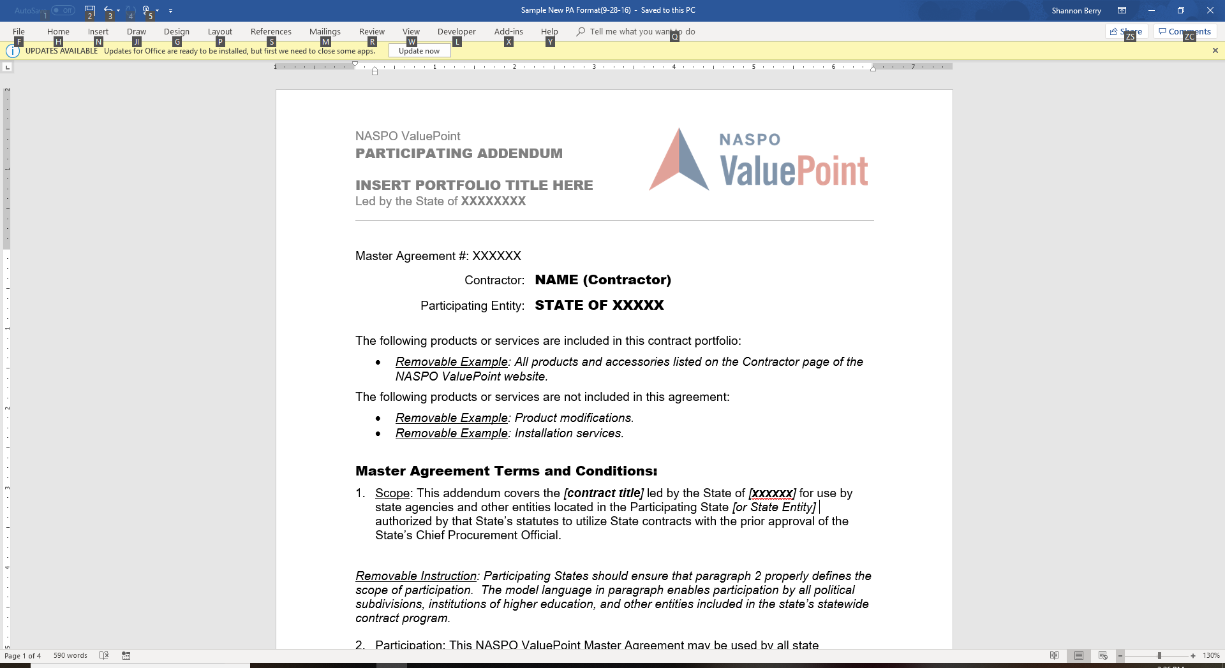
Participating Addendum Document
  Model PA Documents located under each contractor.
  We encourage everyone to use this form as the starting document.
  Don’t attach State’s standard boiler.
  Only add terms and conditions specific to your state and NOT already included in the Master Agreement.
  If you use your own form of PA, please ensure all the terminology is correct and current and there are no conflicts with the terms and conditions of the Master Agreement.

Slide 14

Consider a Strategic Approach When Selecting Contractors
ValuePoint’s practice is to award to multiple suppliers in order to provide sufficient coverage for all states, allow states selection options to complement embedded base goods/services and compatibility.
Recommended Selection Process:
  Review RFP and requirements.
  Review Contractor Proposals.
  Determine State Cost for preferred Contractor(s) Proposal.
  Optional Interview and Demonstrations; recommend 2-3 Contractors.
  Finalize PA with State specific project requirements.
Note: Although this is the recommended process, State will determine selection process necessary to identify the contractor with the best value solution for their State

Slide 15
Participation Opportunity
Participation: This NASPO ValuePoint Master Agreement may be used by all states. Issues of interpretation and eligibility for participation are solely within the authority of the State Chief Procurement Official.
Access to Provider Services Requires State Health & Human Services Approval: Unless otherwise stipulated in this Participating Addendum, specific services accessed through the NASPO ValuePoint cooperative Master Agreements for Provider Services by state executive branch agencies are subject to the authority and prior approval of the State Health & Human Services Office.

Slide 16
Participation Opportunity
Step by Step: Entire State
1. States may contact contractors directly to begin the Participating Addendum process.
2. States may have submitted Intents to Participate during solicitation, this will provide the information for contractors to contact states interested in signing a Participating Addendum.
3. State Chief Procurement Officials (or designated representative) will be the signatory on the PA. They will also be the NASPO ValuePoint point of contact throughout the process.
5. State completes the draft PA for each contractor and then forwards the draft to the contractor. Negotiations will be handled directly between state and contractor. Upon agreement, the state sends a final copy of Participating Addendum to the contractor for signature.
6. Contractor signs PA and sends back to state for signature.
7. State sends fully executed copy to both contractor and ValuePoint at PA@naspovaluepoint.org
4. State’s Medicaid Director (or designated representative) will be the signatory on the PA for the State’s Health and Human Services Department.
Participating Addendum templates are available at www.naspovaluepoint.org
Executed Participating Addendum will be maintained in a repository.

Slide 17
Considerations for
Participating Addendum (PA)
Participating State must have an I-APD approved by CMS for the related scope of work.
Any Offeror who has a signed Master Agreement may be selected by Participating State based on the solution that is the best fit and value for the participating state.
Clarify the scope of services to be included
  Core Provider Enrollment, Screening & Monitoring, Maintenance, and Revalidation
  Option A-Enhanced Self-Service Portal
  Option B-Provider Enrollment and Management Call Center
Identify Primary Contacts (Lead State, Contractor, and Participating Entity)
Identify allowed modifications or additions to the Master Agreement:
  Additional terms and conditions required by the Participating Entity’s state laws, policies and regulations that are not already included in the Master Agreement.
  Participating Addendum Term and Participating Addendum Effective Date
  Defining the Participating Addendum Maximum Amount per Master Agreement Appendix A – Payment Milestones, Deliverables, and Considerations

Slide 18
Considerations for
Participating Addendum (PA)
Administrative Fees to be paid by the Contractor:
  The Contractor shall pay to NASPO ValuePoint, or its assignee, a NASPO ValuePoint Administrative Fee of one-quarter of one percent (0.25% or 0.0025) on DDI payments received from the Participating Entity no later than sixty (60) days following the end of each calendar quarter.
  Each State may assess an additional procurement administrative fee not to exceed one half of one percent (.5% or .005) on DDI payments received from the Participating Entity no later than sixty (60) days following the end of each calendar quarter. A State cannot assess a procurement administrative fee if the State requests Enhanced Federal Financial Participation reimbursement from CMS for the procurement expenditures.

Slide 19
Considerations for
Participating Addendum (PA)
Identify the Vendor Contract Manager, Project Manager and Key Resources
Exhibit 1 - Attachment G – Pricing Schedule
Exhibit 2 – Project Work Plan
Exhibit 3 – Revised Attachment F – Requirements Matrix
  Necessary only if there are changes (additions, deletions or language changes) to specific requirements.
Exhibit 4 – Revised Appendix B – Performance Standards
  Necessary only if there are changes (additions, deletions or language changes) specific to SLAs.
  CMS will only allow the deletion of SLAs if they correspond to requirements that were removed from scope (Attachment F - Requirements Matrix)
Exhibit 5 - Attachment H – Resource Allocation Schedule

Slide 20
Considerations for
Participating Addendum (PA)
  Master Agreement changes that may negatively impact CMS Approval of the Participating Addendum
  Changes to State liability
  Changes to Indemnification
  Changes to Insurance
  Changes to Performance Standards
  Changes to Ownership / Licenses
  Changes to Warranties
  Changes to the Letter of Credit
  Changes to Limitation of Liability
  Changes to Termination
  **CMS will only consider changes to the Master Agreement provisions outlined in this slide if they are required to support the Participating Entity’s state laws and the Participating Entity provides CMS clear justification for the change.
Notes:
CMS will only consider changes to the Master Agreement provisions outlined in this slide if they are required to support the Participating Entity’s state laws and the Participating Entity provides CMS clear justification for the change.

Slide 21
Additional Considerations
for the Participating Addendum
Schedule B – Payment Milestones
Attachment G Pricing Schedules - Schedule B outlines the payment milestones for the DDI phases of the project.
Once the DDI Costs are determined, the payment milestones are defined by completing the matrix below.
Each of the four payment milestones must be within the minimum/maximum percentages outlined in the table below.
The Master Agreement only allows payments to be made for delivered software, the completion of user acceptance testing, implementation, and certification.
Schedule B-1: Provider Services Base Scope of Work Design, Development & Implementation (DDI) Payment Milestone by Phase
Payment Milestone | DDI Phase
 | Development Configuration and Build | User Acceptance Testing and Integration Testing | Implementation and Acceptance | Certification | Total Cost
Provider Enrollment
Provider Maintenance
Provider Self-Service Portal
Total Cost By Phase | $0.00 | $0.00 | $0.00 | $0.00 | $0.00
Total Percentage By Phase | #DIV/0! | #DIV/0! | #DIV/0! | #DIV/0! | #DIV/0!
Minimum percent of total DDI cost cannot be less than the following percentages for each phase.** | 5% | 15% | 25% | 10%
Maximum percent of total DDI cost cannot exceed the following percentages for each phase.** | 35% | 30% | 50% | 25%
Grand Total | $0.00
* The sum of four phases must equal the grand total (100% ). The phase percentage must be greater than or equal to the minimum percentage and less than or equal to the maximum percentage. Example: Total DDI Cost = $1,000,000, the Development Configuration and Build Cost must be between $50,000 and $350,000 ($50,000/$1,000,000= 5% and $350,000/$1,000,000=35%). The sum of four phase percentages must equal 100%. Example: Development Configuration and Build = 25% User Acceptance Testing and Integration Testing = 20% Implementation and Acceptance = 40% Certification = 15%

Slide 22
Approval Process for the Participating Addendum (PA)
Each State will obtain CMS approval of a participating addendum prior to final execution of participating addendum with a contractor.
State submits the Participating Addendum to CMS Regional Office.
CMS will review the components of the Participating Addendum (e.g., scope, any changes to the Master Agreement, cost, changes to SLA’s, and project timelines).
CMS will review any such submissions and provide approval or request additional information within 30 days of receipt of the request.

Slide 23
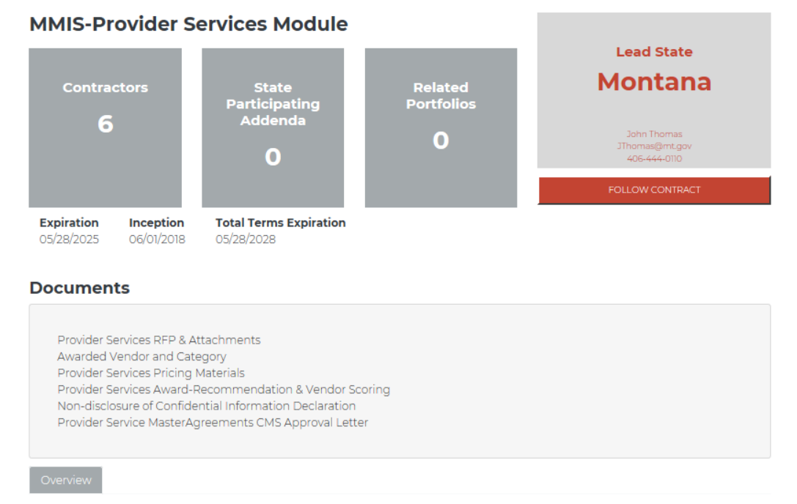
NASPO ValuePoint Website
Notes:
All procurement materials are posted on the NASPO ValuePoint Website. The landing page of the procurement contains the RFP and all attachments, an informational page identifying the names of the awarded vendors, and scope of each award. Also available are pricing materials states can use to identify cost and compare cost for each contractors services, the evaluation scores summary and award recommendation, the non-disclosure of confidential information and the CMS Provider Services Master Agreement Approval Letter.

Slide 24
NASPO ValuePoint Website – Solicitation Documentation
Provider Services RFP and Attachments
  MPATH Provider Services RFP (includes Amendment 1&2)
  Attachment A: Standard Terms and Conditions
  Attachment C: RFP Instructions
  Attachment D: MECT Mapping
  Attachment E: Sourcing State Information
  Attachment F: Requirements Response Matrix
  Attachment G: Pricing Schedules
  Attachment H: Resource Allocation Schedules
  Attachment I: Provider Services Evaluation and Scoring
  Attachment J: Service Level Agreements
  Attachment K: Business Associates Agreement
  Attachment L: Technology Matrix
*Attachment B: Master Agreement (listed under each vendor’s portfolio)
Notes:
Provider Services RFP and Attachments is a zip file containing the MPATH provider Services RFP which includes amendments 1 and 2, as well as Attachments A-L, excluding Attachment B – Master Agreement. The Master Agreements are available under each vendor’s portfolio.
Attachment A-represents Montana’s Standard Terms and Conditions, these are also incorporated into the Master Agreement,
Attachment C-RFP instructions reflects the instructions to the vendors who responded to the procurement.
Attachment D-Montana mapped the MECT Certification Checklist criteria to the MPATH Provider Services requirements to ensure the solution would meet federal certification.
Attachment E – Sourcing State information document contains information specific to the sourcing states as reference information for the vendors.
Attachment F – Requirements Response Matrix, lists all requirements that are included in the procurement. The sections from the MPATH Provider Services corresponds to column A Requirement Section.
Attachment G – Pricing Schedules-these are the blank pricing schedules included in the solicitation. Each Vendor portfolio has a completed Attachment G, which will allow states to price the solution as it’s applicable to them.
Attachment H – Resource Allocation Schedule collects information about the number of FTEs needed by phase and the number of hours per FTE by phase.
Attachment I – reflects the scoring criteria the evaluation team used to assess each technical proposal and vendor demonstration
Attachment J – Detail the Service Level Agreement requirements for Core, Option A and Option B
Attachment K – Business Associates Agreement-reflects the BAA incorporated into the Master Agreements.
Attachment L – Technology Matrix-collects the solution technology details for each vendor.

Slide 25
NASPO ValuePoint Website – Provider Services Pricing Materials
Provider Services Pricing Workbook for Participating States
  Tool that provides detailed, step by step instructions to complete Attachment G – Pricing Schedules and the Cost Comparison Matrix.
  Attachment G - Pricing Schedules
  One for each awarded vendor.
  Used by Participating States to calculate the Total State Specific Costs for DDI, Operations, and Enhancement Pool hours for a specific vendor.
Notes:
The Provider Services Pricing Materials include a blank Attachment G – Pricing Schedule for each vendor., A NASPO ValuePoint Provider Services Cost Comparison Matrix and Provider Services Pricing Workbook for Participating State. Together, these documents enable Participating States to compare the price of each vendors solution based on the services desired and the number of active de-duplicated providers.

Slide 26
NASPO ValuePoint Website – Provider Services Pricing Materials
NASPO ValuePoint Provider Services Cost Comparison Matrix
Tool that will allow Participating States to compare Provider Services Vendor solution costs from the Master List to determine for the scope of work, best value.
  Provider Services Pricing Materials allow Participating States to tailor the Provider solution and services to meet their state specific needs.
  Note: Option A and Option B services are not offered as standalone solutions without the Core Provider Services solution; however, Participating States may choose to procure only Core Provider Services, Core Provider Services and Option A, Core Provider Services and Option B, or Core Provider Services and Options A and B.

Slide 27
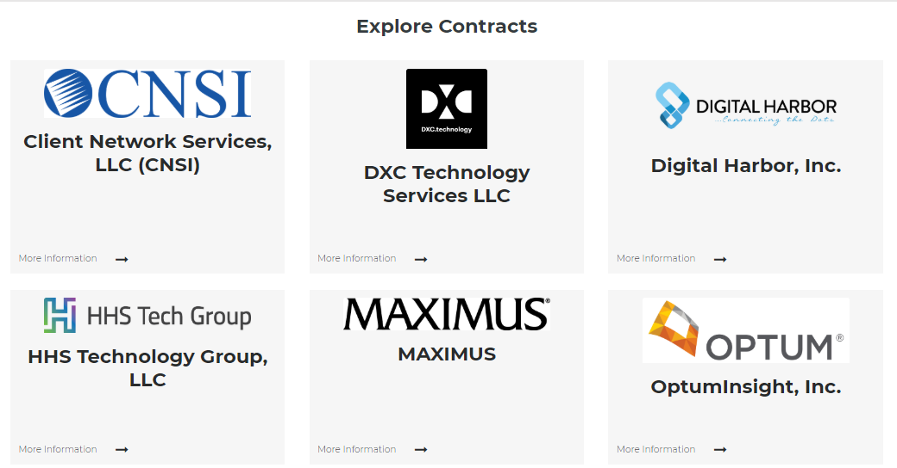
NASPO ValuePoint Website - Vendor Portfolios

Slide 28
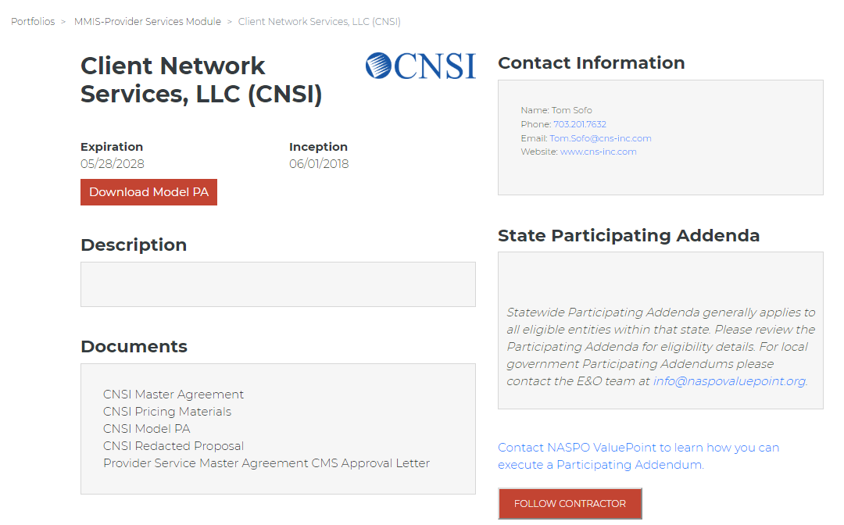
NASPO ValuePoint Website - Vendor Portfolios
Contractor Name
Contractor Logo
XXX Master Agreement
XXX Pricing Materials
XXX Model PA
XXX Redacted Proposal
Provider Services Master Agreement CMS Approval Letter
Notes:
Each Portfolio Contains a brief description of the vendor’s available services. The signed Master Agreement, Vendor specific pricing materials, a model Participating Addendum, Vendor Proposal, and CMS approval letter. In order to access the non-redacted proposal, complete the Non-Disclosure form on the main page of the procurement and send to John Thomas, Montana’s Procurement Officer. Contact information for John can be found at the end of this presentation.

Slide 29

Things to Remember
Sample PA’s are located on the NASPO ValuePoint Website under each master agreement portfolio.
Executed Participating Addendum will be maintained on www.naspovaluepoint.org and in a repository.
Participating states will be identified on the map of the USA on each Master Agreement page on www.naspovaluepoint.org
The Lead State and NASPO ValuePoint do not get involved with negotiations.
Only submit completed and negotiated PA’s with signatures from both parties.
Submit completed PA’s in PDF format to pa@naspovaluepoint.org
    Must have signatures from both parties
    Submit in PDF format
Notes:
29

Slide 30
Solicitation & Master Agreement Questions?
Contract Lead:
John Thomas
State of Montana
Phone Number: 406-444-0110
Email: JThomas@mt.gov
Contract Web Page:
http://www.naspovaluepoint.org
Notes:
.

Slide 31
OTHER QUESTIONS?
*Shannon Berry
NASPO ValuePoint Cooperative Development Coordinator
SBerry@NASPOValuePoint.org
775-720-3404 (PST)
  * NASPO ValuePoint Contact for these Master Agreements.
Notes:
31

Slide 32

Thank You!

