Slide 1




Rotary Youth Exchange
FAMILY TO FAMILY
SHORT TERM
(STEP)
Add District or Presenter

Slide 2
What is Rotary?
  Founded in 1905 in Chicago, IL
  Over 1.2 Million members in over 45,000 clubs in approximately 200 countries
  Donates/invests over $350 million/year
  Programs: Polio Plus, Shelter Box, Community Service, Scholarships, Peace Initiatives including Youth Exchange Programs, etc.

Slide 3
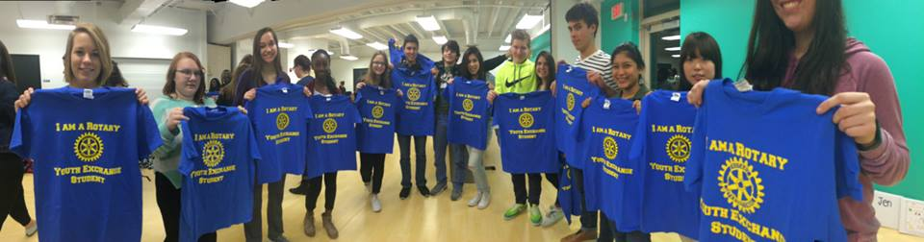
Rotary Youth Exchange
Established in 1929 in Denmark (86 years!)
Our District works with many students who participate in Long and Short Term exchanges with over 25 different countries
Worldwide about 9,000 students (age 15-18.5) participate annually in 80 countries

Slide 4
WHY EXCHANGE THROUGH ROTARY?
Large Reach - Over 1.2 Million members in over 45,000 clubs in approximately 200 countries
Your son or daughter is sponsored by a club here and a club in another country. Additionally, they are sponsored by 2 districts and there are 2 country contacts working with the students. They are not alone.
Low Cost - Rotary is a volunteer organization, therefore the cost of the program makes 4-6 weeks in another country financially affordable.
Local Immersion - Your son or daughter will be living with a native family. People who know the area and the language. They will be immersed in language and culture.
The program is long established and well known. It will be a significant addition to your students resume and make them a seasoned, world citizen.

Slide 5

FAMILY TO FAMILY EXCHANGE
15-18.5 years old at time of travel
Go to another country and stay with a student of similar age, sex and interests
Host your match for approximately 4-6 weeks
Costs associated with hosting a student – Room, Board, Activities
Student may not participate in a summer job/activities while hosting an exchange student that will interfere with your hosting obligations
Program costs (Administration fee, Airfare, Insurance, Spending money)
Sign and abide by the program rules

Slide 6
What makes a Rotary Exchange Different?
We ask your son or daughter to be Ambassadors for the US and Rotary, so their actions are held to high standards.
We have rules (4D’s) and responsibilities that we have the students will embrace (6B’s).
As a family you will work with another family to coordinate the exchange and your calendars to make your son/daughter’s time there and your match’s time here happen. (Some exchanges are extended beyond 45 days.)
If problems arise, Rotary is there to help solve them. We ask your son or daughter to reach out to the Rotarians who can help them.

Slide 7
THE 4 D’s
While on exchange:
No Dating
No Drinking
No Driving
No Drugs
Other D’s:
No Decorating (Tattoo’s, Piercings)
No Downloading (Digital Disrespect)
No Dumb Stuff

Slide 8

RYE Six Be’s
The Pillars of Success
(student responsibilities)

Slide 9
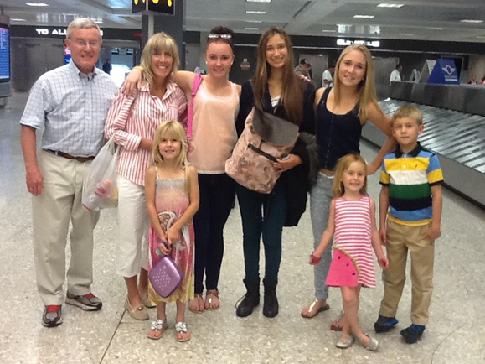
How to be a great Host Family
Work with your student on the Native Language. Most students want to become more fluent.
Do some traveling even if it is close to home.
Show them some of your favorite customs, foods, stores. (a trip to the grocery can be fun!)
Treat them like family not
like a guest. Have them help
with chores, cooking, etc.
(remember the 6 B’s help them
achieve these too)

Slide 10
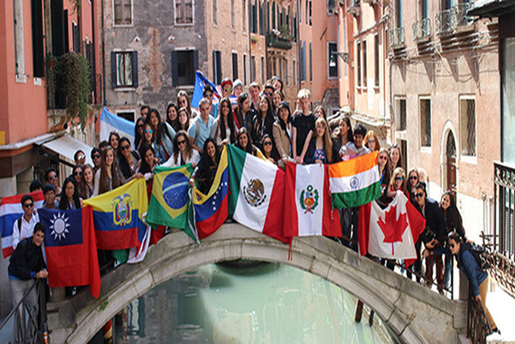
Impact of Exchange
“My dream is that every 17-year-old could become an exchange
student. If the world could achieve this, there would be no more wars!”
-Carl-Wilhelm Stenhammar, RI President 2005-06, at his 2005-06 theme address at the 2005 International Assembly
“Research shows that experience in other countries makes us more flexible, creative and complex thinkers.”
-Annie Murphy Paul, “How Studying or Working Abroad Makes You Smarter,” Time Magazine, 4/29/2014
“People who have international experience or identify with more than one nationality are better problem solvers and display more creativity.”
-William Maddux, Associate Professor of Organizational Behavior, INSEAD

Slide 11
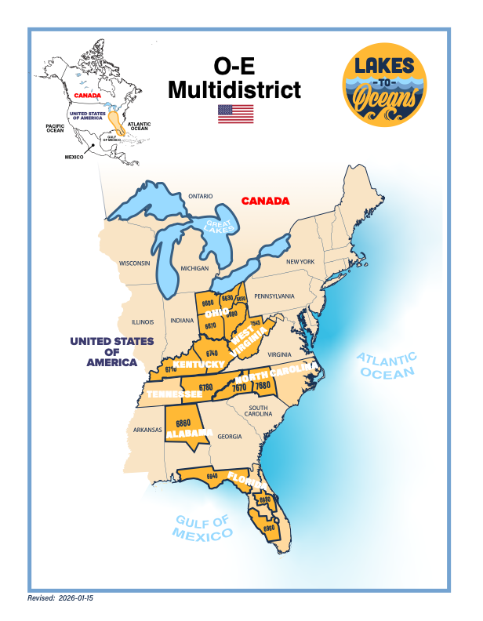
Add a picture
Of your District
Or Multi-District
Here.

Slide 12
RYE Organization
Rotary International
Multi-District
Local District Committee
Local Club & YEOs
Students
(and Parents)

Slide 13
HOW YOUR STUDENT COMMUNITCATES
Your son or daughter and matched sibling
WHILE HOSTING
WHILE ABROAD
Parents of Sponsoring Family
Parents of host family
Sponsoring District & Club here
Sponsoring District/Club Abroad
Multi-District or Matching Contact
Country Contacts (both)
Multi-District or Matching Contact
Natural Parents
Your Parents

Slide 14
RYE Travel Policy
While on exchange:
Students may only travel outside of their home district with their host parents (not siblings) or with an approved Rotarian. (Local trips permitted)
Independent travel is not permitted.

Slide 15
Review Rules/Conditions
Verbal overview of RYE Application
-Obey all host country laws -Don’t borrow money
-Abide by host districts rules/conditions -Pay bills promptly and in full
-No drugs -Communicate with your first host
-No alcohol (unless with host family, supervised in the home) family prior to leaving the U.S.
-No driving (anything with an engine) -Respect your hosts’ wishes
-Smoking is discouraged -Attend Rotary-sponsored events and
-No body piercing/tattoos host family events voluntarily
-Make every effort to learn host language -Get involved in school and
-Limit use of internet and phones community events
-No downloading of pornographic materials -Don’t spend all of your time with
-Must attend school regularly with other exchange students
-Must have health/accident/travel insurance -Choose friends carefully
-Must have liability coverage -Before agreeing to join, attend,
-Must have sufficient financial support travel, etc. make sure you
-Must follow travel rules of host district understand the full cost before you
-Must return directly back to U.S. after exchange say yes.
-Student/parents are responsible for costs related to
an early return, tours, tutoring, etc.
-Serious romantic involvement is discouraged; sexual activity is forbidden
-Talk with host club counselor, host parents or other trusted adult if you encounter any form of abuse or harassment.

Slide 16
Language Preparation
Appropriate language training is essential once you find out your host country.
We use online tutors (iTalkie) or find a local tutor, talk to inbound students, take classes, etc.
The more you prepare before departure, the better/faster you will adjust to your new culture and host family.

Slide 17
Outbound Contacts
District Contact
Club Contact
Multi - District Contact

Slide 18
Questions
If you have questions...PLEASE ASK, ASK OFTEN and ASK EARLY.
We’re here to help! We want you and your child to feel comfortable and educated about the program, so please don’t hesitate to ask any questions you may have.

Slide 19
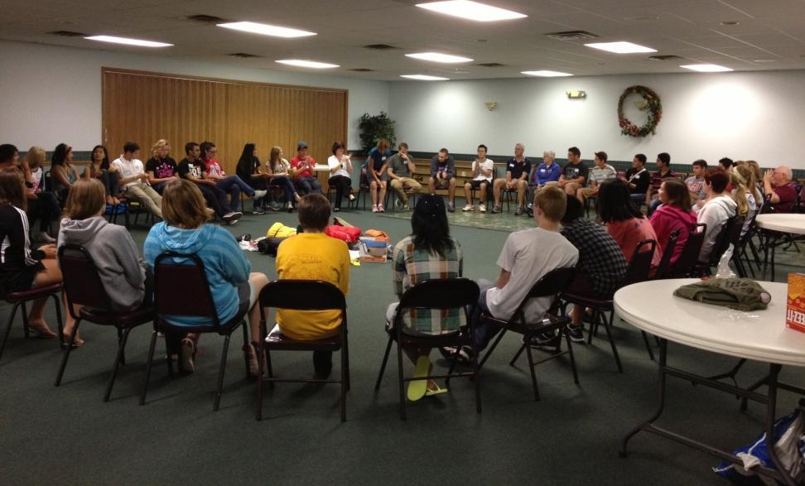
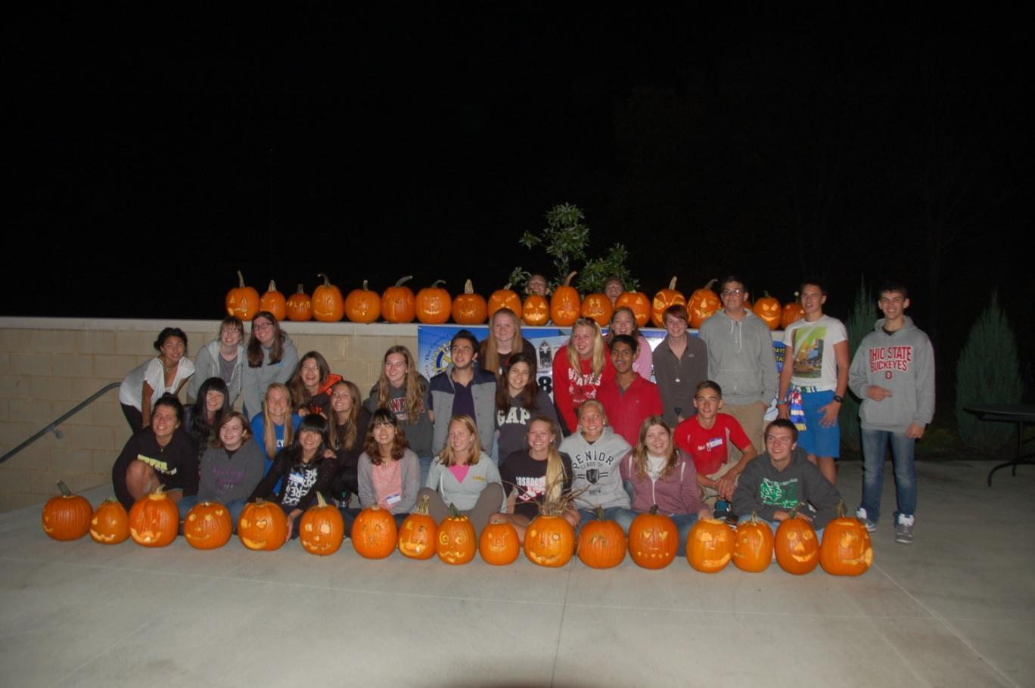
Thank you!

