Slide 1
Plant Structure and Function
Biology for Majors
Notes:
All text in these slides is taken from https://courses.lumenlearning.com/wm-biology1/ where it is published under one or more open licenses.
All images in these slides are attributed in the notes of the slide on which they appear and licensed as indicated.
Cover Image: "Peacock Feathers." Authored by: Andre Mouton. Provided by: Unsplash. Located at: https://unsplash.com/photos/_d3sppFprWI. Content Type: CC Licensed Content, Shared Previously. License: CC0: No Rights Reserved.

Slide 2
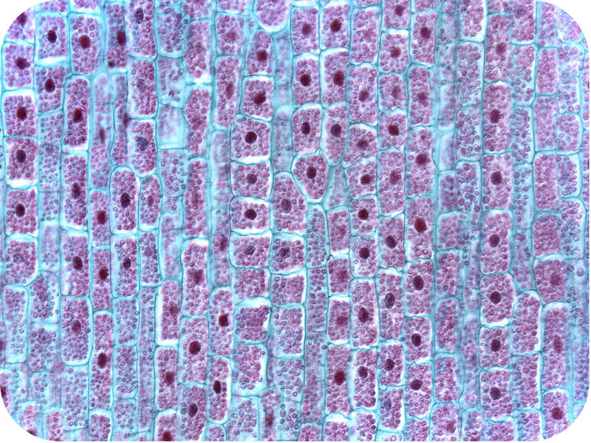
Plant Cells
Notes:
Plant Cells. Authored by: Douglas Wilkin, Ph.D. and Jean Brainard, Ph.D.. Provided by: CK-12. Located at: http://www.ck12.org/biology/Plant-Cells/lesson/Plant-Cells/r34/. License: CC BY-NC: Attribution-NonCommercial

Slide 3
Typical Plant Cell
Notes:
Plant Cells. Authored by: Douglas Wilkin, Ph.D. and Jean Brainard, Ph.D.. Provided by: CK-12. Located at: http://www.ck12.org/biology/Plant-Cells/lesson/Plant-Cells/r34/. License: CC BY-NC: Attribution-NonCommercial

Slide 4
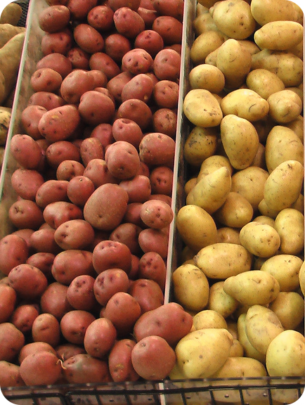
Types of Plant Cells: Parenchymal
Structure | Functions | Example
cube-shaped loosely packed thin-walled relatively unspecialized contain chloroplasts | photosynthesis cellular respiration storage | food storage tissues of potatoes
Notes:
Plant Cells. Authored by: Douglas Wilkin, Ph.D. and Jean Brainard, Ph.D.. Provided by: CK-12. Located at: http://www.ck12.org/biology/Plant-Cells/lesson/Plant-Cells/r34/. License: CC BY-NC: Attribution-NonCommercial

Slide 5
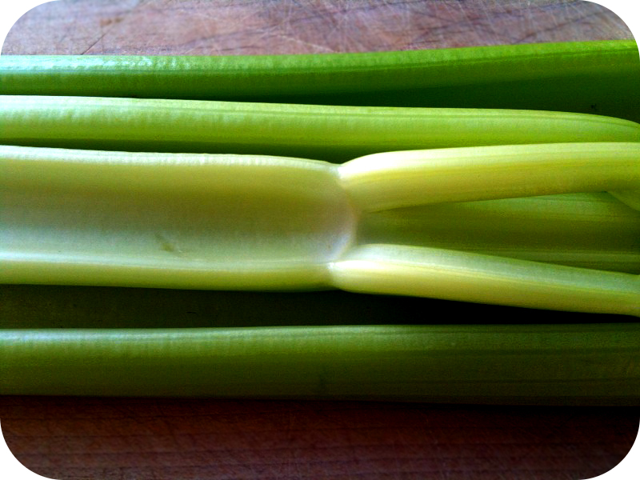
Collenchymal
Structure | Function | Example
elongated irregularly thickened walls | support wind resistance | strings running through a stalk of celery
Notes:
Plant Cells. Authored by: Douglas Wilkin, Ph.D. and Jean Brainard, Ph.D.. Provided by: CK-12. Located at: http://www.ck12.org/biology/Plant-Cells/lesson/Plant-Cells/r34/. License: CC BY-NC: Attribution-NonCommercial

Slide 6
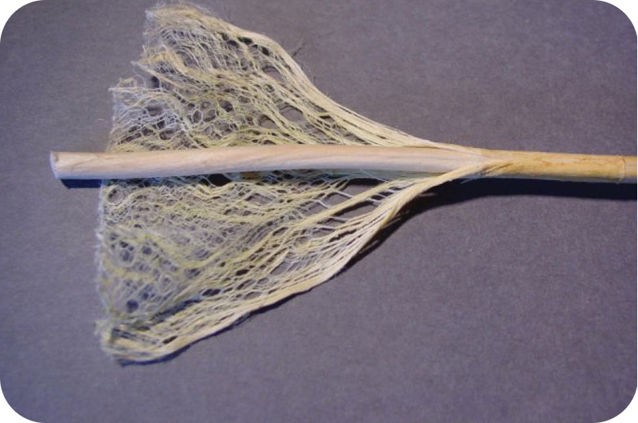
Sclerenchymal
Structure | Function | Example
very thick cell walls containing lignin | support strength | tough fibers in jute (used to make rope)
Notes:
Plant Cells. Authored by: Douglas Wilkin, Ph.D. and Jean Brainard, Ph.D.. Provided by: CK-12. Located at: http://www.ck12.org/biology/Plant-Cells/lesson/Plant-Cells/r34/. License: CC BY-NC: Attribution-NonCommercial

Slide 7
Plant Tissue Types
Plant tissue systems fall into one of two general types: meristematic tissue and permanent (or non-meristematic) tissue. Cells of the meristematic tissue are found in meristems, which are plant regions of continuous cell division and growth. Meristematic tissue cells are either undifferentiated or incompletely differentiated, and they continue to divide and contribute to the growth of the plant. In contrast, permanent tissue consists of plant cells that are no longer actively dividing.

Slide 8
Meristematic Tissue Types
Meristematic tissues consist of three types, based on their location in the plant:
Apical meristems contain meristematic tissue located at the tips of stems and roots, which enable a plant to extend in length.
Lateral meristems facilitate growth in thickness or girth in a maturing plant.
Intercalary meristems occur only in monocots, at the bases of leaf blades and at nodes (the areas where leaves attach to a stem). This tissue enables the monocot leaf blade to increase in length from the leaf base

Slide 9
Permanent Tissue Types
Cells take on specific roles and lose their ability to divide further. They differentiate into three main types:
Dermal tissue covers and protects the plant.
Vascular tissue transports water, minerals, and sugars to different parts of the plant.
Ground tissue serves as a site for photosynthesis, provides a supporting matrix for the vascular tissue, and helps to store water and sugars.

Slide 10
Tissue Types in a Stem Cross-section
Notes:
(biophotos)”/Flickr; scale-bar data from Matt Russell) in Biology. Provided by: OpenStax College. Located at: http://cnx.org/contents/e42bd376-624b-4c0f-972f-e0c57998e765@4.4. License: CC BY: Attribution. License Terms: Download for free at http://cnx.org/contents/e42bd376-624b-4c0f-972f-e0c57998e765@4.4

Slide 11
Dermal Tissue
The dermal tissue of the stem consists primarily of epidermis, a single layer of cells covering and protecting the underlying tissue. Woody plants have a tough, waterproof outer layer of cork cells commonly known as bark, which further protects the plant from damage. Epidermal cells are the most numerous and least differentiated of the cells in the epidermis. Trichomes are hair-like structures on the epidermal surface. They help to reduce transpiration (the loss of water by aboveground plant parts), increase solar reflectance, and store compounds that defend the leaves against predation by herbivores.

Slide 12
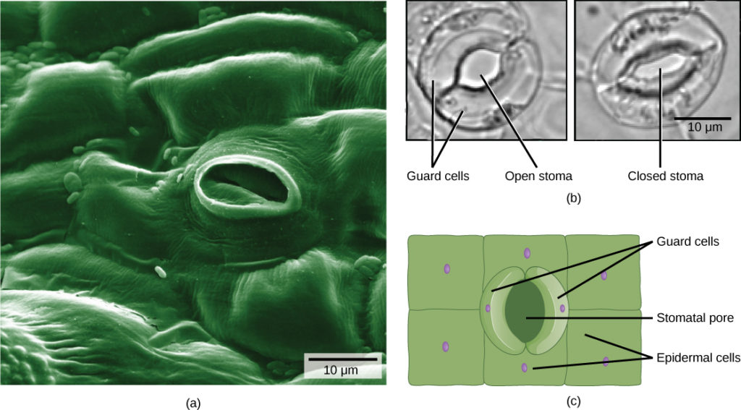
Dermal Tissue: Stomata
Notes:
Biology. Provided by: OpenStax College. Located at: http://cnx.org/contents/e42bd376-624b-4c0f-972f-e0c57998e765@4.4. License: CC BY: Attribution. License Terms: Download for free at http://cnx.org/contents/e42bd376-624b-4c0f-972f-e0c57998e765@4.4

Slide 13
Vascular Tissue
Notes:
Biology. Provided by: OpenStax College. Located at: http://cnx.org/contents/e42bd376-624b-4c0f-972f-e0c57998e765@4.4. License: CC BY: Attribution. License Terms: Download for free at http://cnx.org/contents/e42bd376-624b-4c0f-972f-e0c57998e765@4.4

Slide 14
Xylem Tissue
Xylem tissue has three types of cells: xylem parenchyma, tracheids, and vessel elements. The latter two types conduct water and are dead at maturity. Tracheids are xylem cells with thick secondary cell walls that are lignified. Water moves from one tracheid to another through regions on the side walls known as pits, where secondary walls are absent. Vessel elements are xylem cells with thinner walls; they are shorter than tracheids. Each vessel element is connected to the next by means of a perforation plate at the end walls of the element. Water moves through the perforation plates to travel up the plant.

Slide 15
Phloem Tissue
Phloem tissue is composed of sieve-tube cells, companion cells, phloem parenchyma, and phloem fibers. A series of sieve-tube cells (also called sieve-tube elements) are arranged end to end to make up a long sieve tube, which transports organic substances such as sugars and amino acids. The sugars flow from one sieve-tube cell to the next through perforated sieve plates, which are found at the end junctions between two cells. Although still alive at maturity, the nucleus and other cell components of the sieve-tube cells have disintegrated. Companion cells are found alongside the sieve-tube cells, providing them with metabolic support. The companion cells contain more ribosomes and mitochondria than the sieve-tube cells, which lack some cellular organelles.

Slide 16
Ground Tissue
Ground tissue is mostly made up of parenchyma cells, but may also contain collenchyma and sclerenchyma cells that help support the stem. The ground tissue towards the interior of the vascular tissue in a stem or root is known as pith, while the layer of tissue between the vascular tissue and the epidermis is known as the cortex.

Slide 17
Plant Organs
Vascular plants have two distinct organ systems: a shoot system, and a root system. The shoot system consists of two portions: the vegetative (non-reproductive) parts of the plant, such as the leaves and the stems, and the reproductive parts of the plant, which include flowers and fruits. The shoot system generally grows above ground, where it absorbs the light needed for photosynthesis. The root system, which supports the plants and absorbs water and minerals, is usually underground.

Slide 18
Roots and Shoots
Notes:
Biology. Provided by: OpenStax College. Located at: http://cnx.org/contents/e42bd376-624b-4c0f-972f-e0c57998e765@4.4. License: CC BY: Attribution. License Terms: Download for free at http://cnx.org/contents/e42bd376-624b-4c0f-972f-e0c57998e765@4.4

Slide 19
Stems
Stems provide support to the plant, holding leaves, flowers and buds; in some cases, stems also store food for the plant. The stem of the plant connects the roots to the leaves, helping to transport absorbed water and minerals to different parts of the plant. It also helps to transport the products of photosynthesis, from the leaves to the rest of the plant.
Notes:
(credit: Rolf-Dieter Mueller) in

Slide 20
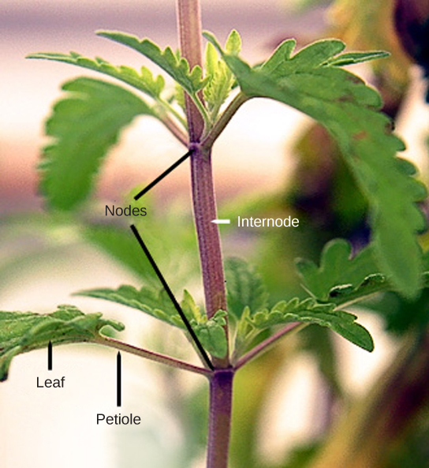
Stem Structure
Leaves are attached to the plant stem at areas called nodes. An internode is the stem region between two nodes. The petiole is the stalk connecting the leaf to the stem. The leaves just above the nodes arose from axillary buds.
Notes:
Biology. Provided by: OpenStax CNX. Located at: http://cnx.org/contents/185cbf87-c72e-48f5-b51e-f14f21b5eabd@10.8. License: CC BY: Attribution. License Terms: Download for free at http://cnx.org/contents/185cbf87-c72e-48f5-b51e-f14f21b5eabd@10.8

Slide 21
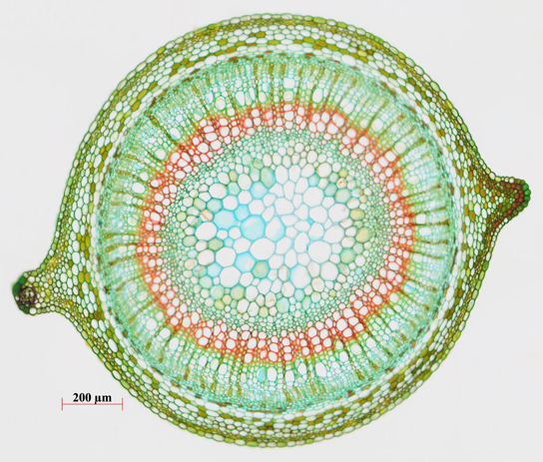
Parenchyma Cells
Parenchyma cells, the most common plant cells, are found in the stem, the root, the inside of the leaf, and the pulp of the fruit. They are responsible for metabolic functions, such as photosynthesis, and they help repair and heal wounds. Some also store starch. At right the central pith (greenish-blue, in the center) and peripheral cortex (narrow zone 3–5 cells thick just inside the epidermis) are made of parenchyma cells.
Notes:
(credit: Rolf-Dieter Mueller) in Biology. Provided by: OpenStax CNX. Located at: http://cnx.org/contents/185cbf87-c72e-48f5-b51e-f14f21b5eabd@10.8. License: CC BY: Attribution. License Terms: Download for free at http://cnx.org/contents/185cbf87-c72e-48f5-b51e-f14f21b5eabd@10.8

Slide 22
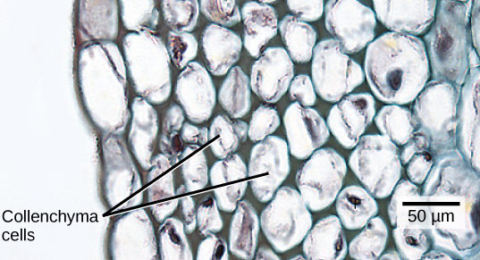
Collenchyma Cells
Collenchyma cells are elongated cells with unevenly thickened walls. They provide structural support, mainly to the stem and leaves. These cells are alive at maturity and are usually found below the epidermis.
Notes:
(credit: modification of work by Carl Szczerski; scale-bar data from Matt Russell) in Biology. Provided by: OpenStax CNX. Located at: http://cnx.org/contents/185cbf87-c72e-48f5-b51e-f14f21b5eabd@10.8. License: CC BY: Attribution. License Terms: Download for free at http://cnx.org/contents/185cbf87-c72e-48f5-b51e-f14f21b5eabd@10.8

Slide 23
Sclerenchyma cells
Sclerenchyma cells also provide support to the plant, but unlike collenchyma cells, many of them are dead at maturity. They have secondary cell walls that are thickened with deposits of lignin, an organic compound that is a key component of wood. There are two types of sclerenchyma cells: fibers and sclereids.
Notes:
(credit a: modification of work by Emmanuel Boutet based on original work by Ryan R. MacKenzie) in Biology. Provided by: OpenStax CNX. Located at: http://cnx.org/contents/185cbf87-c72e-48f5-b51e-f14f21b5eabd@10.8. License: CC BY: Attribution. License Terms: Download for free at http://cnx.org/contents/185cbf87-c72e-48f5-b51e-f14f21b5eabd@10.8

Slide 24
Stem Modifications
Notes:
(credit a: modification of work by Maja Dumat; credit c: modification of work by Harry Rose; credit d: modification of work by Rebecca Siegel; credit e: modification of work by Scott Bauer, USDA ARS; credit f: modification of work by Stephen Ausmus, USDA ARS)

Slide 25
Tendrils and Thorns
Notes:
(credit a: modification of work by Christopher Meloche, USDA ARS; credit b: modification of work by “macrophile”/Flickr) in Biology. Provided by: OpenStax CNX. Located at: http://cnx.org/contents/185cbf87-c72e-48f5-b51e-f14f21b5eabd@10.8. License: CC BY: Attribution. License Terms: Download for free at http://cnx.org/contents/185cbf87-c72e-48f5-b51e-f14f21b5eabd@10.8

Slide 26
Parts of a Leaf
Notes:
Biology. Provided by: OpenStax CNX. Located at: http://cnx.org/contents/185cbf87-c72e-48f5-b51e-f14f21b5eabd@10.8. License: CC BY: Attribution. License Terms: Download for free at http://cnx.org/contents/185cbf87-c72e-48f5-b51e-f14f21b5eabd@10.8

Slide 27
Venation in Monocot (a), Dicot (b), and Gingko (c)
Notes:
(credit a photo: modification of work by “Drewboy64”/Wikimedia Commons; credit b photo: modification of work by Roger Griffith; credit c photo: modification of work by “geishaboy500″/Flickr; credit abc illustrations: modification of work by Agnieszka Kwiecień) in Biology. Provided by: OpenStax CNX. Located at: http://cnx.org/contents/185cbf87-c72e-48f5-b51e-f14f21b5eabd@10.8. License: CC BY: Attribution. License Terms: Download for free at http://cnx.org/contents/185cbf87-c72e-48f5-b51e-f14f21b5eabd@10.8

Slide 28
Leaf Arrangement
The arrangement of leaves on a stem, known as phyllotaxy, enables maximum exposure to sunlight. Each plant species has a characteristic leaf arrangement and form. The pattern of leaf arrangement may be alternate, opposite, or spiral.

Slide 29
Leaf Form
Notes:
(credit a: modification of work by “BazzaDaRambler”/Flickr; credit b: modification of work by Roberto Verzo; credit c: modification of work by Eric Dion; credit d: modification of work by Valerie Lykes) in Biology. Provided by: OpenStax CNX. Located at: http://cnx.org/contents/185cbf87-c72e-48f5-b51e-f14f21b5eabd@10.8. License: CC BY: Attribution. License Terms: Download for free at http://cnx.org/contents/185cbf87-c72e-48f5-b51e-f14f21b5eabd@10.8

Slide 30
Leaf Structure
Leaf tissue consists of the epidermis, which forms the outermost cell layer, and mesophyll and vascular tissue, which make up the inner portion of the leaf.
Notes:
(credit b: modification of work by Robert R. Wise) in Biology. Provided by: OpenStax CNX. Located at: http://cnx.org/contents/185cbf87-c72e-48f5-b51e-f14f21b5eabd@10.8. License: CC BY: Attribution. License Terms: Download for free at http://cnx.org/contents/185cbf87-c72e-48f5-b51e-f14f21b5eabd@10.8

Slide 31
Types of Root Systems
Notes:
(credit b: modification of work by “Austen Squarepants”/Flickr) in Biology. Provided by: OpenStax CNX. Located at: http://cnx.org/contents/185cbf87-c72e-48f5-b51e-f14f21b5eabd@10.8. License: CC BY: Attribution. License Terms: Download for free at http://cnx.org/contents/185cbf87-c72e-48f5-b51e-f14f21b5eabd@10.8

Slide 32
Root Growth and Structure
Notes:
Biology. Provided by: OpenStax CNX. Located at: http://cnx.org/contents/185cbf87-c72e-48f5-b51e-f14f21b5eabd@10.8. License: CC BY: Attribution. License Terms: Download for free at http://cnx.org/contents/185cbf87-c72e-48f5-b51e-f14f21b5eabd@10.8

Slide 33
Vascular Structure in Roots
Notes:
Biology. Provided by: OpenStax CNX. Located at: http://cnx.org/contents/185cbf87-c72e-48f5-b51e-f14f21b5eabd@10.8. License: CC BY: Attribution. License Terms: Download for free at http://cnx.org/contents/185cbf87-c72e-48f5-b51e-f14f21b5eabd@10.8

Slide 34
Dicot and Monocot Roots
Notes:
Biology. Provided by: OpenStax CNX. Located at: http://cnx.org/contents/185cbf87-c72e-48f5-b51e-f14f21b5eabd@10.8. License: CC BY: Attribution. License Terms: Download for free at http://cnx.org/contents/185cbf87-c72e-48f5-b51e-f14f21b5eabd@10.8

Slide 35
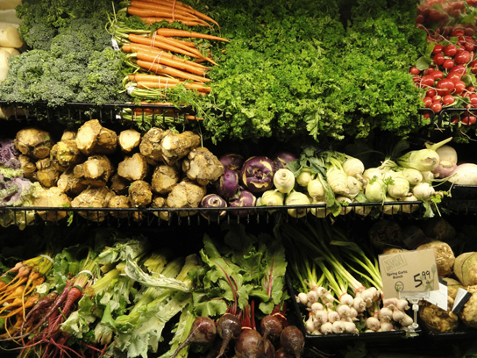
Root Modifications: Vegetables
Root structures may be modified for specific purposes. For example, some roots are bulbous and store starch. Tap roots, such as carrots, turnips, and beets, are examples of roots that are modified for food storage
Notes:
Biology. Provided by: OpenStax CNX. Located at: http://cnx.org/contents/185cbf87-c72e-48f5-b51e-f14f21b5eabd@10.8. License: CC BY: Attribution. License Terms: Download for free at http://cnx.org/contents/185cbf87-c72e-48f5-b51e-f14f21b5eabd@10.8

Slide 36
Aerial and Prop Roots
Notes:
(credit a: modification of work by “psyberartist”/Flickr; credit b: modification of work by David Eikhoff) in Biology. Provided by: OpenStax CNX. Located at: http://cnx.org/contents/185cbf87-c72e-48f5-b51e-f14f21b5eabd@10.8. License: CC BY: Attribution. License Terms: Download for free at http://cnx.org/contents/185cbf87-c72e-48f5-b51e-f14f21b5eabd@10.8

Slide 37
Water Potential
Plants use the potential energy in water to move water and solutes from one part of the plant to another. The water potential in plant solutions is influenced by solute concentration, pressure, gravity, and factors called matrix effects. Water potential can be broken down into its individual components using the following equation:
Ψ_{system} = Ψ_{total} = Ψ_{s} + Ψ_{p} + Ψ_{g} + Ψ_{m}
where Ψ_{s}, Ψ_{p}, Ψ_{g}, and Ψm refer to the solute, pressure, gravity, and matric potentials, respectively. “System” can refer to the water potential of the soil water (Ψ^{soil}), root water (Ψ^{root}), stem water (Ψ^{stem}), leaf water (Ψ^{leaf}) or the water in the atmosphere (Ψ^{atmosphere}): whichever aqueous system is under consideration.

Slide 38
Plants can change Solute Pressure
Notes:
Biology. Provided by: OpenStax CNX. Located at: http://cnx.org/contents/185cbf87-c72e-48f5-b51e-f14f21b5eabd@10.8. License: CC BY: Attribution. License Terms: Download for free at http://cnx.org/contents/185cbf87-c72e-48f5-b51e-f14f21b5eabd@10.8

Slide 39
Pressure Potential
Pressure potential (Ψp), also called turgor potential, may be positive or negative. Positive pressure inside cells is contained by the cell wall, producing turgor pressure. A plant can manipulate Ψp via its ability to manipulate Ψs and by the process of osmosis. If a plant cell increases the cytoplasmic solute concentration, Ψs will decline, Ψtotal will decline, the ΔΨ between the cell and the surrounding tissue will decline, water will move into the cell by osmosis, and Ψp will increase. Ψp is also under indirect plant control via the opening and closing of stomata. Stomatal openings allow water to evaporate from the leaf, reducing Ψp and Ψtotal of the leaf and increasing ii between the water in the leaf and the petiole, thereby allowing water to flow from the petiole into the leaf.

Slide 40
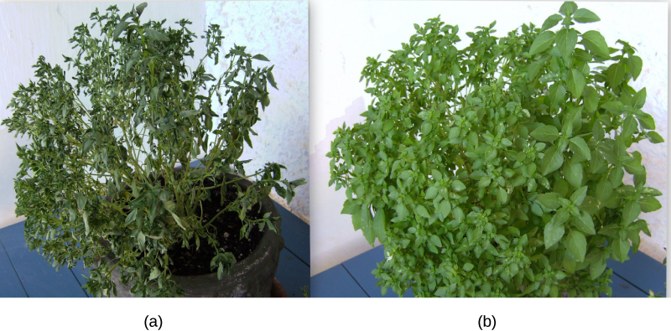
Turgor Potential Keeps Plants Erect
When (a) total water potential (Ψtotal) is lower outside the cells than inside, water moves out of the cells and the plant wilts. When (b) the total water potential is higher outside the plant cells than inside, water moves into the cells, resulting in turgor pressure (Ψ_{p}) and keeping the plant erect.
Notes:
(credit: modification of work by Victor M. Vicente Selvas) in Biology. Provided by: OpenStax CNX. Located at: http://cnx.org/contents/185cbf87-c72e-48f5-b51e-f14f21b5eabd@10.8. License: CC BY: Attribution. License Terms: Download for free at http://cnx.org/contents/185cbf87-c72e-48f5-b51e-f14f21b5eabd@10.8

Slide 41
Gravity Potential
Gravity potential (Ψ_{g}) is always negative to zero in a plant with no height. It always removes or consumes potential energy from the system. The force of gravity pulls water downwards to the soil, reducing the total amount of potential energy in the water in the plant (Ψ_{total}). The taller the plant, the taller the water column, and the more influential Ψ_{g} becomes. On a cellular scale and in short plants, this effect is negligible. However, over the height of a tall tree, the gravitational pull of –0.1 MPa m⁻¹ is equivalent to an extra 1 MPa of resistance that must be overcome for water to reach the leaves of the tallest trees. Plants are unable to manipulate Ψ_{g}.

Slide 42
Matric Potential
Matric potential (Ψm) is always negative to zero. In a dry system, it can be as low as –2 MPa and it is zero in a water-saturated system. The binding of water to a matrix always removes or consumes potential energy from the system. Every plant cell has a cellulosic cell wall and the cellulose in the cell walls is hydrophilic, producing a matrix for adhesion of water: hence the name matric potential. Ψm is very large (negative) in dry tissues such as seeds or drought-affected soils. However, it quickly goes to zero as the seed takes up water or the soil hydrates. Ψm cannot be manipulated by the plant and is typically ignored in well-watered roots, stems, and leaves.

Slide 43
Transpiration
Transpiration is the loss of water from the plant through evaporation at the leaf surface. It is the main driver of water movement in the xylem. Transpiration is caused by the evaporation of water at the leaf–atmosphere interface; it creates negative pressure (tension) equivalent to –2 MPa at the leaf surface. Water from the roots is pulled up by this tension. At night, when stomata shut and transpiration stops, the water is held in the stem and leaf by the adhesion of water to the cell walls of the xylem vessels and tracheids, and the cohesion of water molecules to each other. Transpiration is a passive process; it does not use ATP.

Slide 44
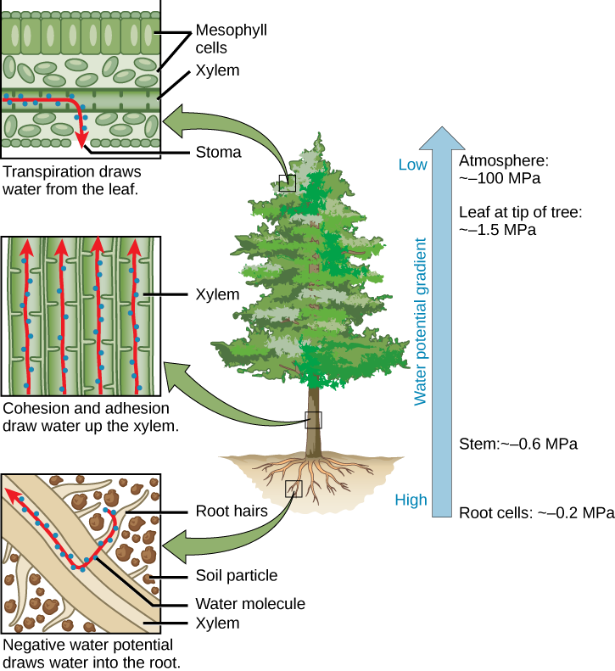
Cohesion-tension Theory of Sap Ascent
Notes:
Biology. Provided by: OpenStax CNX. Located at: http://cnx.org/contents/185cbf87-c72e-48f5-b51e-f14f21b5eabd@10.8. License: CC BY: Attribution. License Terms: Download for free at http://cnx.org/contents/185cbf87-c72e-48f5-b51e-f14f21b5eabd@10.8

Slide 45
Plants Adapt to Control Transpiration in their Environments
Notes:
Biology. Provided by: OpenStax CNX. Located at: http://cnx.org/contents/185cbf87-c72e-48f5-b51e-f14f21b5eabd@10.8. License: CC BY: Attribution. License Terms: Download for free at http://cnx.org/contents/185cbf87-c72e-48f5-b51e-f14f21b5eabd@10.8

Slide 46
Phloem
Phloem is comprised of cells called sieve-tube elements. Phloem sap travels through perforations called sieve tube plates. Neighboring companion cells carry out metabolic functions for the sieve-tube elements and provide them with energy. Lateral sieve areas connect the sieve-tube elements to the companion cells.

Slide 47
Translocation
Sucrose is actively transported from source cells into companion cells and then into the sieve-tube elements. This reduces the water potential, which causes water to enter the phloem from the xylem. The resulting positive pressure forces the sucrose-water mixture down toward the roots, where sucrose is unloaded. Transpiration causes water to return to the leaves through the xylem vessels.

Slide 48
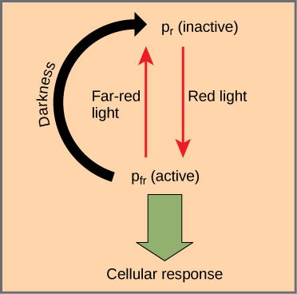
How the Phytochrome System Works
The biologically inactive form of phytochrome (Pr) is converted to the biologically active form Pfr under illumination with red light. Far-red light and darkness convert the molecule back to the inactive form.
Notes:
Biology. Provided by: OpenStax CNX. Located at: http://cnx.org/contents/185cbf87-c72e-48f5-b51e-f14f21b5eabd@10.8. License: CC BY: Attribution. License Terms: Download for free at http://cnx.org/contents/185cbf87-c72e-48f5-b51e-f14f21b5eabd@10.8

Slide 49
Phototropism
Phototropism—the directional bending of a plant toward or away from a light source—is a response to blue wavelengths of light. Positive phototropism is growth towards a light source, while negative phototropism (also called skototropism) is growth away from light.
Phototropins are protein-based receptors responsible for mediating the phototropic response. Like all plant photoreceptors, phototropins consist of a protein portion and a light-absorbing portion, called the chromophore. Other responses under the control of phototropins are leaf opening and closing, chloroplast movement, and the opening of stomata.

Slide 50
Photoperiodism
Plants also use the phytochrome system to sense the change of season. Photoperiodism is a biological response to the timing and duration of day and night. It controls flowering, setting of winter buds, and vegetative growth. Detection of seasonal changes is crucial to plant survival. Although temperature and light intensity influence plant growth, they are not reliable indicators of season because they may vary from one year to the next. Day length is a better indicator of the time of year.

Slide 51
Plant Responses to Gravity
Whether or not they germinate in the light or in total darkness, shoots usually sprout up from the ground, and roots grow downward into the ground. A plant laid on its side in the dark will send shoots upward when given enough time. Gravitropism ensures that roots grow into the soil and that shoots grow toward sunlight. Growth of the shoot apical tip upward is called negative gravitropism, whereas growth of the roots downward is called positive gravitropism.

Slide 52
How Do Plants Sense Gravity?
Amyloplasts are specialized plastids that contain starch granules and settle downward in response to gravity. Amyloplasts are found in shoots and in specialized cells of the root cap. When amyloplasts settle to the bottom of the gravity-sensing cells in the root or shoot, they physically contact the endoplasmic reticulum (ER), causing the release of calcium ions from inside the ER. This calcium signaling in the cells causes polar transport of the plant hormone IAA to the bottom of the cell. In roots, a high concentration of IAA inhibits cell elongation. The effect slows growth on the lower side of the root, while cells develop normally on the upper side. IAA has the opposite effect in shoots.

Slide 53
Responses to Touch and Wind
The movement of a plant subjected to constant directional pressure is called thigmotropism. Thigmomorphogenesis is a slow developmental change in the shape of a plant subjected to continuous mechanical stress. When trees bend in the wind, for example, growth is usually stunted and the trunk thickens.

Slide 54
Plant Defense
The first line of defense in plants is an intact and impenetrable barrier. Bark and the waxy cuticle can protect against predators. Other adaptations against herbivory include thorns, which are modified branches, and spines, which are modified leaves. They discourage animals by causing physical damage and inducing rashes and allergic reactions. A plant’s exterior protection can be compromised by mechanical damage, which may provide an entry point for pathogens.

Slide 55
Secondary Metabolites
If the first line of defense is breached, the plant must resort to a different set of defense mechanisms, such as toxins and enzymes. Secondary metabolites are compounds that are not directly derived from photosynthesis and are not necessary for respiration or plant growth and development. Many metabolites are toxic, and can even be lethal to animals that ingest them. Some metabolites are alkaloids, which discourage predators with noxious odors or repellent tastes. Other alkaloids affect herbivores by causing either excessive stimulation or lethargy. Some compounds become toxic after ingestion.

Slide 56
Systemic Response
Long-distance signaling elicits a systemic response aimed at deterring the predator. The infected and surrounding cells may die, thereby stopping the spread of infection. As tissue is damaged, jasmonates may promote the synthesis of compounds that are toxic to predators. Jasmonates also elicit the synthesis of volatile compounds that attract parasitoids, which are insects that spend their developing stages in or on another insect, and eventually kill their host. The plant may activate abscission of injured tissue if it is damaged beyond repair.

Slide 57
How Plants Grow
Most plants continue to grow as long as they live. They grow through a combination of cell growth and cell division (mitosis). The key to plant growth is meristem, a type of plant tissue consisting of undifferentiated cells that can continue to divide and differentiate. Meristem allows plant stems and roots to grow longer (primary growth) and wider (secondary growth).

Slide 58
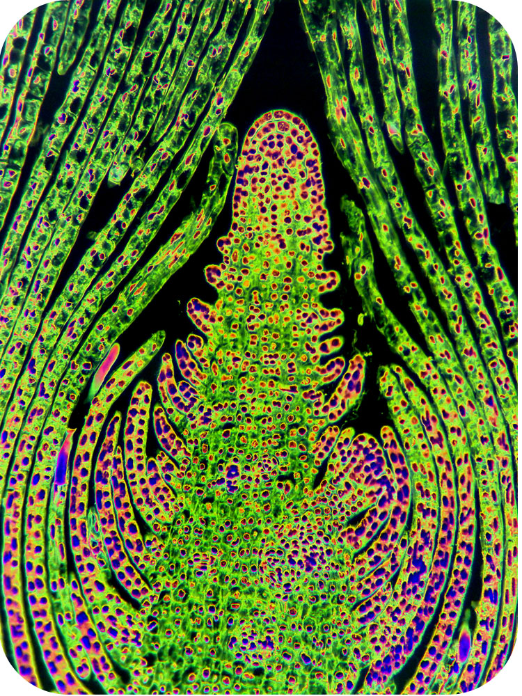
Apical Meristem
Notes:
Plant Growth. Authored by: CK-12. Located at: http://www.ck12.org/biology/Plant-Growth/lesson/Plant-Growth/r35/. Project: Biology. License: CC BY-NC: Attribution-NonCommercial

Slide 59
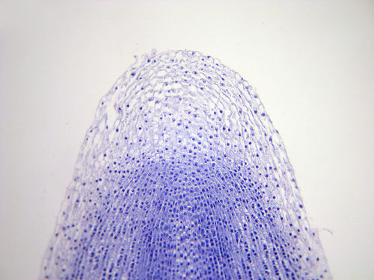
Root Tip
Notes:
Plant Growth. Authored by: CK-12. Located at: http://www.ck12.org/biology/Plant-Growth/lesson/Plant-Growth/r35/. Project: Biology. License: CC BY-NC: Attribution-NonCommercial

Slide 60
Primary and Secondary Growth
Notes:
Plant Growth. Authored by: CK-12. Located at: http://www.ck12.org/biology/Plant-Growth/lesson/Plant-Growth/r35/. Project: Biology. License: CC BY-NC: Attribution-NonCommercial

Slide 61
Annual Rings
Notes:
(credit: Adrian Pingstone) in Biology. Provided by: OpenStax CNX. Located at: http://cnx.org/contents/185cbf87-c72e-48f5-b51e-f14f21b5eabd@10.8. License: CC BY: Attribution. License Terms: Download for free at http://cnx.org/contents/185cbf87-c72e-48f5-b51e-f14f21b5eabd@10.8

Slide 62
Plant Hormones
A plant’s sensory response to external stimuli relies on chemical messengers. Plant hormones affect all aspects of plant life, from flowering to fruit setting and maturation, and from phototropism to leaf fall. Potentially every cell in a plant can produce plant hormones. They can act in their cell of origin or be transported to other portions of the plant body, with many plant responses involving the synergistic or antagonistic interaction of two or more hormones.

Slide 63
Auxins
The term auxin is derived from the Greek word auxein, which means “to grow.” Auxins are the main hormones responsible for cell elongation in phototropism and gravitropism. They also control the differentiation of meristem into vascular tissue, and promote leaf development and arrangement. Flowering, fruit setting and ripening, and inhibition of abscission (leaf falling) are other plant responses under the direct or indirect control of auxins.

Slide 64
Other Plant Hormones
Cytokinin is a hormone that promotes cytokinesis (cell division.
Abscisic acid inhibits stem elongation and induces dormancy in lateral buds.
Ethylene is associated with fruit ripening, flower wilting, and leaf fall.
Jasmonates coordinate defense responses to herbivory.
Oligosaccharins play a role in plant defense against bacterial and fungal infections.
Strigolactones promote seed germination and play a role in the establishment of mycorrhizae

Slide 65
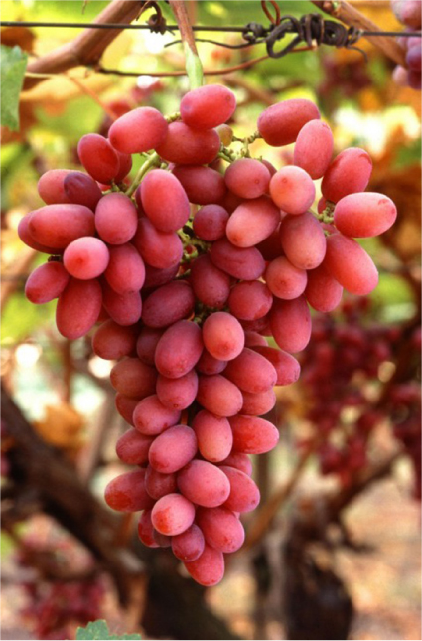
Gibberellins
Gibberellins (GAs) are a group of about 125 closely related plant hormones that stimulate shoot elongation, seed germination, and fruit and flower maturation.
Notes:
(credit: Bob Nichols, USDA) in Biology. Provided by: OpenStax CNX. Located at: http://cnx.org/contents/185cbf87-c72e-48f5-b51e-f14f21b5eabd@10.8. License: CC BY: Attribution. License Terms: Download for free at http://cnx.org/contents/185cbf87-c72e-48f5-b51e-f14f21b5eabd@10.8

Slide 66
Plant Nutrition
Plants absorb inorganic nutrients and water through their root system, and carbon dioxide from the environment. The combination of organic compounds, along with water, carbon dioxide, and sunlight, produce the energy that allows plants to grow. Inorganic compounds form the majority of the soil solution. Plants access water though the soil. Water is absorbed by the plant root, transports nutrients throughout the plant, and maintains the structure of the plant. Essential elements are indispensable elements for plant growth. They are divided into macronutrients and micronutrients.

Slide 67
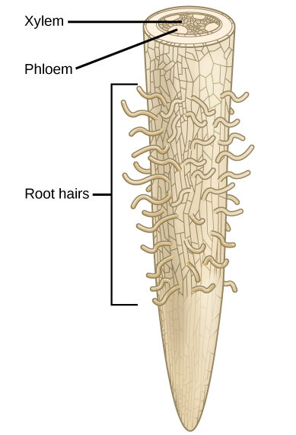
Plants absorb water through root hairs.
Notes:
Biology. Provided by: OpenStax CNX. Located at: http://cnx.org/contents/185cbf87-c72e-48f5-b51e-f14f21b5eabd@10.8. License: CC BY: Attribution. License Terms: Download for free at http://cnx.org/contents/185cbf87-c72e-48f5-b51e-f14f21b5eabd@10.8

Slide 68
Essential Elements for Plant Growth
Macronutrients | Micronutrients
Carbon (C) | Iron (Fe)
Hydrogen (H) | Manganese (Mn)
Oxygen (O) | Boron (B)
Nitrogen (N) | Molybdenum (Mo)
Phosphorus (P) | Copper (Cu)
Potassium (K) | Zinc (Zn)
Calcium (Ca) | Chlorine (Cl)
Magnesium (Mg) | Nickel (Ni)
Sulfur (S) | Cobalt (Co)
 | Sodium (Na)
 | Silicon (Si)
Notes:
Biology. Provided by: OpenStax CNX. Located at: http://cnx.org/contents/185cbf87-c72e-48f5-b51e-f14f21b5eabd@10.8. License: CC BY: Attribution. License Terms: Download for free at http://cnx.org/contents/185cbf87-c72e-48f5-b51e-f14f21b5eabd@10.8

Slide 69
One Reason Plants Need Carbon
Notes:
Biology. Provided by: OpenStax CNX. Located at: http://cnx.org/contents/185cbf87-c72e-48f5-b51e-f14f21b5eabd@10.8. License: CC BY: Attribution. License Terms: Download for free at http://cnx.org/contents/185cbf87-c72e-48f5-b51e-f14f21b5eabd@10.8

Slide 70
Practice Question
What do plant use cellulose for?
Notes:
Cellulose is a structural compound in plants: it gives them rigidity and stiffness.

Slide 71
Nutritional Deficiencies
Notes:
(credit c: modification of work by Jim Conrad; credit d: modification of work by Malcolm Manners) in Biology. Provided by: OpenStax CNX. Located at: http://cnx.org/contents/185cbf87-c72e-48f5-b51e-f14f21b5eabd@10.8. License: CC BY: Attribution. License Terms: Download for free at http://cnx.org/contents/185cbf87-c72e-48f5-b51e-f14f21b5eabd@10.8

Slide 72
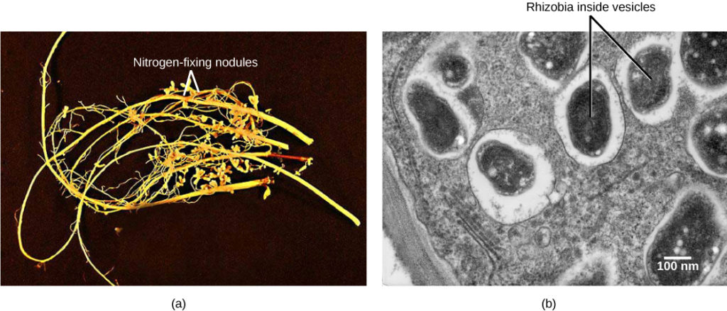
Nitrogen Fixing Bacteria
Soybean roots contain (a) nitrogen-fixing nodules. Cells within the nodules are infected with Bradyrhyzobium japonicum, a rhizobia or “root-loving” bacterium. The bacteria are encased in (b) vesicles inside the cell.
Notes:
(credit a: modification of work by USDA; credit b: modification of work by Louisa Howard, Dartmouth Electron Microscope Facility; scale-bar data from Matt Russell)

Slide 73
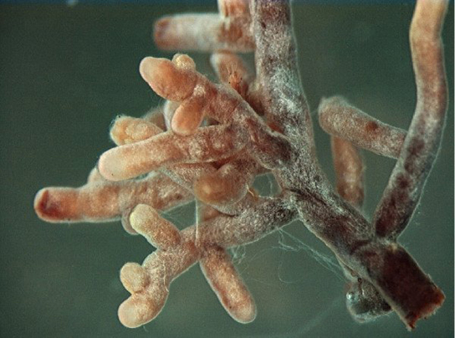
Mycorrhizae
Fungi form symbiotic associations called mycorrhizae with plant roots, in which the fungi actually are integrated into the physical structure of the root. Through mycorrhization, the plant gains essential elements from the soil because narrow hyphae can spread beyond the nutrient depletion zone. The plant gives the fungus nutrients, such as sugars.

Slide 74
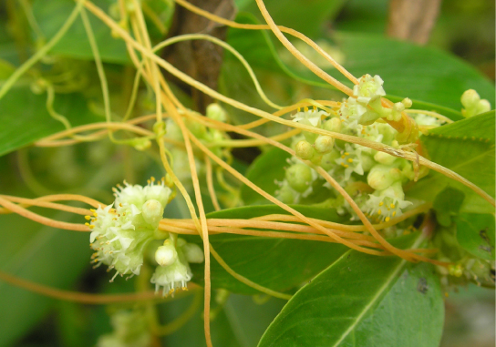
Parasitic Plants
A parasitic plant depends on its host for survival. Some parasitic plants have no leaves. The parasitic plant obtains water and nutrients through these connections. The plant above is a total parasite (a holoparasite) because it is completely dependent on its host. Other parasitic plants (hemiparasites) are fully photosynthetic and only use the host for water and minerals.
Notes:
(credit: “Lalithamba”/Flickr) in Biology. Provided by: OpenStax CNX. Located at: http://cnx.org/contents/185cbf87-c72e-48f5-b51e-f14f21b5eabd@10.8. License: CC BY: Attribution. License Terms: Download for free at http://cnx.org/contents/185cbf87-c72e-48f5-b51e-f14f21b5eabd@10.8

Slide 75
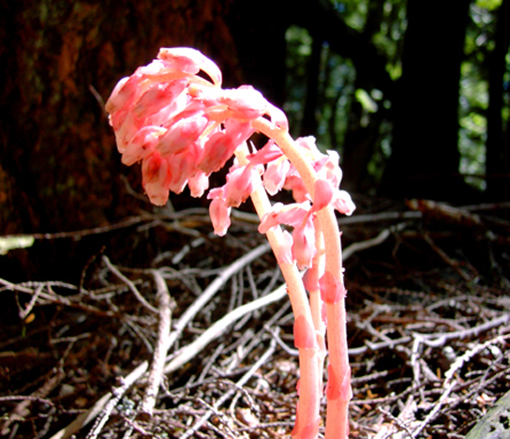
Saprophytes
A saprophyte is a plant that does not have chlorophyll and gets its food from dead matter. Plants like these use enzymes to convert organic food materials into simpler forms from which they can absorb nutrients. Most saprophytes do not directly digest dead matter: instead, they parasitize fungi that digest dead matter, or are mycorrhizal, ultimately obtaining photosynthate from a fungus that derived photosynthate from its host. Saprophytic plants are uncommon.
Notes:
(credit: modification of work by Iwona Erskine-Kellie) in Biology. Provided by: OpenStax CNX. Located at: http://cnx.org/contents/185cbf87-c72e-48f5-b51e-f14f21b5eabd@10.8. License: CC BY: Attribution. License Terms: Download for free at http://cnx.org/contents/185cbf87-c72e-48f5-b51e-f14f21b5eabd@10.8

Slide 76
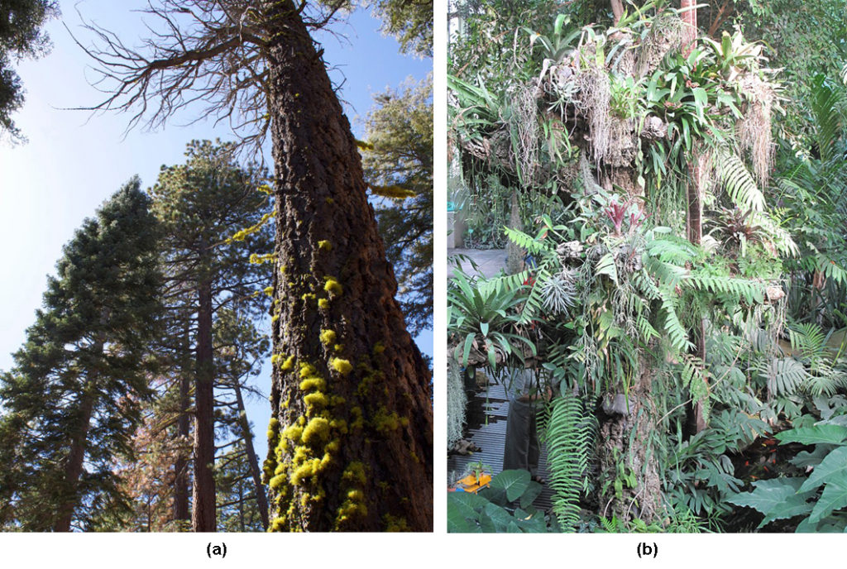
Epiphyte
An epiphyte is a plant that grows on other plants, but is not dependent upon the other plant for nutrition. Epiphytes have two types of roots: clinging aerial roots, which absorb nutrients from humus that accumulates in the crevices of trees; and aerial roots, which absorb moisture from the atmosphere.
Notes:
(credit: a “benketaro”/Flickr) in Biology. Provided by: OpenStax CNX. Located at: http://cnx.org/contents/185cbf87-c72e-48f5-b51e-f14f21b5eabd@10.8. License: CC BY: Attribution. License Terms: Download for free at http://cnx.org/contents/185cbf87-c72e-48f5-b51e-f14f21b5eabd@10.8

Slide 77
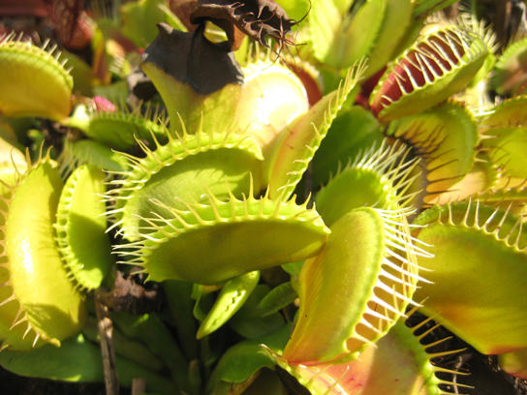
Insectivorous Plants
An insectivorous plant has specialized leaves to attract and digest insects. The minerals it obtains from prey compensate for those lacking in low pH soil. There are three sensitive hairs in the center of each half of each leaf. Nectar secreted by the plant attracts flies to the leaf. When a fly touches the sensory hairs, the leaf immediately closes. Next, fluids and enzymes break down the prey and minerals are absorbed by the leaf.
Notes:
(credit: “Selena N. B. H.”/Flickr) in Biology. Provided by: OpenStax CNX. Located at: http://cnx.org/contents/185cbf87-c72e-48f5-b51e-f14f21b5eabd@10.8. License: CC BY: Attribution. License Terms: Download for free at http://cnx.org/contents/185cbf87-c72e-48f5-b51e-f14f21b5eabd@10.8

Slide 78
Practice Question:
How do trees overcome gravity to get water from their roots to their leaves?
Notes:
See slides 37-44.

Slide 79
Quick Review
What are the basic common structures of plants?
How are water and solutes transported in plants?
What are common sensory systems and responses in plants?
What are the key elements and processes in plant growth?
What are the common nutritional needs of plants?

