Slide 1
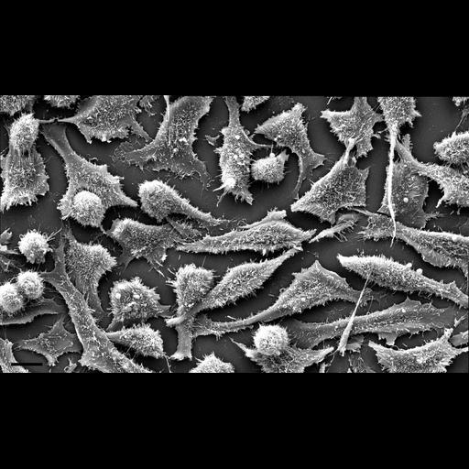
Chemistry of Life
Biology for Majors
Notes:
All text in these slides is taken from https://courses.lumenlearning.com/wm-biology1/ where it is published under one or more open licenses.
All images in these slides are attributed in the notes of the slide on which they appear and licensed as indicated.
Cover Image: Microscope: amyloplasts and leucoplastos. Authored by: emanuel1901. Located at: https://pixabay.com/en/microscope-amyloplasts-leucoplastos-1221391/. License: CC0: Public Domain.

Slide 2
Matter
Matter is any substance that occupies space and has mass.
Elements are unique forms of matter with specific chemical and physical properties that cannot be broken down into smaller substances by ordinary chemical reactions.

Slide 3
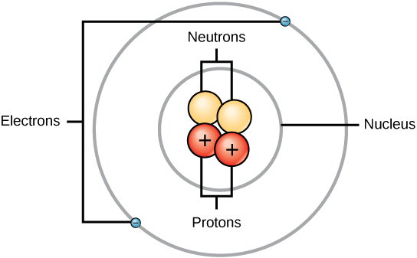
The Atom
An atom is the smallest unit of matter that retains all of the chemical properties of an element. Atoms are made up of protons and neutrons located within the nucleus, with electrons orbiting the nucleus.
Helium Atom
Notes:
Biology. Provided by: OpenStax CNX. Located at: http://cnx.org/contents/185cbf87-c72e-48f5-b51e-f14f21b5eabd@10.8. License: CC BY: Attribution. License Terms: Download for free at http://cnx.org/contents/185cbf87-c72e-48f5-b51e-f14f21b5eabd@10.8

Slide 4
Protons, Neutrons, and Electrons
Type | Charge | Mass (amu) | Location
Proton | +1 | 1 | nucleus
Neutron | 0 | 1 | nucleus
Electron | –1 | 0 | orbitals

Slide 5
Atomic Number
Atoms of each element contain a characteristic number of protons and electrons.
The number of protons determines an element’s atomic number and is used to distinguish one element from another.

Slide 6
Isotopes
Isotopes are different forms of the same atom that vary only in the number of neutrons they possess.
Notes:
fresh litter. Authored by: Magalie LAbbe. Located at: https://flic.kr/p/9yeYXd. License: CC BY-NC: Attribution-NonCommercial

Slide 7
Atomic Mass
Atomic mass is the calculated mean of the mass number for the naturally occurring isotopes of an element.

Slide 8
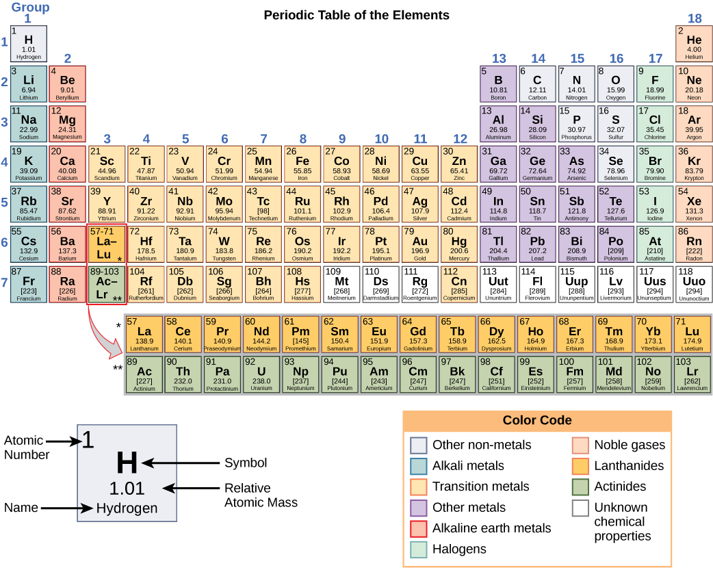
The Periodic Table
Notes:
Biology. Provided by: OpenStax CNX. Located at: http://cnx.org/contents/185cbf87-c72e-48f5-b51e-f14f21b5eabd@10.8. License: CC BY: Attribution. License Terms: Download for free at http://cnx.org/contents/185cbf87-c72e-48f5-b51e-f14f21b5eabd@10.8

Slide 9
How is the Periodic Table Organized?
The elements are organized and displayed according to their atomic number and are arranged in a series of rows and columns based on shared chemical and physical properties.
The periodic table also displays the element’s atomic mass.

Slide 10
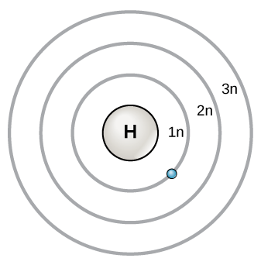
Electron Shells and the Bohr Model
The Bohr model shows the atom as a central nucleus containing protons and neutrons, with the electrons in circular orbitals at specific distances from the nucleus. These orbits are also called energy levels because takes less energy for electrons to be in the shell closest to the nucleus.
Notes:
Biology. Provided by: OpenStax CNX. Located at: http://cnx.org/contents/185cbf87-c72e-48f5-b51e-f14f21b5eabd@10.8. License: CC BY: Attribution. License Terms: Download for free at http://cnx.org/contents/185cbf87-c72e-48f5-b51e-f14f21b5eabd@10.8

Slide 11
Energy Levels
The energy levels are designated by a number and the symbol “n.” For example, 1n represents the first energy level located closest to the nucleus.
Electrons fill orbitals in a consistent order: they first fill the orbitals closest to the nucleus, then they continue to fill orbitals of increasing energy further from the nucleus.

Slide 12
The Octet Rule
The octet rule states that with the exception of the innermost shell (which holds 2 electrons) that atoms are more stable energetically when they have eight electrons in their valence shell, the outermost electron shell.

Slide 13
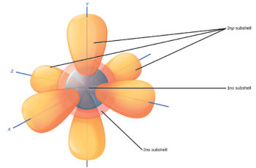
Electron Orbitals
Electron orbitals are the area where an electron is most likely to be found. These relatively complex shapes result from the fact that electrons behave not just like particles, but also like waves.

Slide 14
Contrasting Orbitals with the Bohr Model
While the concepts of electron shells and orbitals are closely related, orbitals provide a more accurate depiction of the electron configuration of an atom because the orbital model specifies the different shapes and orientations of all the places that electrons may occupy.
Notes:
The (a) rooted tree attempts to identify when various species diverged from a common ancestor while the (b) unrooted tree does not.
(credit a: modification of work by Eric Gaba)
Biology. Provided by: OpenStax CNX. Located at: http://cnx.org/contents/185cbf87-c72e-48f5-b51e-f14f21b5eabd@10.8. License: CC BY: Attribution. License Terms: Download for free at http://cnx.org/contents/185cbf87-c72e-48f5-b51e-f14f21b5eabd@10.8

Slide 15
Chemical Bonds
Since not all elements have enough electrons to fill their outermost shells, atoms form chemical bonds with other atoms thereby obtaining the electrons they need to attain a stable electron configuration. When two or more atoms chemically bond with each other, the resultant chemical structure is a molecule.

Slide 16
Chemical Bonds and Molecules
Molecules are two or more atoms chemically bonded together.
When two atoms form a molecule, their electrons, which form the outermost region of each atom, come together first.

Slide 17
Ions
Some atoms are more stable when they gain or lose an electron (or possibly two) and form ions. This fills their outermost electron shell and makes them energetically more stable. Because the number of electrons does not equal the number of protons, each ion has a net charge.
Cations are positive ions that are formed by losing electrons.
Negative ions are formed by gaining electrons and are called anions.

Slide 18
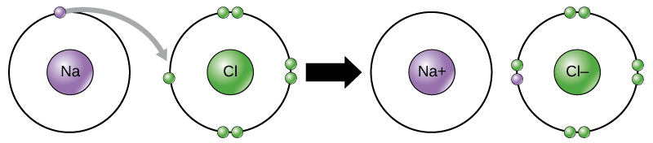
Electron Transfer
The movement of electrons from one element to another is referred to as electron transfer. Below sodium donates an electron to chlorine so they can both have complete outermost shells. Each is now an ion and has a +1 (sodium cation) or –1 (chloride anion) charge.
Ionic bonds form between ions with opposite charges, in this case making sodium chloride or table salt.
Notes:
Biology. Provided by: OpenStax CNX. Located at: http://cnx.org/contents/185cbf87-c72e-48f5-b51e-f14f21b5eabd@10.8. License: CC BY: Attribution. License Terms: Download for free at http://cnx.org/contents/185cbf87-c72e-48f5-b51e-f14f21b5eabd@10.8

Slide 19
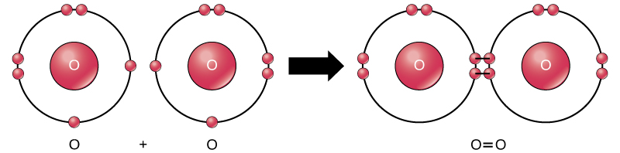
Covalent Bonds
Another way the octet rule can be satisfied is by the sharing of electrons between atoms to form covalent bonds. These bonds are stronger and much more common than ionic bonds in the molecules of living organisms. Below, two oxygen atoms share electrons.
Notes:
Biology. Provided by: OpenStax CNX. Located at: http://cnx.org/contents/185cbf87-c72e-48f5-b51e-f14f21b5eabd@10.8. License: CC BY: Attribution. License Terms: Download for free at http://cnx.org/contents/185cbf87-c72e-48f5-b51e-f14f21b5eabd@10.8

Slide 20
Types of Covalent Bonds
Nonpolar
Polar
Electrons are unequally shared by the atoms and are attracted more to one nucleus than the other. A slightly positive (δ+) or slightly negative (δ–) charge develops.
Electrons are equally shared.

Slide 21
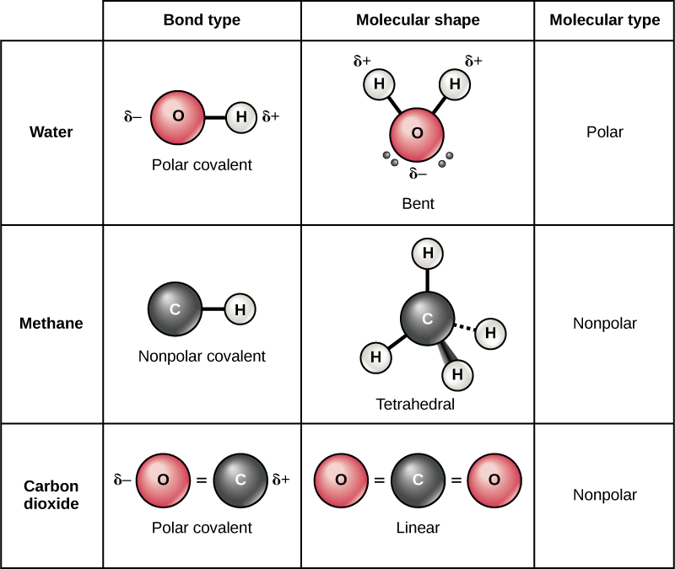
Common Covalent Bonds
Notes:
Biology. Provided by: OpenStax CNX. Located at: http://cnx.org/contents/185cbf87-c72e-48f5-b51e-f14f21b5eabd@10.8. License: CC BY: Attribution. License Terms: Download for free at http://cnx.org/contents/185cbf87-c72e-48f5-b51e-f14f21b5eabd@10.8

Slide 22
Hydrogen Bonds
The hydrogen electron in polar covalent bonds is pulled more strongly toward the other element and away from the hydrogen, leaving the hydrogen atom with a slight positive charge.
It is attracted to neighboring negative charges forming a weak bond called a hydrogen bond.

Slide 23
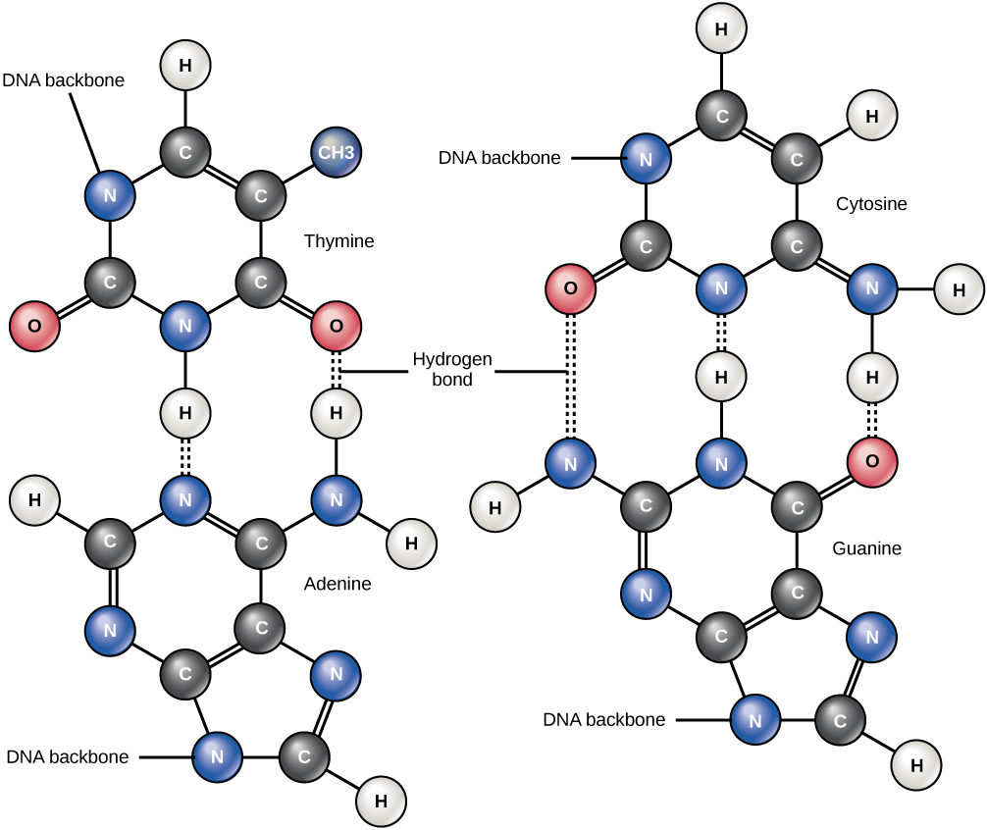
Hydrogen Bonds in DNA
Notes:
Functional Groups. Provided by: Boundless. Located at: https://www.boundless.com/biology/textbooks/boundless-biology-textbook/the-chemical-foundation-of-life-2/carbon-52/functional-groups-292-11425/. License: CC BY-SA: Attribution-ShareAlike

Slide 24
Functional Groups
Carbon has four electrons in its outermost shell and can form four bonds, creating molecules vital to cellular function. Carbon and hydrogen can form hydrocarbon chains or rings.
Functional groups are groups of atoms that confer specific properties to hydrocarbon (or substituted hydrocarbon) chains or rings that define their overall chemical characteristics and function.

Slide 25

Hydroxyl
Polar
Hydrophilic
Characterized by presence of Hydrogen and Oxygen
Simple structure
Notes:
Functional Groups. Provided by: Boundless. Located at: https://www.boundless.com/biology/textbooks/boundless-biology-textbook/the-chemical-foundation-of-life-2/carbon-52/functional-groups-292-11425/. License: CC BY-SA: Attribution-ShareAlike

Slide 26
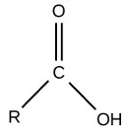
Carboxyl
Charged, ionized to release H+. Since carboxyl groups can release H+ ions into a solution, they are considered acidic.
Characterized by central C bound to O and OH
Acidic
Notes:
Functional Groups. Provided by: Boundless. Located at: https://www.boundless.com/biology/textbooks/boundless-biology-textbook/the-chemical-foundation-of-life-2/carbon-52/functional-groups-292-11425/. License: CC BY-SA: Attribution-ShareAlike

Slide 27
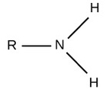
Amino
Charged, accepts H+ to form NH3+. Since amino groups can remove H+ from solution, they are considered basic
Characterized by presence of Nitrogen
Branched structure
Notes:
Functional Groups. Provided by: Boundless. Located at: https://www.boundless.com/biology/textbooks/boundless-biology-textbook/the-chemical-foundation-of-life-2/carbon-52/functional-groups-292-11425/. License: CC BY-SA: Attribution-ShareAlike

Slide 28
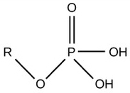
Phosphate
Charged, ionizes to release H+. Since phosphate groups can release H+ ions into solution, they are considered acidic.
Characterized by presence of Phosphorus
Complex structure
Notes:
Functional Groups. Provided by: Boundless. Located at: https://www.boundless.com/biology/textbooks/boundless-biology-textbook/the-chemical-foundation-of-life-2/carbon-52/functional-groups-292-11425/. License: CC BY-SA: Attribution-ShareAlike

Slide 29

Methyl
Nonpolar
Characterized by presence of Hydrogen and Carbon
Simple structure
Notes:
Functional Groups. Provided by: Boundless. Located at: https://www.boundless.com/biology/textbooks/boundless-biology-textbook/the-chemical-foundation-of-life-2/carbon-52/functional-groups-292-11425/. License: CC BY-SA: Attribution-ShareAlike

Slide 30

Carbonyl
Polar
Characterized by central Carbon and Oxygen
Bound to 2 organic side groups
Double bond to oxygen increases the polarity
Notes:
Functional Groups. Provided by: Boundless. Located at: https://www.boundless.com/biology/textbooks/boundless-biology-textbook/the-chemical-foundation-of-life-2/carbon-52/functional-groups-292-11425/. License: CC BY-SA: Attribution-ShareAlike

Slide 31

Sulfhydryl
Polar
Characterized by presence of Sulfur
Simple branched structure
Notes:
Functional Groups. Provided by: Boundless. Located at: https://www.boundless.com/biology/textbooks/boundless-biology-textbook/the-chemical-foundation-of-life-2/carbon-52/functional-groups-292-11425/. License: CC BY-SA: Attribution-ShareAlike

Slide 32
Acids
An acid is a substance that increases the concentration of hydrogen ions (H+) in a solution, usually by having one of its hydrogen atoms dissociate.

Slide 33
Bases
A base provides either hydroxide ions (OH–) or other negatively charged ions that combine with hydrogen ions, reducing their concentration in the solution and thereby raising the pH.

Slide 34
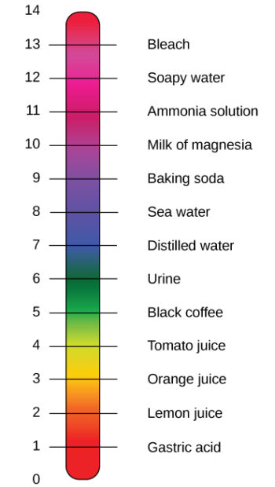
The pH Scale
The pH scale measures the concentration of hydrogen ions in a solution. It is an inverse logarithm and ranges from 0 to 14. Anything below 7.0 (ranging from 0.0 to 6.9) is acidic, and anything above 7.0 (from 7.1 to 14.0) is alkaline. Extremes in pH in either direction from 7.0 are usually considered inhospitable to life.
Notes:
PH Scale. Authored by: Edward Stevens. Located at: https://commons.wikimedia.org/wiki/File:PH_Scale.svg. License: CC BY: Attribution

Slide 35

Buffers
Buffers readily absorb excess H+ or OH–, keeping the pH in the narrow range required for survival.
The diagram shows the body’s buffering of blood pH levels. The blue arrows show the process of raising pH as more CO2 is made. The purple arrows indicate the reverse process: the lowering of pH as more bicarbonate is created.
Notes:
Biology. Provided by: OpenStax CNX. Located at: http://cnx.org/contents/185cbf87-c72e-48f5-b51e-f14f21b5eabd@10.8. License: CC BY: Attribution. License Terms: Download for free at http://cnx.org/contents/185cbf87-c72e-48f5-b51e-f14f21b5eabd@10.8

Slide 36
Chemical Reactions
Chemical reactions occur when two or more atoms bond together to form molecules or when bonded atoms are broken apart.
The substances used in the beginning of a chemical reaction are called the reactants (usually found on the left side of a chemical equation), and the substances found at the end of the reaction are known as the products (usually found on the right side of a chemical equation).
2H + O → H2O

Slide 37
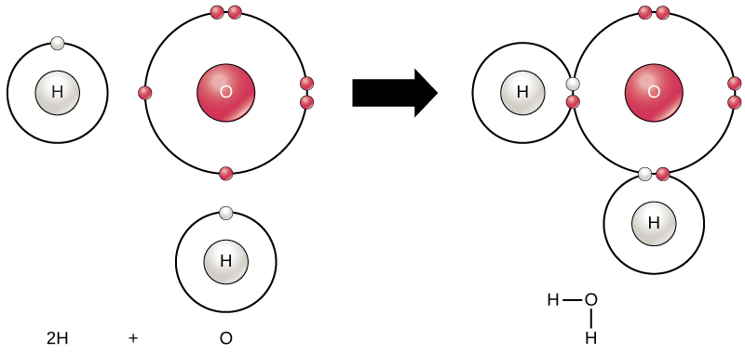
Compounds
Compounds, such as water, contain atoms of more than one type of element.
Notes:
Biology. Provided by: OpenStax CNX. Located at: http://cnx.org/contents/185cbf87-c72e-48f5-b51e-f14f21b5eabd@10.8. License: CC BY: Attribution. License Terms: Download for free at http://cnx.org/contents/185cbf87-c72e-48f5-b51e-f14f21b5eabd@10.8

Slide 38
Chemical Equations
In a balanced chemical equation the number of atoms of each element is the same on each side of the equation.

Slide 39
Types of Chemical Reactions
Reversible
Irreversible
can proceed in one direction until the reactants are all used up. The equations that describe these reactions contain a unidirectional arrow and are irreversible.
can go in either direction. Reactants are turned into products until the concentration of products reaches a certain threshold, then they are converted back into reactants. Ultimately, a relative balance occurs—a state called equilibrium.

Slide 40
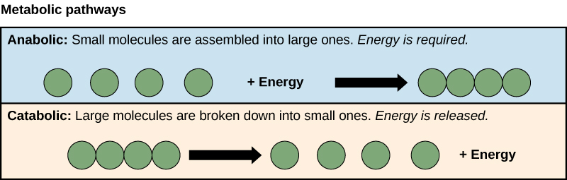
Anabolic and Catabolic Pathways
Anabolic pathways use energy to assemble large molecules form smaller ones. Catabolic pathways break large molecules into small pieces, releasing energy.
Notes:
Biology. Provided by: OpenStax CNX. Located at: http://cnx.org/contents/185cbf87-c72e-48f5-b51e-f14f21b5eabd@10.8. License: CC BY: Attribution. License Terms: Download for free at http://cnx.org/contents/185cbf87-c72e-48f5-b51e-f14f21b5eabd@10.8

Slide 41
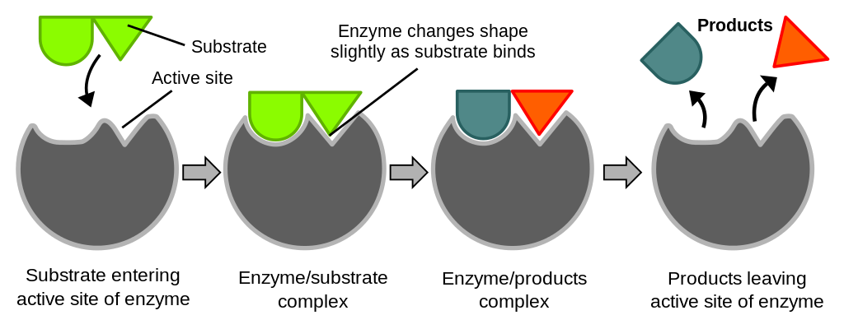
Enzymes
Enzymes are proteins that speed up reactions by reducing the activation energy. Each enzyme typically binds only one substrate. Enzymes are not consumed during a reaction; instead they are available to bind new substrates and catalyze the same reaction repeatedly.
Notes:
Induced fit diagram. Authored by: TimVickers; vectorized by Fvasconcellos. Located at: https://en.wikipedia.org/wiki/File:Induced_fit_diagram.svg. License: CC0: No Rights Reserved

Slide 42
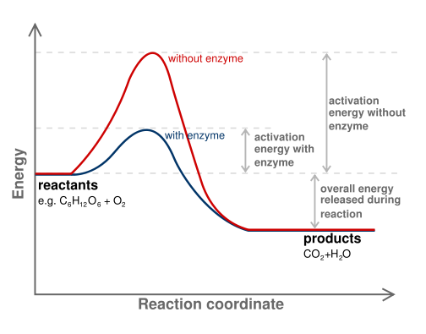
How Enzymes Work
An enzyme reduces the energy barrier required to activate the substrate, allowing more substrates to become activated, which increases the rate of product formation.
This diagram shows the difference in activation energy in uncatalysed and catalysed reaction.
Notes:
How Enzymes Work. Provided by: Open Learning Initiative. Located at: https://oli.cmu.edu/jcourse/workbook/activity/page?context=434a5d6380020ca600f6190aedc2f27b. Project: Introduction to Biology (Open + Free). License: CC BY-NC-SA: Attribution-NonCommercial-ShareAlike

Slide 43
Open and Closed Systems
An open system is one in which energy can be transferred between the system and its surroundings. Biological organisms are open systems.
A closed system is one that cannot transfer energy to its surroundings.

Slide 44
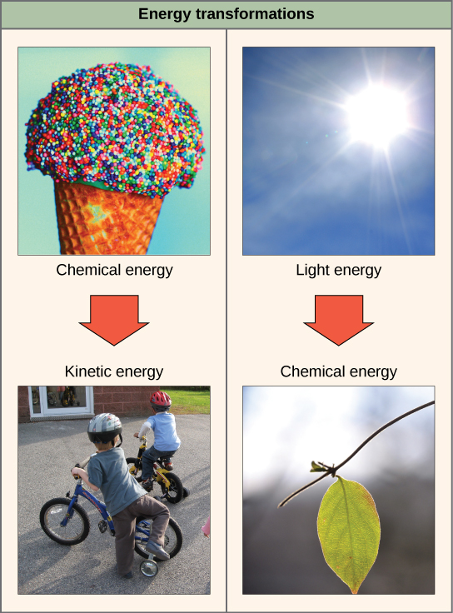
The First Law of Thermodynamics
Energy may be transferred from place to place or transformed into different forms, but it cannot be created or destroyed. The diagram shows two common energy transformations.
Notes:
(credit “ice cream”: modification of work by D. Sharon Pruitt; credit “kids on bikes”: modification of work by Michelle Riggen-Ransom; credit “leaf”: modification of work by Cory Zanker) in Biology. Provided by: OpenStax CNX. Located at: http://cnx.org/contents/185cbf87-c72e-48f5-b51e-f14f21b5eabd@10.8. License: CC BY: Attribution. License Terms: Download for free at http://cnx.org/contents/185cbf87-c72e-48f5-b51e-f14f21b5eabd@10.8

Slide 45
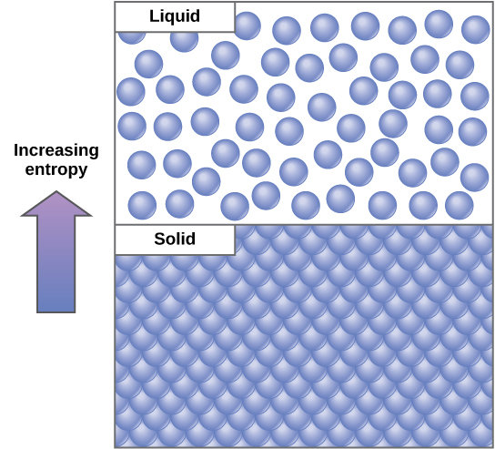
The Second Law of Thermodynamics
All energy transfers result in the loss of some usable energy. The second law of thermodynamics states that every energy transfer increases the entropy, randomness or disorder, of the universe. Even though living things are highly ordered and maintain a state of low entropy, the entropy of the universe in total is constantly increasing.
Notes:
Biology. Provided by: OpenStax CNX. Located at: http://cnx.org/contents/185cbf87-c72e-48f5-b51e-f14f21b5eabd@10.8. License: CC BY: Attribution. License Terms: Download for free at http://cnx.org/contents/185cbf87-c72e-48f5-b51e-f14f21b5eabd@10.8

Slide 46
Practice Question
An internet commenter says “evolution violates the second law of thermodynamics.” Is this statement correct? Explain.
Notes:
The internet commenter does not understand the second law of thermodynamics as it applies to living organisms. Living things are open systems, so they can maintain a state of low entropy even though the entropy of the universe is increasing.

Slide 47
Quick Review
What are the building blocks of matter?
What are the different types of atomic bonds?
How are molecules categorized according to their functional group?
Explain the pH scale.
Explain basic chemical reactions.
What are the first and second laws of thermodynamics?

