Slide 1

Ethics and Social Responsibility
Principles of Marketing
Notes:
All text in these slides is taken from https://courses.lumenlearning.com/waymakerintromarketingxmasterfall2016/, where it is published under one or more open licenses.
All images in these slides are attributed in the notes of the slide on which they appear and licensed as indicated.
Cover Image: No title Authored by: Nicolai Berntsen Located at: https://unsplash.com/photos/F3uyey6ours License: Creative Commons Zero

Slide 2
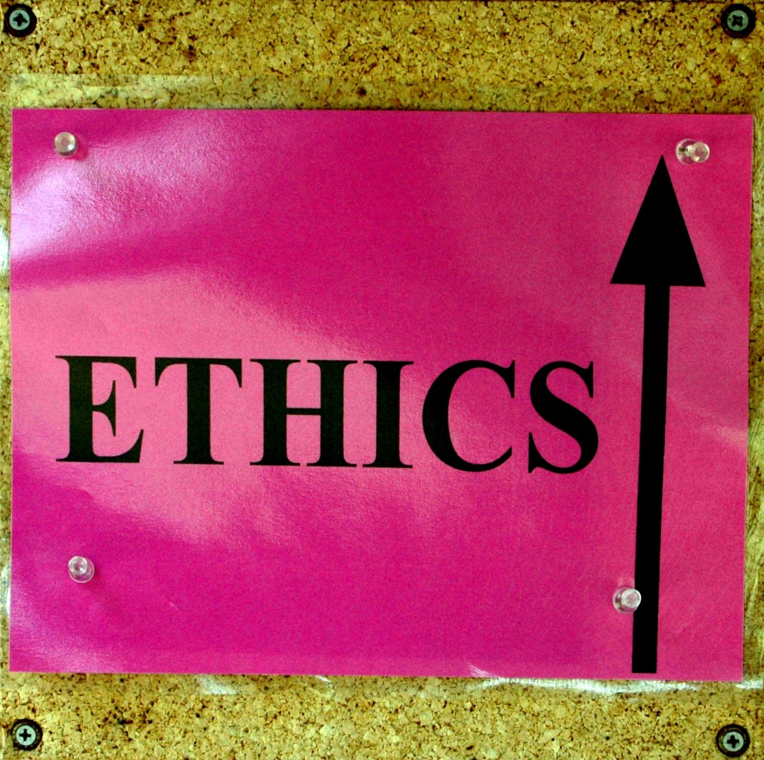
Ethics
Ethics is the set of moral principles or values that guides behavior
If a company acts unethically, it risks damaging its reputation and its customers’ trust—worse, it can face lawsuits and criminal prosecution

Slide 3
Norms and Values
Norms are established standards of conduct that are expected and maintained by society and/or professional organizations
Values represent the collective conception of what communities find desirable, important, and morally proper

Slide 4
Common Ethical Issues in Marketing
Most Difficult Issue | Percent of Marketing Professionals Responding
Bribery | Gifts from outside vendors, payment of questionable commissions, “money under the table” | 15%
Fairness | Unfairly placing company interests over family obligations, taking credit for the work of others, inducing customers to use services not needed, manipulation of others | 14%
Honesty | Lying to customers to obtain orders, misrepresenting services and capabilities | 12%
Price | Differential pricing, charging higher prices than firms with similar products while claiming superiority | 12%
Product | Product safety, product and brand infringement, exaggerated performance claims, products that do not benefit consumers | 11%
Personnel | Firing, hiring, employee evaluation | 10%
Confidentiality | Temptations to use or obtain classified, secret, or competitive information | 5%
Advertising | Crossing the line between exaggeration and misrepresentation, misleading customers | 4%
Manipulation of Data | Falsifying figures or misusing statistics or information, distortion | 4%

Slide 5
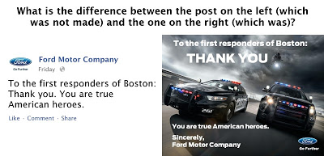
Brand Management
What does the product and brand imagery of the post on the right add (if anything) to the sincerity of the gratitude compared to the simple text version?
Notes:
Three Steps to Improve Ethics in Social Media Marketing. Authored by: Augie Ray. Provided by: Experience: The Blog. Located at: http://www.experiencetheblog.com/2013/04/three-steps-to-improve-ethics-in-social.html. License: CC BY: Attribution

Slide 6

Corporate Social Responsibility
Corporate social responsibility is the ethical behavior of a company toward society
It means acting responsibly toward the stakeholders—not just the shareholders—who have a legitimate interest in the business
Notes:
Honey Bee (Apis mellifera Linnaeus). Authored by: Jim, the Photographer. Located at: https://www.flickr.com/photos/jcapaldi/6162898675/. License: CC BY: Attribution

Slide 7
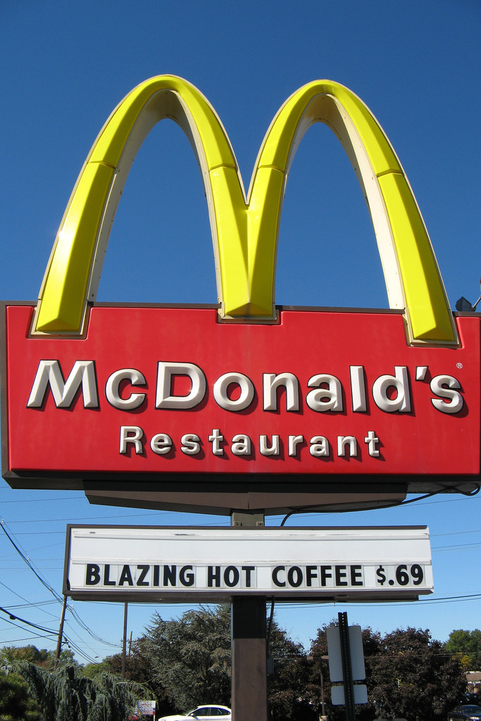
Product Liability: Marketing Defects
Marketing defects result from flaws in the way a product is marketed
Examples include improper labeling, poor or incomplete instructions, or inadequate safety warnings
Notes:
Lawsuits Welcome. Authored by: Chris Tengi. Located at: https://www.flickr.com/photos/cjtengi/2022308688/. License: CC BY-NC-ND: Attribution-NonCommercial-NoDerivatives

Slide 8
Privacy
Do-Not-Call Implementation Act of 2003
The Controlling the Assault of Non-Solicited Pornography and Marketing (CAN-SPAM) Act

Slide 9
Keep Customer Information Secure
Start with security: only collect customer data when necessary; be transparent; and treat the data with extreme care
Control and restrict access to sensitive data
Make sure your service providers implement reasonable security measures: write security into contracts and verify compliance
Establish procedures to keep your security current and address vulnerabilities that may arise; heed credible security warnings
Secure paper, physical media, and devices—not all data are stored digitally

Slide 10
Fair Information Practice Principles.
The Federal Trade Commission recommends that companies follow these guidelines:
Notice: Consumers should be given notice before any personal information is collected from them.
Choice: Consumers can control how their data is used.
  Opt in or opt out models
Access: The consumer’s ability to view the data collected and also to verify and contest its accuracy.
Security: Information collectors should ensure that the data they collect is accurate and secure.

Slide 11
Fraud
The Federal Trade Commission has determined that a representation, omission, or practice is deceptive if it is likely to:
Mislead consumers and
Affect consumers’ behavior or decisions about the product or service.
When it comes to marketing fraud, the two key words are deliberate deception

Slide 12
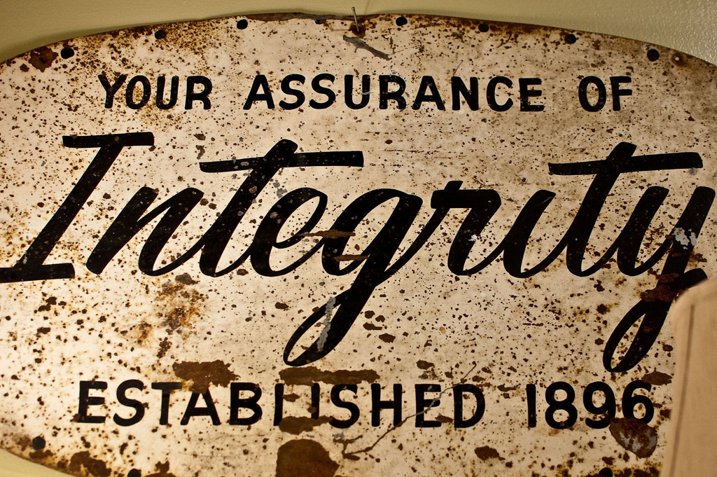
Trust
The goal of marketing is not to deceive the customer; it is, in fact, to build trust
Notes:
Integrity. Authored by: atalou. Located at: https://www.flickr.com/photos/natalieguinsler/5565750498/. License: CC BY-NC-ND: Attribution-NonCommercial-NoDerivatives

Slide 13
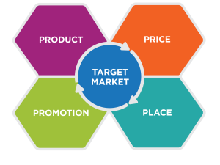
Deception in Product
Is the product designed and manufactured as the customer would expect, given the other elements of the marketing mix?
Is the customer warned about the product’s limitations or uses that are not recommended?
Notes:
Fraud in Marketing. Provided by: Lumen Learning. License: CC BY: Attribution

Slide 14
Deception in Price
Is the total price of the product fairly presented to the customer?
Is the price charged for the product the same as the price posted or advertised?
Has something been marketed as “free” and, if so, does it meet FTC guidelines for the definition of free?
Does the company disclose information about finance charges?
Notes:
Fraud in Marketing. Provided by: Lumen Learning. License: CC BY: Attribution

Slide 15
Deception in Promotion
Can claims made to consumers be substantiated?
Are disclaimers clear and conspicuous?
For products marketed to children, is extra care taken to accurately represent the product?
Notes:
Fraud in Marketing. Provided by: Lumen Learning. License: CC BY: Attribution

Slide 16
Deception in Place
Does the distribution channel deliver the product at the price and quality promised?
Do other companies in the distribution channel (wholesalers, retailers) perform as promised and deliver on expectations set for product, price, and promotions?
Notes:
Fraud in Marketing. Provided by: Lumen Learning. License: CC BY: Attribution

Slide 17
Challenges of B2B Ethics:
Personal sales are relationship based, requiring the seller to tailor the process according to the buyer’s personality and approach
B2B sales are often large and complex
Pricing is negotiated between the buyer and seller, rather than being set and uniform across all customers
Communication about the product and pricing takes place mainly through informal or formal verbal presentations and discussions

Slide 18
Company Policies
Company policies generally define:
The total purchase authority of a single individual or department
The threshold at which a purchase decision must go out for competitive bid
The circumstances under which the company’s status as a customer can be disclosed
A dollar threshold for gifts from vendors
It is wise for B2B Marketers to understand these rules to avoid putting people in awkward positions.

Slide 19
Business Gifts
Business gifts are usually seen as an advertising, sales-promotion, and marketing-communication medium. Such gifting is usually practiced for the following reasons:
In appreciation for past client relationships, placing a new order, referrals to other clients, etc
In the hopes of creating a positive first impression that might help to establish an initial business relationship
As a quid pro quo—returning a favor or expecting a favor in return for something

Slide 20
Standards for Business Conduct
Define the threshold for behavior: Companies require their employees to follow the law
Create expectations for behavior: The policies identify common issues that employees may encounter—such as accepting gifts from suppliers—and explain how they should be handled
Set policy: establish company protocols for handling confidential information, including customer data, etc.
Give guidance on making judgment calls
Describe reporting and enforcement procedures

Slide 21

Judgement Calls
Is it legal? If it’s not legal, don’t do it.
Is it ethical? If it feels wrong, it probably is wrong.
How would it look in the newspaper? If you wouldn’t feel comfortable if your friends and family knew about your actions, you probably shouldn’t do it.
Notes:
Acer Ferrari One. Authored by: Masaru Kamikura. Located at: https://www.flickr.com/photos/kamikura/3976320866/. License: CC BY: Attribution

Slide 22
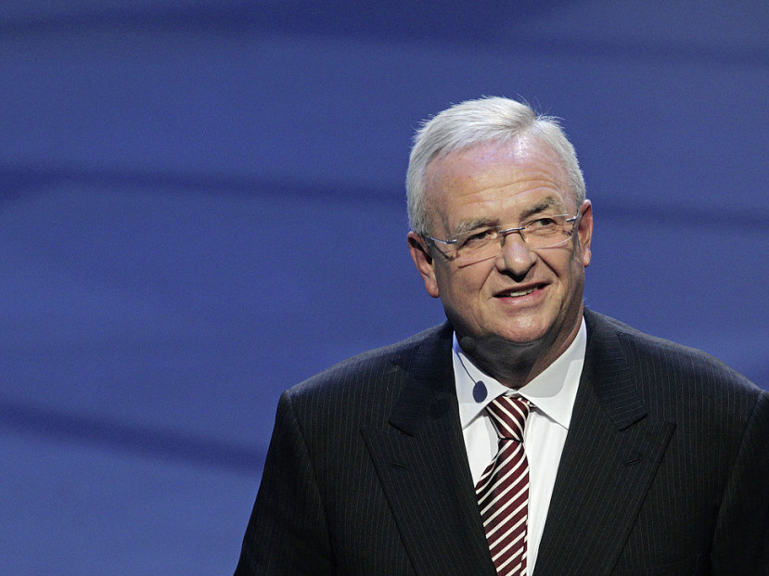
Executives Shape
Company Culture and Policy
They set objectives, policies, and make personnel decisions.
Notes:
Martin Winterkorn. Authored by: Volkswagon AG. Provided by: Wikimedia. Located at: https://commons.wikimedia.org/wiki/File:Martin_Winterkorn_2013-09-09_001.jpg. License: CC BY: Attribution

Slide 23
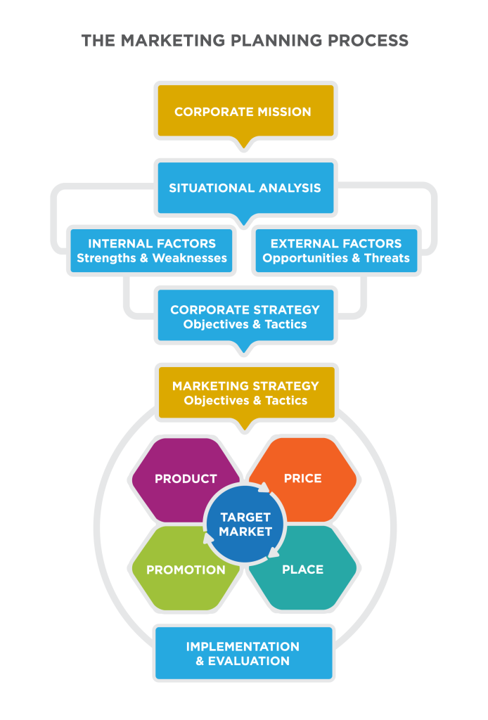
Social Responsibility in Marketing Strategy
Social responsibility may be a corporate-level strategy with specific objectives.
Social responsibility may be part of the marketing mix based on the situation analysis

Slide 24
Sustainable Products
A sustainable product is constantly environmental-friendly during its entire life
From the moment the raw materials are extracted to the moment the final product is disposed of, there must be no permanent damage to the environment

Slide 25
Ethics for Marketing Employees
Demonstrate respect for uour target customer
Prepare the sales team to sell effectively and ethically
Demonstrate high personal standards in business relationships
Provide fair value to the target customer
Play nicely in the competitive environment
Be truthful

Slide 26
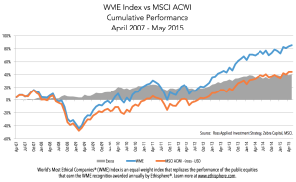
Ethics Makes (Dollars and) Cents
The world’s most ethical companies outperform their peers in the stock market.
Notes:
Putting It Together: Ethical and Social Responsibility. Provided by: Lumen Learning . License: CC BY: Attribution

Slide 27
Practice Question
You are creating a marketing plan for a pharmaceutical company
Which of these is an appropriate gift for doctors?
A golf vacation
A free continuing education seminar
A coffee mug
Notes:
The seminar and mug are probably ok.

Slide 28
Quick Review
What types of ethical and social responsibility issues does marketing need to address?
What laws regulate marketing?
How do ethical dilemmas in business-to-business marketing differ from those in consumer marketing?
What measures do companies take to encourage ethical behavior?
How can demonstrating corporate social responsibility impact marketing?

