Slide 1
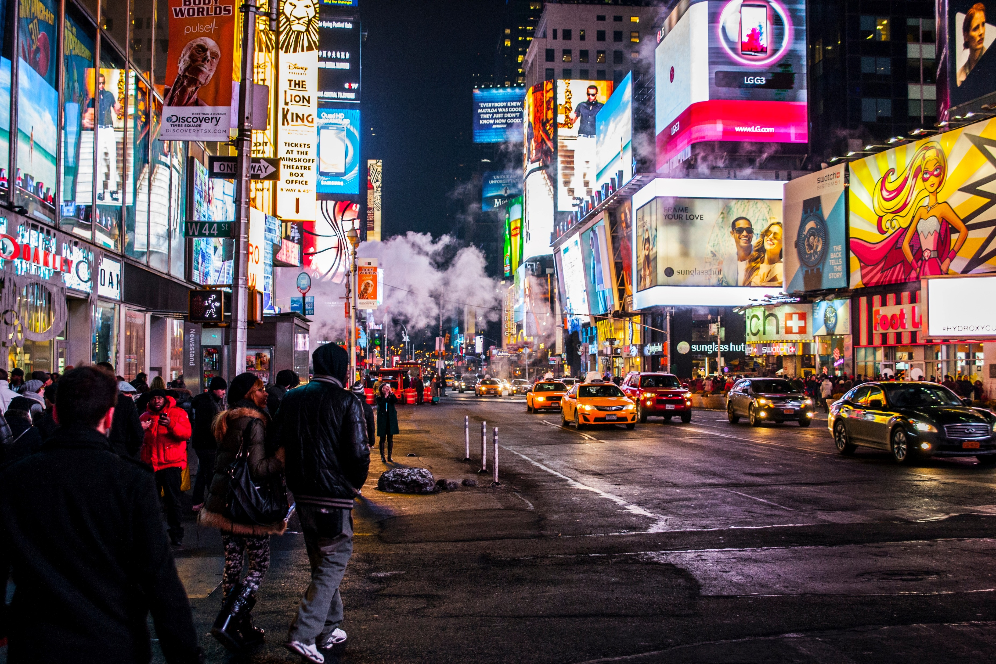
Branding
Principles of Marketing
Notes:
All text in these slides is taken from https://courses.lumenlearning.com/waymakerintromarketingxmasterfall2016/, where it is published under one or more open licenses.
All images in these slides are attributed in the notes of the slide on which they appear and licensed as indicated.
Cover Image: No title Authored by: Nicolai Berntsen Located at: https://unsplash.com/photos/F3uyey6ours License: Creative Commons Zero

Slide 2
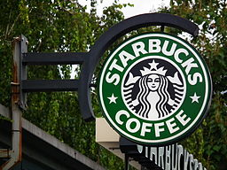
What is a Brand?
An identifier
A promise
An asset
A set of perceptions
A “mind share”
Notes:
Reading: Branding. Authored by: Linda Williams and Lumen Learning. Located at: https://courses.candelalearning.com/masterybusiness2xngcxmasterfall2015/chapter/reading-branding-labeling-and-packaging/. License: CC BY-SA: Attribution-ShareAlike

Slide 3
Tangible and Intangible Elements
Brands are a combination of tangible and intangible elements
Tangible
Visual design elements - logo, color, images, tagline, packaging, etc.
Distinctive product features - quality, design sensibility, personality, etc.
Intangible
Customers’ experience with a product or company - reputation, customer experience

Slide 4
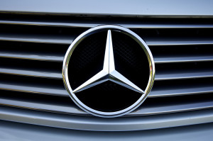
Brands Convey Meaning
Attributes: specific product features
Benefits: attributes translate into functional and emotional benefits
Values: company values and operational principles
Culture: cultural elements of the company and brand
Personality: strong brands often project a distinctive personality
User: brands may suggest the
types of consumers who buy
and use the product
Notes:
Mercedes Benz 500sl 1996. Authored by: Martin Pettitt. Located at: https://www.flickr.com/photos/mdpettitt/7980662156/. License: CC BY: Attribution

Slide 5
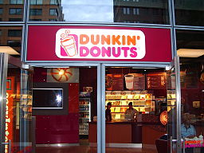
Brands Create Value for Consumers
Brands help simplify consumer choices
Brands help create trust, so that a person knows what to expect from a branded company, product, or service
This builds customer loyalty, which is valuable to businesses
Notes:
Reading: Branding. Authored by: Linda Williams and Lumen Learning. Located at: https://courses.candelalearning.com/masterybusiness2xngcxmasterfall2015/chapter/reading-branding-labeling-and-packaging/. License: CC BY-SA: Attribution-ShareAlike

Slide 6
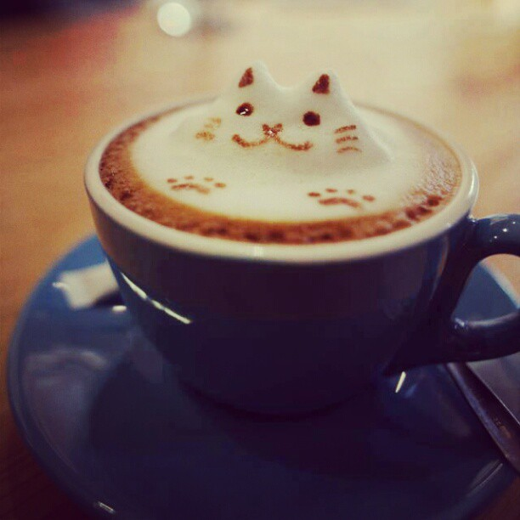
Types of Brands
Different types of brands include
Individual products
Product ranges
Services
Organizations
Individual persons
Groups
Events
Geographic places
Private label brands
Media
e-brands
Notes:
Coffee Art in 3D. Authored by: JC Awe. Located at: https://www.flickr.com/photos/qqjawe/8452733327/. License: CC BY: Attribution

Slide 7
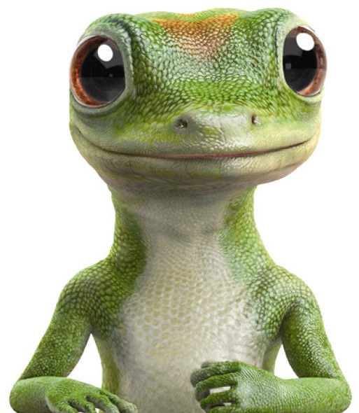
Brand Equity
Brand equity refers to the value of a well-known brand that conjures positive (or negative) mental and emotional associations.
Notes:
Screenshot Geico Gecko. Provided by: Lumen Learning. License: CC BY: Attribution

Slide 8
How to Measure Brand Equity
Price premium
Customer satisfaction/loyalty
Perceived quality
Leadership/popularity
Value
Brand personality
Organizational associations
Brand awareness
Market share
Market price and distribution coverage

Slide 9
Brand Asset Valuator
Differentiation: the defining characteristics of the brand and its distinctiveness relative to competitors
Relevance: the appropriateness and connection of the brand to a given consumer
Esteem: consumers’ respect for and attraction to the brand
Knowledge: consumers’ awareness of the brand and understanding of what it represents

Slide 10
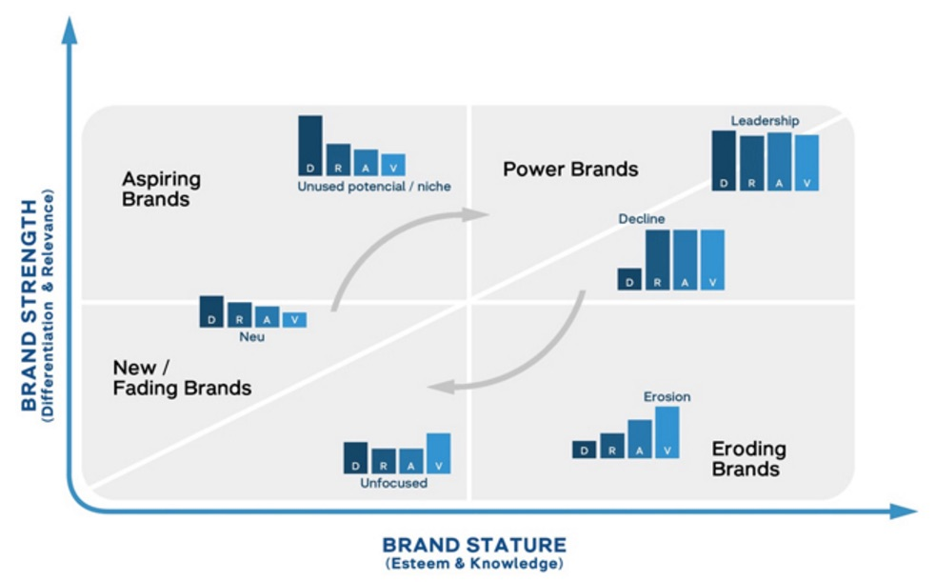
Power Grid
Notes:
Source: http://young-rubicam.de/tools-wissen/tools/brandasset-valuator/?lang=en Screenshot Power Grid. Provided by: Lumen Learning. License: CC BY: Attribution

Slide 11
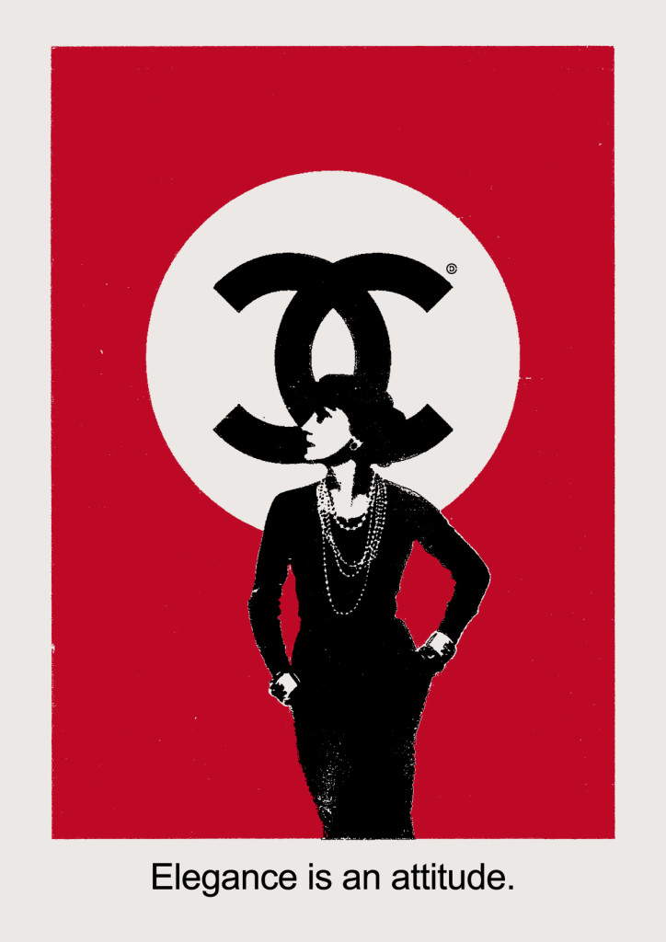
Other Methods to Measure Brand Equity
As a financial asset
As a price differential
As consumer favorability and preference
As consumer perceptions
Notes:
Coco Chanel 2011 . Authored by: Christopher Dombres. Located at: https://www.flickr.com/photos/christopherdombres/6629335105/. License: CC BY: Attribution

Slide 12
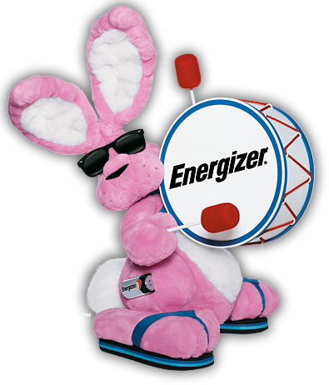
Brand Loyalty
Brand loyalty is a consumer’s commitment to repurchase or otherwise continue using a particular brand by repeatedly buying a product or service. Perceived value, satisfaction, and brand trust are also elements of brand loyalty.
Notes:
Energizer Bunny. Provided by: Energizer. Located at: https://en.wikipedia.org/wiki/File:Energizer_Bunny.png. License: All Rights Reserved. License Terms: Qualifies as fair use under U.S. copyright law

Slide 13
Types of Customers
Hard-core Loyals
Split Loyals
Shifting Loyals
Switchers

Slide 14
Why Create Loyalty Programs?
The benefits of brand loyalty are longer tenure, or staying a customer for longer, and lower sensitivity to price.
By creating promotions and loyalty programs that encourage the consumer to take some sort of action, companies are building brand loyalty by offering more than just an advertisement.

Slide 15
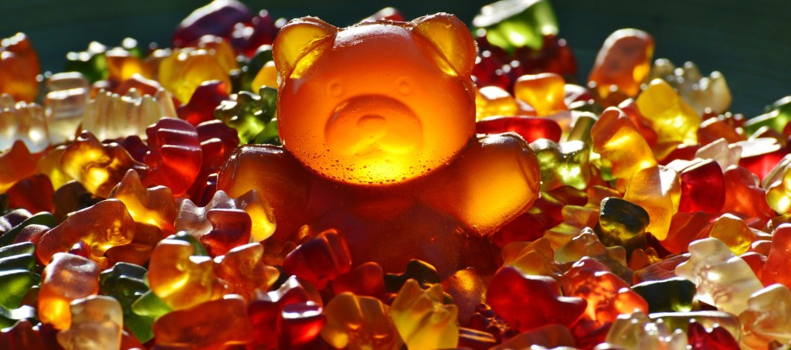
Brand Platform
Mission statement
Value proposition
Brand promise: the singular experience your brand promises to provide to your customers
Core values: guiding principles for how an organization does business
Brand voice or personality
Brand-positioning statement
Notes:
Gummi Bears. Provided by: Pixabay. Located at: https://pixabay.com/en/giant-rubber-bear-gummib%C3%A4r-1089618/. License: CC0: No Rights Reserved

Slide 16

Brand Voice or Personality
A useful template for defining brand voice and personality is the “is/is never” template
Together, the brand voice and personality set the linguistic and visual tone for all brand-related communications
Notes:
Lone Texas Cowboy. Authored by: Don the Upnorth Memories Guy. Located at: https://www.flickr.com/photos/upnorthmemories/5147038060/. License: CC BY-NC-ND: Attribution-NonCommercial-NoDerivatives

Slide 17
Brand Positioning Statement
To [target audience], Brand X is the only [category or frame of reference] that [points of differentiation/benefits delivered] because [reasons to believe].
Note that the target audience for the brand-positioning statement should include all the audiences for the brand, not just the specific, narrowly defined target segment you’d expect in a product- or service-positioning statement

Slide 18
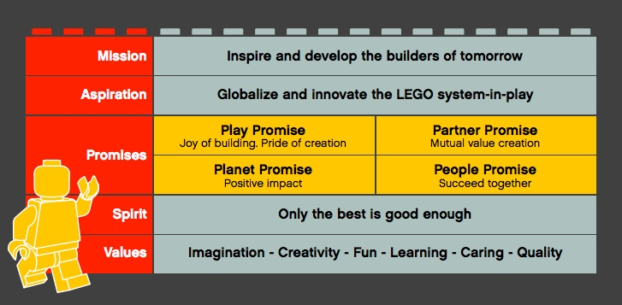
Example: LEGO
Notes:
Screenshot LEGO Brand Framework. Provided by: Lumen Learning. License: CC BY: Attribution

Slide 19
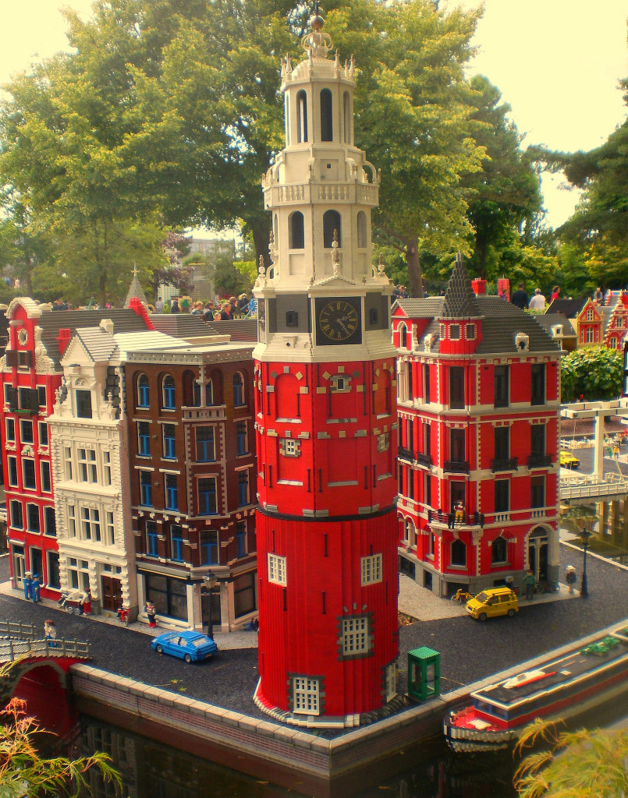
Brand Personality: My LEGO Friend
My LEGO friend . . . has a vivid imagination . . . is curious and likes to try out new things . . . is always positive and optimistic . . . is fun to be around with . . . enjoys bringing people together . . . is friendly and approachable . . . is caring for others . . . doesn’t get bothered by the little things . . . can comfortably adapt to play different roles
Notes:
LEGOLAND. Authored by: lisa-skorpion. Located at: https://www.flickr.com/photos/muszka/19991616450/. License: CC BY-ND: Attribution-NoDerivatives

Slide 20
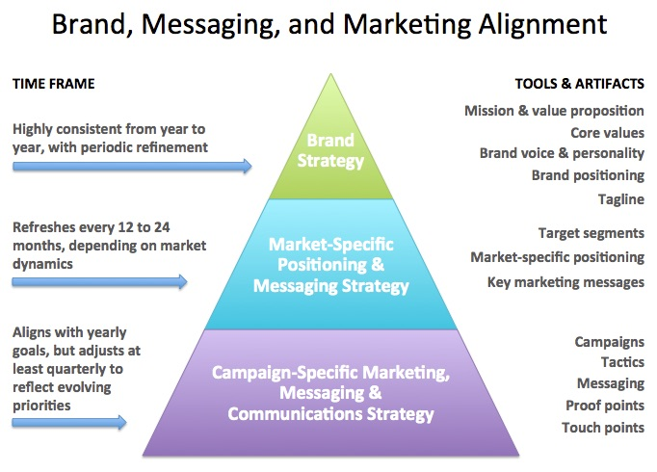
Brand, Messaging, and Marketing Alignment
Notes:
Provided by: Lumen Learning. License: CC BY: Attribution

Slide 21

Selecting a Brand Name
Selecting a brand name is one of the most important product decisions a seller makes
Notes:
Hello, My Name Is Opportunity. Authored by: One Way Stock. Located at: https://www.flickr.com/photos/paulbrigham/8423157044/. License: CC BY-ND: Attribution-NoDerivatives

Slide 22
Steps of Naming a Brand
Define what you’re naming
Check the landscape
Brainstorm ideas
Screen and knock out problematic names
  Perceptual screening
  Legal screening
  Linguistic screening
Check domain name and social media availability
  Look at variations of your chosen name(s)
  Check out your internet “neighbors”
  Reserve domains in geographies where you plan to do business

Slide 23

More Steps to Naming a Brand
6. Customer-test your final short-listed names
7. Make your final selection
8. Take steps to get trademark protection for your new brand
Notes:
Registered Trademark Symbol. Provided by: Pixabay. Located at: https://pixabay.com/en/registered-trademark-brand-sign-98574/. License: CC0: No Rights Reserved

Slide 24
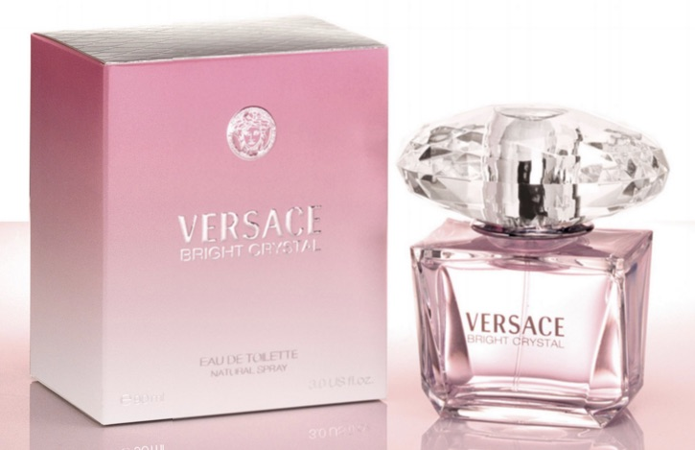
Packaging
Quality
Safety
Instruction
Legal compliance
Distinction
Affordability
Convenience and Utility
Aesthetic beauty
Sustainability
Notes:
Screenshot Versace Bright Crystal Perfume. Provided by: Lumen Learning. License: CC BY: Attribution

Slide 25

Packaging Matters
Packaging should fit the product and the customer and promote brand loyalty
Notes:
Little Pringle. Authored by: Christopher Michel. Located at: https://www.flickr.com/photos/cmichel67/39944369/. License: CC BY: Attribution

Slide 26
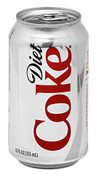
Branding Strategies
Branded house - Apple, BMW
House of brands - Tang, Kool Aid
Private label or store branding - Safeway Organics
“No brand” branding
Personal and organizational
Place branding - Las Vegas
Co-branding - Liz Lange at Target
Licensing – see image to right
Brand extension and line extension - Diet Coke, Jell-O pudding pops
Notes:
Revision and adaptation. Provided by: Lumen Learning. License: CC BY-SA: Attribution-ShareAlike
Branding. Authored by: Linda Williams and Lumen Learning. Located at: https://courses.candelalearning.com/masterybusiness2xngcxmasterfall2015/chapter/reading-branding-labeling-and-packaging/. License: CC BY-SA: Attribution-ShareAlike

Slide 27
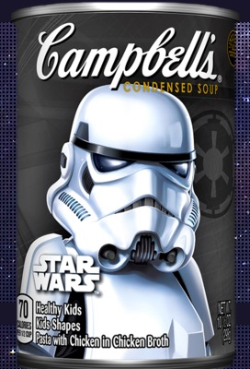
Practice Questions
What are the advantages and disadvantages of licensing for a brand?
Notes:
Advantages: Licensing can be very lucrative. Disadvantages: If the other company is not successful it could reflect poorly on the brand. The company that owns the brand has less control over how it is used, although licensing agreements can restrict how a licensed brand is used.
Screenshot Campbell's Star Wars Soup. Provided by: Lumen Learning. License: CC BY: Attribution
Source: http://www.campbells.com/star-wars/

Slide 28
Quick Review
What are the elements of brand? How do brands add value to an organization’s products and services?
What is brand equity and how is it measured?
How do marketers use brand positioning to align marketing activities and build successful brands?
How does name selection contribute to the success of a brand?
What role does packaging play in the brand-building process?
What are key strategies for developing brands including brand ownership, brand and line extensions, co-branding and licensing?

