Slide 1

Product Marketing
Principles of Marketing
Notes:
All text in these slides is taken from https://courses.lumenlearning.com/waymakerintromarketingxmasterfall2016/, where it is published under one or more open licenses.
All images in these slides are attributed in the notes of the slide on which they appear and licensed as indicated.
Cover Image: No title Authored by: Nicolai Berntsen Located at: https://unsplash.com/photos/F3uyey6ours License: Creative Commons Zero

Slide 2

Product Marketing
Product is the core of the marketing mix
Product defines what will be priced, promoted, and distributed
If you are able to create and deliver a product that provides exceptional value to your target customer, the rest of the marketing mix is easier to manage
Notes:
New Kicks. Authored by: Grace Miller. Located at: https://www.flickr.com/photos/gracemillerphotography/6101851438/. License: CC BY-NC-ND: Attribution-NonCommercial-NoDerivatives

Slide 3
What is a product?
A product is a bundle of attributes (features, functions, benefits, and uses) that a person receives in an exchange
A product can be:
An idea (recycling)
A physical good (a pair of jeans)
A service (banking)
Any combination of the three
Products are divided into consumer and business or B2B products

Slide 4
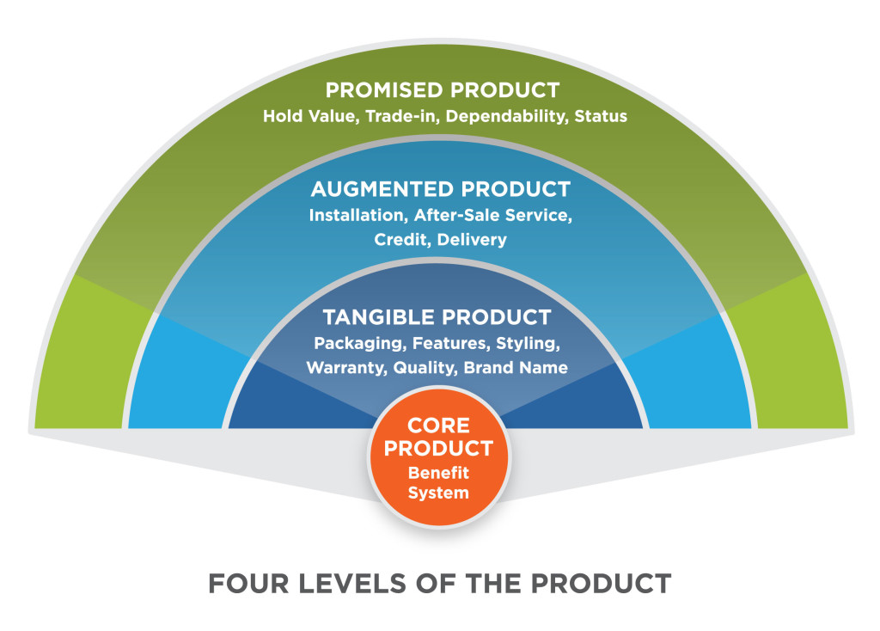
Four Levels of the Product
Notes:
Revision and adaptation. Provided by: Lumen Learning. License: CC BY: Attribution

Slide 5
Types of Consumer Products
Consumer products are often classified into four groups related to different kinds of buying decisions
Convenience - bread, pain reliever, power cords
Shopping - shoes, microwaves
Specialty - highly differentiated, custom goods
Unsought products - funeral plots, pest-control

Slide 6
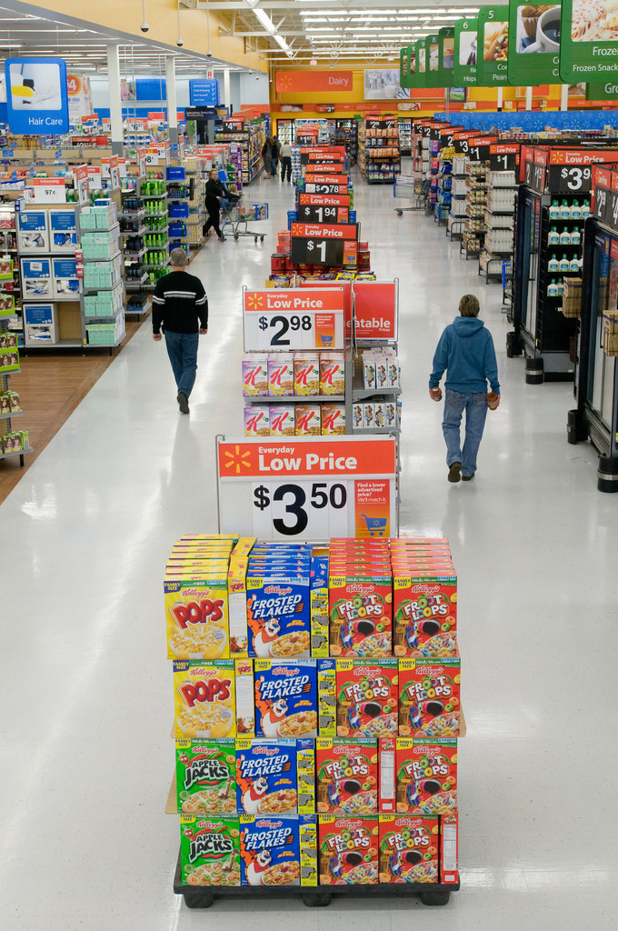
Practice Question
What type of product is shown here?
Notes:
Consumer convenience product
Walmart's Action Alley. Provided by: Walmart. Located at: https://www.flickr.com/photos/walmartcorporate/5684811762/. License: CC BY: Attribution

Slide 7
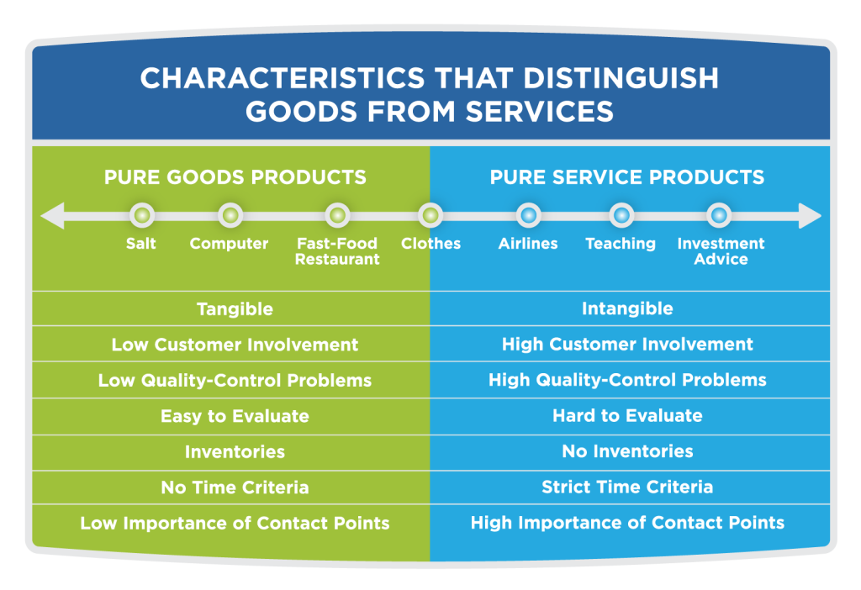
Characteristics that Distinguish Goods from Services
Notes:
Revision and adaptation. Provided by: Lumen Learning. License: CC BY: Attribution

Slide 8

Products Should be
Augmented with Services If:
Services can provide a more complete and satisfying customer experience
Services can increase the total revenue for each sale
Notes:
Zappos concept. Authored by: Alberto Cerriteu00f1o. Located at: https://www.flickr.com/photos/acerriteno/3850366833/. License: CC BY-NC-ND: Attribution-NonCommercial-NoDerivatives

Slide 9
Product Marketing Responsibilities: Inputs to the Company
Define market needs or problems that the product should address
Complete a competitive analysis to understand other offerings in the market
Identify which market segments the product will target
Define market requirements for the product
Create buyer persona documents that describe the personality, behavior, and desires of buyer types
Determine price

Slide 10
Product Marketing Responsibilities: Outputs to the Market
Define key messages to the communicate product benefits to the target market
Create marketing materials about the product
Define the sales approach
Create lead generation plans
Develop sales materials such as Web site content, brochures, presentations, and product demonstrations
Provide training and support to distribution channel partners

Slide 11
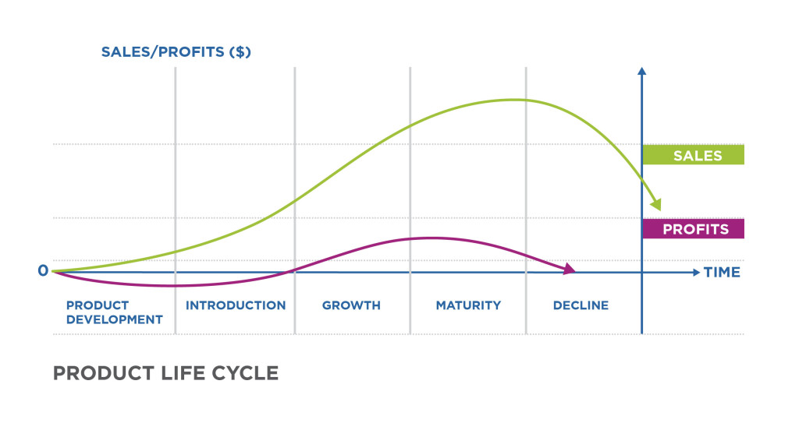
Product Life Cycle
Notes:
Revision and adaptation. Provided by: Lumen Learning. License: CC BY: Attribution

Slide 12
Stages of Product Lifecycle
0. Product development stage | new product ideas are generated and tested; investment is made sales have not begun
1. Market introduction stage | costs are very high with slow sales volumes to start little or no competition demand has to be created and customers have to be prompted to try the product makes little money at this stage
2. Growth stage | costs reduced due to economies of scale as sales volume increases 2. profitability begins to rise 3. public awareness increases 4. competition begins to increase with a few new players in establishing market, increased competition leads to price decreases
3. Maturity stage | costs are lowered as a result of increasing production volumes and experience curve effects sales volume peaks and market saturation is reached new competitors enter the market, prices tend to drop brand and feature diversification needed to maintain market share profits decline
4. Decline stage | costs increase due to loss of economies of scale as sales volume declines, prices and profitability diminish profit becomes more a challenge of production/distribution efficiency than increased sales
Notes:
Product Life-cycle Management (Marketing). Provided by: Wikipedia. Located at: https://en.wikipedia.org/wiki/Product_life-cycle_management_(marketing). License: CC BY-SA: Attribution-ShareAlike

Slide 13
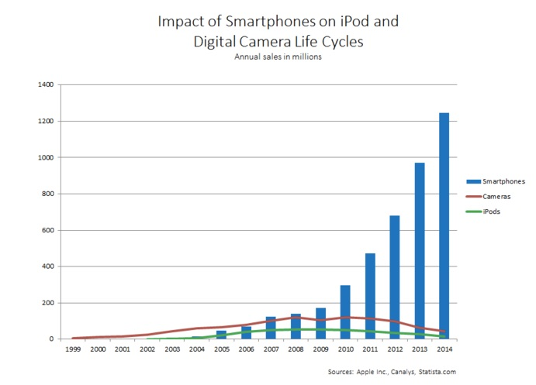
Practice Question
How does this graph show a limitation in the Product Lifecycle Model?
Notes:
Reading: Challenges in the Product Life Cycle. Provided by: Lumen Learning. License: CC BY: Attribution
The product life cycle is not forward looking. At any point on the graph, a marketer can see what has already occurred but not what is ahead. In planning a product strategy, it is important to understand the past sales performance of the product and the industry broadly, but the role of marketing is to shape future performance, and the product life cycle doesn’t offer many tools to inform that proactive work.
The product life cycle can focus a marketer on a defined set of products and competitors in the current market—but miss broad trends or innovations in adjacent markets and products.

Slide 14
Product Line
A product line is a group of products marketed by an organization to one general market
They have some characteristics, customers, and/or uses in common, and may also share technologies, distribution channels, prices, services, etc
There are often product lines within product lines.
Example: full range of Tylenol products, or over-the-counter medicines

Slide 15
Strategic Business Unit
A strategic business unit or SBU is a self-contained planning unit for which discrete business strategies can be developed.
An example of a strategic business unit is consumer health care products.

Slide 16
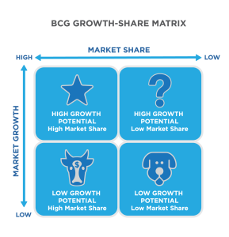
Using the Growth-Share Matrix
Companies evaluate product portfolios and SBUs using the growth-share matrix
Notes:
Reading: The Product Portfolio. Provided by: Lumen Learning. License: CC BY: Attribution

Slide 17
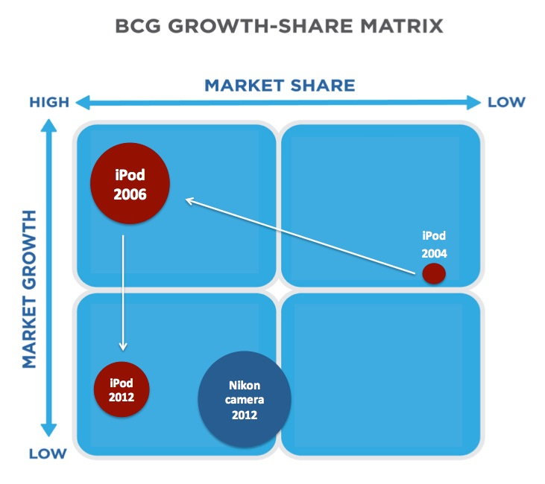
Product Life Cycles and Growth-Share
Knowing about the product life cycle is also important to understanding market growth
Notes:
Reading: The Product Portfolio. Provided by: Lumen Learning. License: CC BY: Attribution

Slide 18

Product Portfolio Management
Product portfolio management requires marketers to consider each product individually but also understand the way the products fit together collectively
Notes:
Gandini Juggling. Authored by: Dani Alvarez. Located at: https://www.flickr.com/photos/danialvarezfotos/8056057415/. License: CC BY-NC-ND: Attribution-NonCommercial-NoDerivatives

Slide 19
Portfolio Management Strategies
In order to optimize the product portfolio, marketers may:
Change the marketing mix for a product
  Change the product
  Reposition the product
Change a product line
  Line extension
Delete products
Introduce new products

Slide 20

Considerations in Line Extension
Can the new product support itself?
Will it cannibalize existing products?
Will existing outlets be willing to stock it?
Will competitors fill the gap if we do not?
What will happen if we do not act?
Notes:
Current Bon Ami Products on the Market. Provided by: Faultless Starch/Bon Ami Company. Located at: https://en.wikipedia.org/wiki/File:Photo_of_Bon_Ami_Products.jpg#/media/File:Photo_of_Bon_Ami_Products.jpg. License: Other. License Terms: Qualifies as fair use under U.S. copyright law

Slide 21
Beyond Line Extension
Product proliferation
Brand extension
Private branding

Slide 22
Reasons for Product Deletion
Product is losing money
Product-line simplification can prevent internal competition and consumer confusion.
Company’s productive, financial, and marketing resources are spread too thin
Problem products absorb too much management attention
Missed-opportunity costs

Slide 23
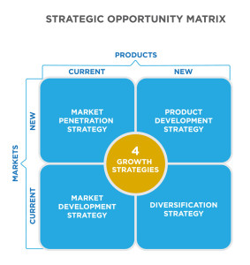
New Product Development
The internet has increased the pace and importance of new product development
New products have greater risk but may bring greater rewards
Notes:
Reading: New Products in the Portfolio. Provided by: Lumen Learning. License: CC BY: Attribution

Slide 24
Product Development Process
Phase I: Generating and Screening Ideas | Phase II: Developing New Products | Phase III: Commercializing New Products
Stage 1: Generating New Product Ideas | Stage 4: Business Case Analysis | Stage 6: Test Marketing
Stage 2: Screening Product Ideas | Stage 5: Technical and Marketing Development | Stage 7: Launch
Stage 3: Concept Development and Testing |  | Stage 8: Evaluation
Notes:
Revision and Adaptation. Provided by: Lumen Learning. License: CC BY: Attribution

Slide 25
Fuzzy Front End vs. NPD
 | Fuzzy Front End (FFE) | New-Product Development (NPD)
Nature of Work | Experimental, often chaotic. “Eureka” moments. | Can schedule work—but not invention. Disciplined and goal oriented with a project plan.
Commercialization Date | Unpredictable or uncertain. | High degree of certainty.
Funding | Variable | Budgeted.
Revenue Expectations | Often uncertain, with a great deal of speculation. | Predictable, with increasing certainty, as the product release date gets closer.
Activity | Individuals and team research to minimize risk and optimize potential. | Multifunction product and/or process development team.
Measures of Progress | Strengthened concepts. | Milestone achievement.
Notes:
Reading: Generating and Screening Ideas. Provided by: Lumen Learning. License: CC BY: Attribution

Slide 26
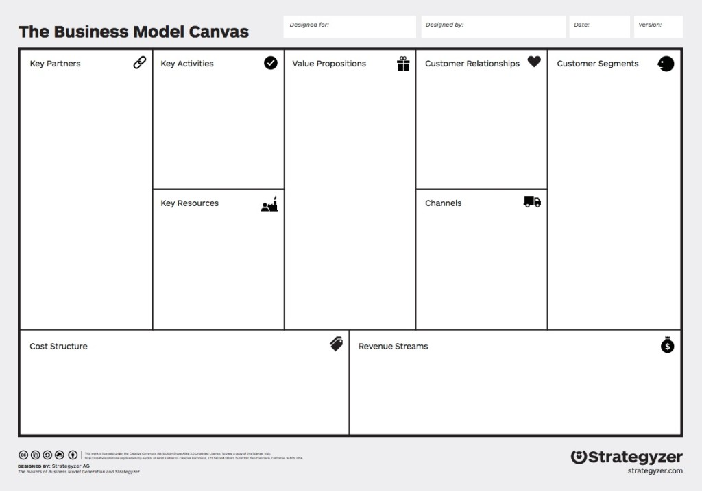
The Business Model Canvas
Notes:
Business Model Canvas. Authored by: Business Model Alchemist. Provided by: Wikimedia. Located at: https://en.wikipedia.org/wiki/Business_Model_Canvas#/media/File:Business_Model_Canvas.png. License: CC BY-SA: Attribution-ShareAlike

Slide 27
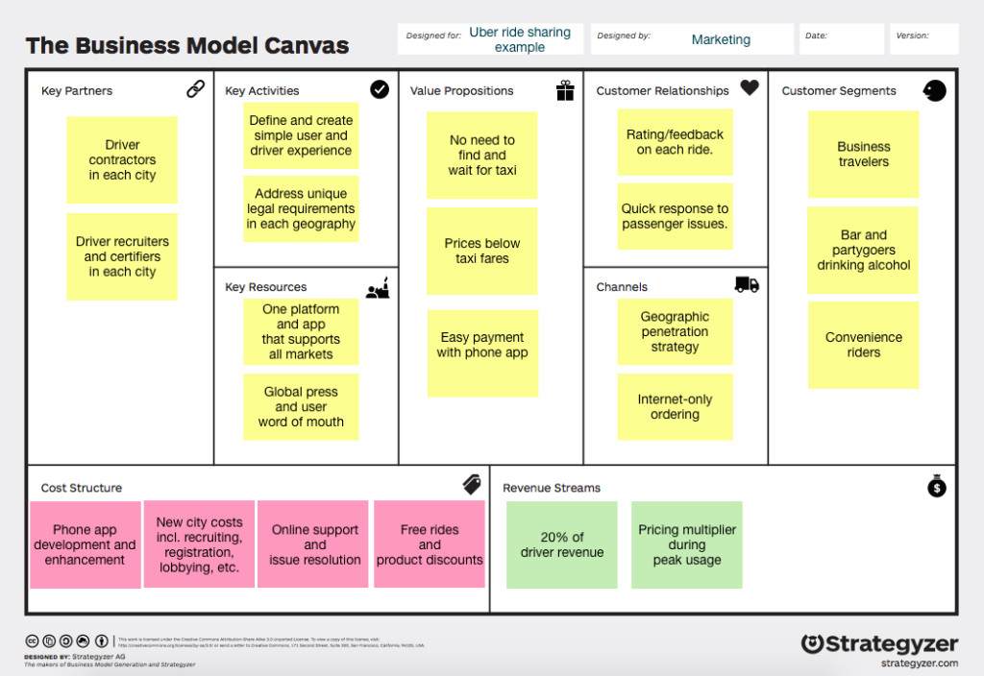
Business Model Canvas: Example
Notes:
Putting It Together: Product Marketing. Provided by: Lumen Learning. License: CC BY: Attribution

Slide 28
Business Case Analysis
Before companies make a significant investment in a product’s development, they need to be sure that it will bring a sufficient return, by asking:
What is the market opportunity for this product?
What are the costs to bring the product to market?
What are the costs through the product life cycle?
Where does the product fit in the product portfolio and how will it impact existing product sales?
How does this product impact the brand?
How does this product impact other corporate objectives such as social responsibility?

Slide 29
Test Marketing Decisions
Duration of testing
Selection of test markets
Sample size determination

Slide 30
Launch Marketing Strategies
Press strategies: Press releases to get earned media to build visibility and credibility
Price discounts
Channel partner incentives to encourage partners to sell or distribute the new product

Slide 31
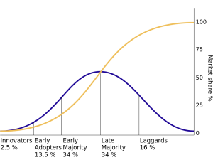
Diffusion of Innovation
Yellow=cumulative market share
Purple=the percentage of the market that will buy a new product in each phase of product adoption
Notes:
Diffusion of Innovation. Provided by: Lumen Learning. License: CC BY: Attribution
CC LICENSED CONTENT, SHARED PREVIOUSLY

Slide 32

Ways to Improve Product Development
User-centered design
Lean Startup Methodology: The company develops and launches its minimum viable product to a limited audience, captures market and user data, and quickly uses that information to make adjustments
Notes:
Fits Like a Glove. Authored by: Paul & Hien Brown. Located at: https://www.flickr.com/photos/p-r-b/2501319678/. License: CC BY-NC: Attribution-NonCommercial

Slide 33
Quick Review
What is a product? How are products important in the marketing mix?
What is the product life cycle and how does it affect marketing?
What is product portfolio management? How does it relate to the organization’s marketing strategy and tactics?
What is the process for creating new products?
What are the challenges associated with creating a successful new product?

