Slide 1
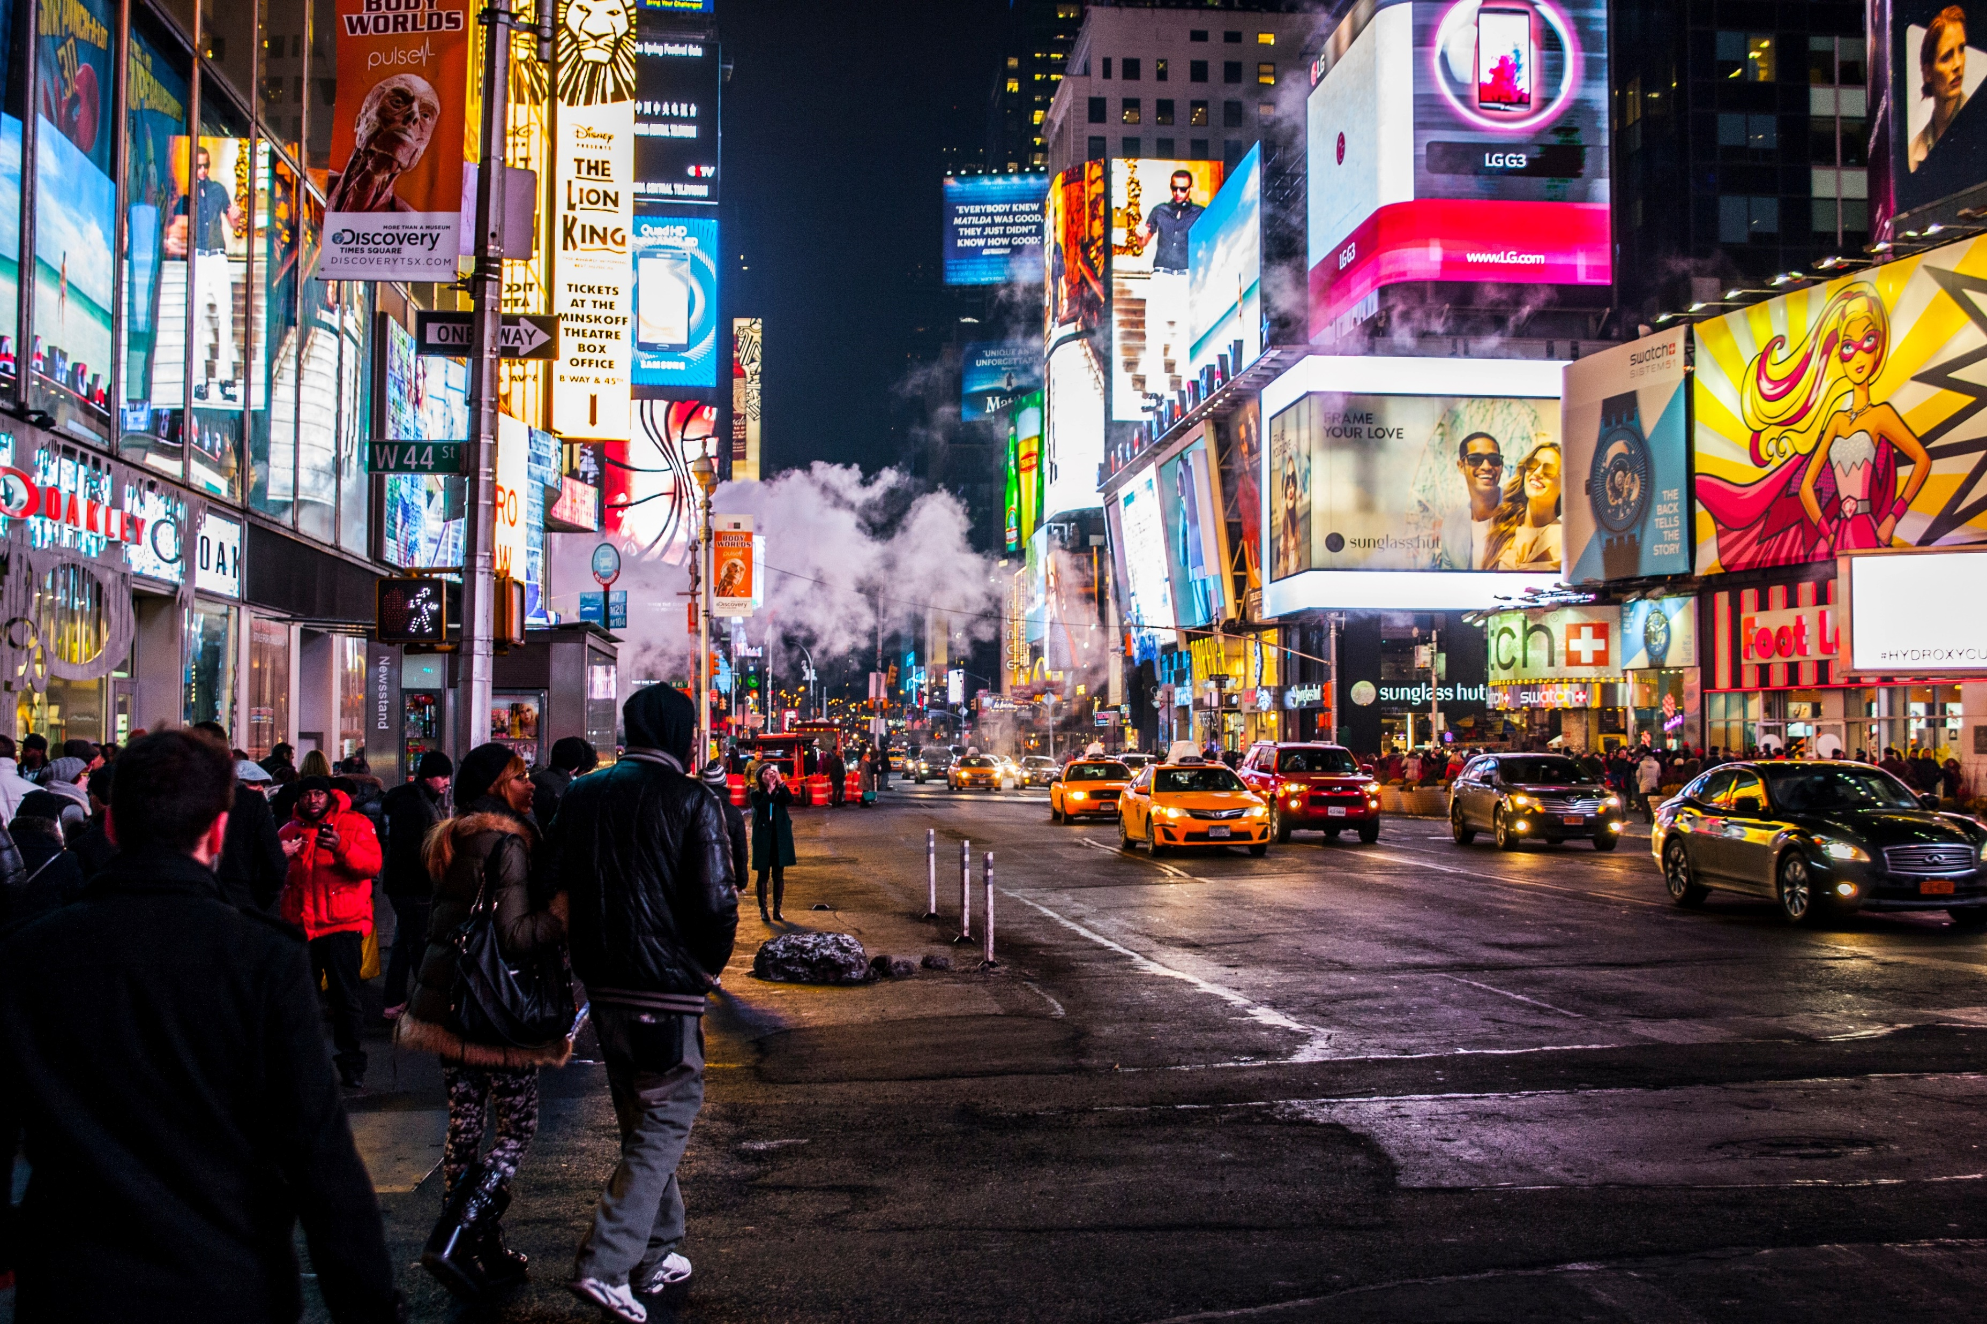
Marketing Globally
Principles of Marketing
Notes:
All text in these slides is taken from https://courses.lumenlearning.com/waymakerintromarketingxmasterfall2016/, where it is published under one or more open licenses.
All images in these slides are attributed in the notes of the slide on which they appear and licensed as indicated.
Cover Image: No title Authored by: Nicolai Berntsen Located at: https://unsplash.com/photos/F3uyey6ours License: Creative Commons Zero

Slide 2

Globalization
Globalization is the growing level of interconnection between people, businesses, and countries around the world.
Notes:
How Did These Hipsters Get Here?. Authored by: Betty Tsang. Located at: https://www.flickr.com/photos/bettytsang/3231176585/. License: CC BY-NC-ND: Attribution-NonCommercial-NoDerivatives

Slide 3
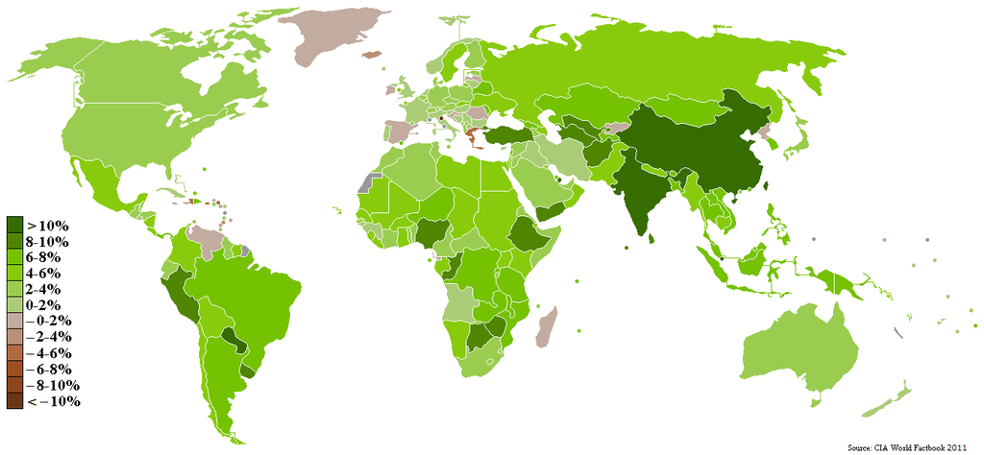
GDP Growth Rate by Country
Notes:
Revision and adaptation. Provided by: Lumen Learning. License: CC BY-SA: Attribution-ShareAlike

Slide 4
Classifying Countries by Growth Rate
Industrialized nations have economies characterized by a healthy climate for private enterprise (business) and a consumer orientation
Less-developed nations have extensive poverty, low per capita income and standards of living, low literacy rates, and very limited technology
Developing nations are those that are making the transition from economies based on agricultural and raw-materials production to industrialized economies. They exhibit rising levels of education, technology, and per capita incomes

Slide 5
Practice Question
Why would marketers want to market to each type of county?
Notes:
Industrialized nations have wealth. Developing nations have rapid growth and less market saturation. Less developed nations can sometimes benefit greatly from being brought into the world economy and they often have large populations.

Slide 6
Benefits of Globalization
Larger volumes of sales and exchange
Larger growth rates in GDP
More empowerment of individuals and political systems through the acquisition of additional resources and capital
Multinational companies can lower production costs

Slide 7
Challenges of Globalization
Ethical Business Practices
‘Organizational Structure
Public Relations
Leadership
Legal and Regulatory Structure

Slide 8
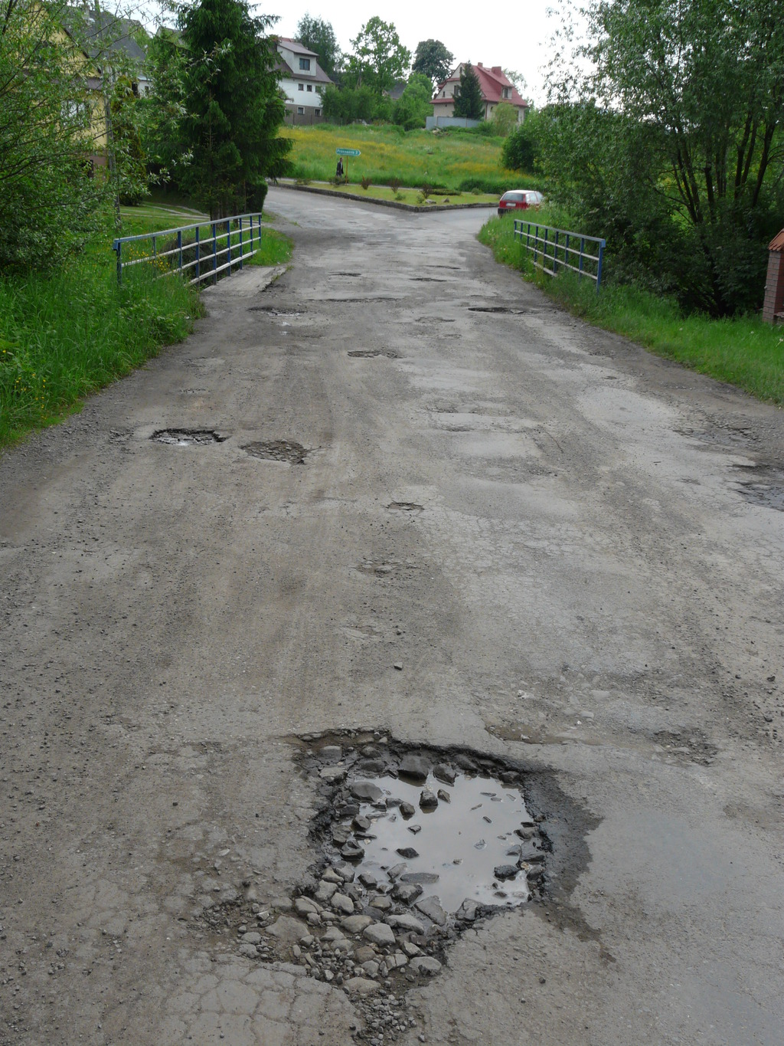
Additional Challenges of LDCs
Infrastructure:
Will roads, bridges, water supply, sewers, electrical grids, and telecommunications support operations?
Can the company rely on a stable government, property rights, judicial system, banking and financial systems, and basic social services?
Technology:
Will the level of technology in the country support business operations?
Notes:
The Global Marketing Environment: Natural Resources and Infrastructure. Provided by: Lumen Learning. Located at: https://courses.candelalearning.com/principlesmktg1x2kscope/chapter/the-global-marketing-environment-natural-resources-and-infrastructure/. License: CC BY-SA: Attribution-ShareAlike

Slide 9
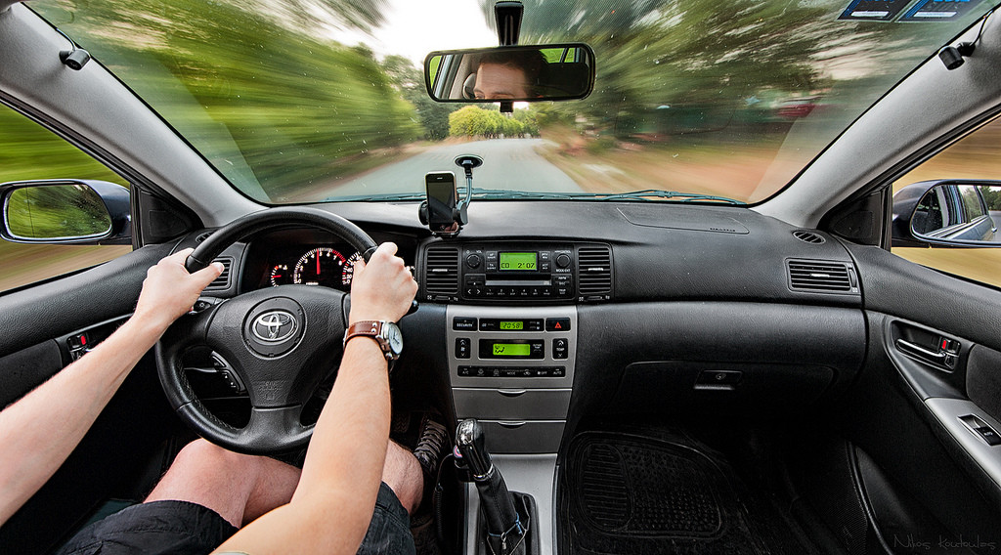
Global Entry Strategies
Export
Licensing and franchising
Joint ventures
Direct investment
US commercial centers
Trade intermediaries
Notes:
Acceleration!. Authored by: Nikos Koutoulas. Located at: https://www.flickr.com/photos/33284937@N04/7507679046/. License: CC BY: Attribution

Slide 10
Standardization
Offer the optimal combination of price, quality, and reliability with products that are identical in design and function throughout the world
Standardization can translate into lower operating costs and economies of scale in product development and marketing
The ability to develop and invest in a unified brand and/or company identity throughout the world
Companies manage a smaller total number of brands

Slide 11
Localization
Localization may involve:
altering existing products to fit the needs of the local target market
creating completely new products to fit the needs of the local target market
Increases the cost and complexity but results in products and marketing strategy that are a better fit for local market needs and ultimately a greater sales success

Slide 12
Additional Elements of
Global Segmentation
Culture: The interplay between language, religion, education, values, identity, history, and traditions
Economic status: Stage of economic development, wealthy vs. poor nations, employment, GDP
Social environment: Conditions and operational stability for business, government, politics, the legal system, health care, education, and other societal support structures

Slide 13
Global Targeting Decisions
Should Consider
Market size and growth potential
Competition
Compatibility

Slide 14

Language in Global Promotions
There are nearly 3,000 languages in the world
Even countries that use the same language have words with different meanings
May be even more significant if a country’s population speaks several languages
Consider literacy rates
Notes:
Global Marketing Mix. Provided by: Lumen Learning. Located at: https://courses.candelalearning.com/principlesmktg1x2kscope/chapter/13-3-global-marketing-mix/. License: CC BY-SA: Attribution-ShareAlike

Slide 15
Global Considerations in Promotions
Colors: Colors may have different meanings in different cultures
Values: An individual’s values arise from his or her education, moral or religious beliefs and are learned through experiences
Business norms
Religious beliefs and holidays

Slide 16
Global Pricing Considerations
Pricing needs to account for risk associated with fluctuations in the relative value of different currencies in the markets where businesses operate
Cultural expectations may dictate what consumers are willing to pay

Slide 17

Global Considerations for Distribution
A country’s transportation and economic infrastructure, customs, marketplace conditions, and the competitive landscape
Product’s positioning in the marketplace
How products will be distributed across the different shopping venues unique to a particular country or market
Notes:
Global Marketing Mix: Placement. Provided by: Lumen Learning. Located at: https://courses.candelalearning.com/principlesmktg1x2kscope/chapter/global-marketing-mix-placement/. License: CC BY-SA: Attribution-ShareAlike

Slide 18
Demographics
Age
Social class
Gender
Religious affiliations
Income brackets
Education
Geography

Slide 19
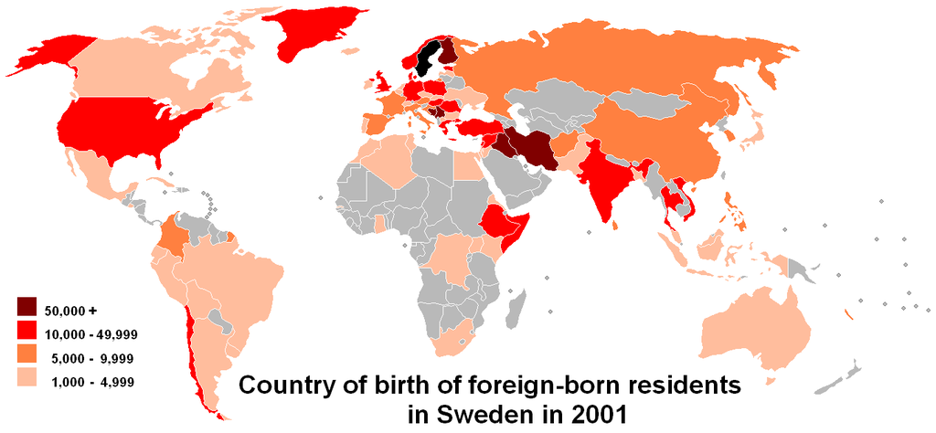
Demographic Analysis
Notes:
The Global Marketing Environment: Demographic Factors. Provided by: Lumen Learning. Located at: https://courses.candelalearning.com/principlesmktg1x2kscope/chapter/the-global-marketing-environment-demographic-factors/. License: CC BY-SA: Attribution-ShareAlike

Slide 20
Cautions about Using Demographics
Demographic profiling is essentially an exercise in making generalizations about groups of people
Marketers must also be careful to avoid interpreting demographic information using the mindset of their own “home” cultures

Slide 21

Cultural Factors in Global Marketing
Language
Customs and taboos
Values
Time and punctuality
Business norms
Religious beliefs and celebrations
Notes:
Fixing my hijab. Authored by: rana ossama. Located at: https://www.flickr.com/photos/ranoush/2113881040/. License: CC BY-SA: Attribution-ShareAlike

Slide 22
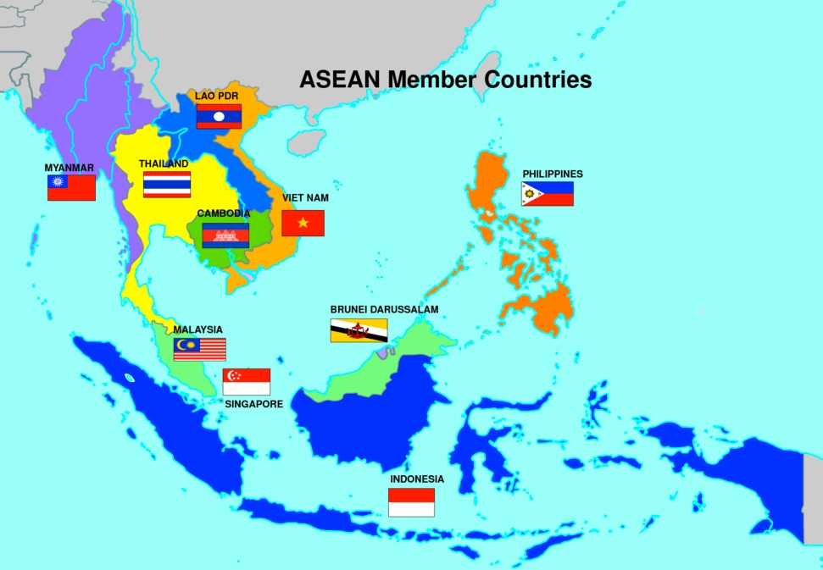
Regional Trade Block
Notes:
Screenshot ASEAN Member Countries. Provided by: Lumen Learning. License: CC BY: Attribution

Slide 23
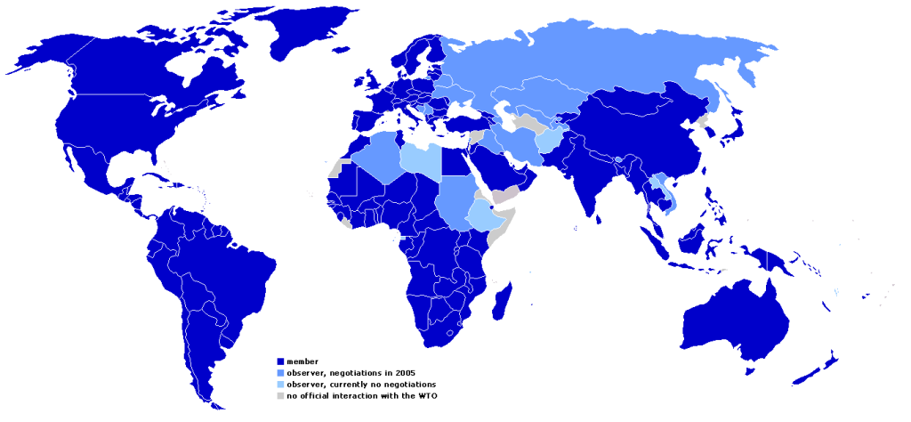
World Trade Organization
Notes:
WTO Map. Provided by: Wikimedia. Located at: https://commons.wikimedia.org/wiki/File:WTO_map_2005en.png#/media/File:WTO_map_2005en.png. License: CC BY-SA: Attribution-ShareAlike

Slide 24

Fair Trade
The fair trade movement promotes the use of labor, environmental, and social standards for the production of commodities, particularly those exported from developing countries to industrialized nations
Notes:
Fair Trade Mark. Located at: https://en.wikipedia.org/wiki/File:Fairtrade.png. License: All Rights Reserved. License Terms: Qualifies as fair use under U.S. copyright law

Slide 25
Practice Question
Why would companies want to combine standardization with localization? What are some examples of how companies balance these strategies?
Notes:
Standardization provides economies of scale and efficiency. But the marketing mix needs to be adapted to different customer segments around the world. L’oreal sells beauty, but how women from different cultures define beauty affects the products and marketing mix in each culture.

Slide 26
Quick Review
What is globalization? What major benefits and challenges does it pose for multinational organizations penetrating global markets?
What are common approaches used by organizations to compete successfully on a global scale?
Why is it important to understand how demographic, cultural and institutional factors shape the global marketing environment?

