Slide 1


Boundless Lecture Slides
Available on the Boundless Teaching Platform
Free to share, print, make copies and changes. Get yours at www.boundless.com

Slide 2
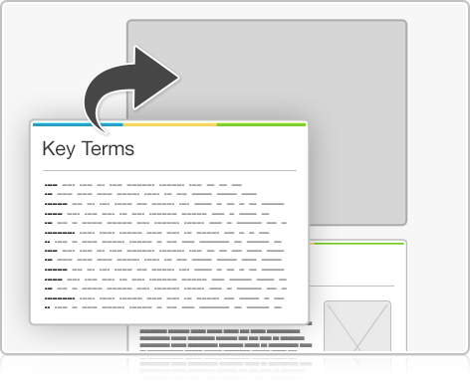
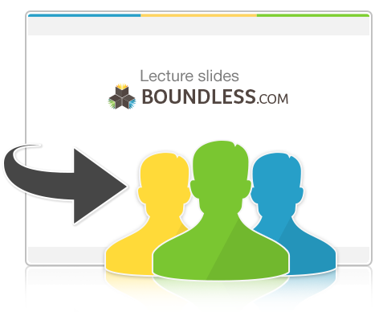

Using Boundless Presentations
Boundless Teaching Platform
Boundless empowers educators to engage their students with affordable, customizable textbooks and intuitive teaching tools. The free Boundless Teaching Platform gives educators the ability to customize textbooks in more than 20 subjects that align to hundreds of popular titles. Get started by using high quality Boundless books, or make switching to our platform easier by building from Boundless content pre-organized to match the assigned textbook. This platform gives educators the tools they need to assign readings and assessments, monitor student activity, and lead their classes with pre-made teaching resources.
Get started now at:
The Appendix
  The appendix is for you to use to add depth and breadth to your lectures. You can simply drag and drop slides from the appendix into the main presentation to make for a richer lecture experience.
http://boundless.com/teaching-platform
Free to edit, share, and copy
  Feel free to edit, share, and make as many copies of the Boundless presentations as you like. We encourage you to take these presentations and make them your own.
If you have any questions or problems please email:
educators@boundless.com
Free to share, print, make copies and changes. Get yours at www.boundless.com

Slide 3

About Boundless
Boundless is an innovative technology company making education more affordable and accessible for students everywhere. The company creates the world’s best open educational content in 20+ subjects that align to more than 1,000 popular college textbooks. Boundless integrates learning technology into all its premium books to help students study more efficiently at a fraction of the cost of traditional textbooks. The company also empowers educators to engage their students more effectively through customizable books and intuitive teaching tools as part of the Boundless Teaching Platform. More than 2 million learners access Boundless free and premium content each month across the company’s wide distribution platforms, including its website, iOS apps, Kindle books, and iBooks. To get started learning or teaching with Boundless, visit boundless.com.
Free to share, print, make copies and changes. Get yours at www.boundless.com

Slide 4

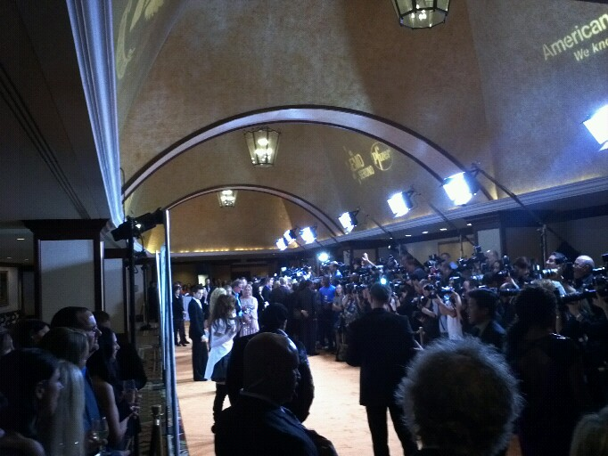
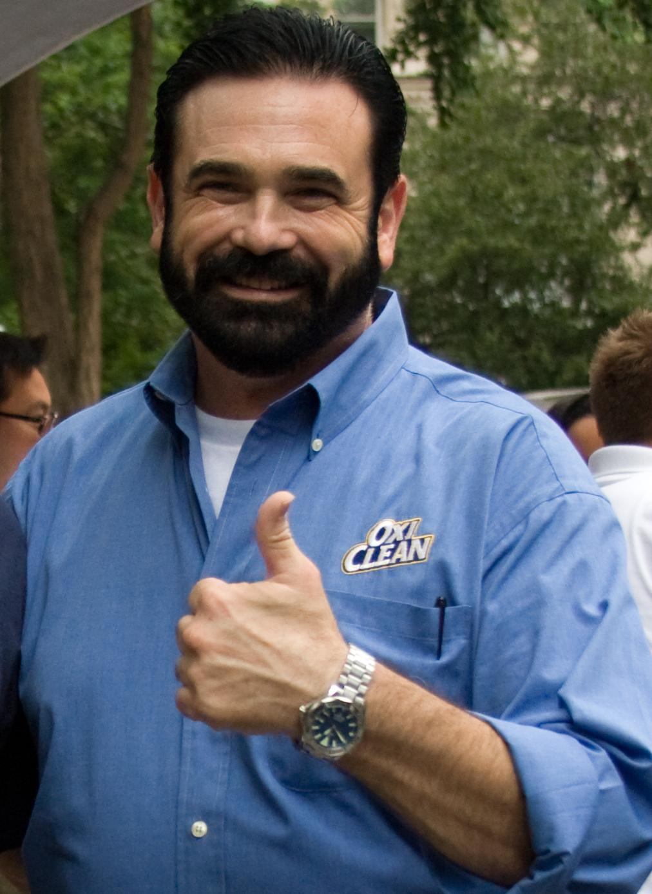
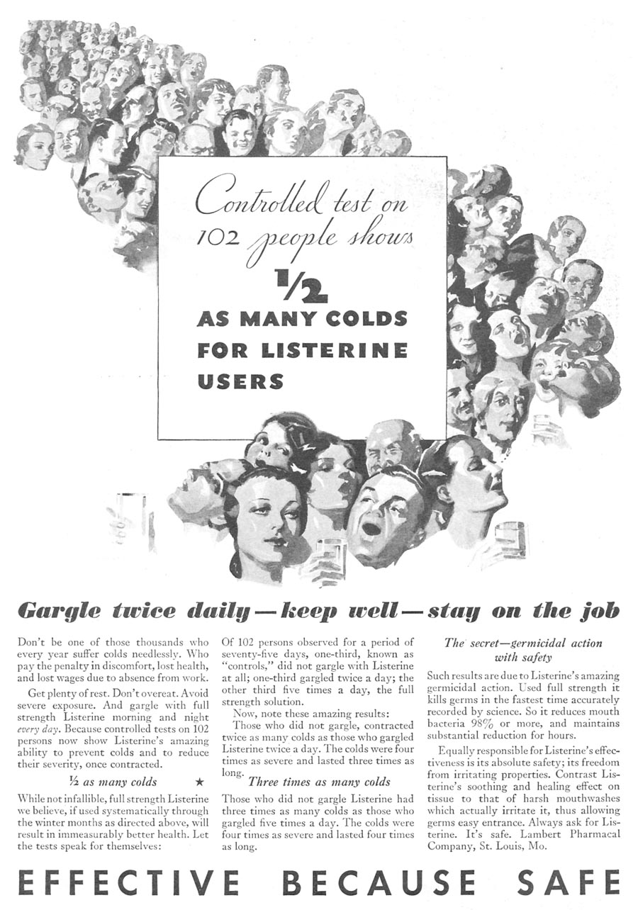
Marketing Communications
Promotion
Public Relations
Personal Selling
Advertising
]
Marketing Communications
Free to share, print, make copies and changes. Get yours at www.boundless.com

Slide 5

Promotion
Marketing Communications > Promotion
Word of Mouth
Digital Marketing
Sampling
Promotion Strategies
The Promotion Mix
A Brief Description
Promotion Objectives
Free to share, print, make copies and changes. Get yours at www.boundless.com
www.boundless.com/business/textbooks/boundless-business-textbook/marketing-communications-17/promotion-104/

Slide 6
Public Relations
Marketing Communications > Public Relations
The Purpose of Public Relations
Types of Public Relations
Free to share, print, make copies and changes. Get yours at www.boundless.com
www.boundless.com/business/textbooks/boundless-business-textbook/marketing-communications-17/public-relations-105/

Slide 7
Personal Selling
Marketing Communications > Personal Selling
Salesperson Personalities
Managing Personal Selling
The Sales Process
Free to share, print, make copies and changes. Get yours at www.boundless.com
www.boundless.com/business/textbooks/boundless-business-textbook/marketing-communications-17/personal-selling-106/

Slide 8
Advertising
Marketing Communications > Advertising
Social and Legal Considerations
Types of Advertising
Trends in Advertising
Agencies
Free to share, print, make copies and changes. Get yours at www.boundless.com
www.boundless.com/business/textbooks/boundless-business-textbook/marketing-communications-17/advertising-107/

Slide 9
Appendix
Free to share, print, make copies and changes. Get yours at www.boundless.com

Slide 10
Key terms
Marketing Communications
Ad agencies A service business dedicated to creating, planning, and handling advertising (and sometimes other forms of promotion) for its clients.
advertising communication whose purpose is to influence potential customers about products and services.
brand A name, symbol, logo, or other item used to distinguish a product, service, or its provider.
closing A sales term which refers to the process of making a sale
cognitive dissonance a conflict or anxiety resulting from inconsistencies between one's beliefs and one's actions or other beliefs
corporate image A corporate image refers to how a business is perceived. It is a generally accepted notion or image of what a company stands for.
customer relationship management Customer relationship management (CRM) is a widely implemented model for managing a company's interactions with customers, clients and sales prospects.
demand The desire to purchase goods or services, coupled with the power to do so, at a particular price.
endorsements In promotion and of advertising, a testimonial or show consists of a person's written or spoken statement extolling the virtue of some product. The term "testimonial" most commonly applies to the sales-pitches attributed to ordinary citizens, whereas the word "endorsement" usually applies to pitches by celebrities. Testimonials can be part of communal marketing.
Federal Trade Commission The Federal Trade Commission (FTC) is an independent agency of the United States government, established in 1914 by the Federal Trade Commission Act. Its principal mission is the promotion of consumer protection and the elimination and prevention of anti-competitive business practices, such as coercive monopoly.
freebie Something which is free; a giveaway or handout.
GDP Gross Domestic Product (Economics). A measure of the economic production of a particular territory in financial capital terms over a specific time period.
Free to share, print, make copies and changes. Get yours at www.boundless.com

Slide 11
Marketing Communications
investment A placement of capital in expectation of deriving income or profit from its use.
marketing The promotion, distribution and selling of a product or service; includes market research and advertising.
Order-takers Salesperson with responsibility for handling transactions that are initiated by the customer
personal selling the use of individual interaction with the potential customer to convince them to purchase a product
Proposal A business proposal is a written offer from a seller to a prospective buyer. Business proposals are often a key step in the complex sales process—i.e., whenever a buyer considers more than price in a purchase.
Public relations Public relations (PR) is the practice of managing the flow of information between an individual or an organization and the public.
Public relations Public relations (PR) is the practice of managing the flow of information between an individual or an organization and the public.
sales promotion when media and non-media marketing communication are employed for a pre-determined, limited time to increase consumer demand, stimulate market demand or improve product availability
sample A part of anything taken or presented for inspection, or shown as evidence of the quality of the whole; a specimen.
stakeholders Stakeholder, an entity that can be affected by the results of that in which they are said to be stakeholders, i.e., that in which they have a stake.
viral marketing the use pre-existing social networks and other technologies to produce increases in brand awareness or to achieve other objectives (such as product sales) through self-replicating processes
World Wide Web Collectively, all of the web pages on the Internet which hyperlink to each other and to other kinds of documents and media.
Free to share, print, make copies and changes. Get yours at www.boundless.com

Slide 12

Marketing Communications
Salesperson
  Personal selling, a main tool in marketing communications, is used by retail associates, telemarketers and outside sales managers.
Free to share, print, make copies and changes. Get yours at www.boundless.com
Wikipedia. "Billy Mays Portrait Cropped." CC BY http://en.wikipedia.org/wiki/File:Billy_Mays_Portrait_Cropped.jpg View on Boundless.com

Slide 13

Marketing Communications
Promotion
  Promotion is one of the market mix elements.
Free to share, print, make copies and changes. Get yours at www.boundless.com
EU Domain. CC BY http://www.juicecreative.eu.com/juice_design_sales_promotion.html View on Boundless.com

Slide 14
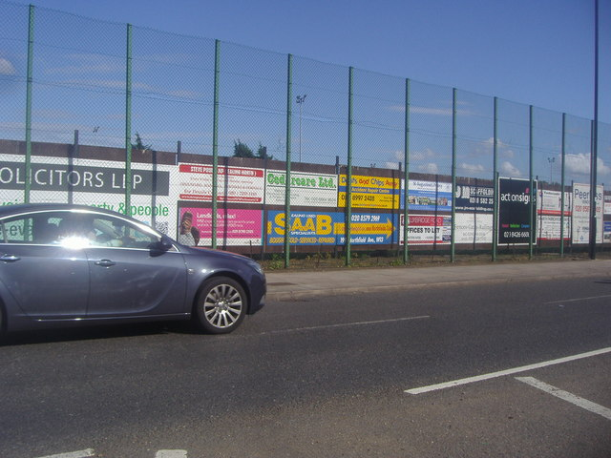
Marketing Communications
Advertising
  Advertisers will have an increasing ability to reach specific audiences due to changes in digital technology.
Free to share, print, make copies and changes. Get yours at www.boundless.com
Geograph. "Advertising outside Perivale sports... (C) David Howard :: Geograph Britain and Ireland." CC BY-SA http://www.geograph.org.uk/photo/3066076 View on Boundless.com

Slide 15
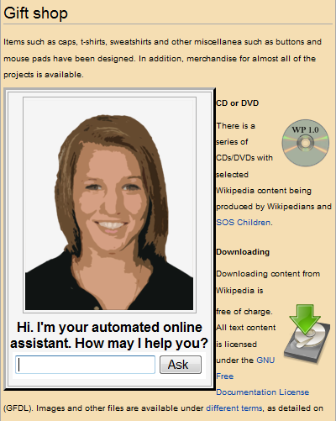
Marketing Communications
Automated online assistant
  An example of E-leadership
Free to share, print, make copies and changes. Get yours at www.boundless.com
Wikipedia. "Automated online assistant." CC BY-SA http://en.wikipedia.org/wiki/File:Automated_online_assistant.png View on Boundless.com

Slide 16
Marketing Communications
Advertising
  Advertisers will have an increasing ability to reach specific audiences due to changes in digital technology.
Free to share, print, make copies and changes. Get yours at www.boundless.com
Geograph. "Advertising outside Perivale sports... (C) David Howard :: Geograph Britain and Ireland." CC BY-SA http://www.geograph.org.uk/photo/3066076 View on Boundless.com

Slide 17
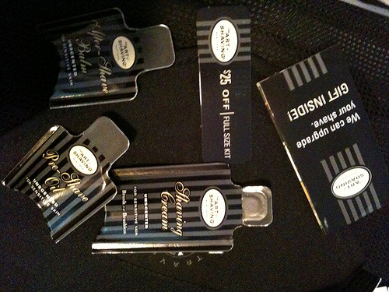
Marketing Communications
Product Samples
  Samples are either free handouts, trial sizes, or coupons for consumer products provided to consumers in the hope that they will eventually purchase the product.
Free to share, print, make copies and changes. Get yours at www.boundless.com
Flickr. "All sizes | The Perfect Shave | Flickr - Photo Sharing!." CC BY http://www.flickr.com/photos/cote/4677421222/sizes/m/in/photostream/ View on Boundless.com

Slide 18

Marketing Communications
Twitter
  Some of the most popular forms of online social media are Facebook, Twitter, and Pinterest.
Free to share, print, make copies and changes. Get yours at www.boundless.com
http://taliamark.com/blog/images/Twitter-Logo.jpg. CC BY-SA http://taliamark.com/blog/images/Twitter-Logo.jpg View on Boundless.com

Slide 19
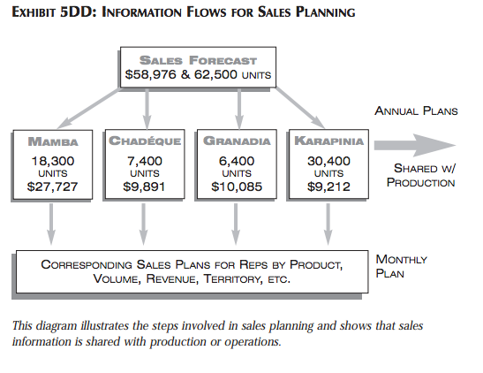
Marketing Communications
Information Flows for Sales Planning
  Sales Planning
Free to share, print, make copies and changes. Get yours at www.boundless.com
Virtue Ventures. CC BY-SA http://www.virtueventures.com/sites/virtueventures.com/files/mdbl-chapter5.pdf View on Boundless.com

Slide 20
Marketing Communications
Listerine advertisement, 1932
  From 1921 until the mid-1970s, Listerine was also marketed as a preventive and remedy for colds and sore throats. In 1976, the Federal Trade Commission ruled that these claims were misleading, and that Listerine had "no efficacy" at either preventing or alleviating the symptoms of sore throats and colds. Warner-Lambert was ordered to stop making the claims, and to include in the next $10.2 million dollars' of Listerine ads specific mention that "contrary to prior advertising, Listerine will not help prevent colds or sore throats or lessen their severity. "
Free to share, print, make copies and changes. Get yours at www.boundless.com
Wikipedia. "Listerine advertisement, 1932." CC BY http://en.wikipedia.org/wiki/File:Listerine_advertisement,_1932.jpg View on Boundless.com

Slide 21

Marketing Communications
A wedding toast
  The toasts that are given at a wedding are an example of special occasion speeches.
Free to share, print, make copies and changes. Get yours at www.boundless.com
Wikimedia. "Helen alan toasting." CC BY http://commons.wikimedia.org/wiki/File:Helen_alan_toasting.jpg View on Boundless.com

Slide 22
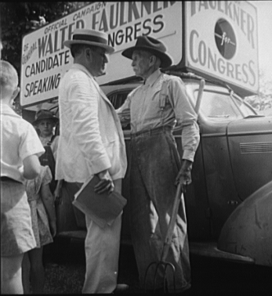
Marketing Communications
Candidate for Congress
  Walter Faulkner, candidate for U.S. Congress, campaigning with a Tennessee farmer. Crossville, Tennessee.
Free to share, print, make copies and changes. Get yours at www.boundless.com
Wikipedia. "CandidateForCongress1938." Public domain http://en.wikipedia.org/wiki/File:CandidateForCongress1938.jpg View on Boundless.com

Slide 23
Marketing Communications
Publicity
  Paparazzi at work.
Free to share, print, make copies and changes. Get yours at www.boundless.com
Wikipedia. "Publicity." CC BY http://en.wikipedia.org/wiki/File:Publicity.jpg View on Boundless.com

Slide 24
Marketing Communications
Salesperson
  Personal selling, a main tool in marketing communications, is used by retail associates, telemarketers and outside sales managers.
Free to share, print, make copies and changes. Get yours at www.boundless.com
Wikipedia. "Billy Mays Portrait Cropped." CC BY http://en.wikipedia.org/wiki/File:Billy_Mays_Portrait_Cropped.jpg View on Boundless.com

Slide 25
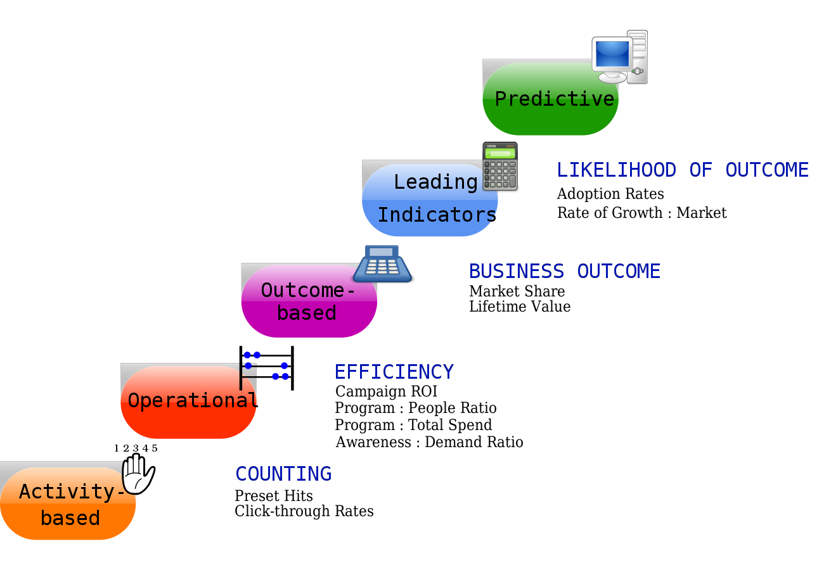
Marketing Communications
Marketing Metrics Continuum
  The Marketing Metrics Continuum provides a framework for how to categorize metrics from the tactical to strategic. By navigating this metrics continuum, from Activity-Based to Predictive, marketers can move towards more effective marketing measurement and align measurement and metrics with business outcomes.
Free to share, print, make copies and changes. Get yours at www.boundless.com
Wikipedia. "Marketing Metrics Continuum." CC BY-SA http://en.wikipedia.org/wiki/File:Marketing_Metrics_Continuum.svg View on Boundless.com

Slide 26
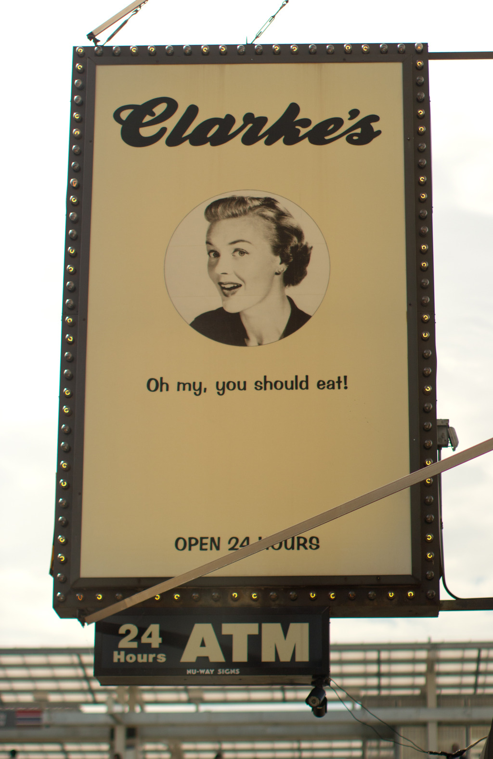
Marketing Communications
Billboard
  Clarkes on Belmont billboard
Free to share, print, make copies and changes. Get yours at www.boundless.com
Wikipedia. "Clarkes on Belmont." CC BY http://en.wikipedia.org/wiki/File:Clarkes_on_Belmont.jpg View on Boundless.com

Slide 27
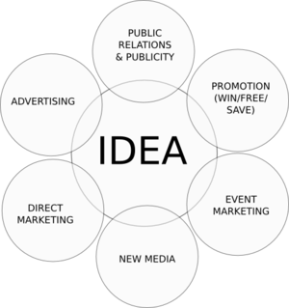
Marketing Communications
The Promotion Mix
  Overview of the elements of the promotion mix.
Free to share, print, make copies and changes. Get yours at www.boundless.com
Cloud Front. GNU FDL https://d3r4ecz8hnfnqf.cloudfront.net/50995c9ae4b041e3d225f90b/full/marcom-20matrix.png View on Boundless.com

Slide 28
Attribution
Marketing Communications
Wiktionary. "stakeholders." CC BY-SA 3.0 http://en.wiktionary.org/wiki/stakeholders
Wikipedia. "Media relations." CC BY-SA 3.0 http://en.wikipedia.org/wiki/Media_relations
Wikipedia. "Employee relationship management." CC BY-SA 3.0 http://en.wikipedia.org/wiki/Employee_relationship_management
Wikipedia. "Public relations." CC BY-SA 3.0 http://en.wikipedia.org/wiki/Public_relations
Wikipedia. "Customer relationship management." CC BY-SA 3.0 http://en.wikipedia.org/wiki/Customer_relationship_management
Wiktionary. "advertising." CC BY-SA 3.0 http://en.wiktionary.org/wiki/advertising
Wiktionary. "GDP." CC BY-SA 3.0 http://en.wiktionary.org/wiki/GDP
Wikipedia. "Advertising." CC BY-SA 3.0 http://en.wikipedia.org/wiki/Advertising
Wikipedia. "Advertising." CC BY-SA 3.0 http://en.wikipedia.org/wiki/Advertising
Wikipedia. "Sales promotion." CC BY-SA 3.0 http://en.wikipedia.org/wiki/Sales_promotion
Wikipedia. "Proposal." CC BY-SA 3.0 http://en.wikipedia.org/wiki/Proposal
Wikipedia. "Sales process." CC BY-SA 3.0 http://en.wikipedia.org/wiki/Sales_process
Wikipedia. "corporate image." CC BY-SA 3.0 http://en.wikipedia.org/wiki/corporate%20image
Wiktionary. "brand." CC BY-SA 3.0 http://en.wiktionary.org/wiki/brand
Wikipedia. "Marketing strategy." CC BY-SA 3.0 http://en.wikipedia.org/wiki/Marketing_strategy
Wikipedia. "Promotion (marketing)." CC BY-SA 3.0 http://en.wikipedia.org/wiki/Promotion_(marketing)
Wiktionary. "demand." CC BY-SA 3.0 http://en.wiktionary.org/wiki/demand
Free to share, print, make copies and changes. Get yours at www.boundless.com

Slide 29
Marketing Communications
Wikipedia. "Product promotion." CC BY-SA 3.0 http://en.wikipedia.org/wiki/Product_promotion
Wikipedia. "Promotion (marketing)." CC BY-SA 3.0 http://en.wikipedia.org/wiki/Promotion_(marketing)
Boundless Learning. "Boundless." CC BY-SA 3.0 http://www.boundless.com//marketing/definition/personal-selling
Boundless Learning. "Boundless." CC BY-SA 3.0 http://www.boundless.com//business/definition/closing
Wikipedia. "Selling technique." CC BY-SA 3.0 http://en.wikipedia.org/wiki/Selling_technique
Wikipedia. "Closing (sales)." CC BY-SA 3.0 http://en.wikipedia.org/wiki/Closing_(sales)
Wikipedia. "Sales presentation." CC BY-SA 3.0 http://en.wikipedia.org/wiki/Sales_presentation
Wiktionary. "freebie." CC BY-SA 3.0 http://en.wiktionary.org/wiki/freebie
Wiktionary. "sample." CC BY-SA 3.0 http://en.wiktionary.org/wiki/sample
Wikispaces. "sanfordferreblog264 - How to Improve New Product Sampling Projects." CC BY-SA http://sanfordferreblog264.wikispaces.com/How+to+Improve+New+Product+Sampling+Projects
Wikispaces. "CrossmediaNY - Product Placement, Sampling, and Word-of-Mouth Collectively Influence Consumer Purchases." CC BY-SA http://crossmediany.wikispaces.com/Product+Placement,+Sampling,+and+Word-of-Mouth+Collectively+Influence+Consumer+Purchases
Wikipedia. "Product sample." CC BY-SA 3.0 http://en.wikipedia.org/wiki/Product_sample
Wikipedia. "endorsements." CC BY-SA 3.0 http://en.wikipedia.org/wiki/endorsements
Wikipedia. "Promotion (marketing)." CC BY-SA 3.0 http://en.wikipedia.org/wiki/Promotion_(marketing)
Wikipedia. "Product promotion." CC BY-SA 3.0 http://en.wikipedia.org/wiki/Product_promotion
Wikipedia. "Public relations." CC BY-SA 3.0 http://en.wikipedia.org/wiki/Public%20relations
Wikipedia. "Promotion mix." CC BY-SA 3.0 http://en.wikipedia.org/wiki/Promotion_mix
Boundless Learning. "Boundless." CC BY-SA 3.0 http://www.boundless.com//business/definition/order-takers
Wikispaces. "issuesinimc - Personal Selling." CC BY-SA http://issuesinimc.wikispaces.com/Personal+Selling
Free to share, print, make copies and changes. Get yours at www.boundless.com

Slide 30
Marketing Communications
Wikispaces. "issuesinimc - three types of personal Selling." CC BY-SA http://issuesinimc.wikispaces.com/three+types+of+personal+Selling
Wikipedia. "Viral marketing." CC BY-SA 3.0 http://en.wikipedia.org/wiki/Viral_marketing
Wiktionary. "marketing." CC BY-SA 3.0 http://en.wiktionary.org/wiki/marketing
Wikipedia. "Word of mouth." CC BY-SA 3.0 http://en.wikipedia.org/wiki/Word_of_mouth
Wikipedia. "customer relationship management." CC BY-SA 3.0 http://en.wikipedia.org/wiki/customer%20relationship%20management
Wikipedia. "E-marketing." CC BY-SA 3.0 http://en.wikipedia.org/wiki/E-marketing
Wikipedia. "Digital marketing." CC BY-SA 3.0 http://en.wikipedia.org/wiki/Digital_marketing
Wiktionary. "cognitive dissonance." CC BY-SA 3.0 http://en.wiktionary.org/wiki/cognitive_dissonance
Wikipedia. "Public relations." CC BY-SA 3.0 http://en.wikipedia.org/wiki/Public%20relations
Wikipedia. "Public relations." CC BY-SA 3.0 http://en.wikipedia.org/wiki/Public_relations
Wikipedia. "Ad agencies." CC BY-SA 3.0 http://en.wikipedia.org/wiki/Ad%20agencies
Wiktionary. "investment." CC BY-SA 3.0 http://en.wiktionary.org/wiki/investment
Wikipedia. "Advertising agency." CC BY-SA 3.0 http://en.wikipedia.org/wiki/Advertising_agency
Wiktionary. "World Wide Web." CC BY-SA 3.0 http://en.wiktionary.org/wiki/World_Wide_Web
Wikipedia. "TYPES OF ADVERTISING." CC BY-SA 3.0 http://en.wikipedia.org/wiki/TYPES_OF_ADVERTISING%23Types_of_advertising
Wikipedia. "Federal Trade Commission." CC BY-SA 3.0 http://en.wikipedia.org/wiki/Federal%20Trade%20Commission
Wikipedia. "False advertising." CC BY-SA 3.0 http://en.wikipedia.org/wiki/False_advertising
Free to share, print, make copies and changes. Get yours at www.boundless.com

