Slide 1


Boundless Lecture Slides
Available on the Boundless Teaching Platform
Free to share, print, make copies and changes. Get yours at www.boundless.com

Slide 2
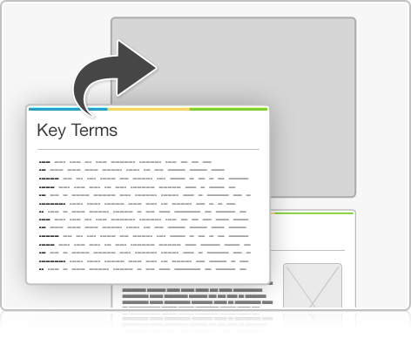
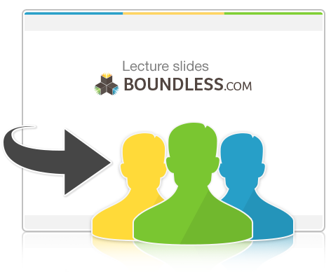

Using Boundless Presentations
Boundless Teaching Platform
Boundless empowers educators to engage their students with affordable, customizable textbooks and intuitive teaching tools. The free Boundless Teaching Platform gives educators the ability to customize textbooks in more than 20 subjects that align to hundreds of popular titles. Get started by using high quality Boundless books, or make switching to our platform easier by building from Boundless content pre-organized to match the assigned textbook. This platform gives educators the tools they need to assign readings and assessments, monitor student activity, and lead their classes with pre-made teaching resources.
Get started now at:
The Appendix
  The appendix is for you to use to add depth and breadth to your lectures. You can simply drag and drop slides from the appendix into the main presentation to make for a richer lecture experience.
http://boundless.com/teaching-platform
Free to edit, share, and copy
  Feel free to edit, share, and make as many copies of the Boundless presentations as you like. We encourage you to take these presentations and make them your own.
If you have any questions or problems please email:
educators@boundless.com
Free to share, print, make copies and changes. Get yours at www.boundless.com

Slide 3

About Boundless
Boundless is an innovative technology company making education more affordable and accessible for students everywhere. The company creates the world’s best open educational content in 20+ subjects that align to more than 1,000 popular college textbooks. Boundless integrates learning technology into all its premium books to help students study more efficiently at a fraction of the cost of traditional textbooks. The company also empowers educators to engage their students more effectively through customizable books and intuitive teaching tools as part of the Boundless Teaching Platform. More than 2 million learners access Boundless free and premium content each month across the company’s wide distribution platforms, including its website, iOS apps, Kindle books, and iBooks. To get started learning or teaching with Boundless, visit boundless.com.
Free to share, print, make copies and changes. Get yours at www.boundless.com

Slide 4
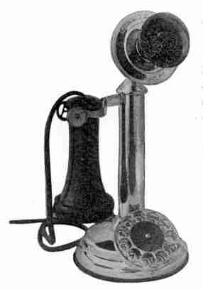

Overview of English Grammar: Punctuation and Mechanics
Commas
Colons and Semicolons
Apostrophes and Quotation Marks
Hyphens and Dashes
]
Other Punctuation
Overview of English Grammar: Punctuation and Me...
Free to share, print, make copies and changes. Get yours at www.boundless.com

Slide 5
Overview of English Grammar: Punctuation and Mechanics
(continued)
General Mechanics
]
Overview of English Grammar: Punctuation and Me...
Free to share, print, make copies and changes. Get yours at www.boundless.com

Slide 6

Commas
Overview of English Grammar: Punctuation and Me... > Commas
Introduction to Commas
Common Comma Mistakes
Free to share, print, make copies and changes. Get yours at www.boundless.com
www.boundless.com/writing/textbooks/boundless-writing-textbook/overview-of-english-grammar-punctuation-and-mechanics-251/commas-31/

Slide 7
Colons and Semicolons
Overview of English Grammar: Punctuation and Me... > Colons and Semicolons
Colons
Semicolons
Free to share, print, make copies and changes. Get yours at www.boundless.com
www.boundless.com/writing/textbooks/boundless-writing-textbook/overview-of-english-grammar-punctuation-and-mechanics-251/colons-and-semicolons-280/

Slide 8
Apostrophes and Quotation Marks
Overview of English Grammar: Punctuation and Me... > Apostrophes and Quotation Marks
Apostrophes
Quotation Marks
Free to share, print, make copies and changes. Get yours at www.boundless.com
www.boundless.com/writing/textbooks/boundless-writing-textbook/overview-of-english-grammar-punctuation-and-mechanics-251/apostrophes-and-quotation-marks-281/

Slide 9
Hyphens and Dashes
Overview of English Grammar: Punctuation and Me... > Hyphens and Dashes
Hyphens
Em Dashes and En Dashes
Free to share, print, make copies and changes. Get yours at www.boundless.com
www.boundless.com/writing/textbooks/boundless-writing-textbook/overview-of-english-grammar-punctuation-and-mechanics-251/hyphens-and-dashes-282/

Slide 10
Other Punctuation
Overview of English Grammar: Punctuation and Me... > Other Punctuation
Parentheses
Ending Punctuation
Free to share, print, make copies and changes. Get yours at www.boundless.com
www.boundless.com/writing/textbooks/boundless-writing-textbook/overview-of-english-grammar-punctuation-and-mechanics-251/other-punctuation-283/

Slide 11
General Mechanics
Overview of English Grammar: Punctuation and Me... > General Mechanics
Common Spelling Errors
Capital Letters
Abbreviations and Acronyms
Numbers
Italics
Free to share, print, make copies and changes. Get yours at www.boundless.com
www.boundless.com/writing/textbooks/boundless-writing-textbook/overview-of-english-grammar-punctuation-and-mechanics-251/general-mechanics-32/

Slide 12
Appendix
Free to share, print, make copies and changes. Get yours at www.boundless.com

Slide 13
Key terms
Overview of English Grammar: Punctuation and Me...
abbreviation A shortened form of a word or phrase, used to represent the whole.
acronym Abbreviations formed from the initial components in a phrase or a word. These components may be individual letters (as in CEO) or parts of words (as in Benelux and Ameslan).
adjective A word that modifies a noun or describes a noun's referent.
adverb A word that modifies a verb, adjective, another adverb, or various other types of words, phrases, or clauses.
apostrophe A punctuation mark, and sometimes a diacritic mark, in languages that use the Latin alphabet or certain other alphabets.
appositive A word or phrase that is placed with another as an explanatory equivalent.
capitalization Writing a word with its first letter as a capital letter (upper-case letter) and the remaining letters in lower case.
comma Punctuation mark, usually indicating a pause between parts of a sentence or between elements in a list.
conjunctive adverbs These words are preceded by a semicolon and followed by a comma. There is a long list, but here are some examples: however, meanwhile, in addition, and therefore.
coordinating conjunction Simple words that connect two independent clauses together or connect an independent clause to a dependent clause (sentence fragment). They are remembered by the acronym FANBOYS.
dependent clause This group of words also contains a subject and/or verb, but do not create a complete, stand-alone sentence.
enumeration A detailed account in which each thing is noted.
Free to share, print, make copies and changes. Get yours at www.boundless.com

Slide 14
Overview of English Grammar: Punctuation and Me...
exclamation mark A punctuation mark usually used after an interjection or exclamation to indicate strong feelings or high volume (shouting).
homograph A word that is spelled the same as another but has a different meaning and usually sounds different.
homophone A word which is pronounced the same as another word but differs in spelling or meaning or origin, for example: carat, caret, carrot, and karat.
hyphen The symbol "-", typically used to join two or more words to form a new word.
independent clause A group of words that contains a subject (noun) and a verb and can stand as a complete sentence.
infinitive The uninflected form of a verb. In English, this is usually formed with the verb stem preceded by "to." For Example: "to sit."
italics A typeface style that is used to add emphasis to words.
nonrestrictive Describes a modifier that can be dropped from a sentence without changing the meaning.
numeral A symbol that is not a word and represents a number, such as the Arabic numerals 1, 2, 3 and the Roman numerals I, V, X, L.
parentheses Punctuation marks used in matched pairs to set apart or interject additional text into a sentence.
participle A form of a verb that may function as an adjective or noun. English has two types of participles: the present participle and the past participle.
participle A form of a verb that may function as an adjective or noun. English has two types of participles: the present participle and the past participle.
Free to share, print, make copies and changes. Get yours at www.boundless.com

Slide 15
Overview of English Grammar: Punctuation and Me...
period The punctuation mark that indicates the end of a sentence.
phonetics The study of the physical sounds of human speech (phones) and the processes of their physiological production, auditory reception, and neurophysiological perception, as well as their representation by written symbols.
preposition Any of a closed class of non-inflecting words typically employed to connect a noun or a pronoun, in an adjectival or adverbial sense, with some other word: a particle used with a noun or pronoun (in English always in the objective case) to make a phrase limiting some other word.
preposition Any of a closed class of non-inflecting words typically employed to connect a noun or a pronoun, in an adjectival or adverbial sense, with some other word: a particle used with a noun or pronoun (in English always in the objective case) to make a phrase limiting some other word.
proper noun A word denoting a particular person, place, organization, ship, animal, event, idea, or other individual entity.
question mark Punctuation at the end of a sentence that asks a direct question.
quotation mark A punctuation mark used to denote speech or when words are copied from another author or speaker; can be double quotations (") or single quotations (').
typo A spelling error.
Free to share, print, make copies and changes. Get yours at www.boundless.com

Slide 16
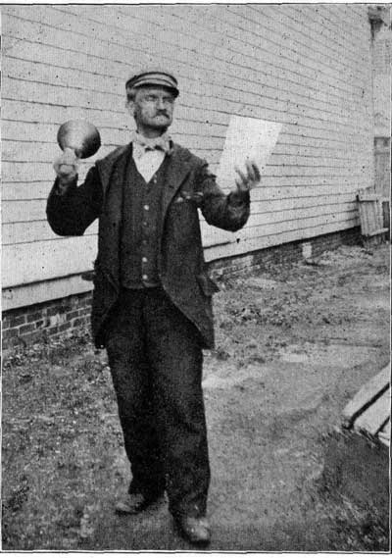
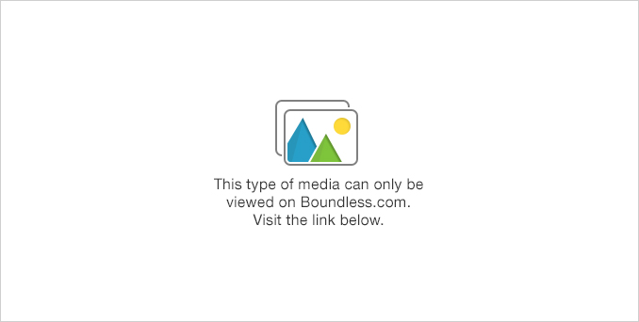
Overview of English Grammar: Punctuation and Me...
Free to share, print, make copies and changes. Get yours at www.boundless.com
Project Gutenberg. Public domain http://www.gutenberg.org/files/14979/14979-h/14979-h.htm View on Boundless.com

Slide 17
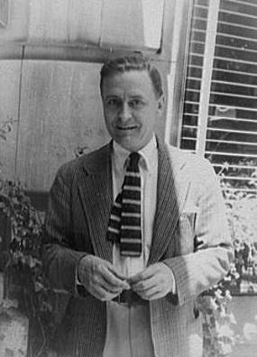
Overview of English Grammar: Punctuation and Me...
Cut out all those exclamation points.
  The famous author F. Scott Fitzgerald was not a fan of exclamation points; in his words: "Cut out all those exclamation points. An exclamation point is like laughing at your own jokes."
Free to share, print, make copies and changes. Get yours at www.boundless.com
Wikimedia. "F Scott Fitzgerald." Public domain http://commons.wikimedia.org/wiki/File:F_Scott_Fitzgerald.jpg View on Boundless.com

Slide 18
Overview of English Grammar: Punctuation and Me...
Calling in sick for work, Beth hoped her boss would not suspect anything
  The title contains a verb in its introductory phrase, which warrants a comma before the final clause. The comma serves a variety of grammatical functions, including to indicate pauses or set off introductory phrases, as in the title example.
Free to share, print, make copies and changes. Get yours at www.boundless.com
Project Gutenberg. Public domain http://www.gutenberg.org/files/33437/33437-h/33437-h.htm View on Boundless.com

Slide 19
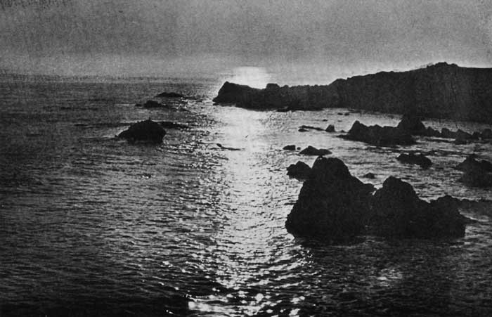
Overview of English Grammar: Punctuation and Me...
Free to share, print, make copies and changes. Get yours at www.boundless.com
Project Gutenberg. Public domain http://www.gutenberg.org/files/12415/12415-h/12415-h.htm View on Boundless.com

Slide 20
Overview of English Grammar: Punctuation and Me...
"How to use a semicolon," by The Oatmeal
  For a hilarious (and well-written) cartoon guide to using semicolons, check out The Oatmeal!
Free to share, print, make copies and changes. Get yours at www.boundless.com
View on Boundless.com

Slide 21
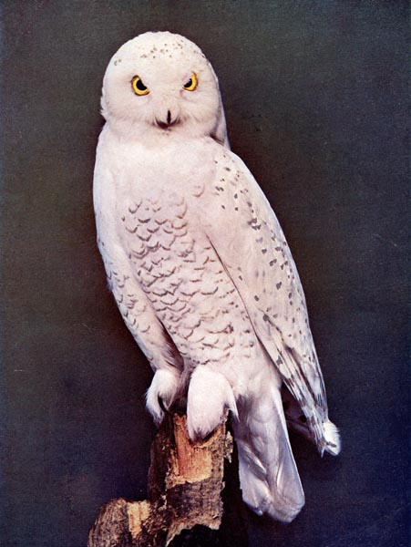
Overview of English Grammar: Punctuation and Me...
Bubo scandiacus
  The species name is italicized because species names are in Latin.
Free to share, print, make copies and changes. Get yours at www.boundless.com
Project Gutenberg. Public domain http://www.gutenberg.org/files/30666/30666-h/30666-h.htm%23Page_210 View on Boundless.com

Slide 22
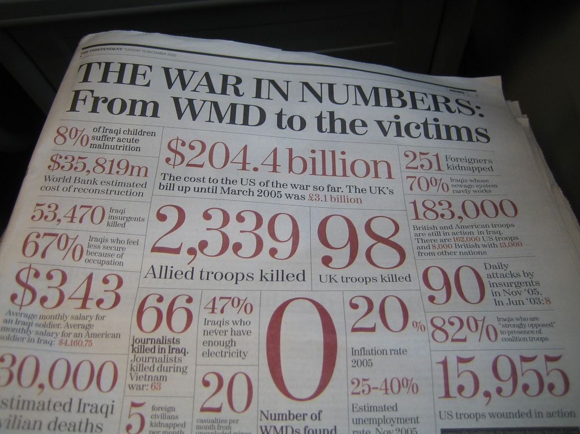
Overview of English Grammar: Punctuation and Me...
Numbers in the news
  When numbers are used in text, many basic formatting rules apply.
Free to share, print, make copies and changes. Get yours at www.boundless.com
Flickr. "Crunching Numbers | Flickr - Photo Sharing!." CC BY http://www.flickr.com/photos/psd/74176687/ View on Boundless.com

Slide 23
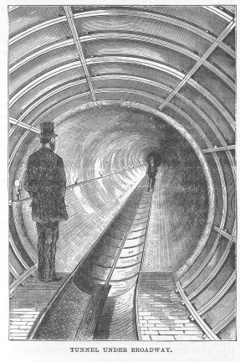
Overview of English Grammar: Punctuation and Me...
When he saw his brother—his long-lost brother who disappeared six years prior—he broke down in tears.
  The title contains an example of em dash usage, which, in this case, shows a break in the sentence.
Free to share, print, make copies and changes. Get yours at www.boundless.com
Project Gutenberg. Public domain http://www.gutenberg.org/files/19642/19642-h/19642-h.htm View on Boundless.com

Slide 24
Attribution
Overview of English Grammar: Punctuation and Me...
Wiktionary. "numeral." CC BY-SA 3.0 http://en.wiktionary.org/wiki/numeral
grammartips Wikispace. "Numbers." CC BY-SA 3.0 http://grammartips.wikispaces.com/Numbers
Wikipedia. "Homophone." CC BY-SA 3.0 http://en.wikipedia.org/wiki/Homophone
Wikipedia. "Commonly misspelled words." CC BY-SA 3.0 http://en.wikipedia.org/wiki/Commonly_misspelled_words
Wiktionary. "typo." CC BY-SA 3.0 http://en.wiktionary.org/wiki/typo
Wiktionary. "phonetics." CC BY-SA 3.0 http://en.wiktionary.org/wiki/phonetics
Wiktionary. "homophone." CC BY-SA 3.0 http://en.wiktionary.org/wiki/homophone
Blogspot. "The Onion Spirit: Typography: Italics - When You Should Use Them." CC BY-SA http://onionspirit.blogspot.com/2009/06/typography-italics-when-you-should-use.html
Wikipedia. "Italic type." CC BY-SA 3.0 http://en.wikipedia.org/wiki/Italic_type%23When_to_use
Wiktionary. "emphasis." CC BY-SA 3.0 http://en.wiktionary.org/wiki/emphasis
Wiktionary. "italics." CC BY-SA 3.0 http://en.wiktionary.org/wiki/italics
Wikipedia. "Abbreviation." CC BY-SA 3.0 http://en.wikipedia.org/wiki/Abbreviation
Wikipedia. "acronym." CC BY-SA 3.0 http://en.wikipedia.org/wiki/acronym
Wikipedia. "Acronym and initialism." CC BY-SA 3.0 http://en.wikipedia.org/wiki/Acronym_and_initialism
Wiktionary. "abbreviation." CC BY-SA 3.0 http://en.wiktionary.org/wiki/abbreviation
Wiktionary. "proper noun." CC BY-SA 3.0 http://en.wiktionary.org/wiki/proper_noun
Wikipedia. "Punctuation." CC BY-SA 3.0 http://en.wikipedia.org/wiki/Punctuation
Free to share, print, make copies and changes. Get yours at www.boundless.com

Slide 25
Overview of English Grammar: Punctuation and Me...
Wikipedia. "Terminal punctuation." CC BY-SA 3.0 http://en.wikipedia.org/wiki/Terminal_punctuation
Wikipedia. "Question mark." CC BY-SA 3.0 http://en.wikipedia.org/wiki/Question_mark
Wikpedia. "Full Stop." CC BY-SA 4.0 https://en.wikipedia.org/wiki/Full_stop
Wikipedia. "Exclamation mark." CC BY-SA 3.0 http://en.wikipedia.org/wiki/Exclamation_mark
Wiktionary. "interrogative." CC BY-SA 3.0 http://en.wiktionary.org/wiki/interrogative
Wikipedia. "Period (punctuation)." CC BY-SA 3.0 http://en.wikipedia.org/wiki/Period_(punctuation)
Wikipedia. "Period (punctuation)." CC BY-SA 3.0 http://en.wikipedia.org/wiki/Period_(punctuation)
Wikipedia. "Quotation mark." CC BY-SA 3.0 http://en.wikipedia.org/wiki/Quotation%20mark
Wikipedia. "Quotation marks." CC BY-SA 3.0 http://en.wikipedia.org/wiki/Quotation_marks
Wikibooks. "English in Use/Punctuation." CC BY-SA 3.0 http://en.wikibooks.org/wiki/English_in_Use/Punctuation%23Quotation_points
Wikibooks. "Rhetoric and Composition/Quotation Marks." CC BY-SA 3.0 http://en.wikibooks.org/wiki/Rhetoric_and_Composition/Quotation_Marks
Wikipedia. "Wikipedia:Manual of Style." CC BY-SA 3.0 http://en.wikipedia.org/wiki/Wikipedia:Manual_of_Style%23Hyphens
Wikipedia. "Hyphen." CC BY-SA 3.0 http://en.wikipedia.org/wiki/Hyphen
Wiktionary. "homograph." CC BY-SA 3.0 http://en.wiktionary.org/wiki/homograph
Wiktionary. "hyphen." CC BY-SA 3.0 http://en.wiktionary.org/wiki/hyphen
Wiktionary. "compound." CC BY-SA 3.0 http://en.wiktionary.org/wiki/compound
Wikipedia. "Semicolon." CC BY-SA 3.0 http://en.wikipedia.org/wiki/Semicolon
Wiktionary. "Independent Clauses." CC BY-SA 3.0 https://en.wiktionary.org/wiki/independent_clause
Wiktionary. "Coordinating Conjunctions." CC BY-SA 3.0 https://en.wiktionary.org/wiki/coordinating_conjunction
Free to share, print, make copies and changes. Get yours at www.boundless.com

Slide 26
Overview of English Grammar: Punctuation and Me...
Wikibooks. "English in Use/Punctuation." CC BY-SA 3.0 http://en.wikibooks.org/wiki/English_in_Use/Punctuation%23Apostrophe
Wikipedia. "apostrophe." CC BY-SA 3.0 http://en.wikipedia.org/wiki/apostrophe
Wikipedia. "elision." CC BY-SA 3.0 http://en.wikipedia.org/wiki/elision
Wikipedia. "Apostrophe." CC BY-SA 3.0 http://en.wikipedia.org/wiki/Apostrophe
Wikibooks. "Rhetoric and Composition/Apostrophes." CC BY-SA 3.0 http://en.wikibooks.org/wiki/Rhetoric_and_Composition/Apostrophes
Wikipedia. "Parantheses." CC BY-SA 3.0 http://en.wikipedia.org/wiki/Parantheses
Wikipedia. "Parentheses." CC BY-SA 3.0 http://en.wikipedia.org/wiki/Parentheses%23Parentheses_.28_.29
Wikipedia. "Dash." CC BY-SA 3.0 http://en.wikipedia.org/wiki/Dash
Wikibooks. "Rhetoric and Composition/Hyphens and Dashes." CC BY-SA 3.0 http://en.wikibooks.org/wiki/Rhetoric_and_Composition/Hyphens_and_Dashes
Wiktionary. "dash." CC BY-SA 3.0 http://en.wiktionary.org/wiki/dash
Wikibooks. "English in Use/Punctuation." CC BY-SA 3.0 http://en.wikibooks.org/wiki/English_in_Use/Punctuation%23Dash
Wikibooks. "Rhetoric and Composition/Parentheses." CC BY-SA 3.0 http://en.wikibooks.org/wiki/Rhetoric_and_Composition/Parentheses
Wikipedia. "Comma." CC BY-SA 3.0 http://en.wikipedia.org/wiki/Comma
Wiktionary. "preposition." CC BY-SA 3.0 http://en.wiktionary.org/wiki/preposition
Wiktionary. "participle." CC BY-SA 3.0 http://en.wiktionary.org/wiki/participle
writingguide Wikispace. "The Comma." CC BY-SA 3.0 https://writingguide.wikispaces.com/The+Comma
Wikibooks. "Rhetoric and Composition/Commas." CC BY-SA 3.0 http://en.wikibooks.org/wiki/Rhetoric_and_Composition/Commas
Wikibooks. "English in Use/Commas." CC BY-SA 3.0 http://en.wikibooks.org/wiki/English_in_Use/Commas
Wiktionary. "comma." CC BY-SA 3.0 http://en.wiktionary.org/wiki/comma
Free to share, print, make copies and changes. Get yours at www.boundless.com

Slide 27
Overview of English Grammar: Punctuation and Me...
Wikipedia. "Apposition." CC BY-SA 3.0 https://en.wikipedia.org/wiki/Apposition
Wikipedia. "Restrictiveness." CC BY-SA 3.0 https://en.wikipedia.org/wiki/Restrictiveness
Wikipedia. "Comma." CC BY-SA 3.0 http://en.wikipedia.org/wiki/Comma
Wiktionary. "adjective." CC BY-SA 3.0 http://en.wiktionary.org/wiki/adjective
Wiktionary. "infinitive." CC BY-SA 3.0 http://en.wiktionary.org/wiki/infinitive
Wiktionary. "preposition." CC BY-SA 3.0 http://en.wiktionary.org/wiki/preposition
Wiktionary. "participle." CC BY-SA 3.0 http://en.wiktionary.org/wiki/participle
writingguide Wikispace. "The Comma." CC BY-SA 3.0 https://writingguide.wikispaces.com/The+Comma+(
Wikibooks. "Rhetoric and Composition/Commas." CC BY-SA 3.0 http://en.wikibooks.org/wiki/Rhetoric_and_Composition/Commas
Wikibooks. "English in Use/Commas." CC BY-SA 3.0 http://en.wikibooks.org/wiki/English_in_Use/Commas
Wiktionary. "adverb." CC BY-SA 3.0 http://en.wiktionary.org/wiki/adverb
Wikipedia. "Colon." CC BY-SA 3.0 http://en.wikipedia.org/wiki/Colon_(punctuation)
Wiktionary. "appositive." CC BY-SA 3.0 http://en.wiktionary.org/wiki/appositive
Wiktionary. "enumeration." CC BY-SA 3.0 http://en.wiktionary.org/wiki/enumeration
Wiktionary. "psionics." CC BY-SA 3.0 https://en.wiktionary.org/wiki/psionics
Free to share, print, make copies and changes. Get yours at www.boundless.com

