Slide 1


Boundless Lecture Slides
Available on the Boundless Teaching Platform
Free to share, print, make copies and changes. Get yours at www.boundless.com

Slide 2
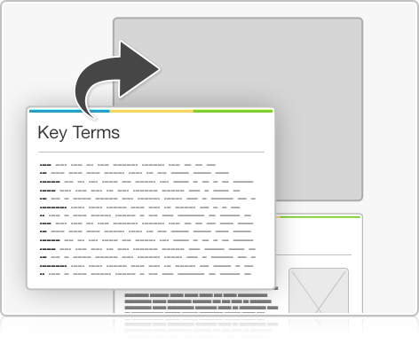
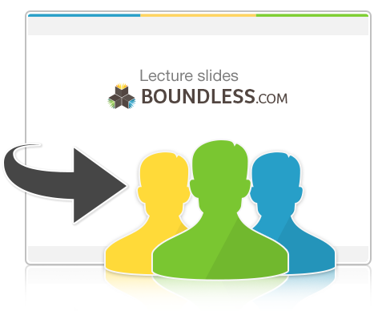

Using Boundless Presentations
Boundless Teaching Platform
Boundless empowers educators to engage their students with affordable, customizable textbooks and intuitive teaching tools. The free Boundless Teaching Platform gives educators the ability to customize textbooks in more than 20 subjects that align to hundreds of popular titles. Get started by using high quality Boundless books, or make switching to our platform easier by building from Boundless content pre-organized to match the assigned textbook. This platform gives educators the tools they need to assign readings and assessments, monitor student activity, and lead their classes with pre-made teaching resources.
Get started now at:
The Appendix
  The appendix is for you to use to add depth and breadth to your lectures. You can simply drag and drop slides from the appendix into the main presentation to make for a richer lecture experience.
http://boundless.com/teaching-platform
Free to edit, share, and copy
  Feel free to edit, share, and make as many copies of the Boundless presentations as you like. We encourage you to take these presentations and make them your own.
If you have any questions or problems please email:
educators@boundless.com
Free to share, print, make copies and changes. Get yours at www.boundless.com

Slide 3

About Boundless
Boundless is an innovative technology company making education more affordable and accessible for students everywhere. The company creates the world’s best open educational content in 20+ subjects that align to more than 1,000 popular college textbooks. Boundless integrates learning technology into all its premium books to help students study more efficiently at a fraction of the cost of traditional textbooks. The company also empowers educators to engage their students more effectively through customizable books and intuitive teaching tools as part of the Boundless Teaching Platform. More than 2 million learners access Boundless free and premium content each month across the company’s wide distribution platforms, including its website, iOS apps, Kindle books, and iBooks. To get started learning or teaching with Boundless, visit boundless.com.
Free to share, print, make copies and changes. Get yours at www.boundless.com

Slide 4

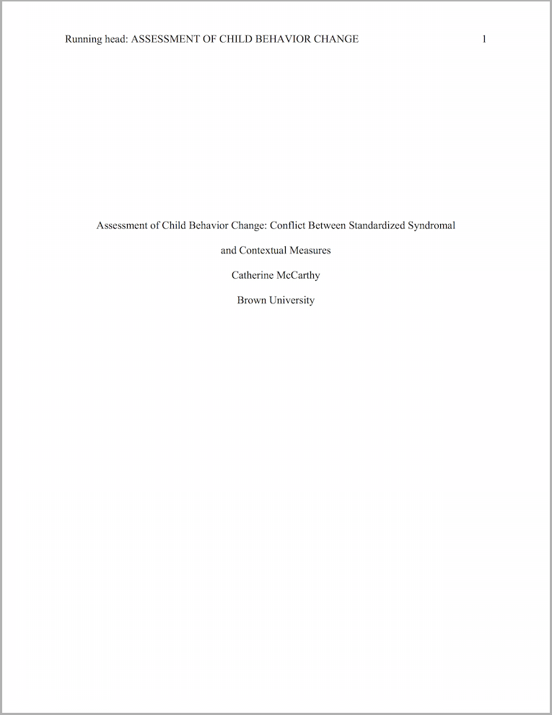
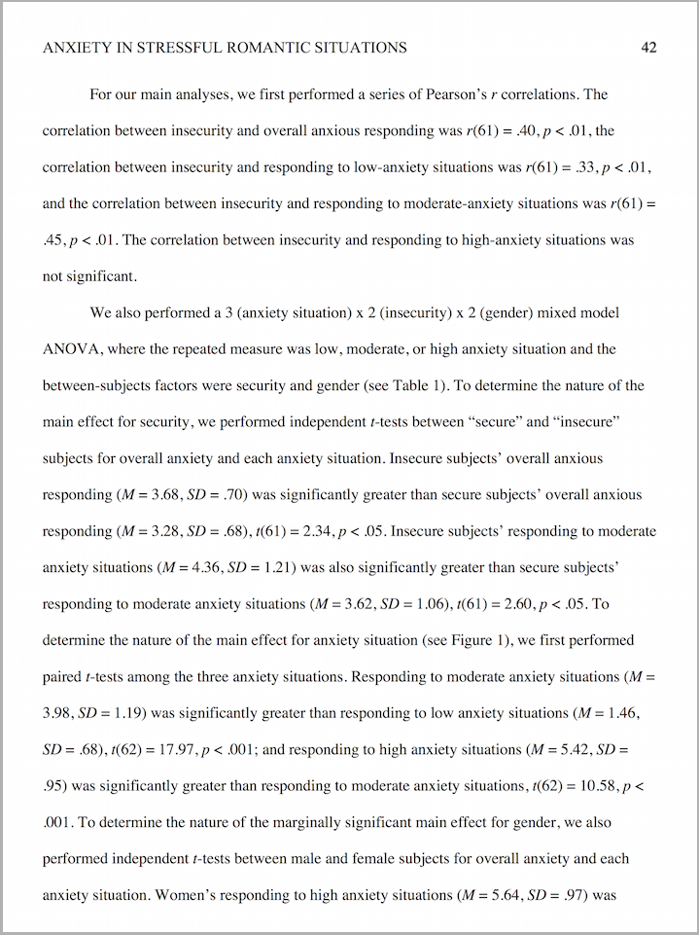
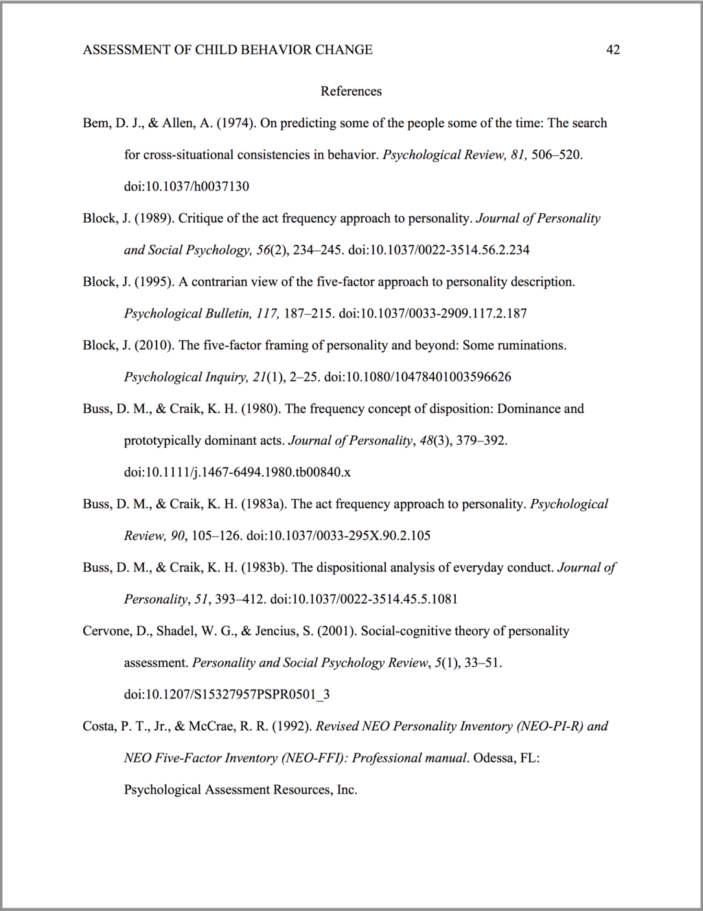
Writing a Paper in APA Style (Social Sciences)
Introduction to APA Style
APA: Structure and Formatting of Specific Elements
APA: Empirical Research Papers
APA: Citations and References
]
Writing a Paper in APA Style (Social Sciences)
Free to share, print, make copies and changes. Get yours at www.boundless.com

Slide 5

Introduction to APA Style
Writing a Paper in APA Style (Social Sciences) > Introduction to APA Style
When to Use APA Style
Overall Structure and Formatting of an APA Paper
Free to share, print, make copies and changes. Get yours at www.boundless.com
www.boundless.com/writing/textbooks/boundless-writing-textbook/writing-a-paper-in-apa-style-social-sciences-256/introduction-to-apa-style-320/

Slide 6
APA: Structure and Formatting of Specific Elements
Writing a Paper in APA Style (Social Sciences) > APA: Structure and Formatting of Specific Elements
APA: Title Page and Running Head
APA: Abstract
APA: Headings
APA: Series and Lists
APA: Block Quotations
Free to share, print, make copies and changes. Get yours at www.boundless.com
www.boundless.com/writing/textbooks/boundless-writing-textbook/writing-a-paper-in-apa-style-social-sciences-256/apa-structure-and-formatting-of-specific-elements-321/

Slide 7
APA: Empirical Research Papers
Writing a Paper in APA Style (Social Sciences) > APA: Empirical Research Papers
APA: Reporting Statistics
APA: Tables and Figures
Free to share, print, make copies and changes. Get yours at www.boundless.com
www.boundless.com/writing/textbooks/boundless-writing-textbook/writing-a-paper-in-apa-style-social-sciences-256/apa-empirical-research-papers-366/

Slide 8
APA: Citations and References
Writing a Paper in APA Style (Social Sciences) > APA: Citations and References
APA: The References Section
APA: How to Reference Different Types of Sources
APA: In-Text Citations and Parentheticals
Free to share, print, make copies and changes. Get yours at www.boundless.com
www.boundless.com/writing/textbooks/boundless-writing-textbook/writing-a-paper-in-apa-style-social-sciences-256/apa-citations-and-references-322/

Slide 9
Appendix
Free to share, print, make copies and changes. Get yours at www.boundless.com

Slide 10
Key terms
Writing a Paper in APA Style (Social Sciences)
abstract A brief summary of a paper.
APA style A common citation and formatting style, used especially often in the social and behavioral sciences.
block quotation A way of formatting a particularly long excerpt or quotation in a paper.
element An item within a series or list.
ellipsis A punctuation mark consisting of three periods in a row, used to indicate an omission, a pause, or additional, unmentioned list items.
hanging indent A formatting style for citations in APA Reference pages in which every line except the first is an inch away from the left margin.
in-text citation Giving the name and year or other identifying information of the author of a source within the text of a paper.
Oxford comma The comma that comes after the second to last item in a list.
running head A header that does not contain the author's name, so that the paper can be evaluated without bias.
sentence case A format in which only the first major word (and any proper noun) is capitalized.
series A simple, relatively short list of three to five items within a paragraph.
statistic A numerical figure from experimental data.
Free to share, print, make copies and changes. Get yours at www.boundless.com

Slide 11
Writing a Paper in APA Style (Social Sciences)
title case A format in which the first letters of major words are capitalized.
Free to share, print, make copies and changes. Get yours at www.boundless.com

Slide 12
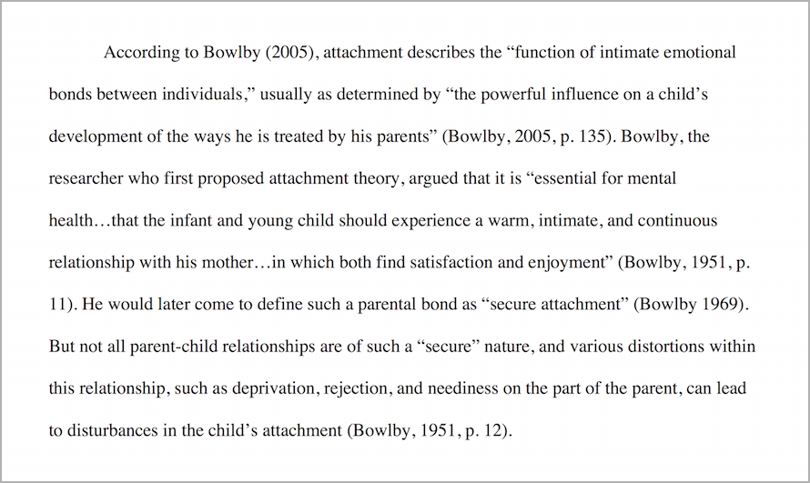

Writing a Paper in APA Style (Social Sciences)
In-text citations
  These in-text citations are properly formatted in APA style.
Free to share, print, make copies and changes. Get yours at www.boundless.com
Catherine McCarthy. "Original figure by Catherine McCarthy. Licensed CC BY-SA 4.0." CC BY-SA 3.0 View on Boundless.com

Slide 13
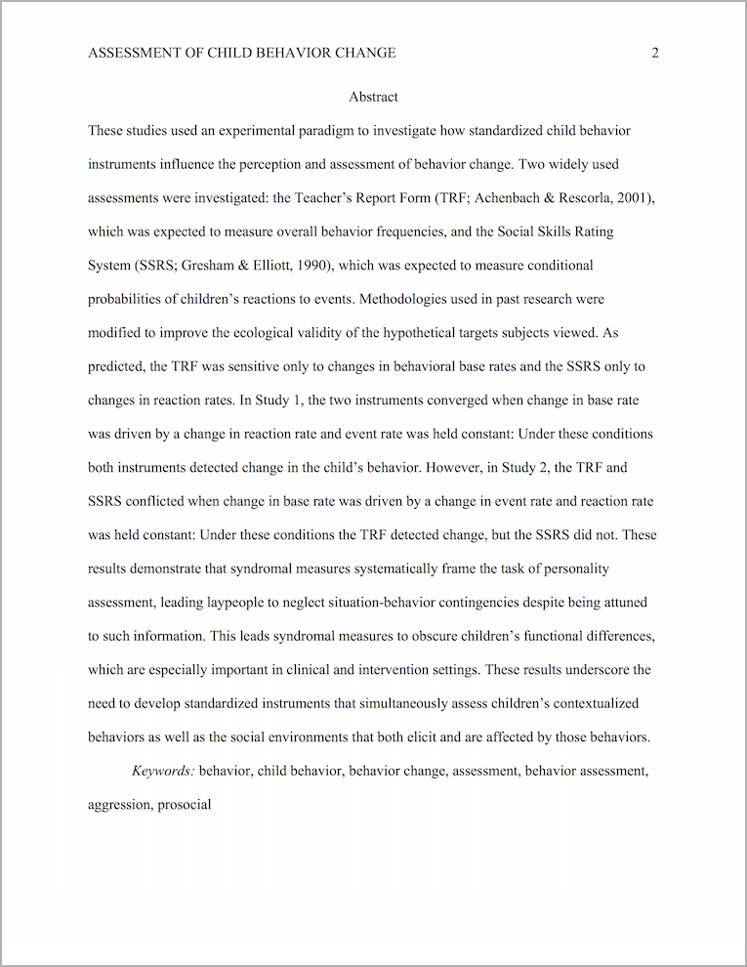
Writing a Paper in APA Style (Social Sciences)
Abstract
  This is an example of an abstract properly formatted in APA style.
Free to share, print, make copies and changes. Get yours at www.boundless.com
Catherine McCarthy. "Original figure by Catherine McCarthy. Licensed CC BY-SA 4.0." CC BY-SA 3.0 View on Boundless.com

Slide 14
Writing a Paper in APA Style (Social Sciences)
Reporting statistics
  This figure shows the proper way to report statistics in an APA-style paper.
Free to share, print, make copies and changes. Get yours at www.boundless.com
Catherine McCarthy. "Original figure by Catherine McCarthy. Licensed CC BY-SA 4.0." CC BY-SA 3.0 View on Boundless.com

Slide 15
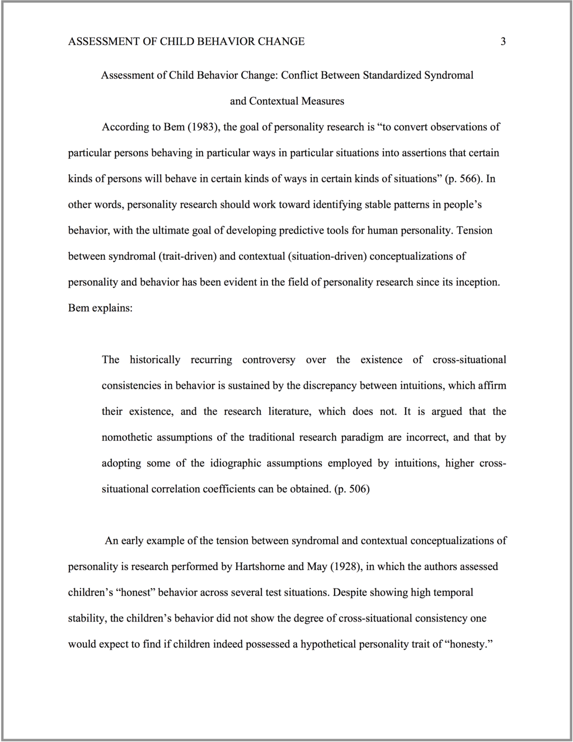
Writing a Paper in APA Style (Social Sciences)
Block quotation
  This block quotation is properly formatted in APA style.
Free to share, print, make copies and changes. Get yours at www.boundless.com
Catherine McCarthy. "Original figure by Catherine McCarthy. Licensed CC BY-SA 4.0." CC BY-SA 3.0 View on Boundless.com

Slide 16
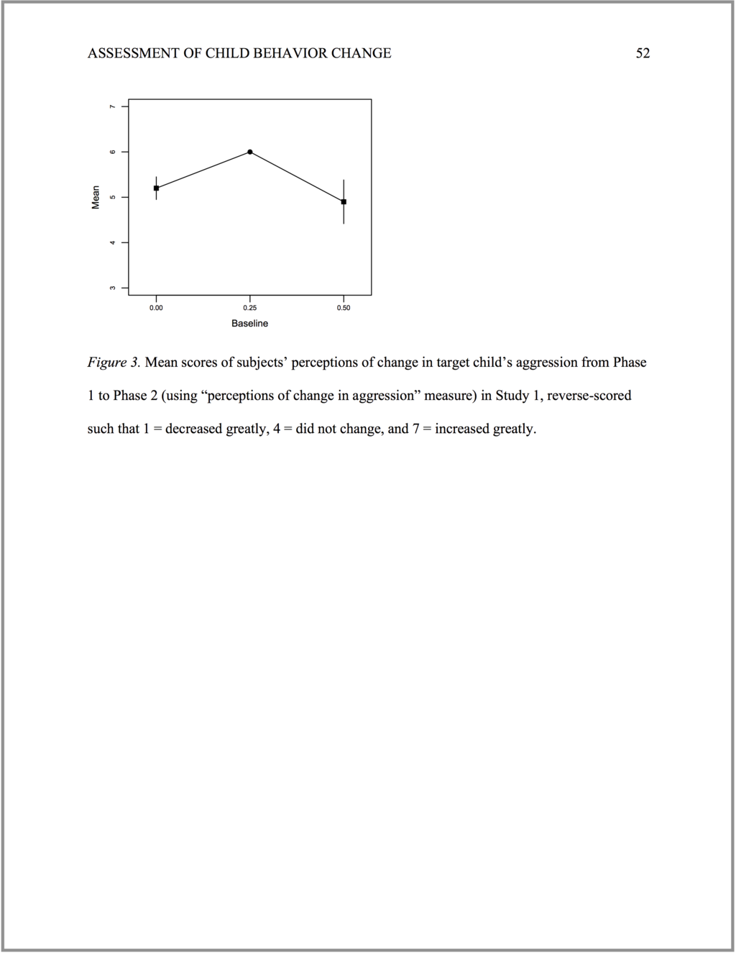
Writing a Paper in APA Style (Social Sciences)
Single-panel figure
  This is a single-panel figure properly formatted in APA style.
Free to share, print, make copies and changes. Get yours at www.boundless.com
Catherine McCarthy. "Original figure by Catherine McCarthy. Licensed CC BY-SA 4.0." CC BY-SA 3.0 View on Boundless.com

Slide 17
Writing a Paper in APA Style (Social Sciences)
References
  This is an example of the first page of a References section properly formatted in APA style.
Free to share, print, make copies and changes. Get yours at www.boundless.com
Catherine McCarthy. "Original figure by Catherine McCarthy. Licensed CC BY-SA 4.0." CC BY-SA 3.0 View on Boundless.com

Slide 18
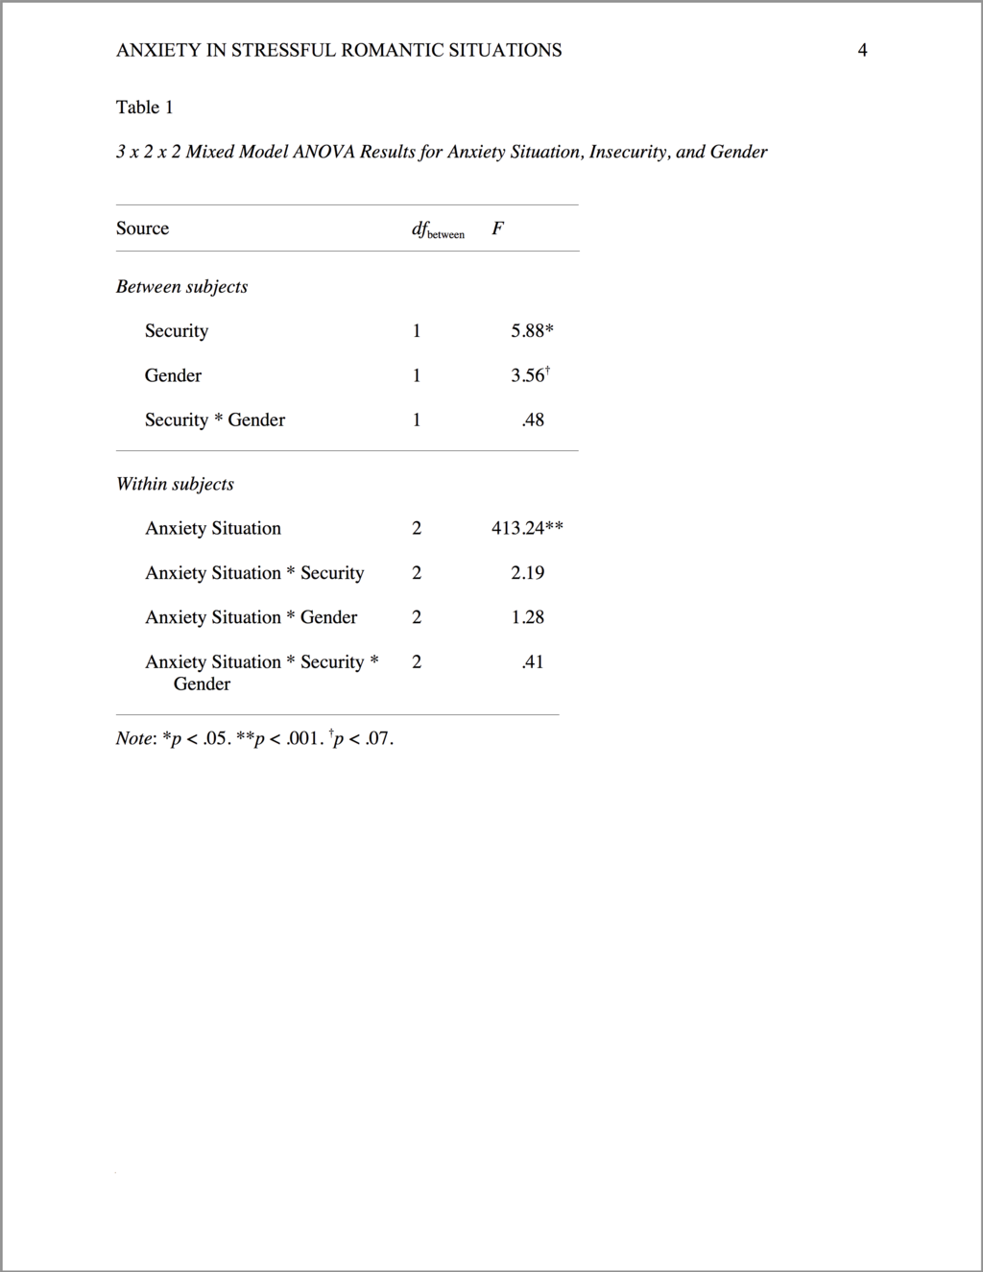
Writing a Paper in APA Style (Social Sciences)
Complicated table
  This more complicated table is properly formatted in APA style; it uses more than three horizontal borders to clearly separate the different sections.
Free to share, print, make copies and changes. Get yours at www.boundless.com
Catherine McCarthy. "Original figure by Catherine McCarthy. Licensed CC BY-SA 4.0." CC BY-SA 3.0 View on Boundless.com

Slide 19
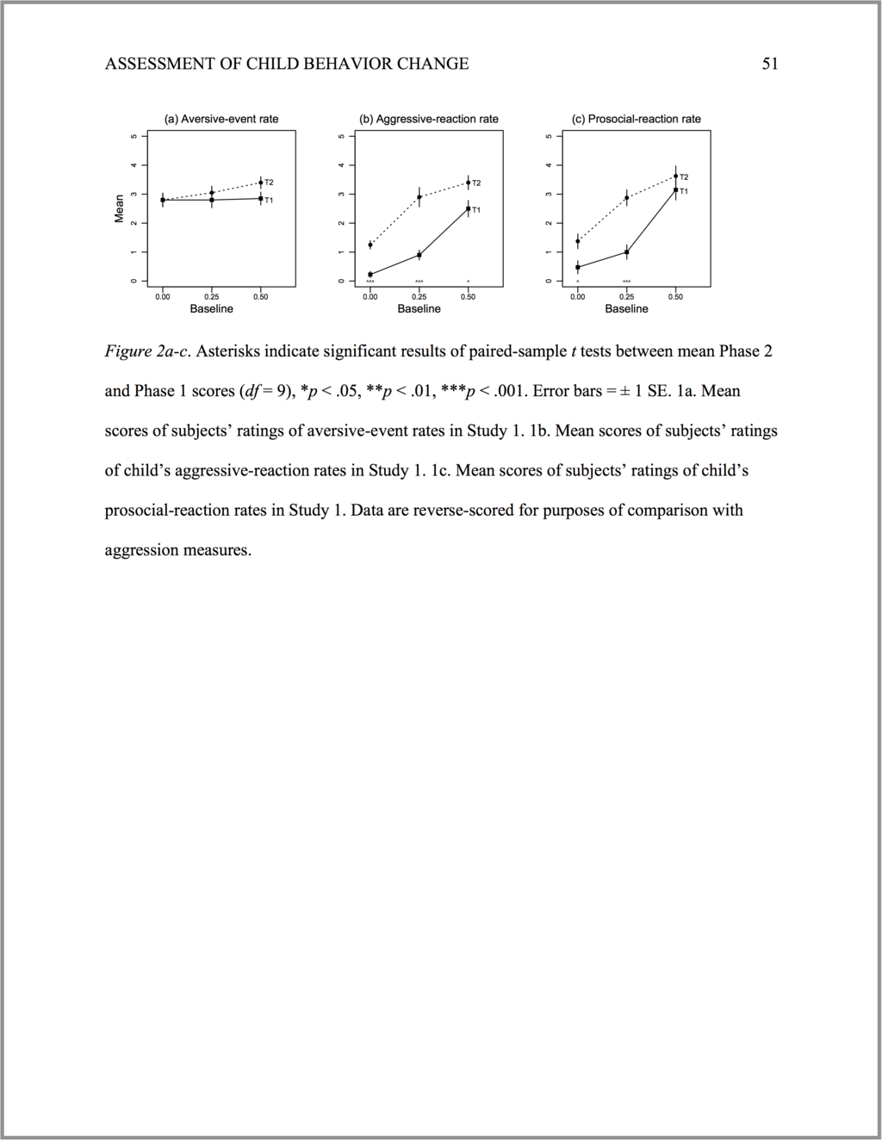
Writing a Paper in APA Style (Social Sciences)
Three-panel figure
  This is a three-panel figure properly formatted in APA style.
Free to share, print, make copies and changes. Get yours at www.boundless.com
Catherine McCarthy. "Original figure by Catherine McCarthy. Licensed CC BY-SA 4.0." CC BY-SA 3.0 View on Boundless.com

Slide 20
Writing a Paper in APA Style (Social Sciences)
Title page
  This is an example of a title page properly formatted in APA style.
Free to share, print, make copies and changes. Get yours at www.boundless.com
Catherine McCarthy. "Original figure by Catherine McCarthy. Licensed CC BY-SA 4.0." CC BY-SA 3.0 View on Boundless.com

Slide 21
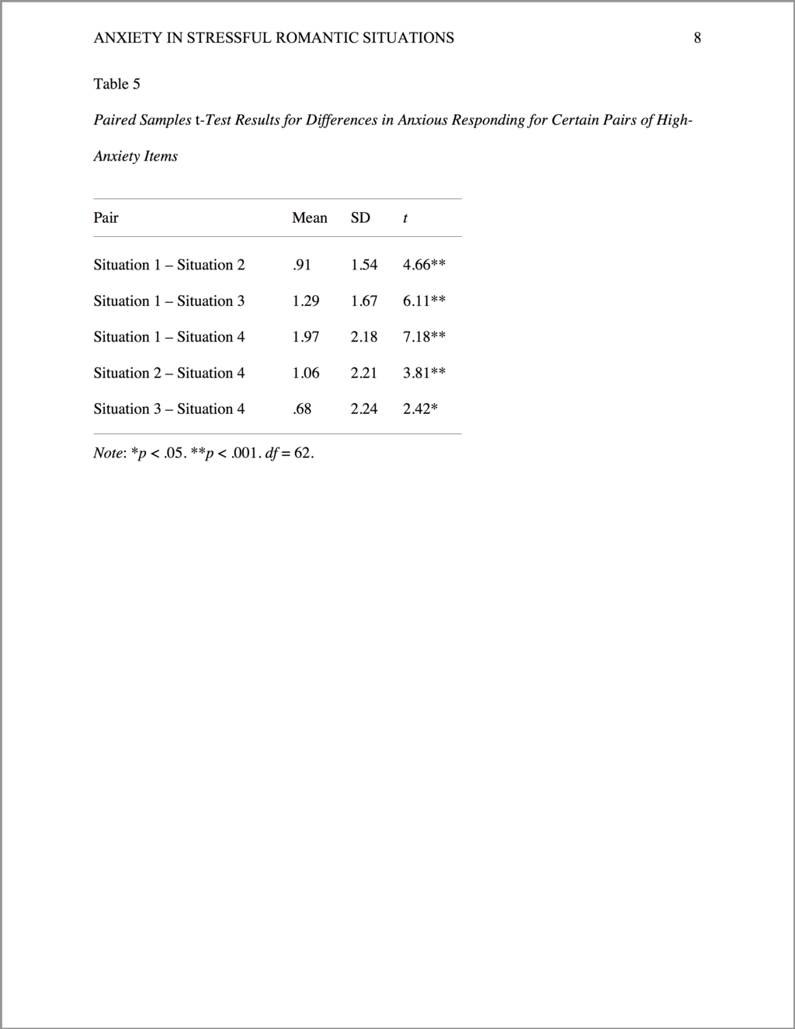
Writing a Paper in APA Style (Social Sciences)
Simple table
  This table is properly formatted in APA style, using only three horizontal borders.
Free to share, print, make copies and changes. Get yours at www.boundless.com
Catherine McCarthy. "Original figure by Catherine McCarthy. Licensed CC BY-SA 4.0." CC BY-SA 3.0 View on Boundless.com

Slide 22
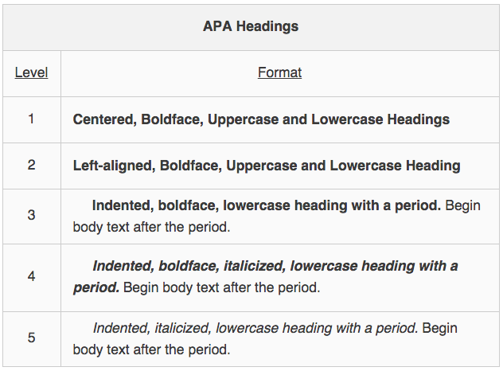
Writing a Paper in APA Style (Social Sciences)
APA heading hierarchy
  These are the formatting rules for different levels of headings in APA style.
Free to share, print, make copies and changes. Get yours at www.boundless.com
Psychology Wikia. "APA Headings." CC BY-SA 3.0 http://psychology.wikia.com/wiki/APA_style%23Headings View on Boundless.com

Slide 23
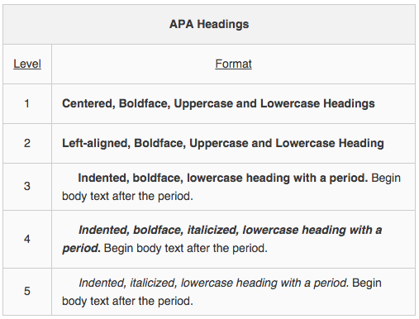
Writing a Paper in APA Style (Social Sciences)
Hierarchy of APA Headings
Free to share, print, make copies and changes. Get yours at www.boundless.com
Psychology Wikia. "APA Headings." CC BY-SA 3.0 http://psychology.wikia.com/wiki/APA_style%23Headings View on Boundless.com

Slide 24
Attribution
Writing a Paper in APA Style (Social Sciences)
Wikipedia. "APA style." CC BY-SA 3.0 https://en.wikipedia.org/wiki/APA_style
Wikipedia. "Colon (punctuation)." CC BY-SA 3.0 https://en.wikipedia.org/wiki/Colon_(punctuation)
Wikiversity. "APA style." CC BY-SA 3.0 https://en.wikiversity.org/wiki/APA_style
Psychology Wiki. "APA style." CC BY-SA 3.0 http://psychology.wikia.com/wiki/APA_style
Psychology Wiki. "APA style." CC BY-SA 3.0 http://psychology.wikia.com/wiki/APA_style
Psychology Wiki. "APA style." CC BY-SA 3.0 http://psychology.wikia.com/wiki/APA_style
Psychology Wiki. "APA style." CC BY-SA 3.0 http://psychology.wikia.com/wiki/APA_style
Youtube. "Basics of Citing, APA, 2 of 3 (References)." CC BY https://www.youtube.com/watch?v=k3zz7VOpuQM
Psychology Wiki. "How to reference and link to summary or text." CC BY-SA 3.0 http://psychology.wikia.com/wiki/How_to_reference_and_link_to_summary_or_text
Youtube. "Basics of Citing, APA, 2 of 3 (References)." CC BY https://www.youtube.com/watch?v=k3zz7VOpuQM
Free to share, print, make copies and changes. Get yours at www.boundless.com

