Slide 1


Boundless Lecture Slides
Available on the Boundless Teaching Platform
Free to share, print, make copies and changes. Get yours at www.boundless.com

Slide 2
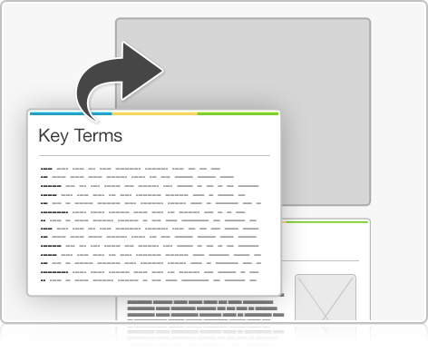
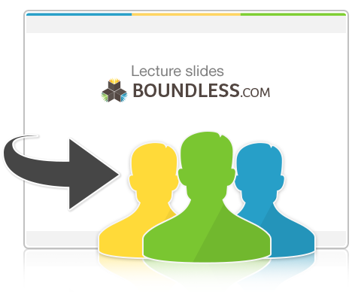

Using Boundless Presentations
Boundless Teaching Platform
Boundless empowers educators to engage their students with affordable, customizable textbooks and intuitive teaching tools. The free Boundless Teaching Platform gives educators the ability to customize textbooks in more than 20 subjects that align to hundreds of popular titles. Get started by using high quality Boundless books, or make switching to our platform easier by building from Boundless content pre-organized to match the assigned textbook. This platform gives educators the tools they need to assign readings and assessments, monitor student activity, and lead their classes with pre-made teaching resources.
Get started now at:
The Appendix
  The appendix is for you to use to add depth and breadth to your lectures. You can simply drag and drop slides from the appendix into the main presentation to make for a richer lecture experience.
http://boundless.com/teaching-platform
Free to edit, share, and copy
  Feel free to edit, share, and make as many copies of the Boundless presentations as you like. We encourage you to take these presentations and make them your own.
If you have any questions or problems please email:
educators@boundless.com
Free to share, print, make copies and changes. Get yours at www.boundless.com

Slide 3

About Boundless
Boundless is an innovative technology company making education more affordable and accessible for students everywhere. The company creates the world’s best open educational content in 20+ subjects that align to more than 1,000 popular college textbooks. Boundless integrates learning technology into all its premium books to help students study more efficiently at a fraction of the cost of traditional textbooks. The company also empowers educators to engage their students more effectively through customizable books and intuitive teaching tools as part of the Boundless Teaching Platform. More than 2 million learners access Boundless free and premium content each month across the company’s wide distribution platforms, including its website, iOS apps, Kindle books, and iBooks. To get started learning or teaching with Boundless, visit boundless.com.
Free to share, print, make copies and changes. Get yours at www.boundless.com

Slide 4

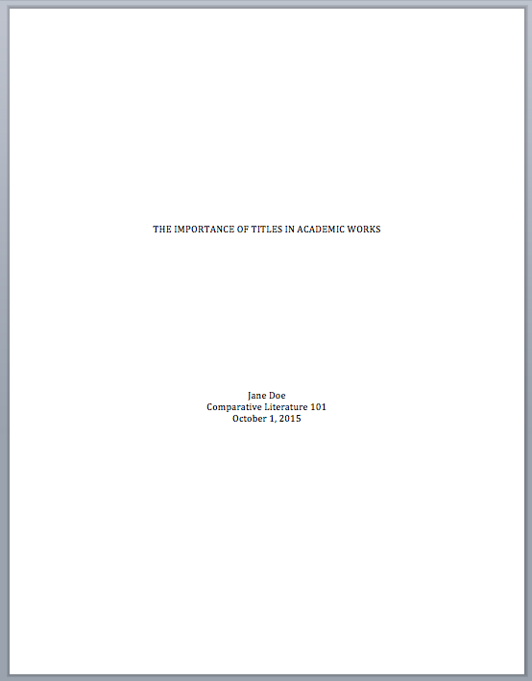
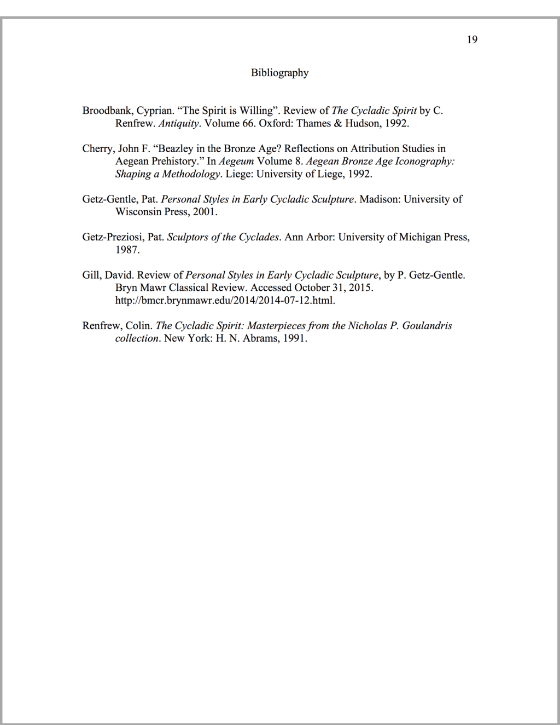

Writing a Paper in Chicago/Turabian Style (History)
Introduction to Chicago/Turabian Style
Chicago/Turabian: Structure and Formatting of Specific Elements
Chicago/Turabian: Citations and References – Notes and Bibliography (NB) System
Chicago/Turabian: Citations and References – Author–Date (AD) System
]
Writing a Paper in Chicago/Turabian Style (Hist...
Free to share, print, make copies and changes. Get yours at www.boundless.com

Slide 5

Introduction to Chicago/Turabian Style
Writing a Paper in Chicago/Turabian Style (Hist... > Introduction to Chicago/Turabian Style
When to Use Chicago/Turabian Style
Overall Structure and Formatting of a Chicago/Turabian Paper
Free to share, print, make copies and changes. Get yours at www.boundless.com
www.boundless.com/writing/textbooks/boundless-writing-textbook/writing-a-paper-in-chicago-turabian-style-history-257/introduction-to-chicago-turabian-style-323/

Slide 6
Chicago/Turabian: Structure and Formatting of Specific Elements
Writing a Paper in Chicago/Turabian Style (Hist... > Chicago/Turabian: Structure and Formatting of S...
Chicago/Turabian: Title Page
Chicago/Turabian: Headings
Chicago/Turabian: Block Quotations
Chicago/Turabian: Tables and Figures
Free to share, print, make copies and changes. Get yours at www.boundless.com
www.boundless.com/writing/textbooks/boundless-writing-textbook/writing-a-paper-in-chicago-turabian-style-history-257/chicago-turabian-structure-and-formatting-of-specific-elements-324/

Slide 7
Chicago/Turabian: Citations and References – Notes and Bibliography (NB) System
Writing a Paper in Chicago/Turabian Style (Hist... > Chicago/Turabian: Citations and References – No...
Chicago/Turabian (NB): The Bibliography Section
Chicago/Turabian (NB): How to Reference Different Types of Sources
Chicago/Turabian (NB): Footnotes and Endnotes
How to Reference Different Types of Sources in Footnotes
Free to share, print, make copies and changes. Get yours at www.boundless.com
www.boundless.com/writing/textbooks/boundless-writing-textbook/writing-a-paper-in-chicago-turabian-style-history-257/chicago-turabian-citations-and-references-notes-and-bibliography-nb-system-325/

Slide 8
Chicago/Turabian: Citations and References – Author–Date (AD) System
Writing a Paper in Chicago/Turabian Style (Hist... > Chicago/Turabian: Citations and References – Au...
Chicago/Turabian (Author–Date): The References Section
Chicago/Turabian (Author–Date): How to Reference Different Types of Sources
Chicago/Turabian (Author–Date): In-Text References and Parentheticals
Free to share, print, make copies and changes. Get yours at www.boundless.com
www.boundless.com/writing/textbooks/boundless-writing-textbook/writing-a-paper-in-chicago-turabian-style-history-257/chicago-turabian-citations-and-references-author-date-ad-system-372/

Slide 9
Appendix
Free to share, print, make copies and changes. Get yours at www.boundless.com

Slide 10
Key terms
Writing a Paper in Chicago/Turabian Style (Hist...
Author–Date A subset of the Chicago/Turabian citation style that uses in-text citations and a References page at the end.
bibliography A section of a written work containing citations, not quotations, of all the sources referenced in the work.
dissertation A formal research paper that students write in order to complete the requirements for a doctoral degree.
endnote A note at the end of a paper, corresponding to a number in a text, which gives the reader citation information.
footnote A short piece of text, often numbered, placed at the bottom of a printed page to add a comment, citation, or reference to a designated part of the main text.
footnote A note at the bottom of the page, corresponding to a number in a text, which gives the reader citation information.
hierarchical Arranged according to importance.
Notes and Bibliography A subset of the Chicago/Turabian citation style, which uses footnotes to cite sources in the text.
parenthetical A word or phrase within parentheses.
Free to share, print, make copies and changes. Get yours at www.boundless.com

Slide 11

Writing a Paper in Chicago/Turabian Style (Hist...
Chicago-style title page
  A title page introduces the title of your paper—and you, its author!
Free to share, print, make copies and changes. Get yours at www.boundless.com
Eva Petzinger. "Original figure by Eva Petzinger. Licensed CC BY-SA 4.0." CC BY-SA 3.0 View on Boundless.com

Slide 12
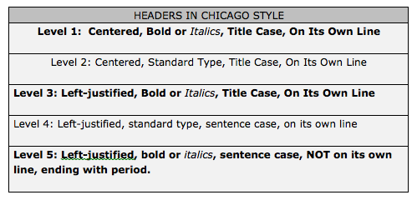
Writing a Paper in Chicago/Turabian Style (Hist...
Chicago heading hierarchy
  These are the formatting rules for different levels of headings in APA style.
Free to share, print, make copies and changes. Get yours at www.boundless.com
Eva Petzinger. "Original figure by Eva Petzinger. Licensed CC BY-SA 4.0." CC BY-SA 3.0 View on Boundless.com

Slide 13
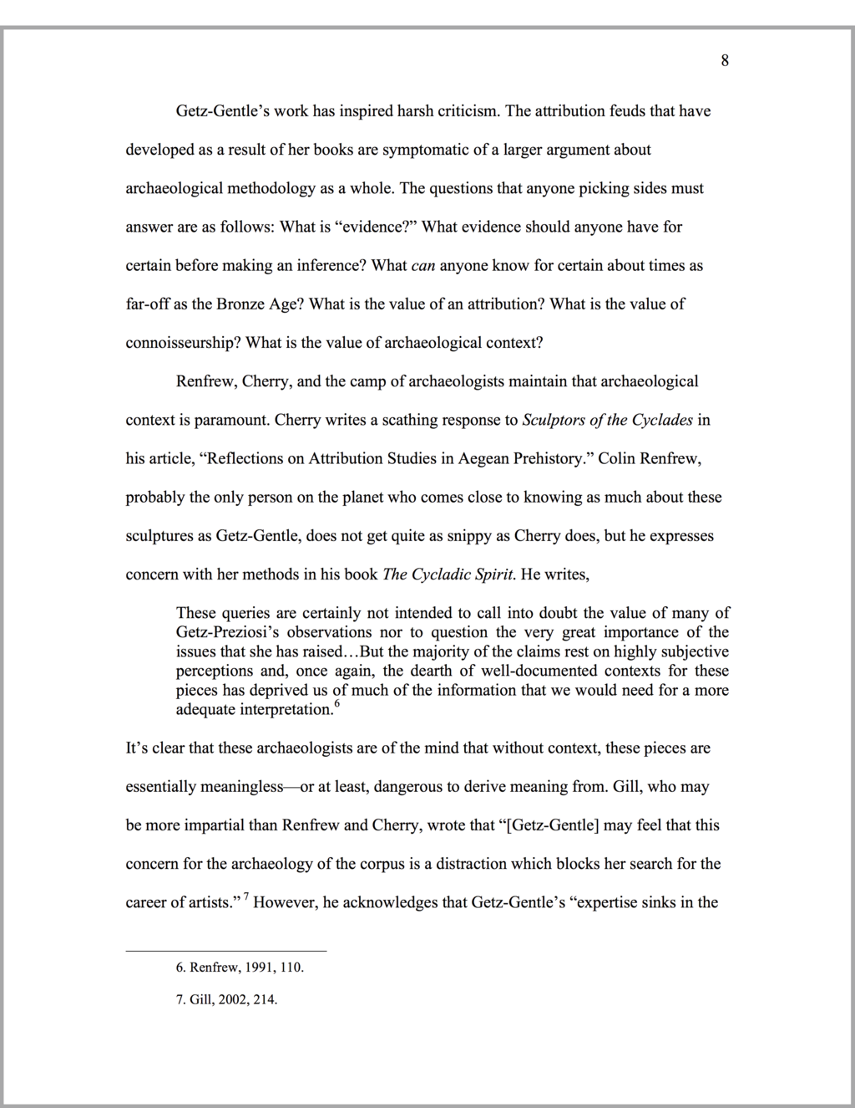
Writing a Paper in Chicago/Turabian Style (Hist...
Block quotations
  This block quotation is correctly formatted according to Chicago/Turabian style.
Free to share, print, make copies and changes. Get yours at www.boundless.com
Eva Petzinger. "Original figure by Eva Petzinger. Licensed CC BY-SA 4.0." CC BY-SA 3.0 View on Boundless.com

Slide 14
Writing a Paper in Chicago/Turabian Style (Hist...
Bibliography
  This is an example of a correctly formatted bibliography in Chicago/Turabian NB style.
Free to share, print, make copies and changes. Get yours at www.boundless.com
Eva Petzinger. "Original figure by Eva Petzinger. Licensed CC BY-SA 4.0." CC BY-SA 3.0 View on Boundless.com

Slide 15
Writing a Paper in Chicago/Turabian Style (Hist...
References page
  This is a correctly formatted References page in Chicago/Turabian Author–Date style.
Free to share, print, make copies and changes. Get yours at www.boundless.com
Eva Petzinger. "Original figure by Eva Petzinger. Licensed CC BY-SA 4.0." CC BY-SA 3.0 View on Boundless.com

Slide 16
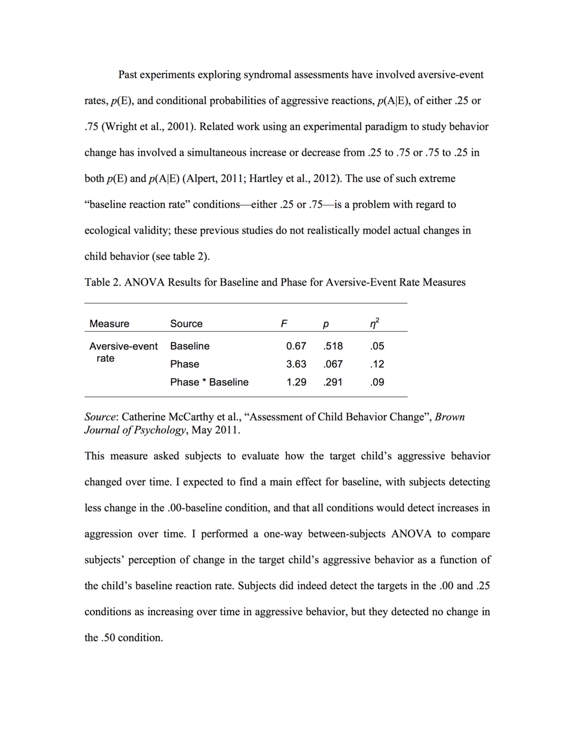
Writing a Paper in Chicago/Turabian Style (Hist...
Sample table
  This table is formatted correctly according to Chicago/Turabian formatting rules.
Free to share, print, make copies and changes. Get yours at www.boundless.com
Eva Petzinger. "Original figure by Eva Petzinger. Licensed CC BY-SA 4.0." CC BY-SA 3.0 View on Boundless.com

Slide 17
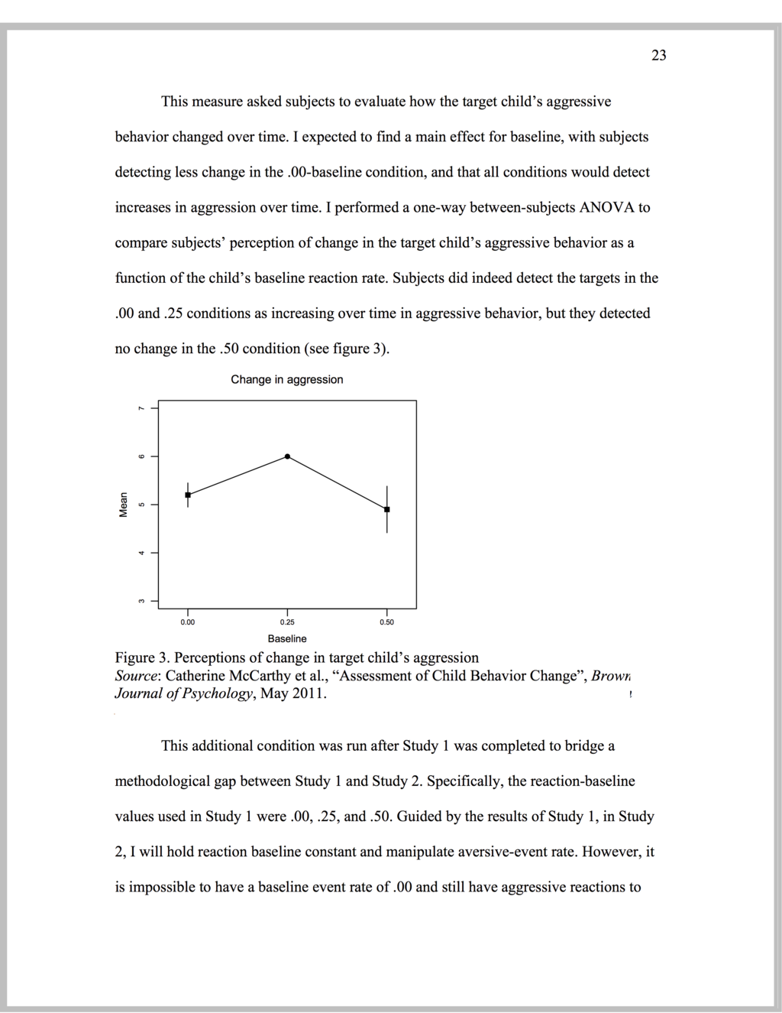
Writing a Paper in Chicago/Turabian Style (Hist...
Sample figure
  This figure is formatted correctly according to Chicago/Turabian formatting rules.
Free to share, print, make copies and changes. Get yours at www.boundless.com
Eva Petzinger. "Original figure by Eva Petzinger. Licensed CC BY-SA 4.0." CC BY-SA 3.0 View on Boundless.com

Slide 18
Attribution
Writing a Paper in Chicago/Turabian Style (Hist...
Wikipedia. "The Chicago Manual of Style." CC BY-SA 3.0 https://en.wikipedia.org/wiki/The_Chicago_Manual_of_Style
Wiktionary. "footnote." CC BY-SA 3.0 https://en.wiktionary.org/wiki/footnote
Wiktionary. "dissertation." CC BY-SA 3.0 https://en.wiktionary.org/wiki/dissertation
USHistory.org. "Common Sense by Thomas Paine." Public domain http://www.ushistory.org/paine/commonsense/singlehtml.htm
Wiktionary. "bibliography." CC BY-SA 3.0 https://en.wiktionary.org/wiki/bibliography
Free to share, print, make copies and changes. Get yours at www.boundless.com

