Slide 1


Boundless Lecture Slides
Available on the Boundless Teaching Platform
Free to share, print, make copies and changes. Get yours at www.boundless.com

Slide 2
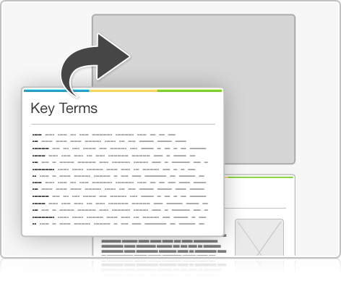


Using Boundless Presentations
Boundless Teaching Platform
Boundless empowers educators to engage their students with affordable, customizable textbooks and intuitive teaching tools. The free Boundless Teaching Platform gives educators the ability to customize textbooks in more than 20 subjects that align to hundreds of popular titles. Get started by using high quality Boundless books, or make switching to our platform easier by building from Boundless content pre-organized to match the assigned textbook. This platform gives educators the tools they need to assign readings and assessments, monitor student activity, and lead their classes with pre-made teaching resources.
Get started now at:
The Appendix
  The appendix is for you to use to add depth and breadth to your lectures. You can simply drag and drop slides from the appendix into the main presentation to make for a richer lecture experience.
http://boundless.com/teaching-platform
Free to edit, share, and copy
  Feel free to edit, share, and make as many copies of the Boundless presentations as you like. We encourage you to take these presentations and make them your own.
If you have any questions or problems please email:
educators@boundless.com
Free to share, print, make copies and changes. Get yours at www.boundless.com

Slide 3

About Boundless
Boundless is an innovative technology company making education more affordable and accessible for students everywhere. The company creates the world’s best open educational content in 20+ subjects that align to more than 1,000 popular college textbooks. Boundless integrates learning technology into all its premium books to help students study more efficiently at a fraction of the cost of traditional textbooks. The company also empowers educators to engage their students more effectively through customizable books and intuitive teaching tools as part of the Boundless Teaching Platform. More than 2 million learners access Boundless free and premium content each month across the company’s wide distribution platforms, including its website, iOS apps, Kindle books, and iBooks. To get started learning or teaching with Boundless, visit boundless.com.
Free to share, print, make copies and changes. Get yours at www.boundless.com

Slide 4

Writing Across Disciplines
Introduction to Writing Across Disciplines
Writing in the Humanities
Writing in the Natural and Social Sciences: The Research Paper and the IMRAD Model
Writing in Business
]
Writing Across Disciplines
Free to share, print, make copies and changes. Get yours at www.boundless.com

Slide 5

Introduction to Writing Across Disciplines
Writing Across Disciplines > Introduction to Writing Across Disciplines
Writing in Different Academic Disciplines
Free to share, print, make copies and changes. Get yours at www.boundless.com
www.boundless.com/writing/textbooks/boundless-writing-textbook/writing-across-disciplines-254/introduction-to-writing-across-disciplines-273/

Slide 6
Writing in the Humanities
Writing Across Disciplines > Writing in the Humanities
Introduction to Writing in the Humanities
Free to share, print, make copies and changes. Get yours at www.boundless.com
www.boundless.com/writing/textbooks/boundless-writing-textbook/writing-across-disciplines-254/writing-in-the-humanities-274/

Slide 7
Writing in the Natural and Social Sciences: The Research Paper and the IMRAD Model
Writing Across Disciplines > Writing in the Natural and Social Sciences: The...
Principles of Writing in the Sciences
Overview of the IMRAD Model
Abstract
Introduction and Thesis
Methods
Results
Discussion and Conclusion
Free to share, print, make copies and changes. Get yours at www.boundless.com
www.boundless.com/writing/textbooks/boundless-writing-textbook/writing-across-disciplines-254/writing-in-the-natural-and-social-sciences-the-research-paper-and-the-imrad-model-275/

Slide 8
Writing in Business
Writing Across Disciplines > Writing in Business
Introduction to Writing in Business
Free to share, print, make copies and changes. Get yours at www.boundless.com
www.boundless.com/writing/textbooks/boundless-writing-textbook/writing-across-disciplines-254/writing-in-business-276/

Slide 9
Appendix
Free to share, print, make copies and changes. Get yours at www.boundless.com

Slide 10
Key terms
Writing Across Disciplines
abstract The overall summary of a scientific paper, usually fewer than 250 words.
bias A definite opinion or position on a subject.
conclusion The end, finish, close, or last part of something.
creative writing The art of crafting texts, such as novels, biographies, short stories, and poems, that fall outside the bounds of professional, journalistic, academic, and technical discourse. Creative writing can be used to tell stories, evoke emotions, build empathy, and inspire new ways of thinking about the world.
discussion Text giving further detail on a subject.
expository Of a type of writing that explains, informs, or describes a process or concept.
genre A category or type of writing.
genres Categories or types of writing, including analytical, creative, explanatory, interpretive, and persuasive (among many others).
humanities The collection of academic disciplines that study human expression, ideas, and thought.
IMRAD An acronym for Introduction, Methods, Results, and Discussion—the conventional structure of a scientific paper.
IMRAD Currently the most prominent norm for the structure of a scientific paper; an acronym for "introduction, methods, results, and discussion."
introduction An initial section that summarizes the subject material of a book or article.
Free to share, print, make copies and changes. Get yours at www.boundless.com

Slide 11
Writing Across Disciplines
lab report A step-by-step explanation of the materials, methods, data, results, analysis,conclusions, and references of an experiment.
literary analysis A piece of academic writing that explores and interprets the meaning behind the story, characters, themes, and purposes of a text.
literature review A synthesis of the critical points of current knowledge in a given field, which includes significant findings as well as theoretical and methodological contributions to a particular topic.
methodology A detailed explanation of specific components of a research project, such as phases, tasks, methods, techniques, and tools.
objectivity The ability to perceive a subject without being influenced by personal biases or emotions.
primary audience The reader or readers for whom a piece of writing is intended.
qualitative Of research methods that create a more subjective understanding by studying a subject's defining qualities and character.
quantitative Of research methods that rely on objective measurements and data analysis.
reproducible Capable of being reproduced at a different time or place and by different people.
result The discovery (or absence of discovery) that arises from the scientific method of investigation.
results The section of a scientific paper that objectively presents the data collected or observed in a research study.
secondary audience The reader or readers who may also read a piece of writing, even if the piece was not originally intended for them.
Free to share, print, make copies and changes. Get yours at www.boundless.com

Slide 12
Writing Across Disciplines
summary A condensed version of the background or main ideas of a text.
testable Also known as falsifiable; able to be disproven.
thesis A claim or theory that must be supported with evidence to argue for or against a specific idea or position.
thesis statement A claim, usually found at the end of the first paragraph of an essay or similar document, that summarizes the main points and arguments of the paper.
Free to share, print, make copies and changes. Get yours at www.boundless.com

Slide 13


Writing Across Disciplines
Royal Academy School
  One of the goals of the literature review is to demonstrate familiarity with a body of knowledge.
Free to share, print, make copies and changes. Get yours at www.boundless.com
Flickr. "Royal Academy School - Scientists of Note | Flickr - Photo Sharing!." CC BY-SA http://www.flickr.com/photos/swanksalot/6298615953/ View on Boundless.com

Slide 14

Writing Across Disciplines
Free to share, print, make copies and changes. Get yours at www.boundless.com
Google. " Google Image Result for http://s0.geograph.org.uk/photos/93/28/932893_55ff837b.jpg." CC BY-SA http://www.google.com/imgres?hl=en&sa=X&biw=1334&bih=723&tbs=sur:fmc&tbm=isch&tbnid=Eui9_9JhKzNXRM:&imgrefurl=http://www.geograph.org.uk/photo/932893&docid=VfK4jFPSAn-90M&imgurl=http://s0.geograph.org.uk/photos/93/28/932893_55ff837b.jpg&w=640&h=480&ei=IBe6T4aXD-HG6AHirfjDCg&zoom=1&iact=hc&vpx=188&vpy=63&dur=29&hovh=193&hovw=258&tx=148&ty=96&sig=107678383186574758964&page=1&tbnh=142&tbnw=200&start=0&ndsp=13&ved=1t:429,r:0,s:0,i:148 View on Boundless.com

Slide 15

Writing Across Disciplines
Conclusion
  Conclusions have been an important part of writing for centuries.
Free to share, print, make copies and changes. Get yours at www.boundless.com
Wikimedia Commons. "conclusion.png." Public domain https://commons.wikimedia.org/wiki/File:Collier_conclusion.jpg View on Boundless.com

Slide 16
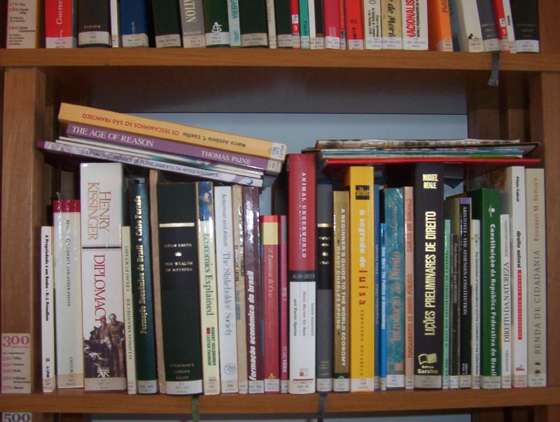
Writing Across Disciplines
Social sciences
  The social sciences include academic disciplines like anthropology, sociology, psychology, and economics
Free to share, print, make copies and changes. Get yours at www.boundless.com
Flickr. "300 Social sciences | Flickr - Photo Sharing!." CC BY-SA http://www.flickr.com/photos/helder/147680983/in/photostream/ View on Boundless.com

Slide 17

Writing Across Disciplines
Test tubes and other recipients in a chemistry lab
  Test tubes and other specialized measuring devices are an important feature of every chemistry laboratory. Accurate measurements are crucial to the success of chemistry experiments.
Free to share, print, make copies and changes. Get yours at www.boundless.com
Fotopedia. "Test tubes and other recipients in chemistry lab by Horia Varlan in Test tube on Fotopedia - Images for Humanity." CC BY-SA 3.0 http://www.fotopedia.com/items/flickr-4273968004 View on Boundless.com

Slide 18
Attribution
Writing Across Disciplines
Wikipedia. "Creative writing." CC BY-SA 3.0 https://en.wikipedia.org/wiki/Creative_writing
Wiktionary. "creative writing." CC BY-SA 3.0 http://en.wiktionary.org/wiki/creative_writing
Wiktionary. "social science." CC BY-SA 3.0 http://en.wiktionary.org/wiki/social_science
Wikibooks. "Rhetoric and Composition/Advanced Topics." CC BY-SA 3.0 http://en.wikibooks.org/wiki/Rhetoric_and_Composition/Advanced_Topics
Wiktionary. "result." CC BY-SA 3.0 http://en.wiktionary.org/wiki/result
Wiktionary. "summary." CC BY-SA 3.0 http://en.wiktionary.org/wiki/summary
Wiktionary. "methodology." CC BY-SA 3.0 http://en.wiktionary.org/wiki/methodology
Wikibooks. "Rhetoric and Composition/Writing in the Sciences." CC BY-SA 3.0 http://en.wikibooks.org/wiki/Rhetoric_and_Composition/Writing_in_the_Sciences%23Elements_of_the_Natural_Sciences_Paper
Wikipedia. "IMRAD." CC BY-SA 3.0 http://en.wikipedia.org/wiki/IMRAD
Boundless Learning. "Boundless." CC BY-SA 3.0 http://www.boundless.com//writing/definition/testability
Wikibooks. "Rhetoric and Composition/Writing in the Sciences." CC BY-SA 3.0 http://en.wikibooks.org/wiki/Rhetoric_and_Composition/Writing_in_the_Sciences
Wiktionary. "reproducible." CC BY-SA 3.0 http://en.wiktionary.org/wiki/reproducible
Wiktionary. "conclusion." CC BY-SA 3.0 http://en.wiktionary.org/wiki/conclusion
Wiktionary. "discussion." CC BY-SA 3.0 http://en.wiktionary.org/wiki/discussion
Wikibooks. "Rhetoric and Composition/Writing in the Sciences." CC BY-SA 3.0 http://en.wikibooks.org/wiki/Rhetoric_and_Composition/Writing_in_the_Sciences%23Social_Sciences
Wikibooks. "Social Research Methods/Reading and Writing Social Research." CC BY-SA 3.0 http://en.wikibooks.org/wiki/Social_Research_Methods/Reading_and_Writing_Social_Research
Wikibooks. "Rhetoric and Composition/Writing in the Sciences." CC BY-SA 3.0 http://en.wikibooks.org/wiki/Rhetoric_and_Composition/Writing_in_the_Sciences%23Social_Sciences
Free to share, print, make copies and changes. Get yours at www.boundless.com

Slide 19
Writing Across Disciplines
Wiktionary. "result." CC BY-SA 3.0 http://en.wiktionary.org/wiki/result
Wikipedia. "literature review." CC BY-SA 3.0 http://en.wikipedia.org/wiki/literature%20review
Wikibooks. "Social Research Methods/Reading and Writing Social Research." CC BY-SA 3.0 http://en.wikibooks.org/wiki/Social_Research_Methods/Reading_and_Writing_Social_Research
devcompage. "Devcompage | A learning resource on development communication." CC BY-SA http://devcompage.com/
Wikipedia. "thesis statement." CC BY-SA 3.0 http://en.wikipedia.org/wiki/thesis%20statement
Wiktionary. "introduction." CC BY-SA 3.0 http://en.wiktionary.org/wiki/introduction
OpenStax CNX. "The Cain Project in Engineering and Professional Communication, Three Modules on Clear Writing Style: An Introduction to The Craft of Argument, by Joseph M. Williams and Gregory Colomb. September 17, 2013." CC BY 3.0 http://cnx.org/content/m17223/latest/?collection=col10551/latest
Wikibooks. "Rhetoric and Composition/Writing in the Sciences." CC BY-SA 3.0 http://en.wikibooks.org/wiki/Rhetoric_and_Composition/Writing_in_the_Sciences%23Social_Sciences
Wikibooks. "Social Research Methods/Reading and Writing Social Research." CC BY-SA 3.0 http://en.wikibooks.org/wiki/Social_Research_Methods/Reading_and_Writing_Social_Research
WIKIPEDIA. "Objectivity (science)." CC BY-SA 3.0 http://en.wikipedia.org/wiki/Objectivity_(science)
WIKIPEDIA. "Case study." CC BY-SA 3.0 http://en.wikipedia.org/wiki/Case_study
Wikipedia. "IMRAD." CC BY-SA 3.0 http://en.wikipedia.org/wiki/IMRAD
Wikipedia. "Precision." CC BY-SA 3.0 http://en.wikipedia.org/wiki/Precision
WIKIPEDIA. "Social science." CC BY-SA 3.0 http://en.wikipedia.org/wiki/Social_science
WIKIPEDIA. "Literature review." CC BY-SA 3.0 http://en.wikipedia.org/wiki/Literature_review
WIKIPEDIA. "Natural science." CC BY-SA 3.0 http://en.wikipedia.org/wiki/Natural_science
Wikibooks. "Case study." CC BY-SA 3.0 https://en.wikibooks.org/wiki/Introduction_to_Psychology/Case_Studies
Wikibooks. "Rhetoric and Composition/Writing in the Sciences." CC BY-SA 3.0 http://en.wikibooks.org/wiki/Rhetoric_and_Composition/Writing_in_the_Sciences
Wiktionary. "objectivity." CC BY-SA 3.0 http://en.wiktionary.org/wiki/objectivity
Free to share, print, make copies and changes. Get yours at www.boundless.com

Slide 20
Writing Across Disciplines
Wiktionary. "bias." CC BY-SA 3.0 http://en.wiktionary.org/wiki/bias
Wikibooks. "Writing in the Humanities." CC BY-SA 3.0 https://en.wikibooks.org/wiki/Rhetoric_and_Composition/Writing_in_the_Humanities
Free to share, print, make copies and changes. Get yours at www.boundless.com

