Slide 1


Boundless Lecture Slides
Available on the Boundless Teaching Platform
Free to share, print, make copies and changes. Get yours at www.boundless.com

Slide 2
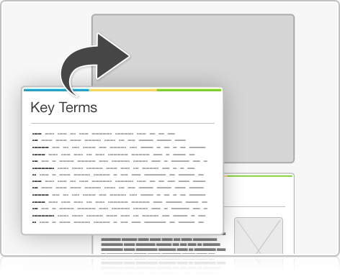
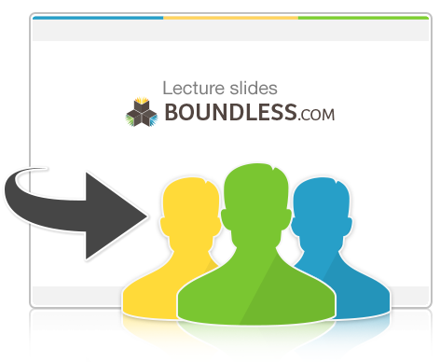

Using Boundless Presentations
Boundless Teaching Platform
Boundless empowers educators to engage their students with affordable, customizable textbooks and intuitive teaching tools. The free Boundless Teaching Platform gives educators the ability to customize textbooks in more than 20 subjects that align to hundreds of popular titles. Get started by using high quality Boundless books, or make switching to our platform easier by building from Boundless content pre-organized to match the assigned textbook. This platform gives educators the tools they need to assign readings and assessments, monitor student activity, and lead their classes with pre-made teaching resources.
Get started now at:
The Appendix
  The appendix is for you to use to add depth and breadth to your lectures. You can simply drag and drop slides from the appendix into the main presentation to make for a richer lecture experience.
http://boundless.com/teaching-platform
Free to edit, share, and copy
  Feel free to edit, share, and make as many copies of the Boundless presentations as you like. We encourage you to take these presentations and make them your own.
If you have any questions or problems please email:
educators@boundless.com
Free to share, print, make copies and changes. Get yours at www.boundless.com

Slide 3

About Boundless
Boundless is an innovative technology company making education more affordable and accessible for students everywhere. The company creates the world’s best open educational content in 20+ subjects that align to more than 1,000 popular college textbooks. Boundless integrates learning technology into all its premium books to help students study more efficiently at a fraction of the cost of traditional textbooks. The company also empowers educators to engage their students more effectively through customizable books and intuitive teaching tools as part of the Boundless Teaching Platform. More than 2 million learners access Boundless free and premium content each month across the company’s wide distribution platforms, including its website, iOS apps, Kindle books, and iBooks. To get started learning or teaching with Boundless, visit boundless.com.
Free to share, print, make copies and changes. Get yours at www.boundless.com

Slide 4


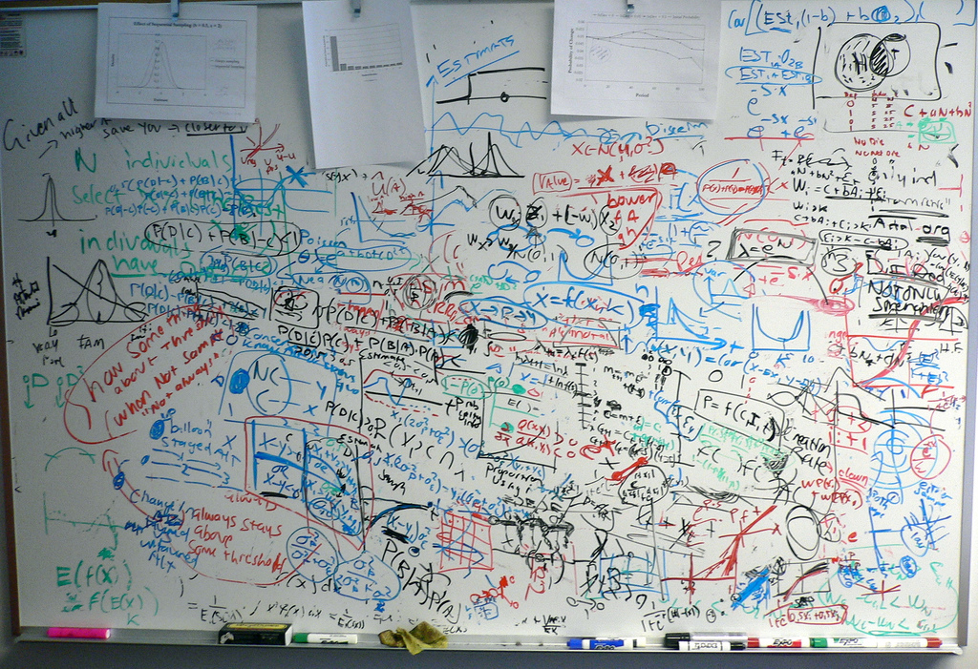
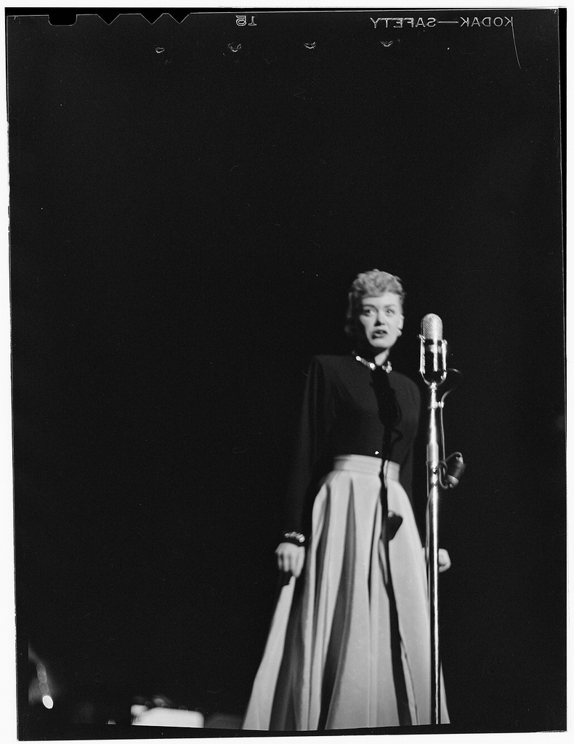
Writing an Effective Paper
Overview of the Process of Writing a Paper
Steps of Writing a Paper
Prewriting Techniques
Building Your Paper
]
Quoting and Paraphrasing
Writing an Effective Paper
Free to share, print, make copies and changes. Get yours at www.boundless.com

Slide 5
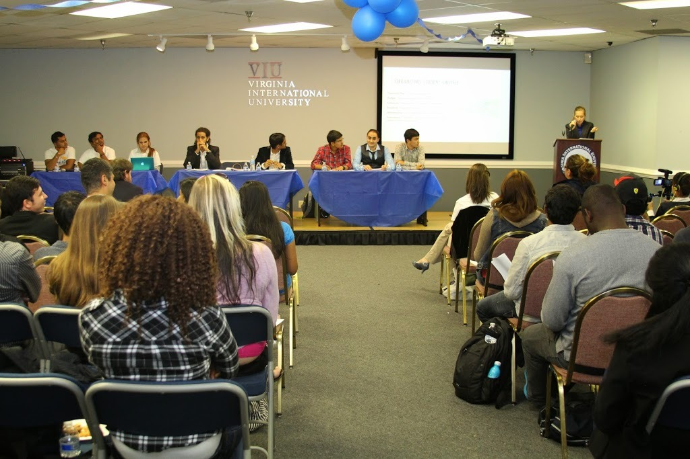
Writing an Effective Paper
(continued)
Incorporating Objections and Opposing Views
]
Writing an Effective Paper
Free to share, print, make copies and changes. Get yours at www.boundless.com

Slide 6

Overview of the Process of Writing a Paper
Writing an Effective Paper > Overview of the Process of Writing a Paper
Introduction to the Writing Process
Introduction to the Thesis Statement
Free to share, print, make copies and changes. Get yours at www.boundless.com
www.boundless.com/writing/textbooks/boundless-writing-textbook/writing-an-effective-paper-235/overview-of-the-process-of-writing-a-paper-236/

Slide 7
Steps of Writing a Paper
Writing an Effective Paper > Steps of Writing a Paper
Step 1: Prewriting and Choosing a Topic
Step 2: Researching
Step 3: Outlining
Step 4: Drafting
Step 5: Revising
Step 6: Editing and Proofreading
Step 7: Completing a Final Review
Free to share, print, make copies and changes. Get yours at www.boundless.com
www.boundless.com/writing/textbooks/boundless-writing-textbook/writing-an-effective-paper-235/steps-of-writing-a-paper-237/

Slide 8
Prewriting Techniques
Writing an Effective Paper > Prewriting Techniques
Brainstorming
Freewriting
Clustering and Concept Mapping
Free to share, print, make copies and changes. Get yours at www.boundless.com
www.boundless.com/writing/textbooks/boundless-writing-textbook/writing-an-effective-paper-235/prewriting-techniques-238/

Slide 9
Building Your Paper
Writing an Effective Paper > Building Your Paper
Modes of Persuasion: Ethos, Pathos, and Logos
Approaches to Your Introductory Paragraph
Approaches to Your Body Paragraphs
Approaches to Your Concluding Paragraph
Free to share, print, make copies and changes. Get yours at www.boundless.com
www.boundless.com/writing/textbooks/boundless-writing-textbook/writing-an-effective-paper-235/building-your-paper-239/

Slide 10
Quoting and Paraphrasing
Writing an Effective Paper > Quoting and Paraphrasing
The Basics of Quotations
Introducing and Formatting Quotations
Paraphrasing
Free to share, print, make copies and changes. Get yours at www.boundless.com
www.boundless.com/writing/textbooks/boundless-writing-textbook/writing-an-effective-paper-235/quoting-and-paraphrasing-240/

Slide 11
Incorporating Objections and Opposing Views
Writing an Effective Paper > Incorporating Objections and Opposing Views
The Importance of Addressing Opposing Views
Techniques for Acknowledging Opposing Views
Refuting Your Opposition
Free to share, print, make copies and changes. Get yours at www.boundless.com
www.boundless.com/writing/textbooks/boundless-writing-textbook/writing-an-effective-paper-235/incorporating-objections-and-opposing-views-241/

Slide 12
Appendix
Free to share, print, make copies and changes. Get yours at www.boundless.com

Slide 13
Key terms
Writing an Effective Paper
argument An attempt to persuade someone of something, by giving reasons or evidence for accepting a particular conclusion.
brainstorming A prewriting technique intended to generate creative ideas quickly and without editing, through word or idea association.
brainstorming Listing ideas about a topic, even the bad ones, until you find one you like.
citation A paraphrase of a passage from a book, or from another person, for the purposes of a scholarly paper.
clustering A prewriting technique consisting of writing a central idea in a circle on a sheet of paper, adding related ideas around the circle, and connecting them with lines to show how they related to each other.
clustering A process in which you start with a main topic, then explore clusters of related subtopics.
concept map A diagram that shows the relationships between concepts. Concepts are written in circles or rectangular boxes, which are connected by arrows that are labeled with phrases such as "is a," "gives rise to," "results in," "is required by," or "contributes to" that denote the relationships between concepts.
concept map A diagram of related ideas.
concession A literary device in which one acknowledges the merits of an opposing argument.
consistency In logic, a consistent theory is one that does not contain a contradiction. The lack of contradiction can be defined in either semantic or syntactic terms.
context The surroundings, circumstances, environment, or background that determine, specify, or clarify the meaning of a piece of writing.
counterargument An argument that is opposed to another argument.
Free to share, print, make copies and changes. Get yours at www.boundless.com

Slide 14
Writing an Effective Paper
credibility Reputation impacting one's ability to be believed.
criteria Standards for judgement or evaluation.
defensible Capable of being defended or justified.
editing The process of selecting and preparing written, visual, audio, and film media used to convey information through the processes of correction, condensation, organization, and other modifications performed with an intention of producing a correct, consistent, accurate, and complete work.
ethos A Greek word meaning "character," used to describe the guiding beliefs or ideals that characterize a community, nation, or ideology. In rhetoric, the term is oftenused in reference to the credibility of an author based on hisor her expertise and/or personal character.
expository writing Derived from the word "expose," expository writing seeks to expose, explain, describe, define, or inform.
freewriting A prewriting technique in which the writer writes continuously for a set period of time without regard to spelling, grammar, or topic.
freewriting The process of writing loosely, without self-censorship, in order to develop ideas spontaneously and naturally.
hyperbole Exaggerated statements or claims not meant to be taken literally.
logos A technique that relies on reasoned argument.
neutral Favoring neither the supporting nor the opposing viewpoint of a topic of debate; unbiased.
opposition An opposite or contrasting position.
Free to share, print, make copies and changes. Get yours at www.boundless.com

Slide 15
Writing an Effective Paper
organization The way in which something is organized, such as a book or an article.
Outlining A prewriting activity that allows you to organize to your ideas by placing them into an ordered sequence of primary and secondary ideas, which shows the relationship of the parts to the whole.
paraphrase A restatement of a text in different words, often to clarify meaning.
paraphrase To restate another's thoughts or ideas in different words.
pathos A communication technique that makes an appeal to the audience's emotions; used most often in rhetoric and in literature, film, and other narrative arts.
peer review Assessment, before publication, by an authority or authorities in the pertinent field of study, of the written form of an idea, hypothesis, theory, and/or written discussion of such.
proofreading The reading of text to detect and correct production errors. Proofreaders are expected to be consistently accurate by default because they occupy the last stage of production before publication.
purpose An object to be reached; a target; an aim; a goal.
quotation A fragment of a human expression that is being referred to by somebody else.
quotation A fragment of a human expression that is being referred to by somebody else.
quotation A fragment of a human expression that is being referred to by somebody else.
quotation marks Symbols used to denote a quotation in writing, written at the beginning and end of the quotation.
Free to share, print, make copies and changes. Get yours at www.boundless.com

Slide 16
Writing an Effective Paper
quote To repeat the exact words of another with the acknowledgement of the source.
recursive Pertaining to a procedure that can be used repeatedly. In composition, a writer may return to the tasks of a previous stage once informed by the activities of a current stage.
refute To prove something (a statement, theory, claim, argument) or someone wrong.
straw man An insubstantial concept, idea, endeavor, or argument, particularly one deliberately set up to be weakly supported, so that it can be easily knocked down; especially to impugn the strength of any related thing or idea.
thesis A claim that a writer must use evidence to defend.
topic sentence An arguable statement summarizing a claim that supports the thesis.
viewpoint The position from which something is observed or considered; an angle, outlook, or point of view.
writing process A series of overlapping steps writers use in composing. The process may differ based on the purpose and form of the composition.
Free to share, print, make copies and changes. Get yours at www.boundless.com

Slide 17
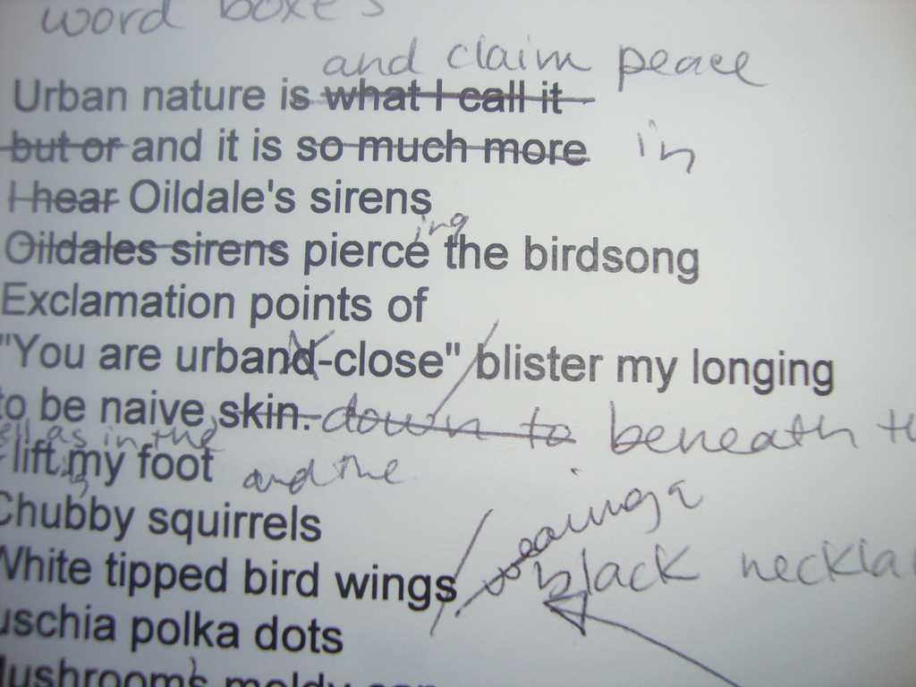

Writing an Effective Paper
Revision
  Revising ideas so that they are persuasive, cogent, and form a solid argument is the real work of writing.
Free to share, print, make copies and changes. Get yours at www.boundless.com
Flickr. "Revision in process | Flickr - Photo Sharing!." CC BY http://www.flickr.com/photos/juliejordanscott/5613078605/ View on Boundless.com

Slide 18
Writing an Effective Paper
No bad ideas
  Sometimes, it helps to stop censoring yourself and write down every idea you have—even the bad ones. You can decide on the best one later!
Free to share, print, make copies and changes. Get yours at www.boundless.com
Flickr. "128239619_1eb47bcb3f_b.jpg." CC BY 2.0 https://www.flickr.com/photos/jurvetson/128239619 View on Boundless.com

Slide 19
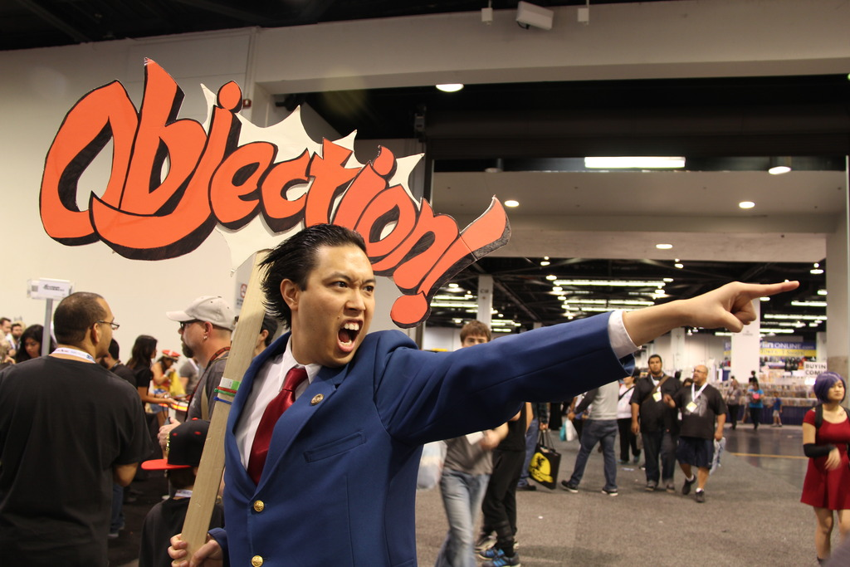
Writing an Effective Paper
Objection!
  To be an ace arguer, you'll need to clearly state your objections to your opponent's arguments and support your objections with evidence.
Free to share, print, make copies and changes. Get yours at www.boundless.com
"WonderCon 2015 - Phoenix Wright (17049616945)" by William Tung from USA - WonderCon 2015 - Phoenix Wright [2]. Licensed under CC BY-SA 2.0 via Commons - https://commons.wikimedia.org/wiki/File:WonderCon_2015_-_Phoenix_Wright_(17049616945).jpg#/media/File:WonderCon_2015_-_Phoenix_Wright_(17049616945).jpg. "Objection.jpg." CC BY-SA 2.0 https://en.wikipedia.org/wiki/Ace_Attorney%23/media/File:WonderCon_2015_-_Phoenix_Wright_(17049616945).jpg View on Boundless.com

Slide 20
Writing an Effective Paper
Debate tournament
  At a debate tournament, you don't know what side of the argument you'll be assigned to, so you have to research both sides!
Free to share, print, make copies and changes. Get yours at www.boundless.com
Wikipedia. "Student_Union_Debate.jpg." CC BY-SA 3.0 https://en.wikipedia.org/wiki/File:Student_Union_Debate.jpg View on Boundless.com

Slide 21

Writing an Effective Paper
Interlocking architectural components
  Paraphrasing links your own thinking with the ideas and research of others, creating a strong and engaging argument.
Free to share, print, make copies and changes. Get yours at www.boundless.com
Flickr. "Interlocked | Flickr - Photo Sharing!." CC BY 2.0 http://www.flickr.com/photos/mpcevat/7214860714/ View on Boundless.com

Slide 22

Writing an Effective Paper
Too Many Sources
  Continually making your search more specific will help you avoid getting overwhelmed by research.
Free to share, print, make copies and changes. Get yours at www.boundless.com
Wikimedia Commons. "Urval_av_de_bocker_som_har_vunnit_Nordiska_radets_litteraturpris_under_de_50_ar_som_priset_funnits_(3).jpg." CC BY 2.5 https://commons.wikimedia.org/wiki/File:Urval_av_de_bocker_som_har_vunnit_Nordiska_radets_litteraturpris_under_de_50_ar_som_priset_funnits_(3).jpg View on Boundless.com

Slide 23

Writing an Effective Paper
Putting the pieces together
  Once you have the elements of your argument, you need to connect them together in an outline, forming the skeleton of an argument that makes sense.
Free to share, print, make copies and changes. Get yours at www.boundless.com
http://nopsa.hiit.fi/pmg/viewer/photo.php?id=1235441. CC BY http://nopsa.hiit.fi/pmg/viewer/photo.php?id=1235441 View on Boundless.com

Slide 24

Writing an Effective Paper
Rugby
  Anticipating your opponents' objections can help you structure your arguments more soundly.
Free to share, print, make copies and changes. Get yours at www.boundless.com
blogs.com. "Rugby-Pioneers: 3 Rugby trade cards." CC BY-SA http://rugby-pioneers.blogs.com/rugby/3_rugby_trade_cards/ View on Boundless.com

Slide 25
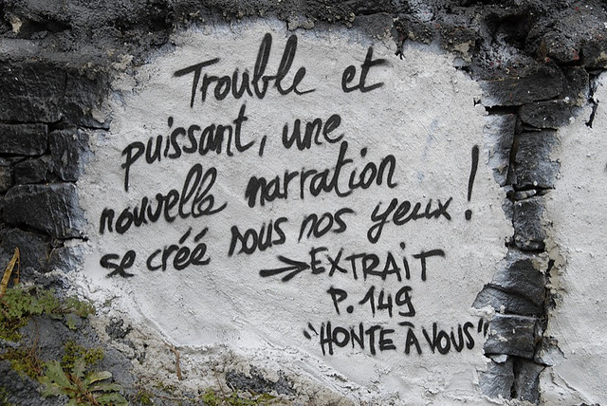
Writing an Effective Paper
Quotation on a rock
  A quote on the wall of Thierry Ehrmann's "Abode of Chaos." This graffiti-style quotation cites its source text and page number.
Free to share, print, make copies and changes. Get yours at www.boundless.com
"Ecrire, voilà l'acte terroriste absolu... _DDC3707.JPG | Flickr - Photo Sharing!.". "Quote on Rock.jpg." CC BY 2.0 http://www.flickr.com/photos/home_of_chaos/3081512135/in/photostream/ View on Boundless.com

Slide 26
Writing an Effective Paper
Notebooks
  Freewriting can be a great way to get ideas moving.
Free to share, print, make copies and changes. Get yours at www.boundless.com
Flickr. "SML Notebooks / 20090903.10D.52443 / SML | Flickr - Photo Sharing!." CC BY-SA http://www.flickr.com/photos/seeminglee/3882941631/ View on Boundless.com

Slide 27
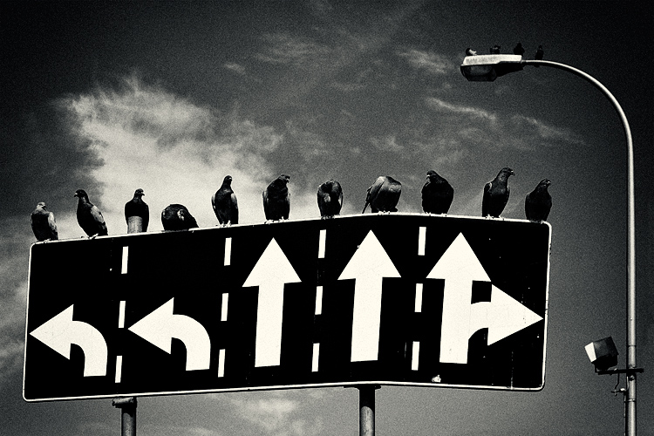
Writing an Effective Paper
Directions
  Reviewing work throughout the writing process helps make sure it's moving in the right direction.
Free to share, print, make copies and changes. Get yours at www.boundless.com
Foto Community. "Freedom of choice - Image & Photo by Krzysztof Poltorak from Details - Photography (22077920) | fotocommunity." CC BY http://www.fotocommunity.com/pc/pc/display/22077920 View on Boundless.com

Slide 28
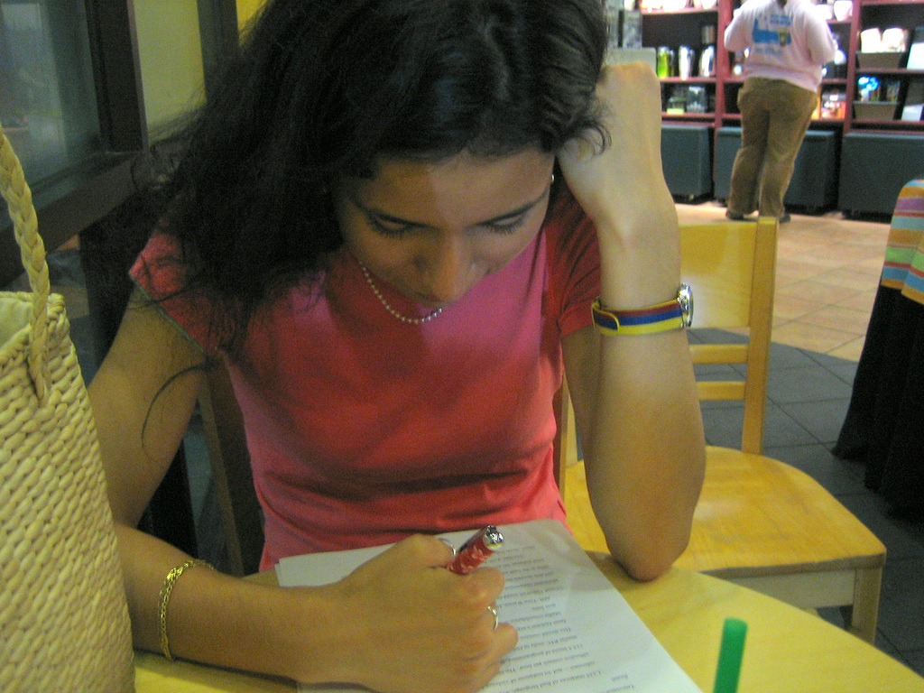
Writing an Effective Paper
Reviewing
  Re-reading completed work is essential for more than just catching typos.
Free to share, print, make copies and changes. Get yours at www.boundless.com
Flickr. "Lina, proofreading my essay.hot.| Flickr - Photo Sharing!." CC BY http://www.flickr.com/photos/bmh4you/54929599/ View on Boundless.com

Slide 29
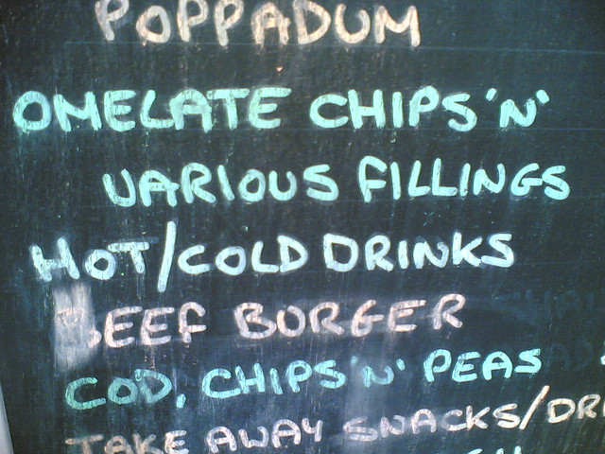
Writing an Effective Paper
Spelling error
  The aim of proofreading is to catch surface mistakes in spelling, punctuation, formatting, etc. -- such as on the restaurant sign above, where the writer misspelled "omelette" as "omelate."
Free to share, print, make copies and changes. Get yours at www.boundless.com
Flickr. "All sizes | Omelate | Flickr - Photo Sharing!." CC BY-SA http://www.flickr.com/photos/smudie/44633735/sizes/z/in/photostream/ View on Boundless.com

Slide 30
Writing an Effective Paper
Capture the attention of your audience with rhetoric
  Using appropriate rhetorical tools and a well-thought-out argumentative structure is a way of ensuring the strength of your writing. In addition, rhetoric gives you ways of capturing the attention of your audience and leading them to the conclusions of your argument.
Free to share, print, make copies and changes. Get yours at www.boundless.com
Flickr. "All sizes | [Portrait of June Christy, 1947 or 1948] (LOC) | Flickr - Photo Sharing!." Public domain http://www.flickr.com/photos/library_of_congress/5354175531/sizes/l/in/photostream/ View on Boundless.com

Slide 31
Attribution
Writing an Effective Paper
Wikipedia. "credibility." CC BY-SA 3.0 http://en.wikipedia.org/wiki/credibility
Wiktionary. "neutral." CC BY-SA 3.0 http://en.wiktionary.org/wiki/neutral
Wiktionary. "opposition." CC BY-SA 3.0 http://en.wiktionary.org/wiki/opposition
Boundless. "Representing Objections Fairly." License: Other https://www.boundless.com/users/364813/textbooks/professional-writing-ae312174-61d8-432f-9276-655b5a888adc/week-3-boundless-presentation-620/responding-to-objections-624/representing-objections-fairly-629-942/
Boundless. "Using Satire to Summarize." License: Other https://www.boundless.com/users/268747/textbooks/fremont-college-english-composition/academic-writing-3/summarizing-18/using-satire-to-summarize-88-1172/
Wikibooks. "Rhetoric and Composition/Argument." CC BY-SA 3.0 http://en.wikibooks.org/wiki/Rhetoric_and_Composition/Argument%23Dealing_With_the_Opposition
Wikipedia. "Nel Noddings." Public domain https://en.wikipedia.org/wiki/Nel_Noddings
Wiktionary. "citation." CC BY-SA 3.0 http://en.wiktionary.org/wiki/citation
Wikibooks. "Writing Better University Essays/Referencing." CC BY-SA 3.0 http://en.wikibooks.org/wiki/Writing_Better_University_Essays/Referencing%23Citations_and_Quotations
Wiktionary. "quotation." CC BY-SA 3.0 http://en.wiktionary.org/wiki/quotation
Wiktionary. "quotation marks." CC BY-SA 3.0 http://en.wiktionary.org/wiki/quotation_marks
Wiktionary. "paraphrase." CC BY-SA 3.0 http://en.wiktionary.org/wiki/paraphrase
Boundless. "Paraphrasing." License: Other https://www.boundless.com/writing/textbooks/boundless-writing-textbook/writing-an-effective-paper-235/quoting-and-paraphrasing-240/paraphrasing-93-1348/
Boundless. "Introducing Quotations." License: Other https://www.boundless.com/users/268747/textbooks/fremont-college-english-composition/academic-writing-3/quoting-19/introducing-quotations-92-8169/
Wikibooks. "Rhetoric and Composition/Quotation Marks." CC BY-SA 3.0 http://en.wikibooks.org/wiki/Rhetoric_and_Composition/Quotation_Marks
Wiktionary. "quotation." CC BY-SA 3.0 http://en.wiktionary.org/wiki/quotation
Wikipedia. "Catholic Church in the United States." CC BY-SA https://en.wikipedia.org/wiki/Catholic_Church_in_the_United_States
Free to share, print, make copies and changes. Get yours at www.boundless.com

Slide 32
Writing an Effective Paper
Wikipedia. "Sandalwood Oil." CC BY-SA https://en.wikipedia.org/wiki/Sandalwood_oil%23cite_note-1
Boundless. "Introducing and Formatting Quotations." License: Other https://www.boundless.com/writing/textbooks/boundless-writing-textbook/writing-an-effective-paper-235/quoting-and-paraphrasing-240/introducing-and-formatting-quotations-91-1349/
Boundless. "Quoting Relevant Passages." License: Other https://www.boundless.com/users/268747/textbooks/fremont-college-english-composition/academic-writing-3/quoting-19/quoting-relevant-passages-90-535/
Wikibooks. "Writing Better University Essays/Main part." CC BY-SA 3.0 http://en.wikibooks.org/wiki/Writing_Better_University_Essays/Main_part%23Weasel_Terms
Wiktionary. "quotation." CC BY-SA 3.0 http://en.wiktionary.org/wiki/quotation
Wikipedia. "Meta-discussion." CC BY-SA 3.0 http://en.wikipedia.org/wiki/Meta-discussion
Wikipedia. "argument." CC BY-SA 3.0 http://en.wikipedia.org/wiki/argument
Boundless. "Assembling Your Argument." License: Other https://www.boundless.com/users/268747/textbooks/fremont-college-english-composition/paper-execution-2/planning-your-argument-10/assembling-your-argument-48-8497/
Boundless. "Anticipating Potential Objections." License: Other https://www.boundless.com/users/268747/textbooks/fremont-college-english-composition/academic-writing-3/summarizing-18/anticipating-potential-objections-86-534/
Wiktionary. "counterargument." CC BY-SA 3.0 http://en.wiktionary.org/wiki/counterargument
Wikibooks. "Rhetoric and Composition/Argument." CC BY-SA 3.0 http://en.wikibooks.org/wiki/Rhetoric_and_Composition/Argument%23Dealing_With_the_Opposition
Wikibooks. "Rhetoric and Composition/Analyzing Assignments." CC BY-SA 3.0 http://en.wikibooks.org/wiki/Rhetoric_and_Composition/Analyzing_Assignments%23Summary.2FResponse_Paper
Wiktionary. "viewpoint." CC BY-SA 3.0 http://en.wiktionary.org/wiki/viewpoint
Boundless. "Addressing Opposing Viewpoints." License: Other https://www.boundless.com/users/364813/textbooks/professional-writing-ae312174-61d8-432f-9276-655b5a888adc/week-3-boundless-presentation-620/responding-to-objections-624/addressing-opposing-viewpoints-632-70/
Wikibooks. "Rhetoric and Composition/Argument." CC BY-SA 3.0 http://en.wikibooks.org/wiki/Rhetoric_and_Composition/Argument
U.S. Department of Justice. "Punitive Damage Awards in State Courts, 2005." License: Other http://www.bjs.gov/content/pub/pdf/pdasc05.pdf
Boundless Learning. "Boundless." CC BY-SA 3.0 http://www.boundless.com//writing/definition/criteria
Wikibooks. "Rhetoric and Composition/Reviewing." CC BY-SA 3.0 http://en.wikibooks.org/wiki/Rhetoric_and_Composition/Reviewing
University of Pittsburgh - Department of Communication. ""Audience Analysis"." CC BY-SA 3.0 http://www.comm.pitt.edu/oral-comm-lab/audience-analysis
Free to share, print, make copies and changes. Get yours at www.boundless.com

Slide 33
Writing an Effective Paper
Wikipedia. "Rhetoric." CC BY-SA 3.0 http://en.wikipedia.org/wiki/Rhetoric
Wikipedia. "Logos." CC BY-SA 3.0 http://en.wikipedia.org/wiki/Logos
Wikipedia. "ethos." CC BY-SA 3.0 http://en.wikipedia.org/wiki/ethos
Wikibooks. "Rhetoric and Composition/Rhetorical Analysis." CC BY-SA 3.0 http://en.wikibooks.org/wiki/Rhetoric_and_Composition/Rhetorical_Analysis%23Critical_Reading
Wikibooks. "Rhetoric and Composition/Analyzing assignments." CC BY-SA 3.0 http://en.wikibooks.org/wiki/Rhetoric_and_Composition/Analyzing_assignments%23Rhetorical_Analysis
Wiktionary. "pathos." CC BY-SA 3.0 http://en.wiktionary.org/wiki/pathos
Centers for Disease Control. "Health Effects of Cigarette Smoking." Public domain http://www.cdc.gov/tobacco/data_statistics/fact_sheets/health_effects/effects_cig_smoking/
National Institutes of Health. "Acupuncture: What You Need to Know." Public domain https://nccih.nih.gov/health/acupuncture/introduction
Wiktionary. "concept map." CC BY-SA 3.0 http://en.wiktionary.org/wiki/concept_map
Wiktionary. "clustering." CC BY-SA 3.0 http://en.wiktionary.org/wiki/clustering
Wiktionary. "freewriting." CC BY-SA 3.0 http://en.wiktionary.org/wiki/freewriting
Wikibooks. "Rhetoric and Composition/Planning and Prewriting." CC BY-SA 3.0 http://en.wikibooks.org/wiki/Rhetoric_and_Composition/Planning_and_Prewriting%23What_are_Some_Other_Ways_to_Get_Ideas.3F
Wikipedia. "five-paragraph essay." CC BY-SA 3.0 http://en.wikipedia.org/wiki/five-paragraph%20essay
OpenStax CNX. "The Cain Project in Engineering and Professional Communication, Three Modules on Clear Writing Style: An Introduction to The Craft of Argument, by Joseph M. Williams and Gregory Colomb. September 17, 2013." CC BY 3.0 http://cnx.org/content/m17224/latest/?collection=col10551/latest
Wikipedia. "consistency." CC BY-SA 3.0 http://en.wikipedia.org/wiki/consistency
Wikipedia. "organization." CC BY-SA 3.0 http://en.wikipedia.org/wiki/organization
Wiktionary. "purpose." CC BY-SA 3.0 http://en.wiktionary.org/wiki/purpose
Wikibooks. "Rhetoric and Composition/Revising." CC BY-SA 3.0 http://en.wikibooks.org/wiki/Rhetoric_and_Composition/Revising%23A_Change_for_the_Better
Wiktionary. "peer review." CC BY-SA 3.0 http://en.wiktionary.org/wiki/peer_review
Free to share, print, make copies and changes. Get yours at www.boundless.com

Slide 34
Writing an Effective Paper
Wikipedia. "editing." CC BY-SA 3.0 http://en.wikipedia.org/wiki/editing
Wikipedia. "proofreading." CC BY-SA 3.0 http://en.wikipedia.org/wiki/proofreading
Boundless. "Using the Dictionary and Thesaurus." License: Other https://www.boundless.com/writing/textbooks/boundless-writing-textbook/writing-effective-sentences-252/word-choice-30/using-the-dictionary-and-thesaurus-effectively-137-1341/
Wikibooks. "Rhetoric and Composition/Editing." CC BY-SA 3.0 http://en.wikibooks.org/wiki/Rhetoric_and_Composition/Editing
Wikibooks. "Rhetoric and Composition/Revising." CC BY-SA 3.0 http://en.wikibooks.org/wiki/Rhetoric_and_Composition/Revising%23Differences_Between_Revising.2C_Editing.2C_and_Proofreading
Boundless. "Supporting Your Thesis." License: Other https://www.boundless.com/users/268747/textbooks/fremont-college-english-composition/paper-execution-2/drafting-your-paper-12/supporting-your-thesis-65-1333/
Boundless. "Getting Help Meeting College Writing Expectations." License: Other https://www.boundless.com/writing/textbooks/boundless-writing-textbook/introduction-to-college-level-writing-233/introduction-to-college-level-writing-234/getting-help-meeting-college-writing-expectations-83-8682/
Boundless. ""So What?"." License: Other https://www.boundless.com/users/364813/textbooks/professional-writing-ae312174-61d8-432f-9276-655b5a888adc/week-5-boundless-presentation-641/so-what-659/so-what-662-943/
Boundless. "Assembling Your Argument." License: Other https://www.boundless.com/users/268747/textbooks/fremont-college-english-composition/paper-execution-2/planning-your-argument-10/assembling-your-argument-48-8497/
Boundless. "Generating Further Questions." License: Other https://www.boundless.com/users/268747/textbooks/fremont-college-english-composition/paper-execution-2/drafting-your-paper-12/generating-further-questions-66-1672/
Boundless. "“Introduction and Thesis.”." License: Other https://www.boundless.com/writing/textbooks/boundless-writing-textbook/writing-across-disciplines-254/writing-in-the-natural-and-social-sciences-the-research-paper-and-the-imrad-model-275/introduction-and-thesis-80-10363/
Wiktionary. "defensible." CC BY-SA 3.0 https://en.wiktionary.org/wiki/defensible
Boundless. "Step 2: Researching." CC BY-SA 4.0 https://www.boundless.com/writing/textbooks/boundless-writing-textbook/writing-an-effective-paper-235/steps-of-writing-a-paper-237/step-2-researching-243-16871/
Boundless. "Step 1: Prewriting and Choosing a Topic." CC BY-SA 4.0 https://www.boundless.com/writing/textbooks/boundless-writing-textbook/writing-an-effective-paper-235/steps-of-writing-a-paper-237/step-1-prewriting-and-choosing-a-topic-47-7910/
Boundless. "Step 1: Prewriting and Choosing a Topic." CC BY-SA 4.0 https://www.boundless.com/writing/textbooks/boundless-writing-textbook/writing-an-effective-paper-235/steps-of-writing-a-paper-237/step-1-prewriting-and-choosing-a-topic-47-7910/
Free to share, print, make copies and changes. Get yours at www.boundless.com

