Slide 1
come back to Maine
The Way Life Should Be
Notes:
Come Back to Maine

Slide 2

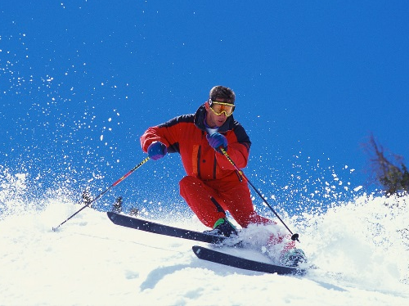
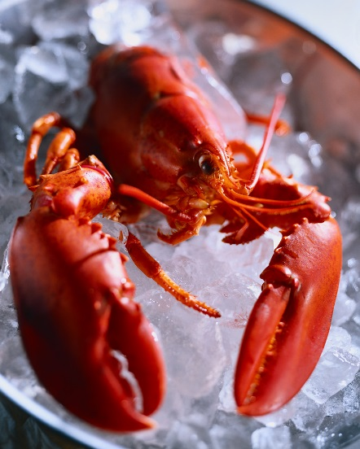
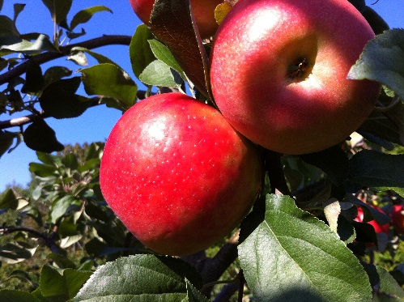

Slide 3
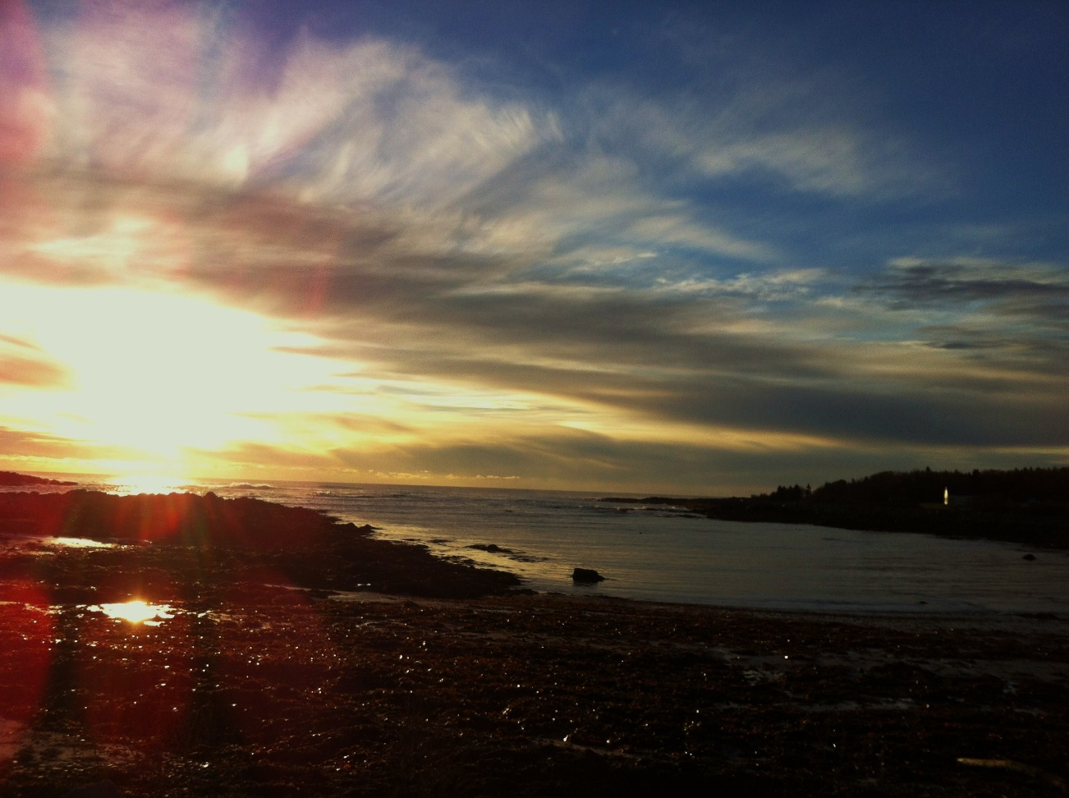
Discover!

Slide 4
Hidden Charms
Urban
  Architecture & history
  Shopping & arts
Rural
  Coastal getaways
  Farms & villages

Slide 5
History and Culture
Regional flavors
  Southern coast
  Mid-coast
  Down East
Working waterfronts
  Lobster and seafood
  Ferries and lighthouses
Red bricks, wood clapboards, and narrow lanes
Performing arts

Slide 6
Natural Beauty
Coastal
  3478 miles of coastline
    Sand beaches in south
    Rocky cliffs mid-coast & Down East
  3100 islands & ledges to explore
Inland
  36 state parks, 3 national parks, 14 natural landmarks
  40 mountains > 3000 feet
  Trails
    Summer: 100s of hiking trails, 1000s of miles
    Winter: 14,500 miles of groomed snowmobile trails

