Slide 1
Deploying Your First Full Stack Application to the Cloud
Women Who Code Workshop
Sheila Loekito
11/15/2017

Slide 2
Introduction
Introduction to “the Cloud”
Workshop to deploy a full stack application to the cloud
Featuring Amazon RDS, EC2 and S3
Using AWS CloudFormation and AWS boto3 API
Stuck? Raise your hand for help!
Other considerations
Security, scalability, other ways to deploy
How to level up
Questions

Slide 3

About Me
Full Stack Developer at Watchguard Technologies
My stack now: angular2, python, MySQL, AWS DynamoDB, SNS/SQS, Kinesis, ECS, lambdas, etc

Slide 4
What is “the Cloud”?
The delivery of computing services—servers, storage, databases, networking, software, analytics, and more—over the Internet
Important characteristics:
Underlying compute resources (storage, processors, RAM, load balancers, etc) entirely abstracted from the consumer
Scalability and elasticity
Scale up or down based on real time load
On demand pricing
Does this mean lower cost? not always
Public Cloud Providers: Amazon Web Services, Microsoft Azure, Google Cloud, others

Slide 5
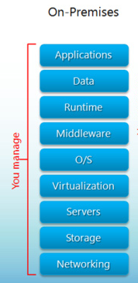
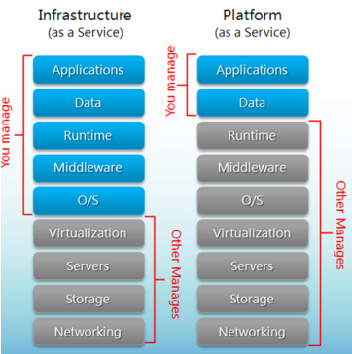
Datacenter vs Cloud Levels of Abstraction

Slide 6
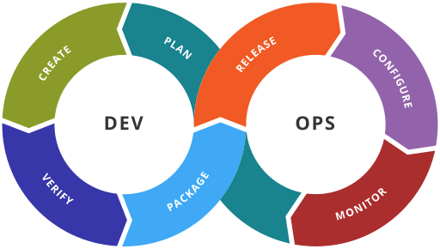
Why Are so Many Companies Moving to the Cloud?
Lower overhead to create, scale up (or down) infrastructure
Quicker time to market
Pay only for what you use – may save cost
Easier to automate infrastructure and code deployment
Infrastructure as Code – automatically manage infrastructure creation through code
Many companies have adopted the ”DevOps” model and have created strong demand for engineers that can work across the entire application lifecycle, or have some knowledge of it

Slide 7
Workshop Overview
Amazon Web Services
Application stack
Infrastructure
Amazon RDS, Amazon EC2, Amazon S3
Deployment scripts
AWS Cloud Formation
AWS boto3 API (python)
Install Prerequisites
Let’s deploy our app!

Slide 8
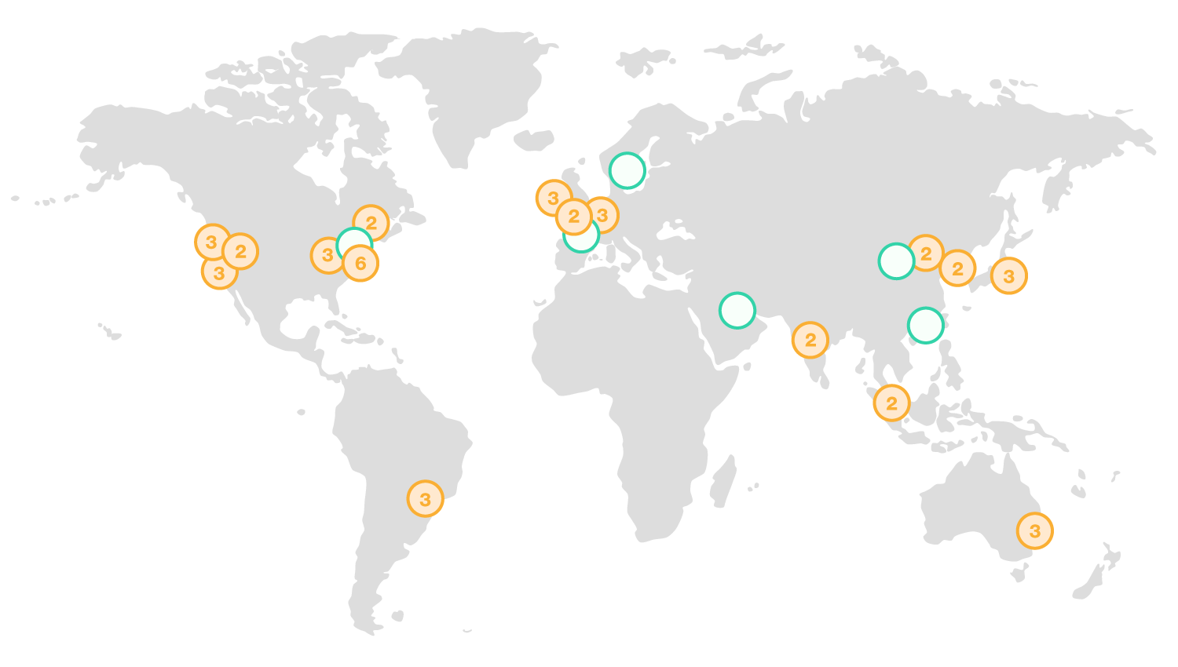
Amazon Web Services
16 Regions
44 Availability Zones (separate datacenters) within regions
Products include compute, storage, databases, networking, IoT, etc

Slide 9
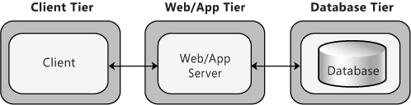
Workshop: Application Stack
Application: simple web app that shows catalog information
Backend: MySQL database
Middleware: python REST API with flask-restful
Frontend: static html and javascript

Slide 10
Workshop: Deployment Tools
AWS CloudFormation
Allows you to use JSON or YAML templates to describe AWS resources and dependencies to run your application
Create and modify ”stacks” – collection of AWS infrastructure such as EC2 Instances, S3 buckets, etc
Automated, repeatable, can be version-controlled
AWS boto3 API
http://boto3.readthedocs.io/en/latest/guide/quickstart.html
Python API to interact with AWS and automate your deployments

Slide 11
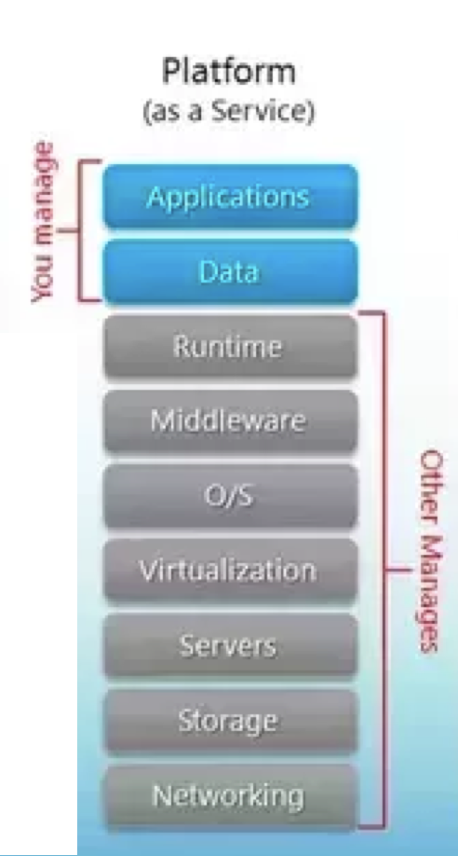
Infrastructure: Amazon RDS
Managed Relational Database Service
Can choose from different database engines: MySQL, PostgreSQL, etc
Considered a “Platform as a Service” meaning you do not have access to the operating system. AWS takes care of the administrative tasks like patching software and creating backups.

Slide 12
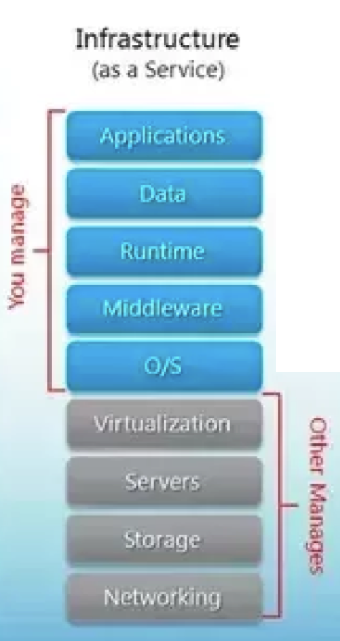
Infrastructure: Amazon EC2
Basically Virtual Machines in the cloud
Considered IaaS (Infrastructure as a Service). AWS takes care of hardware resources while user is responsible for managing the Operating System and application
AMI (Amazon Machine Image): the OS run by the Virtual Machine to host your application code
Can be scaled up and down based rules you define: https://aws.amazon.com/autoscaling/

Slide 13
Infrastructure: Amazon S3
Storage service
Highly available
Simple, no need to manage servers
Can be used to host a HTML/javascript as static website
Fast and cheap for static content delivery

Slide 14
Getting Started
Review Setup Instructions:
https://github.com/sloekito/WWCode-cloud-deploy
Correction for one of the steps:
pip install mysql-connector==2.1.3
Also, Refresh the repo
git pull origin master
Login to AWS, make sure you’re in region us-west-2

Slide 15
Database Deployment Steps Explained
Using AWS CloudFormation with boto3 API:
Create RDS MySQL Instance with admin username/password
Seed database with application data

Slide 16
Database Deployment Script
Review
WWCode-cloud-deploy/catalog-db/deploy.py
WWCode-cloud-deploy/catalog-db/catalog-db.yaml
To deploy, run:
cd catalog-db
python deploy.py \
--stack_name <db stack name> \
--db_admin_user <db admin user> \
--db_admin_password <db password> \
--db_name <db name>
For example:
cd catalog-db
python deploy.py \
--stack_name catalog-db \
--db_admin_user admin \
--db_admin_password adminwwCode1%^%%%% \
--db_name catalog

Slide 17
Middleware Deployment Steps Explained
Create EC2 keypair
Save this in your computer, we will use it later
PEM file is certificate file that lets you ssh to the instance
Create EC2 instance
Use “UserData” section to install packages
Python flask packages
Download the application from github
Run the application

Slide 18
Middleware Deployment Script
Review
WWCode-cloud-deploy/catalog-middleware/deploy.py
WWCode-cloud-deploy/catalog-middleware/catalog-middleware.yaml
Deploy command:
cd catalog-middleware
python deploy.py \
--stack_name <middleware stack name> \
--db_stack_name <database stack name> \ # Use the database stack name we previously created
--db_user <db username> \ # DB username/password we previously created
--db_password <db password> \
--db_name <db name>
Example:
cd catalog-middleware python deploy.py \
--stack_name catalog-middleware \
--db_stack_name catalog-db \
--db_user admin \
--db_password adminwwCode1%^%%%% \
--db_name catalog

Slide 19
Let’s Review Our Deployment
ssh to the ec2 instance
ssh -i ~/wwcode.pem ec2-user@<ec2 public IP>
Troubleshooting
Userdata logs:
/var/lib/cloud/instance/user-data.txt
/var/log/cloud-init-output.log

Slide 20
Frontend Deployment Steps Explained
Create a bucket
Bucket names are globally unique!
Enable static hosting
Set up permissions
Upload static files to the bucket
Website is available in: <bucket-name>.s3-website-<AWS-region>.amazonaws.com

Slide 21
Frontend Deployment Script
Review
WWCode-cloud-deploy/catalog-frontend/deploy.py
WWCode-cloud-deploy/catalog-frontend/catalog-frontend.yaml
Deploy Command:
Bucket names must be globally unique! So pick something that will be unique.
cd catalog-frontend
python deploy.py \
--stack_name <stack name> \
--s3_bucket_name <s3 bucket name – must be globally unique!> \
--middleware_stack_name <middleware stack name we created from before>
Example:
cd catalog-frontend
python deploy.py \
--stack_name catalog-frontend \
--s3_bucket_name catalog-frontend-sheilal \
--middleware_stack_name catalog-middleware

Slide 22
Clean Up
Tear down stacks so you won’t get charged

Slide 23
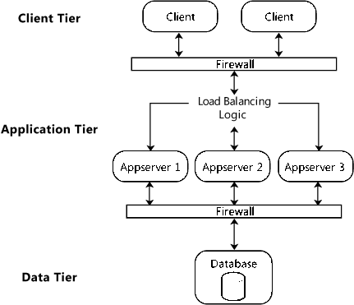
Other Considerations
Security
API and Database can be secured using VPC (Virtual Private Cloud)
For example, you can create a public-facing subnet for your webservers that has access to the Internet, and place your backend systems such as databases or application servers in a private-facing subnet with no Internet access.
Passwords need to be secured
Or manage security using AWS IAM (Identity and Access Management)
Scalability
Use redundant EC2 instances, autoscaling and load balancing:
http://docs.aws.amazon.com/autoscaling/latest/userguide/autoscaling-load-balancer.html
Other ways to deploy
Docker/containers with ECS
Serverless with AWS Lambdas

Slide 24
How to level up
AWS Certifications
https://aws.amazon.com/certification/our-certifications/
Entry level exam: AWS Certified Developer
Study guide by A Cloud Guru:
https://acloud.guru/course/aws-certified-developer-associate/dashboard
AWS Blog:
https://aws.amazon.com/blogs/aws/

Slide 25
Questions? Comments?
Connect with me!
sheila.loekito@gmail.com
https://www.linkedin.com/in/sheilaloekito/

Slide 26
Sources
https://msdn.microsoft.com/en-us/library/ee658120.aspx
http://nvlpubs.nist.gov/nistpubs/Legacy/SP/nistspecialpublication800-145.pdf

